Slide 1
Web services programming Project Presentation --Ecommerce
Jung-ju(Sonia) Lin
Jianshi Yuan
Ting Liu
2016-12-06
1

Slide 2
Agenda
Project Overall Idea
Project Architecture
Implementation
Difficulties and Lessons

Slide 3
Project Overall Idea
A online purchasing platform for customers
- Customer sign up and login
- Search product
- Buy product
- Check order status
- Cancel order
Order/inventory management platform for partners
- Register and create profile of partners
- Add products in market place
- Get acknowledgement of order fulfillment
- Ship order

Slide 4
Project Overall Idea
State diagram (customer)
Search product
Home
(product listing – minimal actions enabled)
Log in
Home
(product listing)
Buy product
Check orders
Order listing
Cancel order

Slide 5
Project Overall Idea
State diagram (partner)
Search product
Home
(product listing – minimal actions enabled)
Log in
Home
(product listing)
Add product
Check orders
Order listing
Ship order

Slide 6
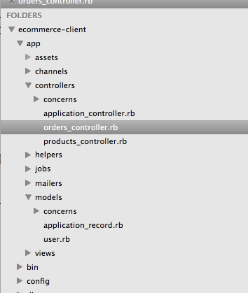
Project Architecture
Client-side structure

Slide 7
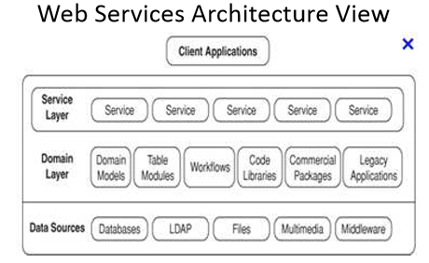
Project Architecture

Slide 8
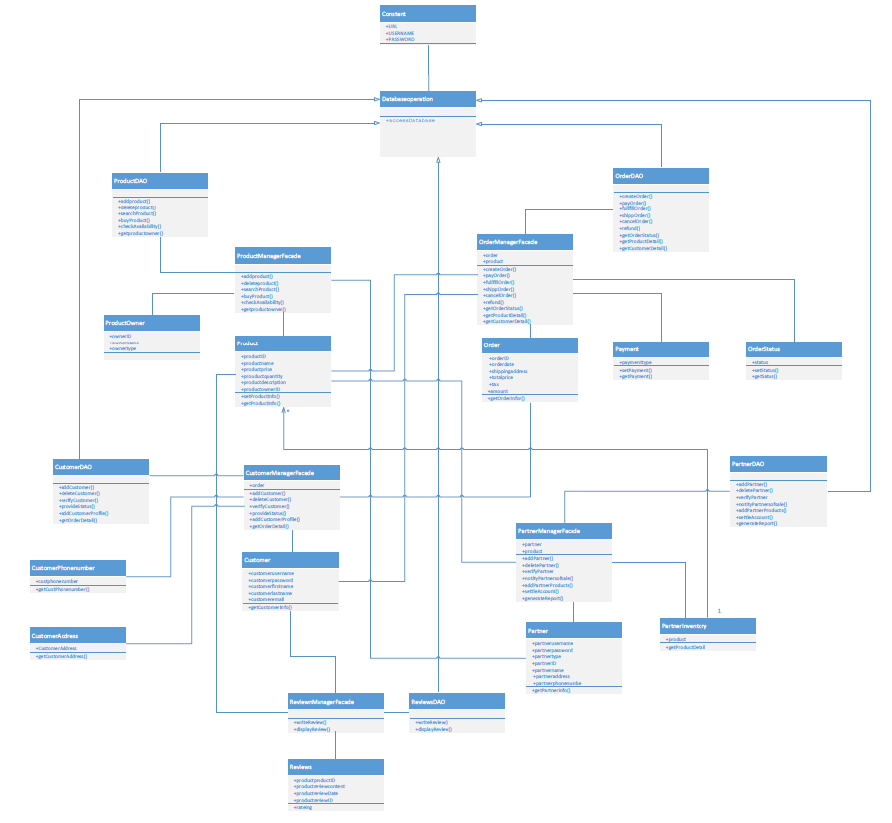
Project Architecture
UML Diagram

Slide 9
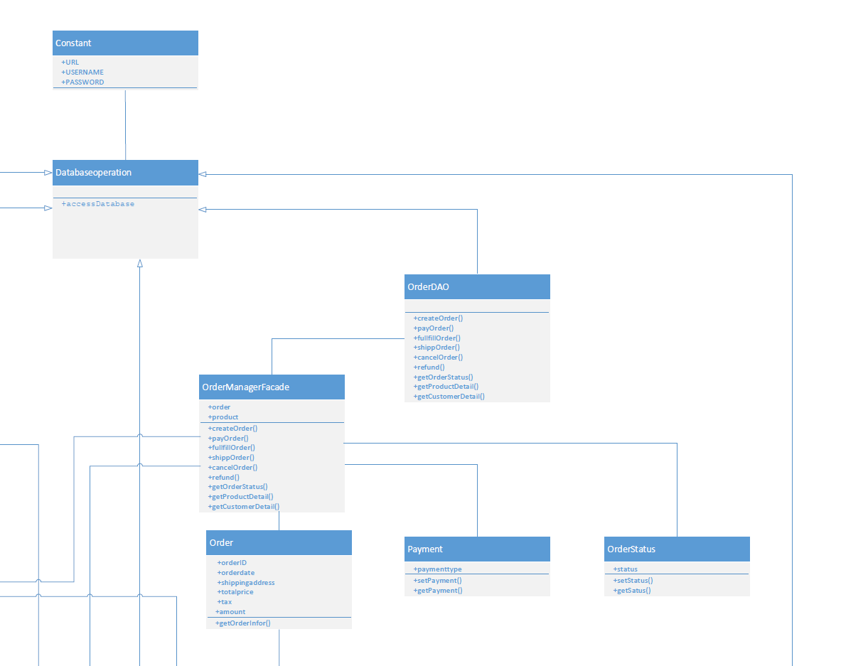
Project Architecture

Slide 10
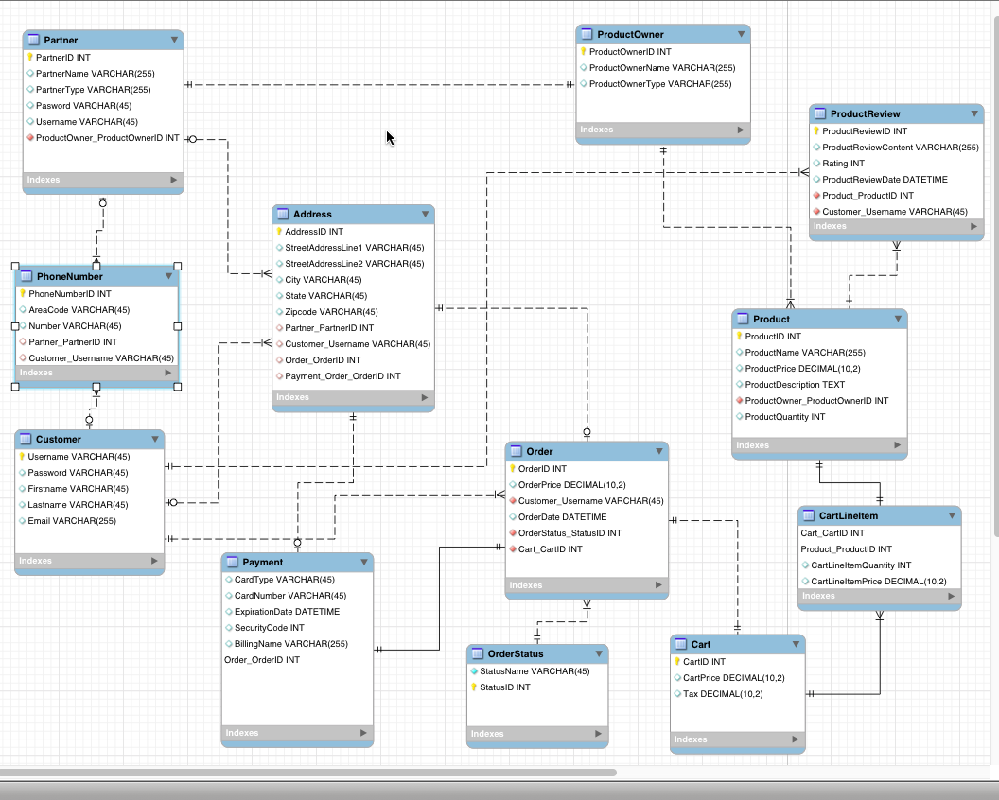
Project Architecture
Database ER diagram
Sample ddl

Slide 11
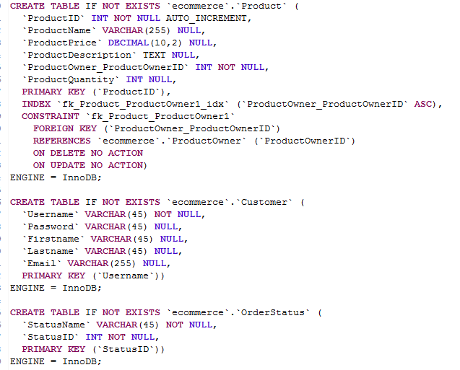
Project Architecture

Slide 12
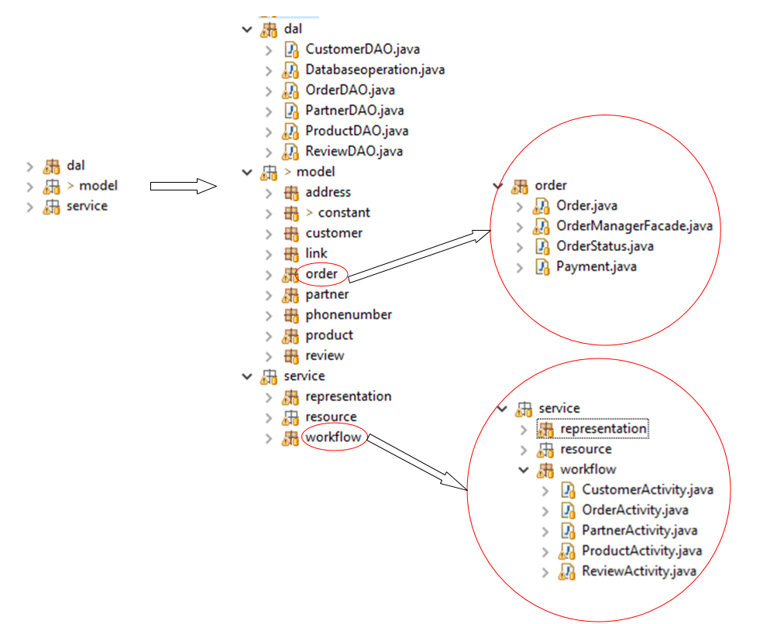
Project Architecture
Server-side structure

Slide 13
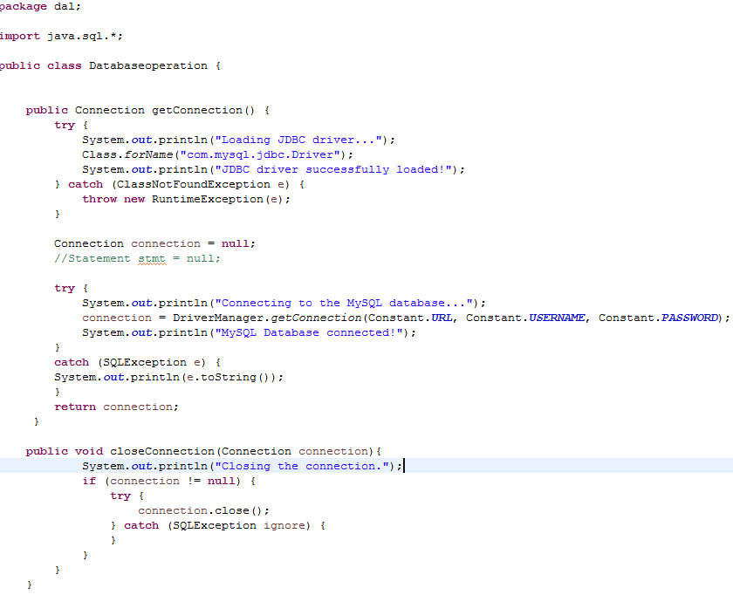
Implementation
Use JDBC to access database

Slide 14
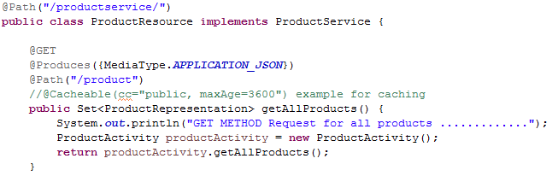
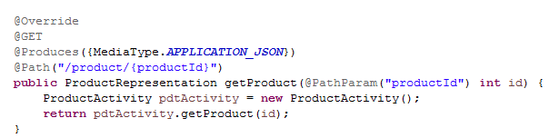
Implementation
Follow ReST design principles to CRUD
Example of the GET method:

Slide 15
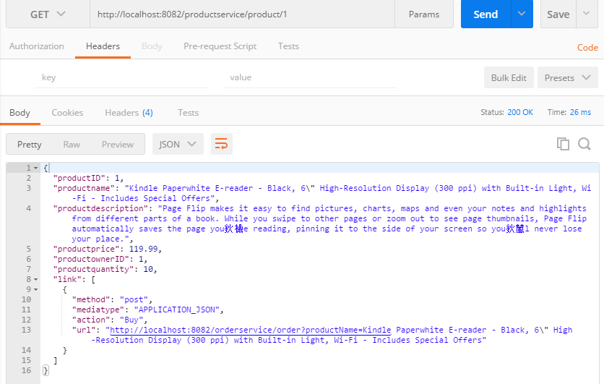
Implementation
Screenshot from postman of get method

Slide 16
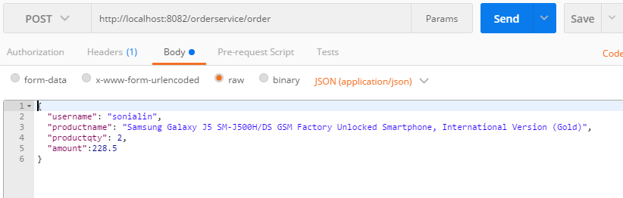
Implementation
Example of the POST method:

Slide 17
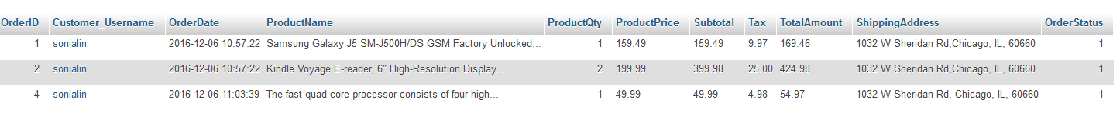
Implementation
Result in database

Slide 18
Difficulties and Lessons
Didn’t know how to create a standard layered structure at the beginning, mixed domain layer and DAC layer
Know how to create it in class
Had difficulty to write a post commend and finally figure it out
The most important is to understand what ReST is, how it works and how to develop a ReST program

Slide 19
THANK YOU!

