Slide 1
Web services programming Project Presentation --Ecommerce
Jung-ju(Sonia) Lin
Jianshi Yuan
Ting Liu
2016-12-06
1

Slide 2
Agenda
Project Overall Idea
Project Architecture
Implementation
Difficulties and Lessons

Slide 3
Project Overall Idea
A online purchasing platform for customers
- Customer sign up and login
- Search product
- Buy product
- Check order status
- Cancel order
Order/inventory management platform for partners
- Register and create profile of partners
- Add products in market place
- Get acknowledgement of order fulfillment
- Ship order

Slide 4
Project Overall Idea
State diagram (customer)
Search product
Home
(product listing – minimal actions enabled)
Log in
Home
(product listing)
Buy product
Check orders
Order listing
Cancel order

Slide 5
Project Overall Idea
State diagram (partner)
Search product
Home
(product listing – minimal actions enabled)
Log in
Home
(product listing)
Add product
Check orders
Order listing
Ship order

Slide 6
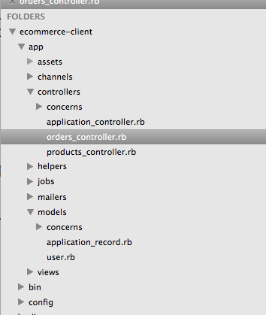
Project Architecture
Client-side structure
MVC
Order and product controllers to handle the business logic of the resource retrieval
User model for authentication

Slide 7
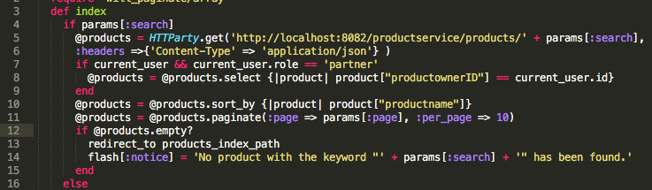
API Consumption Notes
What operations to do locally vs remotely when listing resources
a. get/search products, get orders: remote
b. Sorting, filtering, and paginating the listing are done locally (that are potentially services that can be provided)
a
b

Slide 8
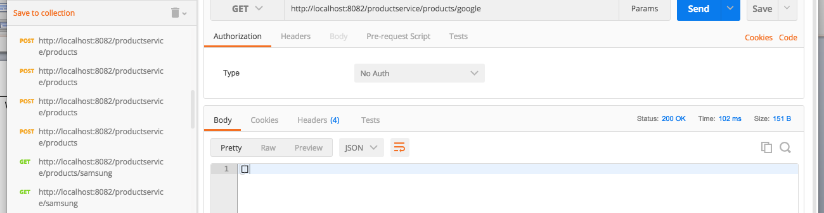
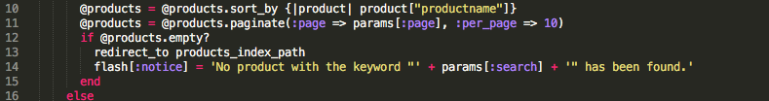
API Consumption Notes
Handle success and exception
500 (or 5xx): Server’s fault
400 (or 4xx): Client’s fault
200 (or 2xx): Success, even with no returned object (searchProduct for example)
Return empty array? No problem.
Client can handle it.

Slide 9
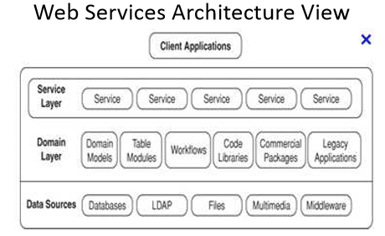
Project Architecture

Slide 10
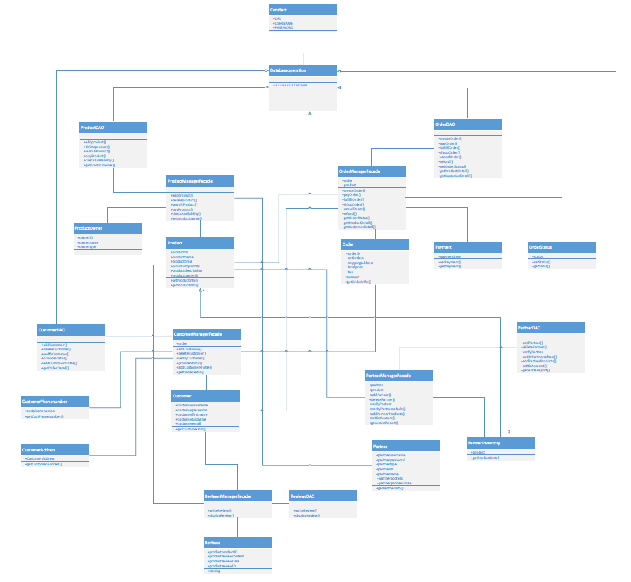
Project Architecture
UML Diagram

Slide 11
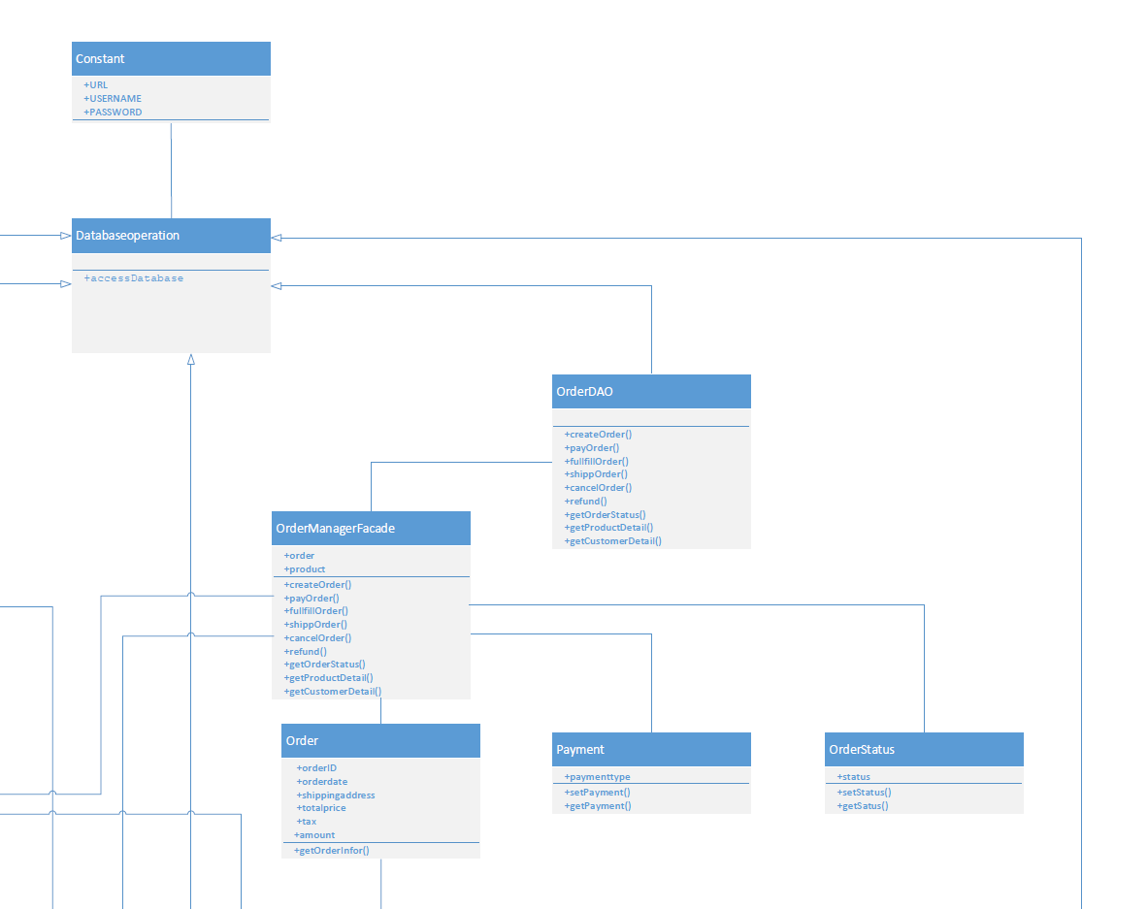
Project Architecture

Slide 12
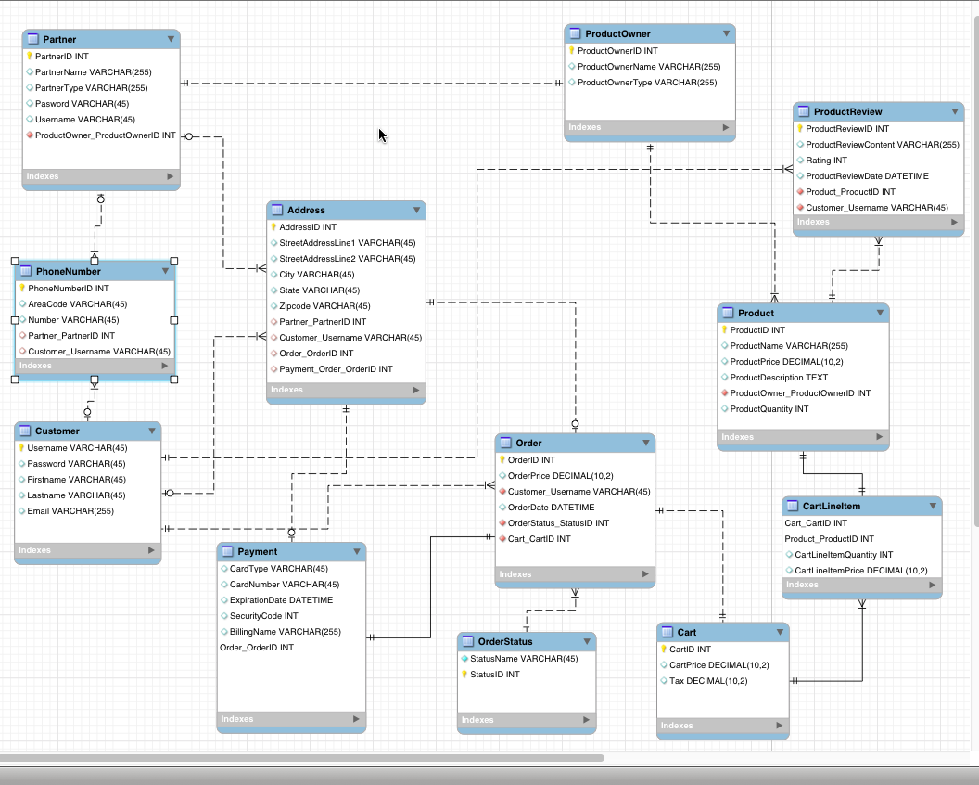
Project Architecture
Database ER diagram
Sample ddl

Slide 13
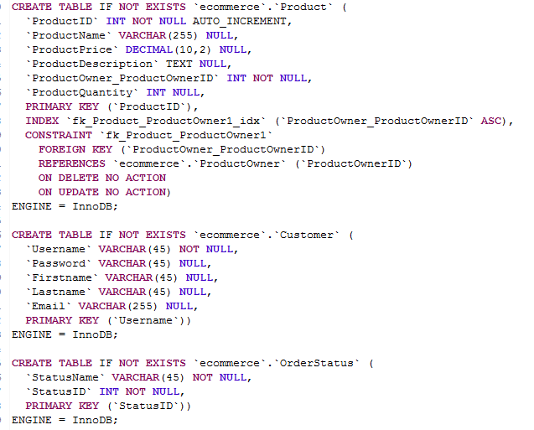
Project Architecture

Slide 14
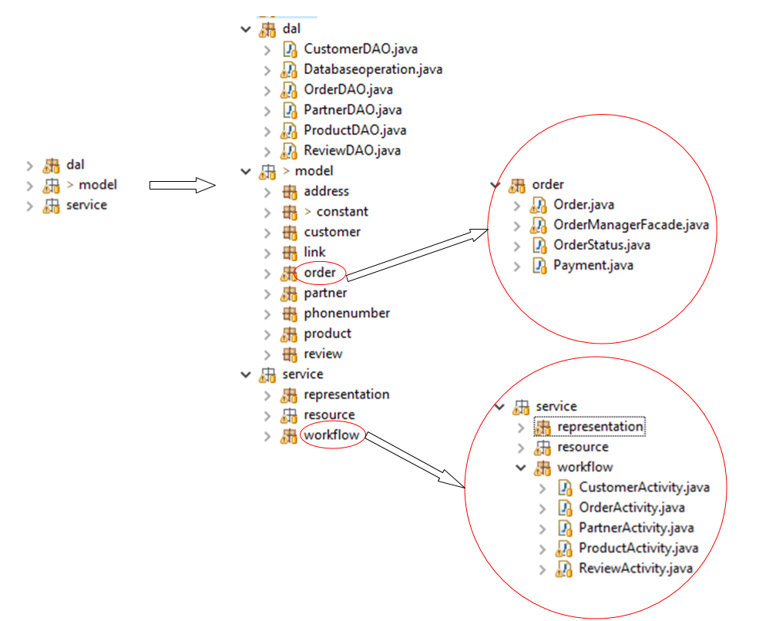
Project Architecture
Server-side structure

Slide 15
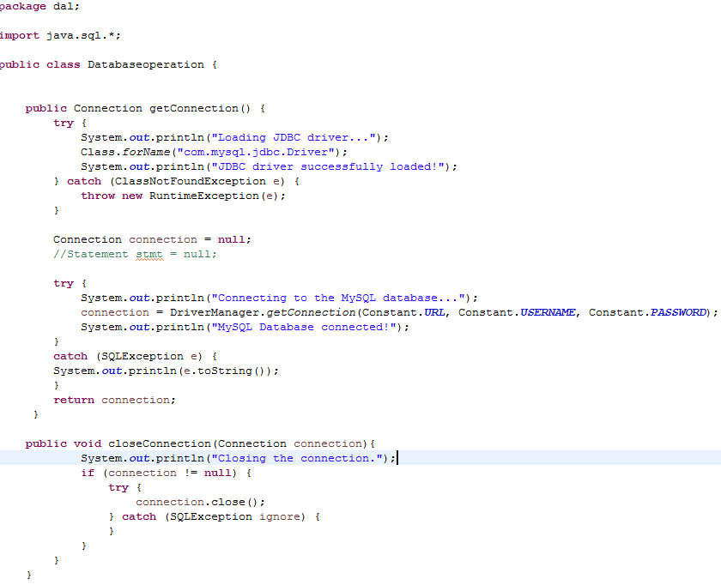
Implementation
Use JDBC to access database

Slide 16
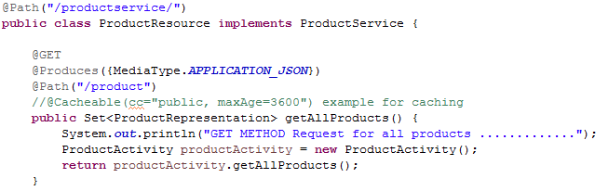
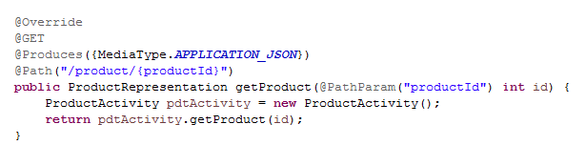
Implementation
Follow ReST design principles to CRUD
Example of the GET method:

Slide 17
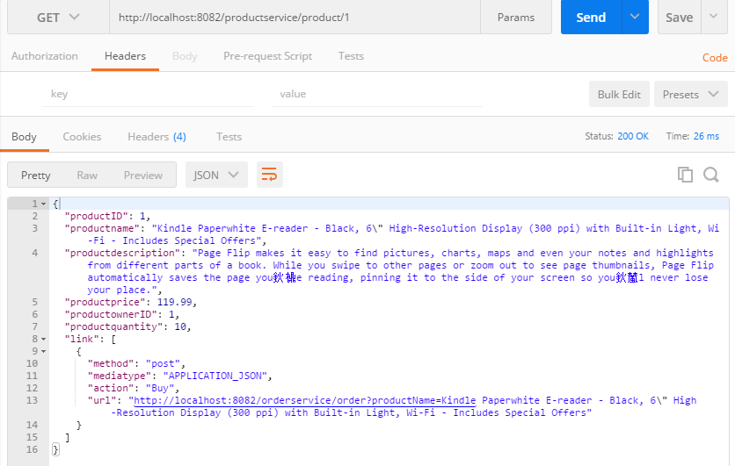
Implementation
Screenshot from postman of get method

Slide 18
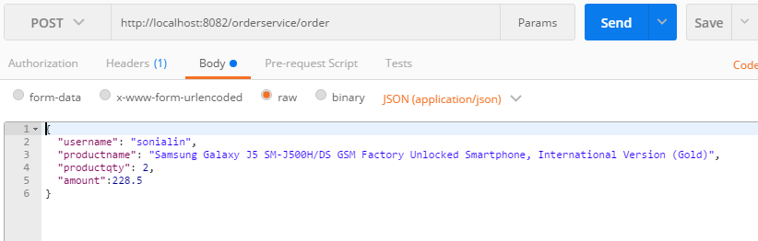
Implementation
Example of the POST method:

Slide 19
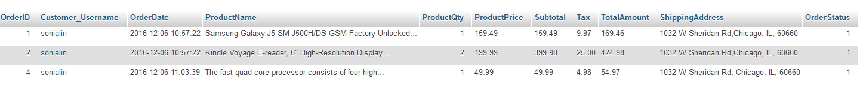
Implementation
Result in database

Slide 20
Difficulties and Lessons
Didn’t know how to create a standard layered structure at the beginning, mixed domain layer and DAC layer
Know how to create it in class
Had difficulty to write a post commend and finally figure it out
The most important is to understand what ReST is, how it works and how to develop a ReST program

Slide 21
THANK YOU!

