Slide 1
Web services programming Project Presentation --Ecommerce
Jung-ju(Sonia) Lin
Jianshi Yuan
Ting Liu
2016-12-06
1

Slide 2
Agenda
Project Overall Idea
Project Architecture
Implementation
Difficulties and Lessons

Slide 3
Project Overall Idea
A online purchasing platform for customers
- Customer sign up and login
- Search product
- Buy product
- Check order status
- Cancel order
Order/inventory management platform for partners
- Register and create profile of partners
- Add products in market place
- Get acknowledgement of order fulfillment
- Ship order

Slide 4
Project Overall Idea
State diagram (customer)
Search product
Home
(product listing – minimal actions enabled)
Log in
Home
(product listing)
Buy product (hypermedia link)
Check orders
Order listing
Cancel order
(hypermedia link)

Slide 5
Project Overall Idea
State diagram (partner)
Search product
Home
(product listing – minimal actions enabled)
Log in
Home
(product listing)
Add product
Check orders
Order listing
Ship order
(hypermedia link)

Slide 6
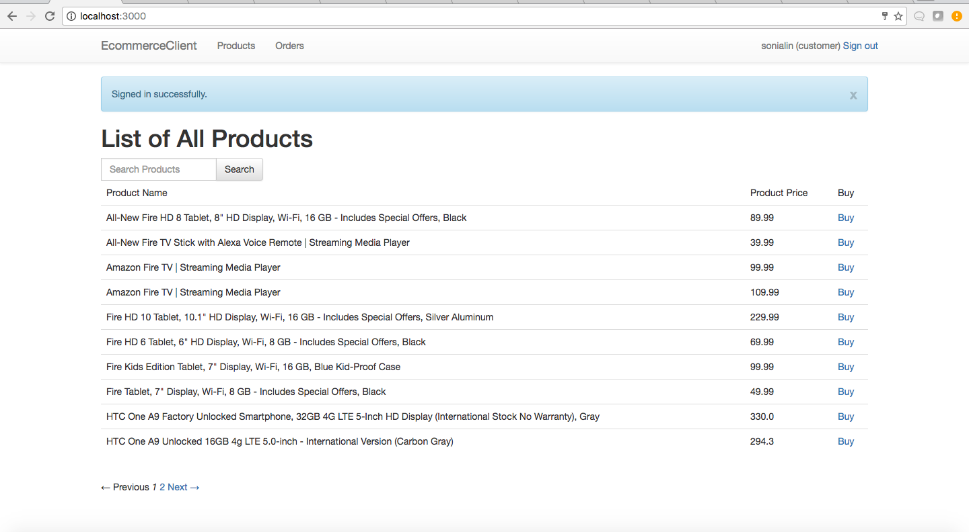
Product Listing – customer’s user story

Slide 7
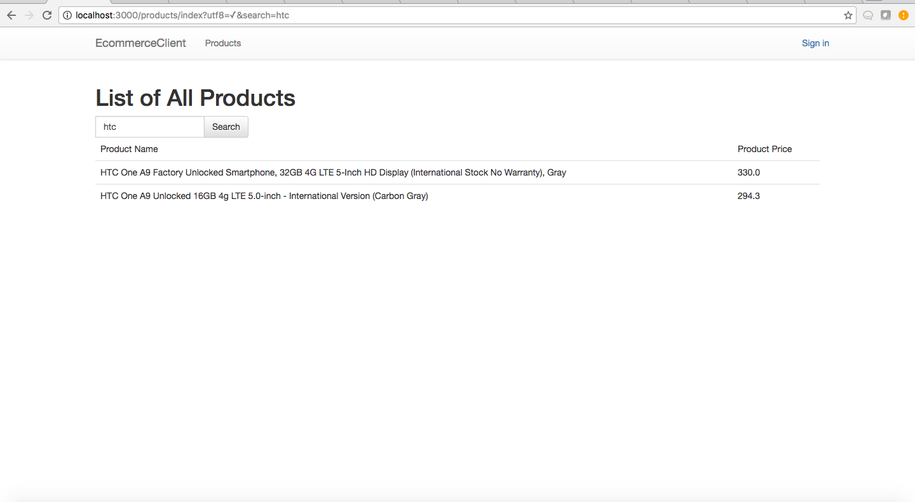
Product Search

Slide 8
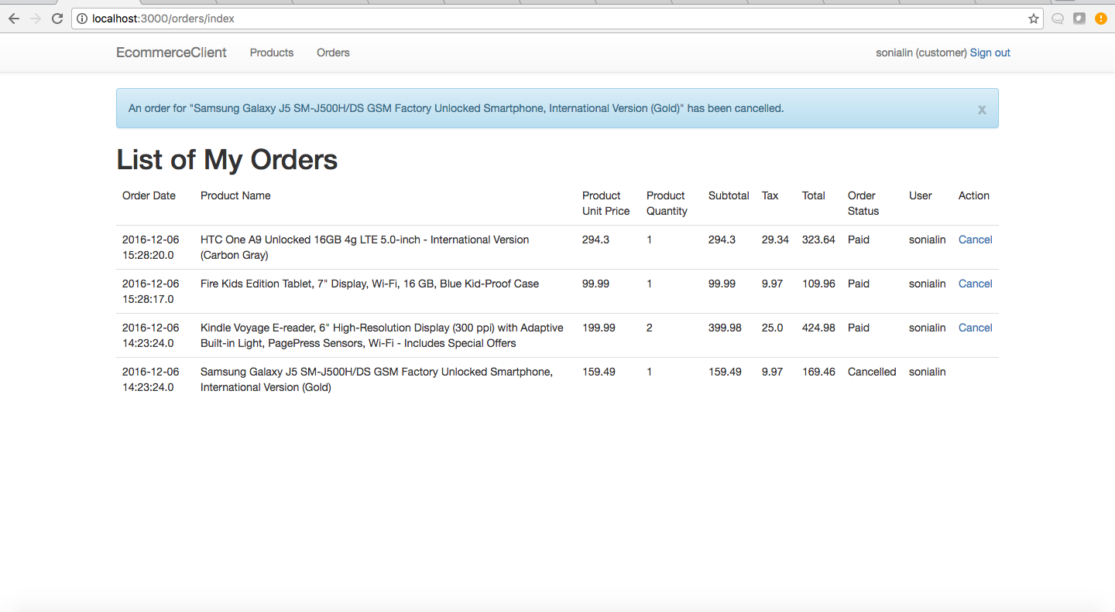
Order Listing – customer’s user story

Slide 9
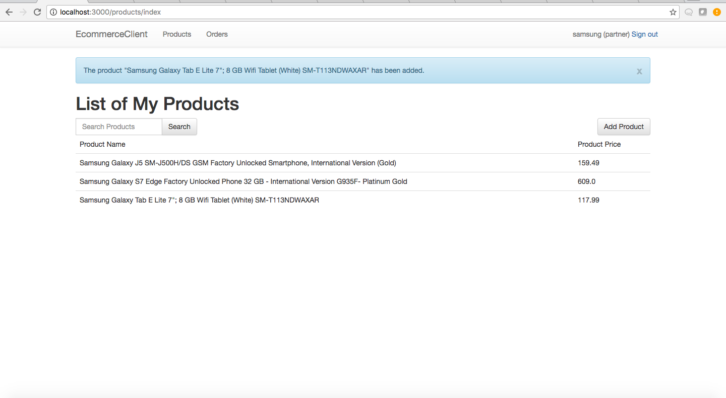
Product Listing – partner’s user story

Slide 10
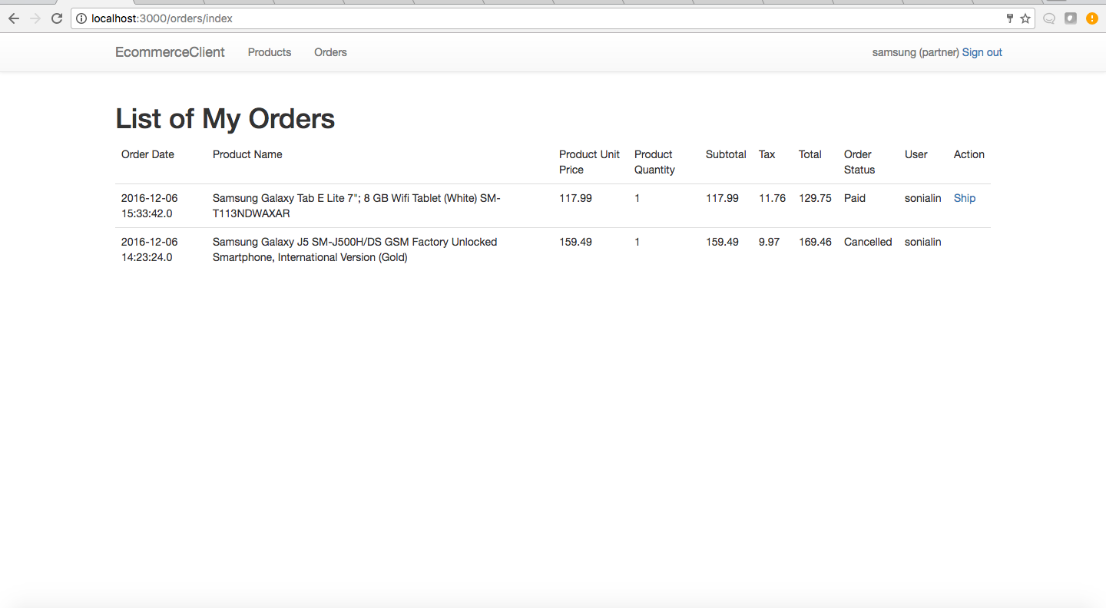
Order Listing – partner’s user story

Slide 11
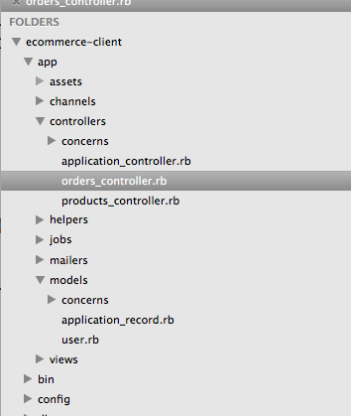
Project Architecture
Client-side structure
MVC
Order and product controllers to handle the business logic of the resource retrieval
User model for authentication

Slide 12
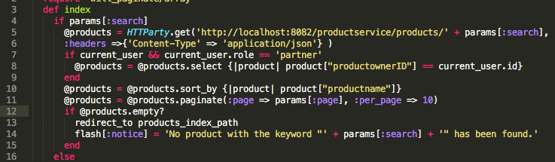
API Consumption Notes
What operations to do locally vs remotely when listing resources
a. get/search products, get orders: remote
b. Sorting, filtering, and paginating the listing are done locally (that are potentially services that can be provided)
a
b

Slide 13
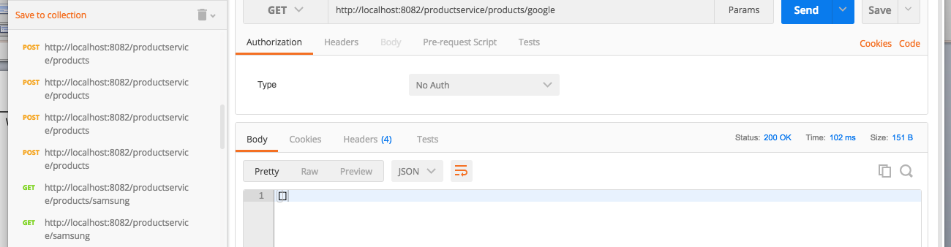
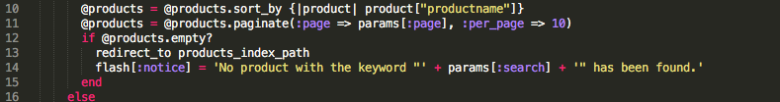
API Consumption Notes
Handle success and exception
500 (or 5xx): Server’s fault
400 (or 4xx): Client’s fault
200 (or 2xx): Success, even with no returned object (searchProduct for example)
Return empty array? No problem.
Client can handle it.

Slide 14
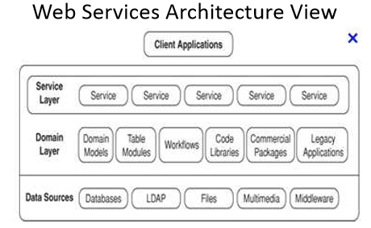
Project Architecture

Slide 15
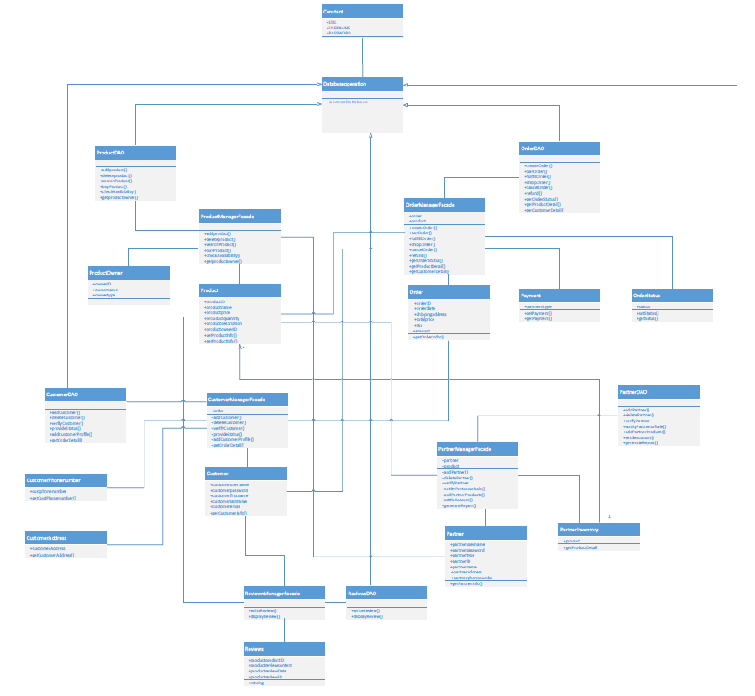
Project Architecture
UML Diagram

Slide 16
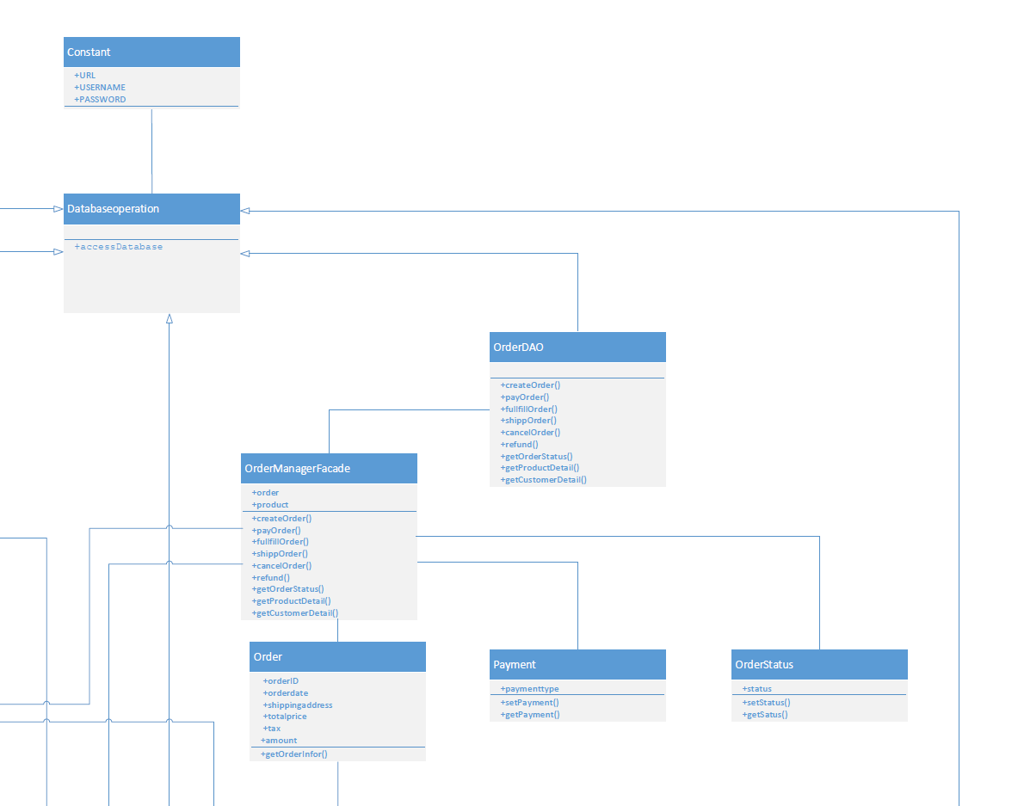
Project Architecture

Slide 17
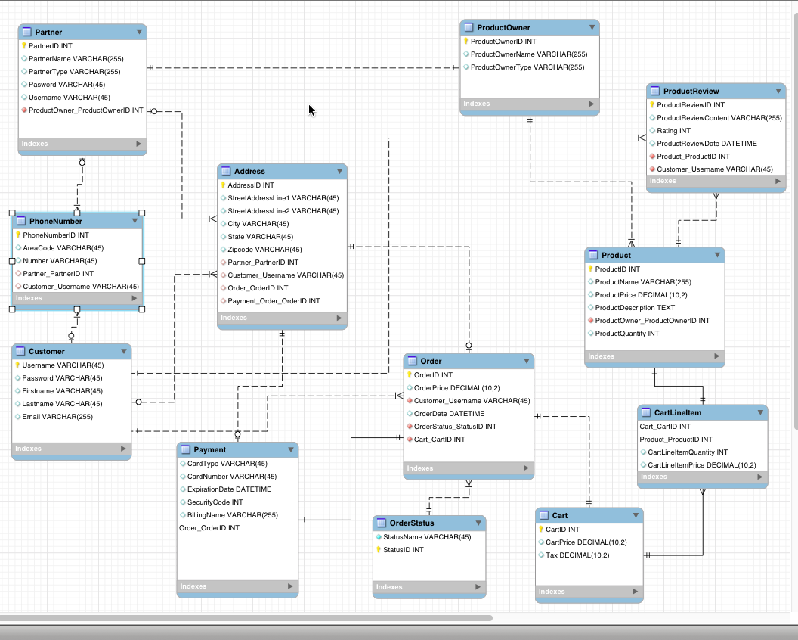
Project Architecture
Database ER diagram
Sample ddl

Slide 18
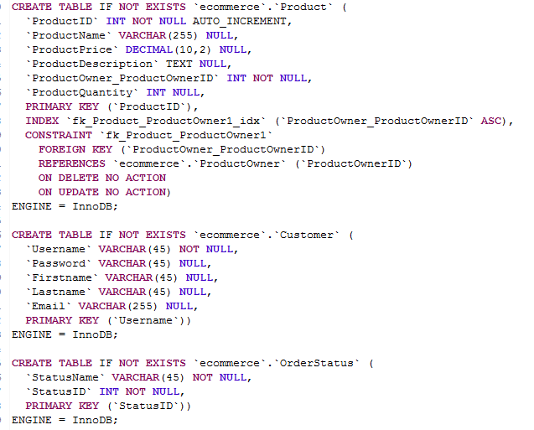
Project Architecture

Slide 19
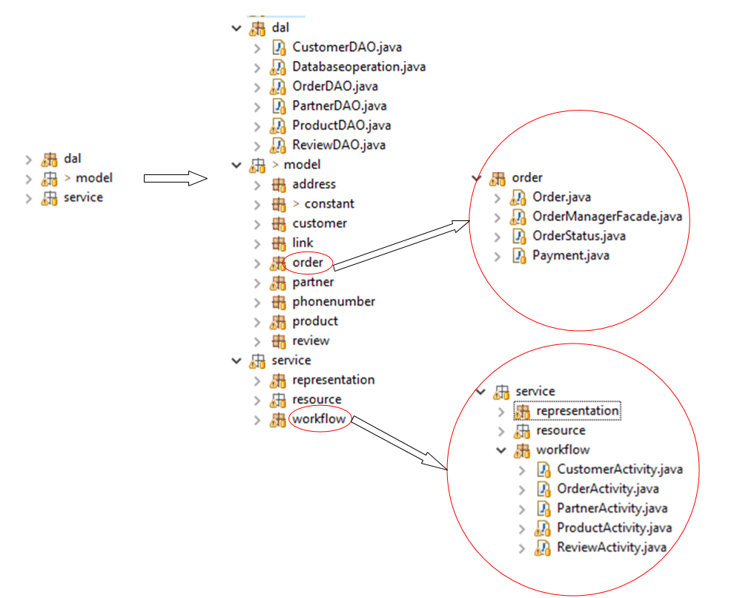
Project Architecture
Server-side structure

Slide 20
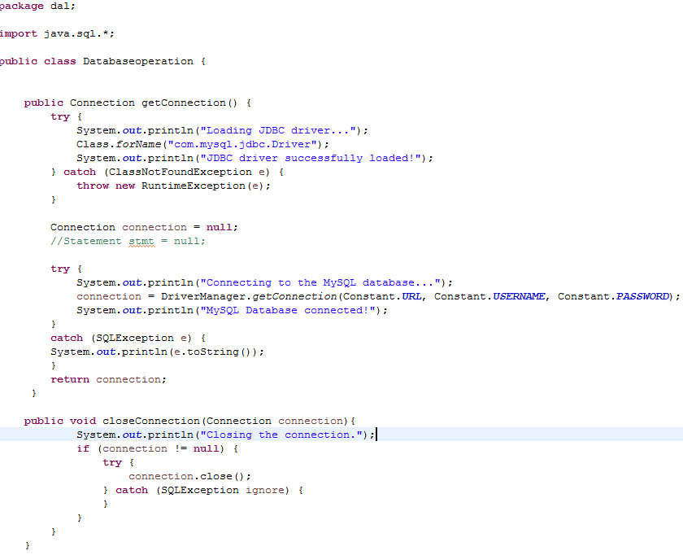
Implementation
Use JDBC to access database

Slide 21
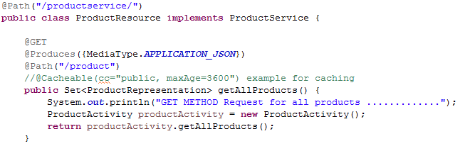
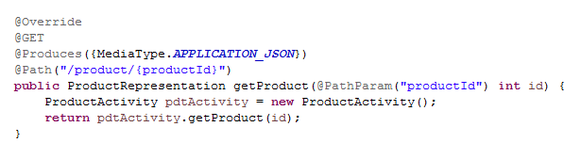
Implementation
Follow ReST design principles to CRUD
Example of the GET method:

Slide 22
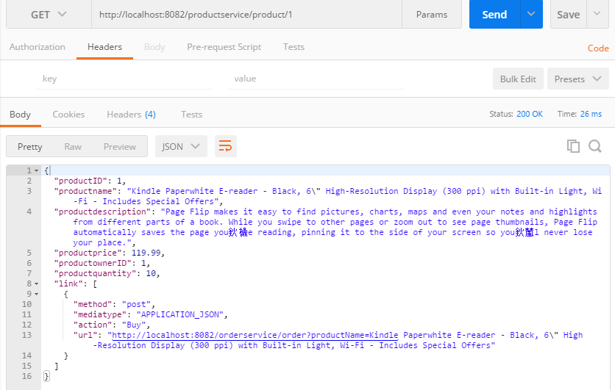
Implementation
Screenshot from postman of get method

Slide 23
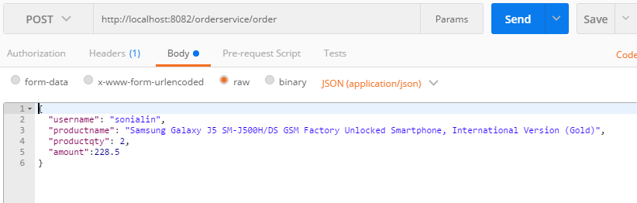
Implementation
Example of the POST method:

Slide 24
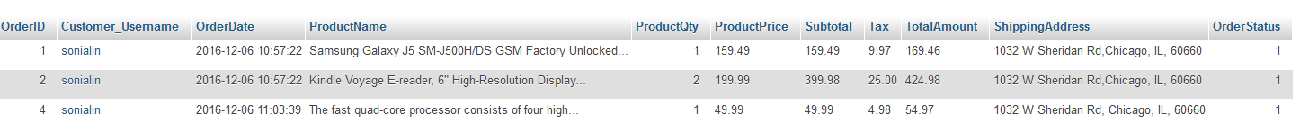
Implementation
Result in database

Slide 25
Difficulties and Lessons
Didn’t know how to create a standard layered structure at the beginning, mixed domain layer and DAC layer
Know how to create it in class
Had difficulty to write a post commend and finally figure it out
The most important is to understand what ReST is, how it works and how to develop a ReST program

Slide 26
THANK YOU!

