Slide 1


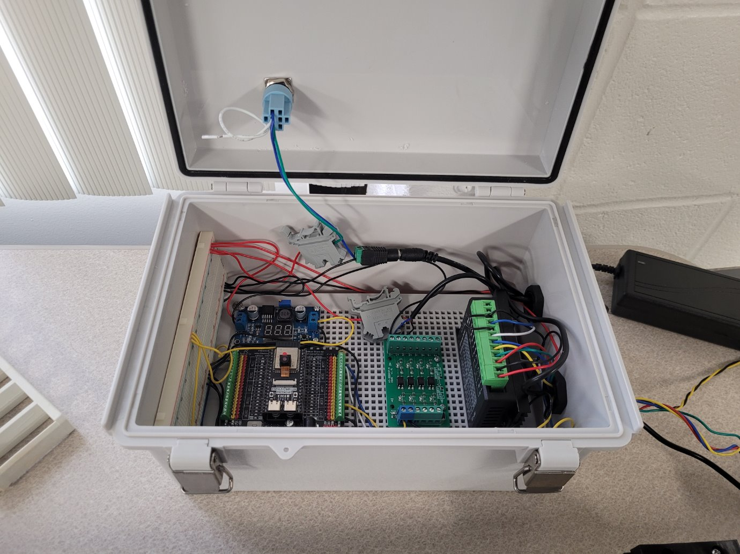
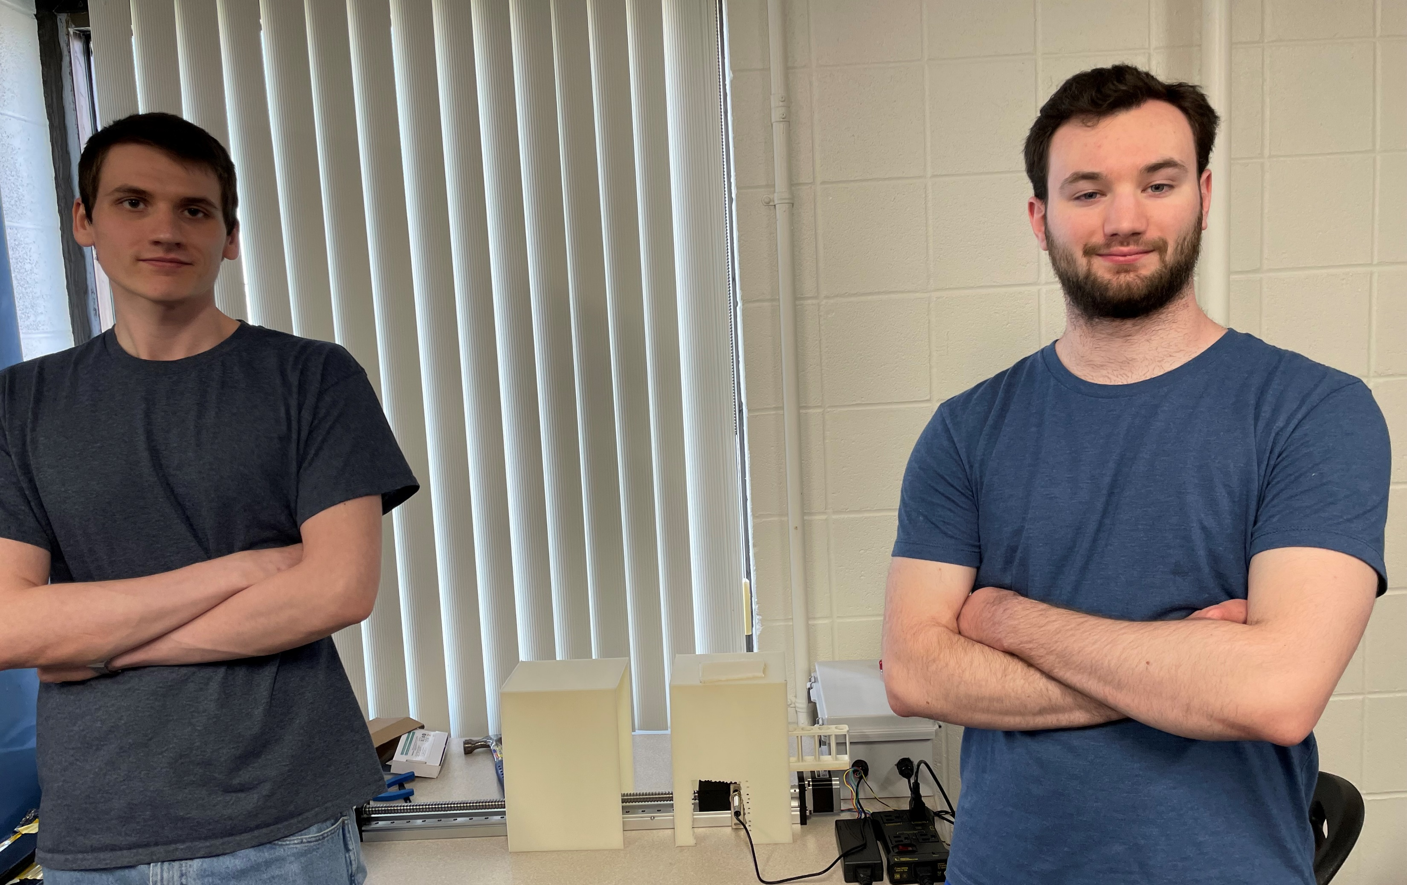
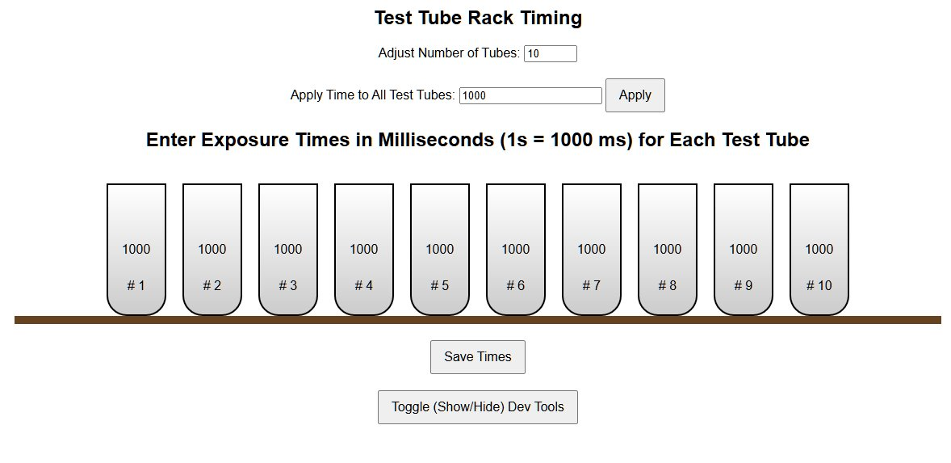
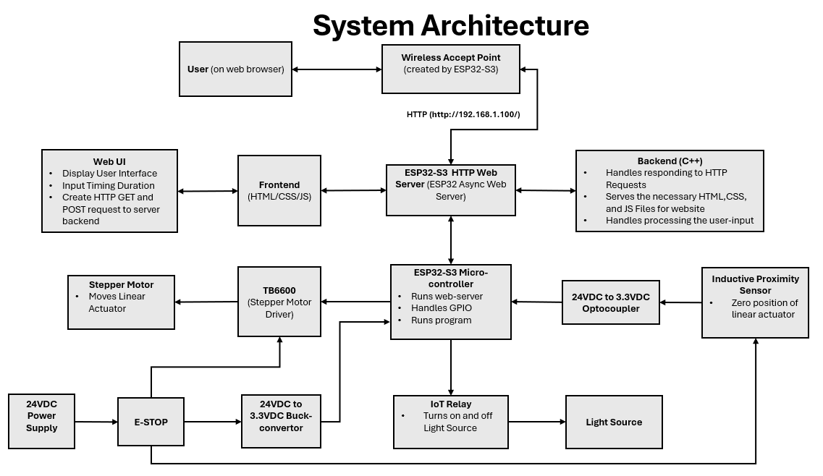
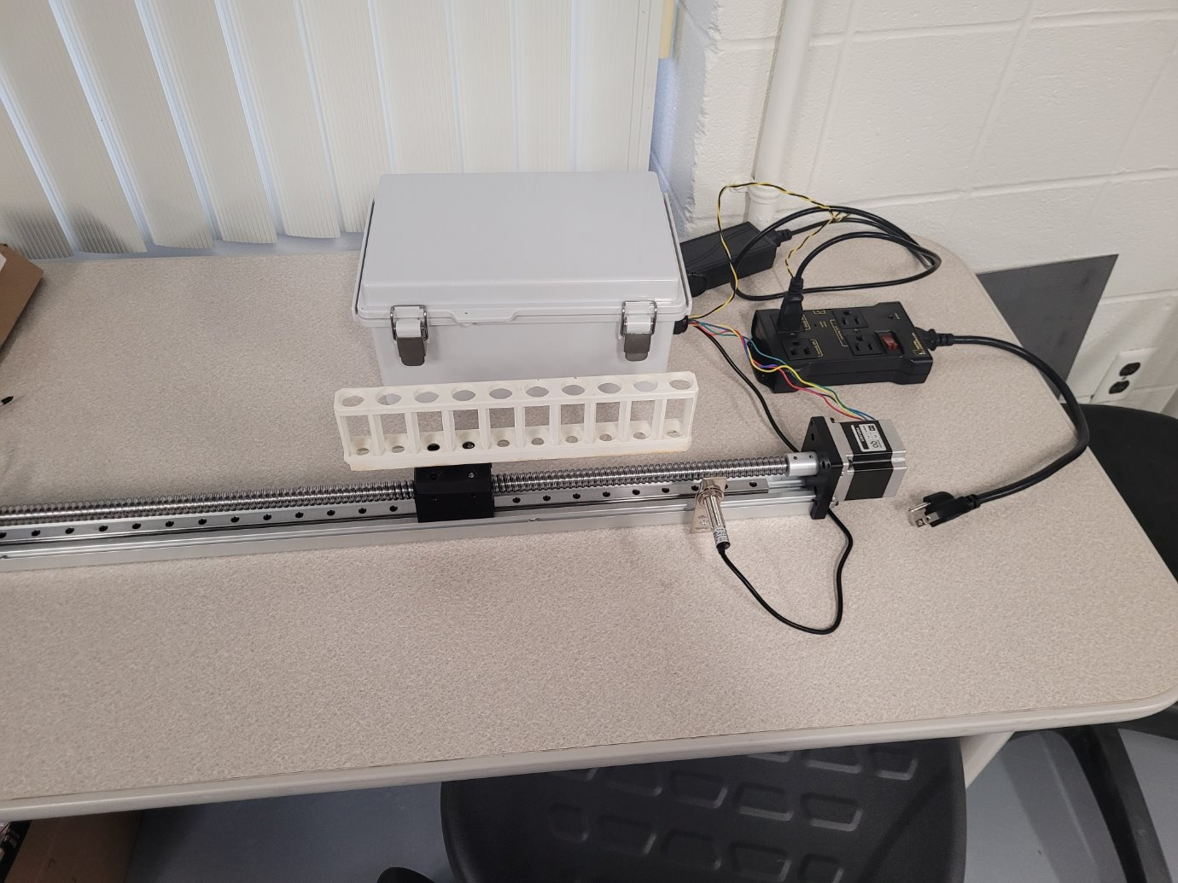
AutoPCRS: Automated Photochemical Reaction System Cameron Collins, Brandon Emmerich
Abstract
Methodology and Implementation
Results and Discussion
Conclusion
Traditional photochemical experiments require manual test tube positioning and light source timing, leading to a labor-intensive, variable, and inefficient process. The Automated Photochemical Reaction System (AutoPCRS) aims to address these issues by automating test tube movement and light exposure control using an ESP32-S3 microcontroller and ball screw linear actuator.
Featuring a web-based interface for real-time monitoring and parameter setting, the system also includes a light shielding enclosure and electronic housing for enhanced safety and reliability. By improving precision, repeatability, and throughput, AutoPCRS offers a scalable solution for photochemical research.
Research Phase: Collaborated with PhD photochemistry students at
BGSU to understand the manual workflow and
identify key variables for automation. Measured
the lab's fume hood and light source to define
design constraints and developed an initial
automation concept.
Prototyping: Constructed a basic prototype using an ESP32-S3
microcontroller, a stepper motor, and a light source.
Successfully tested light activation and basic motion
control.
Hardware Development: Engineered a custom mount to hold the test tube
rack on a linear actuator and designed a light-shielded
enclosure to prevent unwanted exposure. Assembled
and wired all components into a working unit.
Software Development: Programmed the ESP32-S3 to manage actuator
movement and light timing. Built a Wi-Fi-enabled
web interface for setting exposure parameters and
viewing system status. Developed both frontend and
backend systems to support real-time control and
monitoring.
Testing and Refinement: Enhanced the web interface for better user
experience. Validated the accuracy of light
exposure timing and refined actuator travel to
match test tube positions. Integrated all systems
into a final enclosure and confirmed full functionality
of the system.
Main accomplishments:
Developed an automated system which offers precise light exposure control and precise movement of test tubes for photochemical experiments.
Implemented a web-based interface for user input and monitoring of process.
Verified accurate positioning and current timing of light source based on user input.
Reduced manual workload intervention between samples.
Lessons learned:
Prototyping mechanical components often requires multiple design iterations.
Effective time management is critical for meeting project deadlines.
Order parts early, and if you're unsure whether you need a part, order it anyway. It's better to have the parts on hand than to delay progress waiting for a part.
This project highlights the potential of laboratory automation to enhance timing precision, boost the number of experiments that can be conducted, and significantly lessen the manual effort required from researchers when conducting such experiments.
Future Improvements:
Add sensors to confirm tube alignment and reduce reliance on fixed positions.
Improve compatibility with a wider range of test tube rack formats.
Implement a detachable connector for the stepper motor to simplify transport.
Replace solid core wiring with stranded wire and terminal blocks for better durability.
Implement pause and resume functionality.
References
[1] "Getting Started with ESP32-Arduino," ESP-IDF Programming Guide, Espressif Systems. [Online]. Available: https://docs.espressif.com/projects/arduino-esp32/en/latest/getting_started.html. [Accessed: Apr. 25, 2025].
[2] "Arduino Language Reference," Arduino Documentation, Arduino.cc. [Online]. Available: https://docs.arduino.cc/language-reference/. [Accessed: Apr. 25, 2025].
[3] "NEMA 17 Stepper Motor Datasheet and Pinout," Components101. [Online]. Available: https://components101.com/motors/nema17-stepper-motor. [Accessed: Apr. 25, 2025].
[4] "HTTP - Hypertext Transfer Protocol," MDN Web Docs, Mozilla Developer Network. [Online]. Available: https://developer.mozilla.org/en-US/docs/Web/HTTP#reference_documentation. [Accessed: Apr. 25, 2025].
[5] "ESPAsyncWebServer," GitHub, ESP32Async. [Online]. Available: https://github.com/ESP32Async/ESPAsyncWebServer. [Accessed: Apr. 25, 2025].
[6] "AccelStepper Library for Arduino," AirSpayce. [Online]. Available: https://www.airspayce.com/mikem/arduino/AccelStepper/. [Accessed: Apr. 25, 2025].
Introduction
Scientific research relies heavily on experimentation, with certain fields, such as photochemistry, being highly manual, time consuming, and labor intensive. Photochemical studies often require fine tuning variables such as exposure time, light intensity, and reactant concentration to study the resulting chemical behavior.
In traditional photochemical setups, researchers must manually prepare and place reactants into test tubes, adjust and aim light sources by hand, and start and stop the experiment based on the required exposure time.
These exposures can range from seconds to several hours or even days. Researchers must be physically present to stop the reaction with precision, which increases workload, introduces potential timing errors, and limits the number of reactions that can be run efficiently due researchers' schedules.
This project aims to automate this workflow with a microcontroller-based system capable of moving test tubes into position and controlling light exposure duration with high accuracy and minimal user intervention between batch runs. The goal of this system is to create a workflow where a researchers can prepare an entire batch of samples and run them without any intervention besides the initial sample procurement. The system will automatically handle the test tube movement and light exposure based on the user input.
Project Team
Project/Prototype Images
Acknowledgements
Thanks to Dr. Jayaraman Sivaguru and his team for the project’s inception idea.
Thanks to Dr. Sonia Chacko for the support and valuable advice throughout this project.
Thanks to Dr. Zahabul Islam for assisting with use of the lab 3D printers.
Funding Source: Center for Undergraduate Research and Scholarship (CURS)

