Slide 1


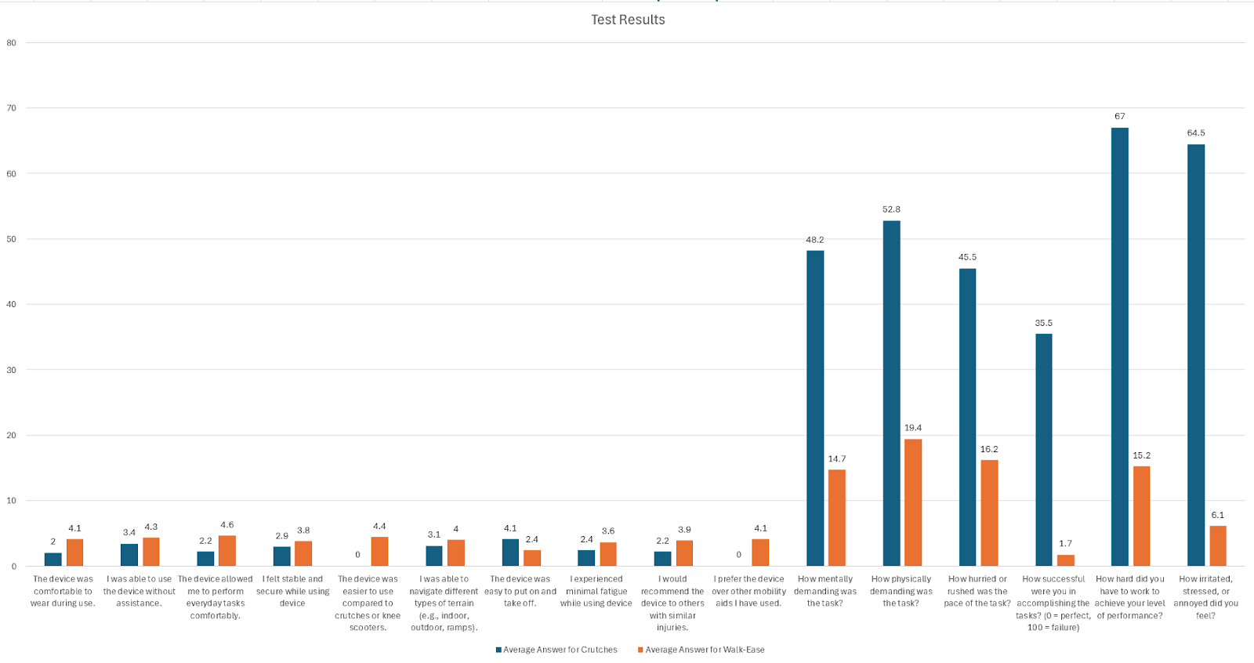
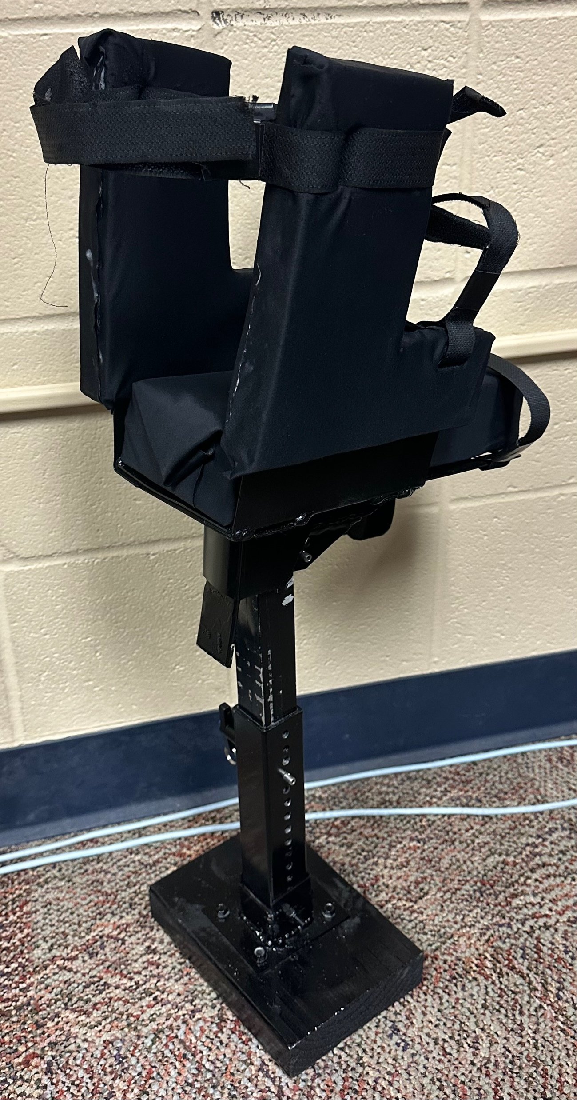
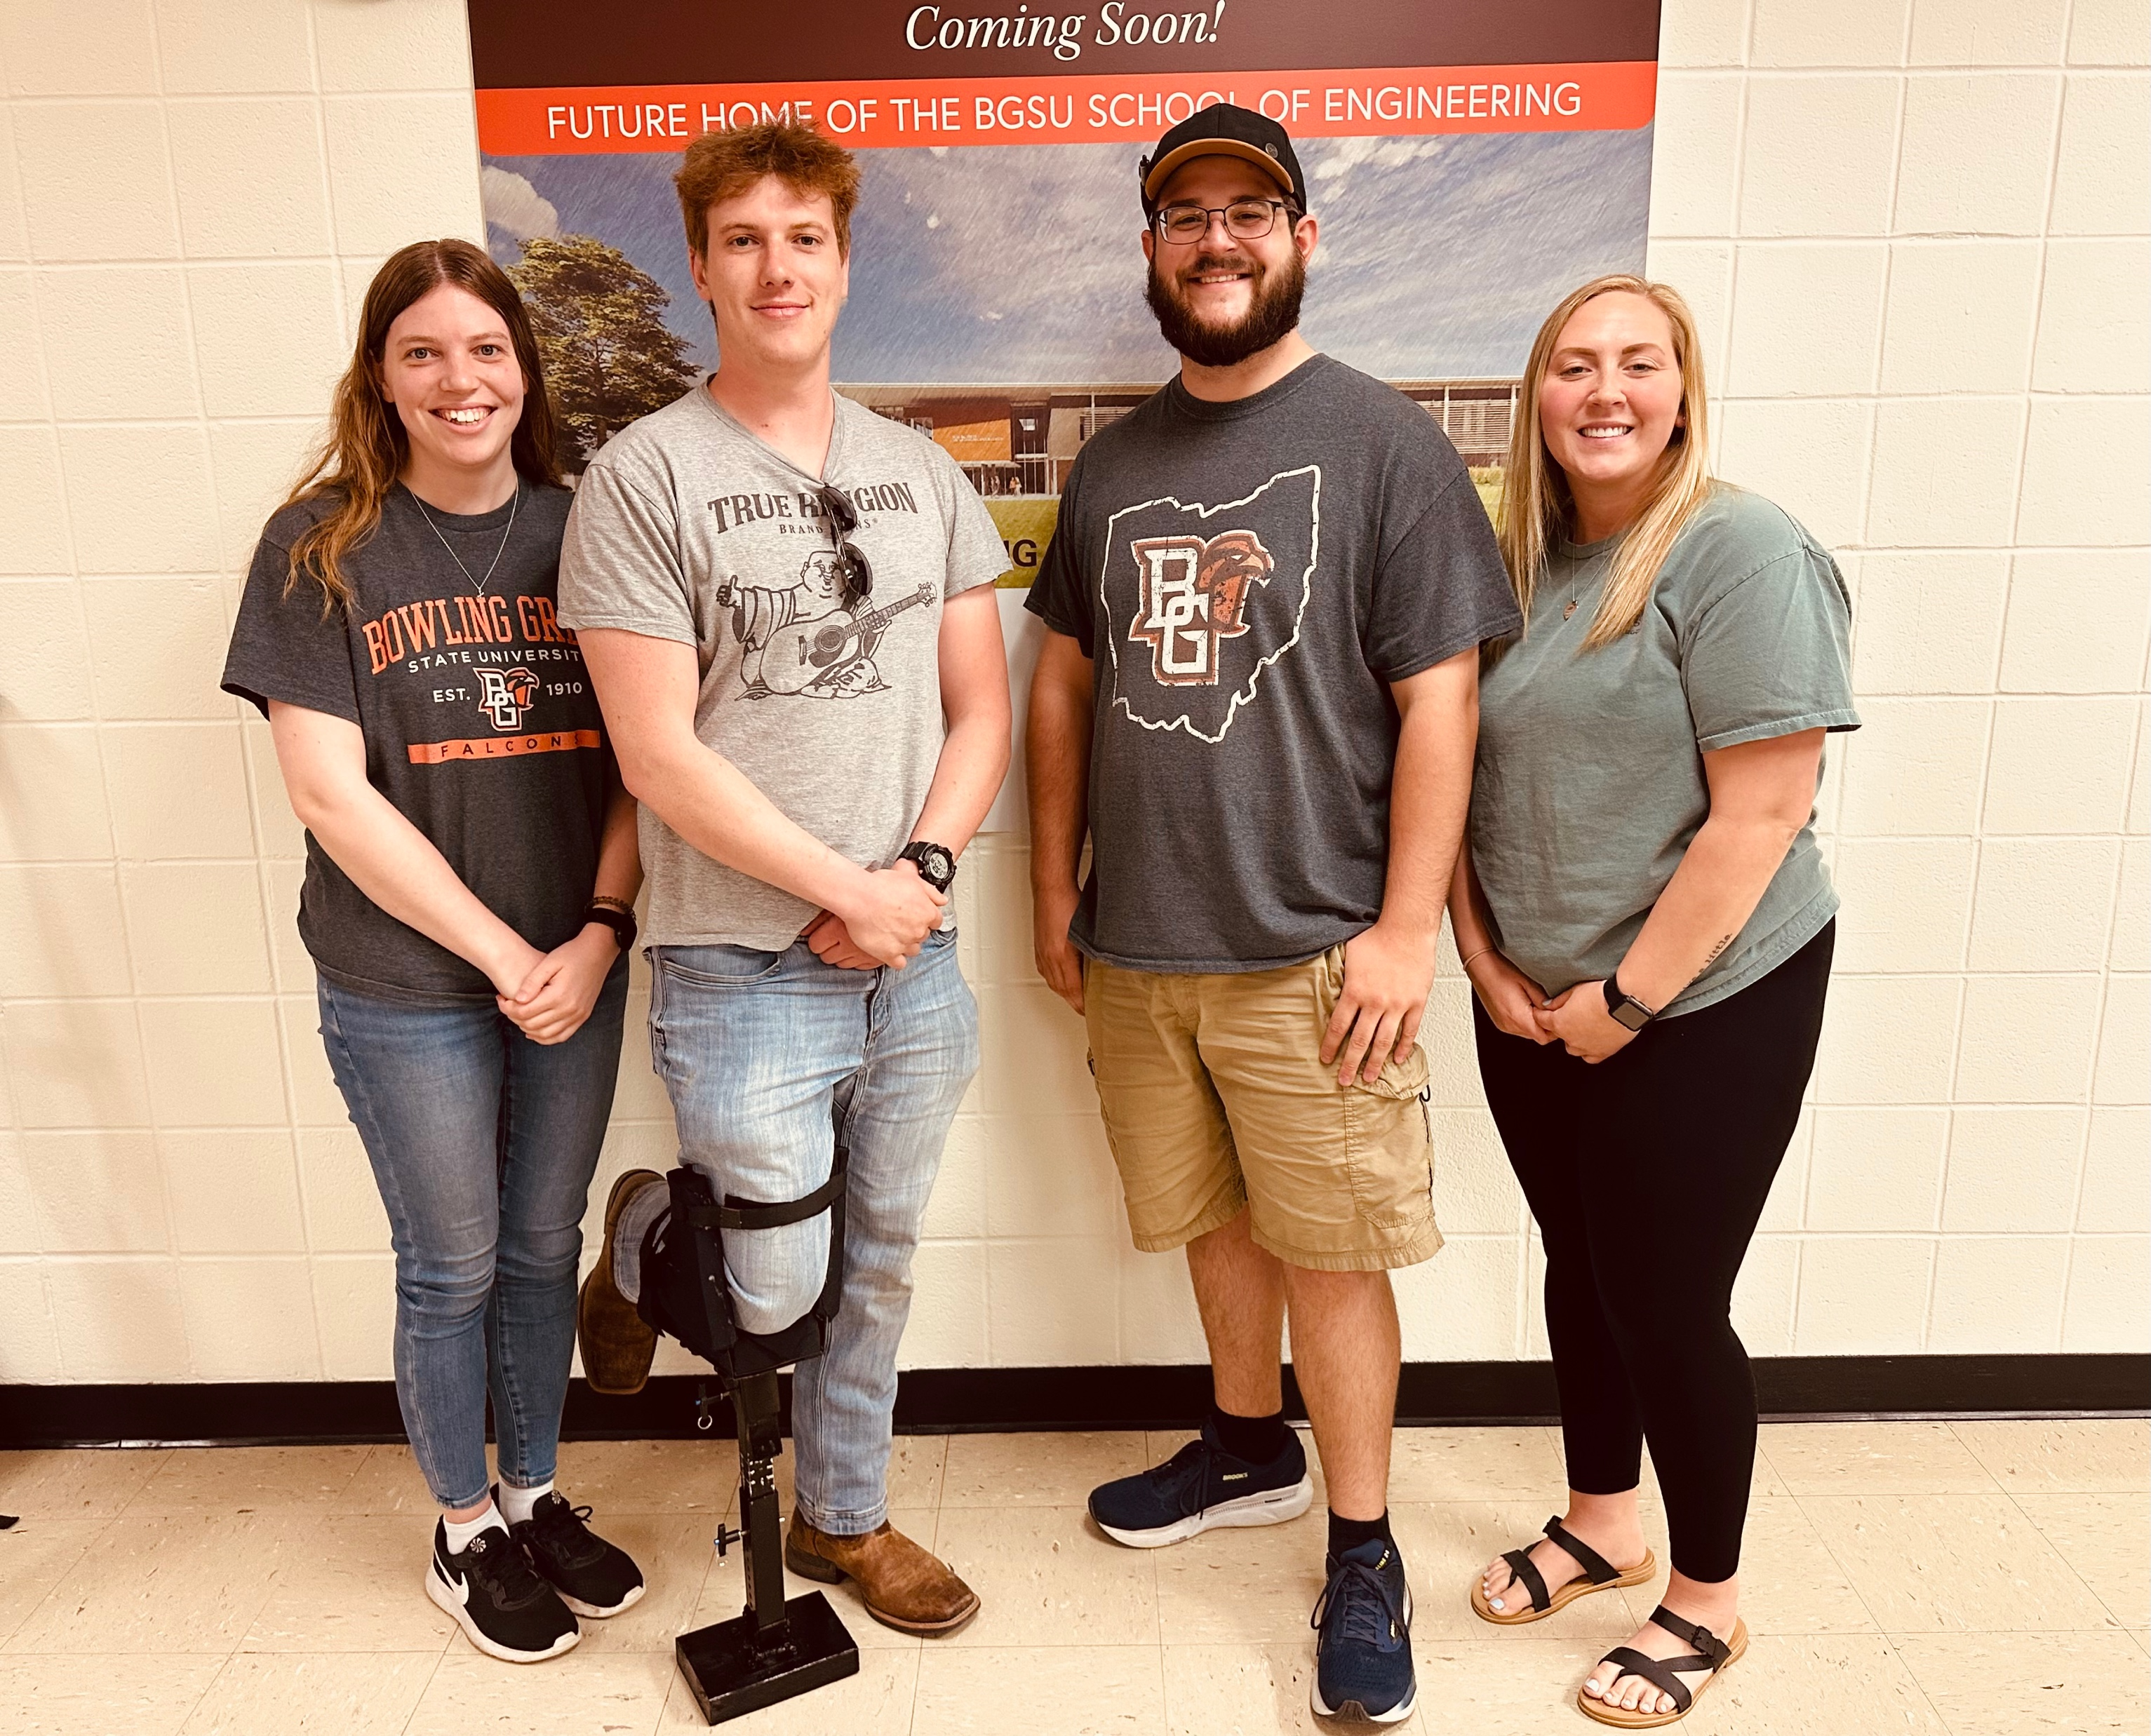
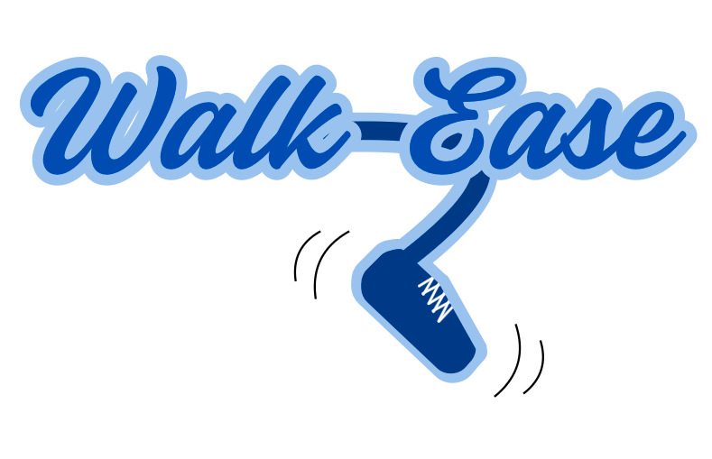
Walk-Ease Brianna Briggs, Sydney Daniels, Alex Mischell, Timothy Pozda
Abstract
Methodology and Implementation
Results and Discussion
Conclusion
Injuries to the lower leg or foot often require assistive devices like crutches or carts, which can be uncomfortable and impractical for long-term use, in addition to being costly. This study aims to design a prosthetic that mimics and supports the leg, offering an alternative to these traditional devices at a comparable or lower cost. The design process utilized SolidWorks for modeling the prosthetic, with simulations in ANSYS Workbench to assess deformations and buckling. Key manufacturing methods included drilling, brazing, and grinding, with practical testing performed by walking around campus to evaluate the prosthetic’s real-world performance. The resulting product, Walk-Ease, is more ergonomic and affordable compared to existing market competitors. Notably, it includes a leg assembly that swings approximately 20 degrees to simulate natural leg movement during walking and a foot rounded at a 10-degree angle to mimic the heel-to-toe motion of a natural foot. A unique feature of Walk-Ease is the ability to fold the leg assembly down when sitting, without needing to fully remove the device, by removing a pin from the knee assembly. This design addresses the limitations of current devices, enhancing comfort and convenience for users. The Walk-Ease prosthetic provides a more functional and cost-effective solution, offering greater mobility and ease of use, which can significantly impact the recovery and rehabilitation of individuals with lower leg injuries.
Results:
Discussion:
There were many problems we ran into with the design of the Walk-Ease. At first, with ordering we would have delays with some parts. So, we had to order stock material off Amazon, then Mill the parts which we were not planning to do. Next, we planned to have a rounded foot that was narrow. Through testing we found that this was not stable and made using the product difficult. To solve this issue, we manufactured a slightly rounded block that was wider, which made the leg and walking more stable. Another problem for support and comfort, was an issue with securing the thigh. It had medal rod fixtures that held your thigh in place. Initially we thought rubber could hold it in place, it did not, it was extremely flimsy, uncomfortable and had adhesive issues. The solution for this was to use foam with the medal encased, then wrap the foam in spandex material to make it quick drying and more comfortable. Also, to secure the leg further we used Velcro straps. With testing and results, we produced the idea that using belts with buckles in the future would be more beneficial for the user.
The Walk-Ease crutch alternative represents a significant advancement in mobility aids for individuals recovering from foot or ankle injuries. By addressing the common drawbacks of traditional crutches, such as muscle atrophy, nerve compression, and poor posture, Walk-Ease offers a more ergonomic and intuitive solution that mimics the natural motion of walking. Through careful research, collaboration with experts, and thoughtful design modifications, we have created a product that is not only more comfortable and supportive but also more affordable than alternatives.
The iterative design process, from identifying key issues with crutch use to consulting with professionals in physical therapy and sports medicine, ensured that Walk-Ease prioritizes the preservation of natural gait patterns and reduces strain on the user's hips, knees, and legs. Through innovations like the adjustable leg length, shock-absorbing features, and the ergonomic knee swing, our design addresses both functional and comfort concerns, setting Walk-Ease apart in the field of mobility aids.
Despite challenges encountered during development, including material issues and structural adjustments, the final prototype successfully meets safety requirements and demonstrates enhanced stability and user comfort. Future iterations of Walk-Ease could involve further refinement through extensive user testing and additional feature enhancements, such as further cost reduction for mass production and improvements based on feedback from users in real-world settings.
Ultimately, Walk-Ease has the potential to revolutionize how individuals with foot or ankle injuries regain their mobility, offering a safer, more comfortable, and cost-effective alternative to traditional crutches. The journey from concept to prototype has been both challenging and rewarding, and the lessons learned will inform future innovations in the field of medical mobility aids.
Methodology:
Our team engaged with an Exercise Science major from Bowling Green State University, specializing in sports medicine, to gather valuable insights for the design of our prosthetic leg. We first sought to identify key areas for improvement in the use of crutches. The expert explained that the primary issue with crutches is misuse. Often, patients are not adequately instructed on their proper use, and by the time they begin physical therapy, their gait patterns have already been significantly altered. As a result, it takes much longer to retrain the leg muscles to walk with a normal gait. The expert emphasized that maintaining a normal stride length during recovery is crucial to preserving a proper gait and preventing atrophy of the quadriceps and hamstrings. This feedback highlights not only the importance of our alternative to crutches but also underscores the significance of ergonomic design.
Additionally, we inquired whether our prosthetic leg should replicate the natural swing of a normal leg. The expert recommended that it should, as doing so enables the patient to maintain a more natural gait while minimizing stress on both the hips and the functional knee. Based on this recommendation, we designed the knee to swing at a 20-degree angle, as suggested by our source.
Implementation:
Our design process began with the creation of a knee block, which serves as the connecting mechanism between the shin-strap and the rest of the prosthetic leg. The knee block features a front panel that functions as a kneecap, limiting the leg's forward swing to a vertical motion. On either side of the knee block, two holes are incorporated: the first allows a pin to pass through the knee and upper leg, facilitating the leg's hinging motion during walking; the second accommodates a removable pin that restricts excessive backward motion while allowing the leg to fold when the user is seated.
The next component is the upper leg, which connects to both the knee block and the lower leg. The pin that joins the upper and lower leg can be removed and repositioned in a different hole to adjust the height of the prosthetic. This part will be fabricated from hollow square stock. While most stock comes pre-drilled with holes, our design requires only two in the upper leg, meaning any square stock can be used, with the primary consideration being cost. The key dimension is the outer width, ensuring that the upper and lower legs can telescope together to enable height adjustments. The top of the upper leg can be rounded using various manufacturing methods, as long as the curvature allows it to rotate around the knee pin.
The lower leg, similarly constructed from hollow square stock, will incorporate multiple holes along its length to accommodate leg length adjustments. The bottom of the stock will feature a welded plate to seal the end, with a threaded hole protruding to facilitate attachment to the foot. A threaded rod will screw into the top of the foot, allowing for precise height adjustments, which can be locked in place with a nut tightened against the foot.
The foot itself will be constructed from a wooden block, shaped with a curve on the bottom to simulate the natural rolling motion of the foot during walking. The wooden block will be coated in rubber for durability, and a female thread insert will be placed at the top, allowing the foot to be securely attached to the threaded rod of the lower leg.
References
BJ;, M. R. M. M. (2020, December 8). Injuries associated with Crutch Use: A narrative review. PM & R : the journal of injury, function, and rehabilitation. https://pubmed.ncbi.nlm.nih.gov/33094912/
Rotolo, Connor. Junior at Bowling Green State University. Majoring in Exercise Science-Focus on Sports Medicine.
Warees, W. M. (2023, August 14). Crutches. StatPearls [Internet]. https://www.ncbi.nlm.nih.gov/books/NBK539724/
Introduction
Walk-Ease is a cost-effective and ergonomic crutch alternative designed to support recovery while maintaining a natural walking motion. Unlike traditional crutches, which can cause discomfort and muscle atrophy, Walk-Ease features a 20-degree knee swing, a rounded foot for smoother strides, and shock-absorbing padding. With expert input and stress-tested materials, our design enhances mobility, reduces rehabilitation time, and provides a more intuitive recovery experience.
Project/Prototype Images
Project Team
Acknowledgements
Funding Source: Center for Undergraduate
Research and Scholarship (CURS)
Faculty/Staff: Benson Ezea, Dr. Mikhail Shilov,
Dr. Sonia Chacko

