Slide 1


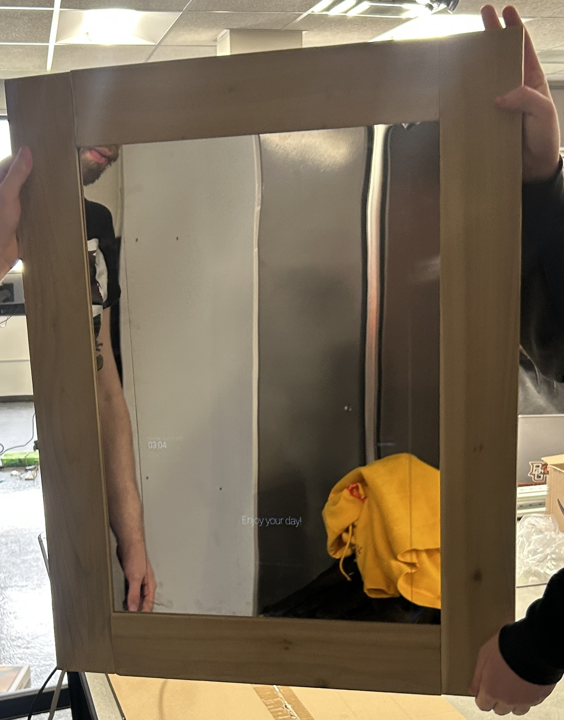
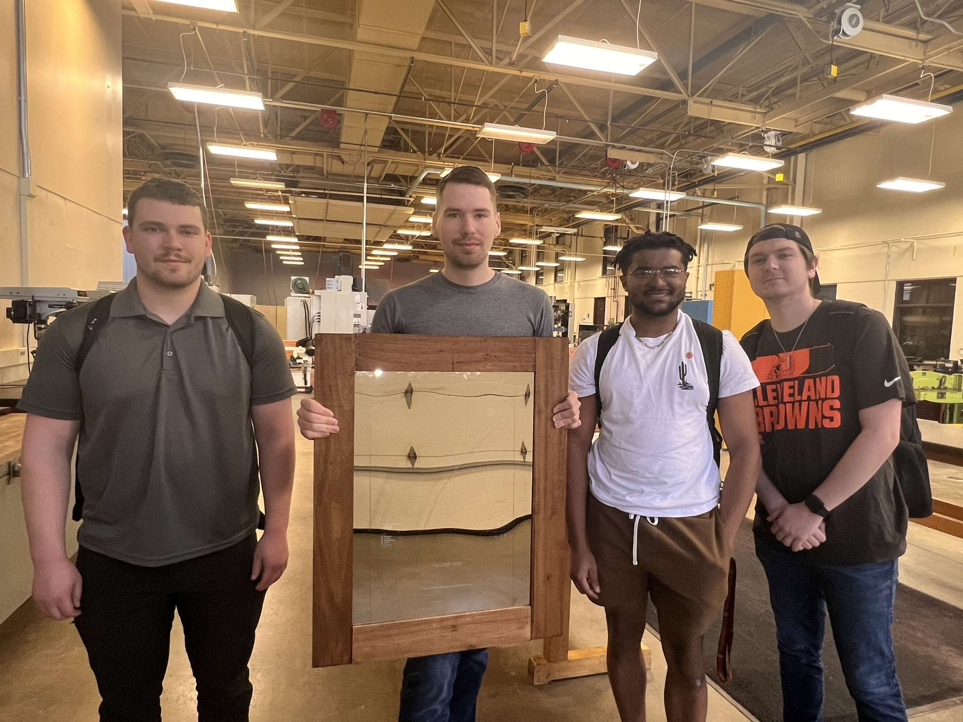
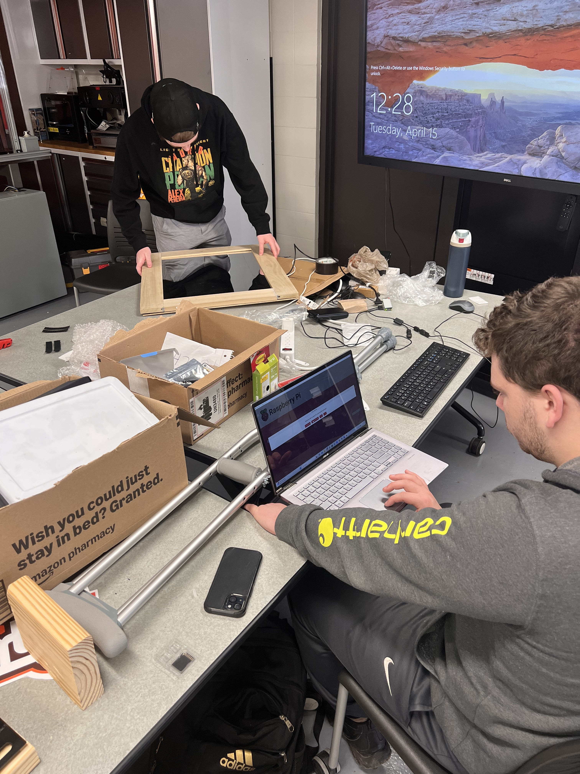
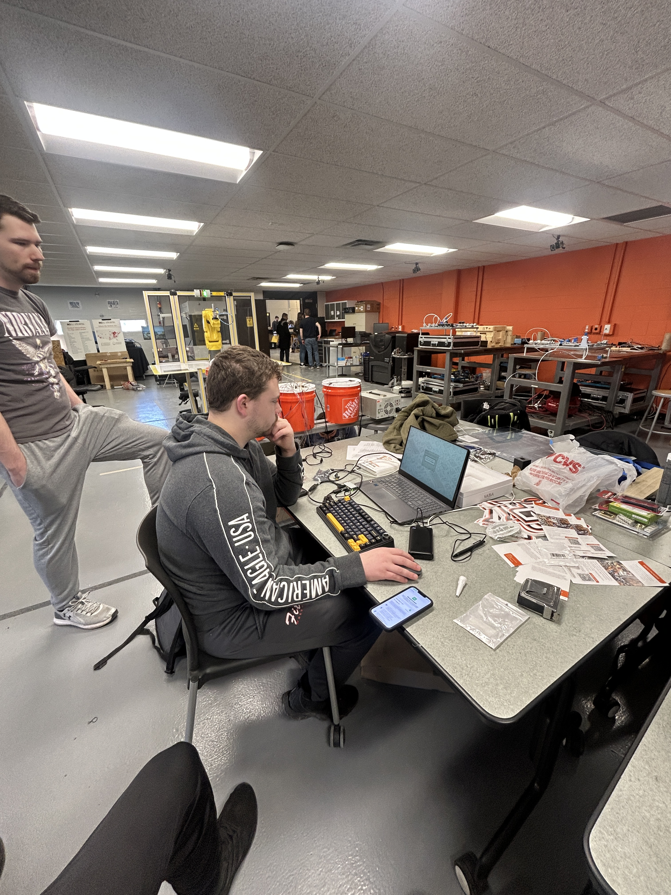
Interactive Smart Mirror Tyler Kordish, Colin Murphy, Brandon Szpendyk, Jalen Webster
Abstract
Methodology and Implementation
Results and Discussion
Conclusion
Our capstone project is a fully functional smart mirror prototype that integrates a two-way mirror with a fully customizable digital interface powered by a Raspberry Pi device. This was designed to reduce the stress of morning routines and make the process of starting your day easier. The mirror displays real-time information including the date, time, weather, news, and calendar events through various API integrations. We designed the mirror in a modular format for the hardware and software components, which allows for future upgrades, such as motion detection, voice activation, and smart home integration. Although we have not implemented motion or voice detection, this prototype serves as a foundation for future upgrades where the possibilities are endless. This project demonstrates how embedded systems can be applied to improve daily routines and efficiency.
Research & Planning
User needs and pain points (e.g., morning routine inefficiencies) with an aim to provide a more efficient morning routine.
Inspiration from existing smart mirrors or related technologies, with the goal to supply the most benefit in a smaller budget.
Selection of features to include (calendar, weather, news, etc.). With further research and integration, modules such as sports scoreboards and music apps could be developed and/or implemented
Design Process
Our UI has 3 basic modules with News, Weather, Time
Hardware layout (18x24" mirror, 15.6" display, Wooden frame and plywood back with electronics mounted)
Designed with a modular system that allows the mirror to be taken out and access the internals for replacement or upgrading.
Technology Stack
Programming languages and frameworks (JavaScript)
Various APIs from different open-source libraries or custom-built modules.
Operating system and platform (Raspberry Pi with Linux)
The mirror is powered by a USB battery pack, which allows for portability and convenience. This could also be replaced with a wall outlet to avoid charging.
There are some additional features we wanted to explore but didn't have the time or capability to do. These features could be added in the future to refine this prototype.
Voice Recognition
Motion Detection
Smart Home Integration
Google Home
Alexa
Touch Screen Display
Water-proofing for bathroom us
Anti-fog functionality
I think we all learned a lot about working in team environments and managing specific roles with varying responsibilities. There is plenty of room for improvement, and growth in learning new technical skills. For instance, working with new hardware and software while also learning how to build and integrate these into a physical object. With added features like voice control, motion detection, touchscreen, and smart home support, it could be an extremely useful product for any consumer. Waterproofing and anti-fog functions could also make the product perfect for bathroom use. Overall, I think there is a lot of room for opportunity for smart appliances.
References
Introduction
Project/Prototype Images
“MagicMirror^{2.}” Magicmirror.builders, 2016, magicmirror.builders.
“MagicMirror Remote Control API.” MagicMirror Remote Control API, 2025, documenter.getpostman.com/view/6167403/Rzfni66c. Accessed 26 Apr. 2025.
We wanted to create a prototype for a device that can serve as an example of what can be done with smart home devices to help make quality of life better and mornings more efficient. Our smart mirror combines the simplicity of a traditional mirror with the power of a customizable digital interface. Using a two-way mirror surface, it offers a seamless and intuitive display experience perfect for enhancing your morning routine.
Whether you're checking the weather, reviewing your calendar, or catching up on the news, this innovative device reduces clutter by replacing multiple gadgets with one streamlined solution. As a key component of smart home integration, it supports better organization and helps simplify everyday tasks all before you've even had your coffee.
Project Team
Acknowledgements
Funding Source: Bowling Green State University Engineering and Technology Department
Dr. Sonia Chacko: Assistance and guidance
throughout the whole Process

