Slide 1


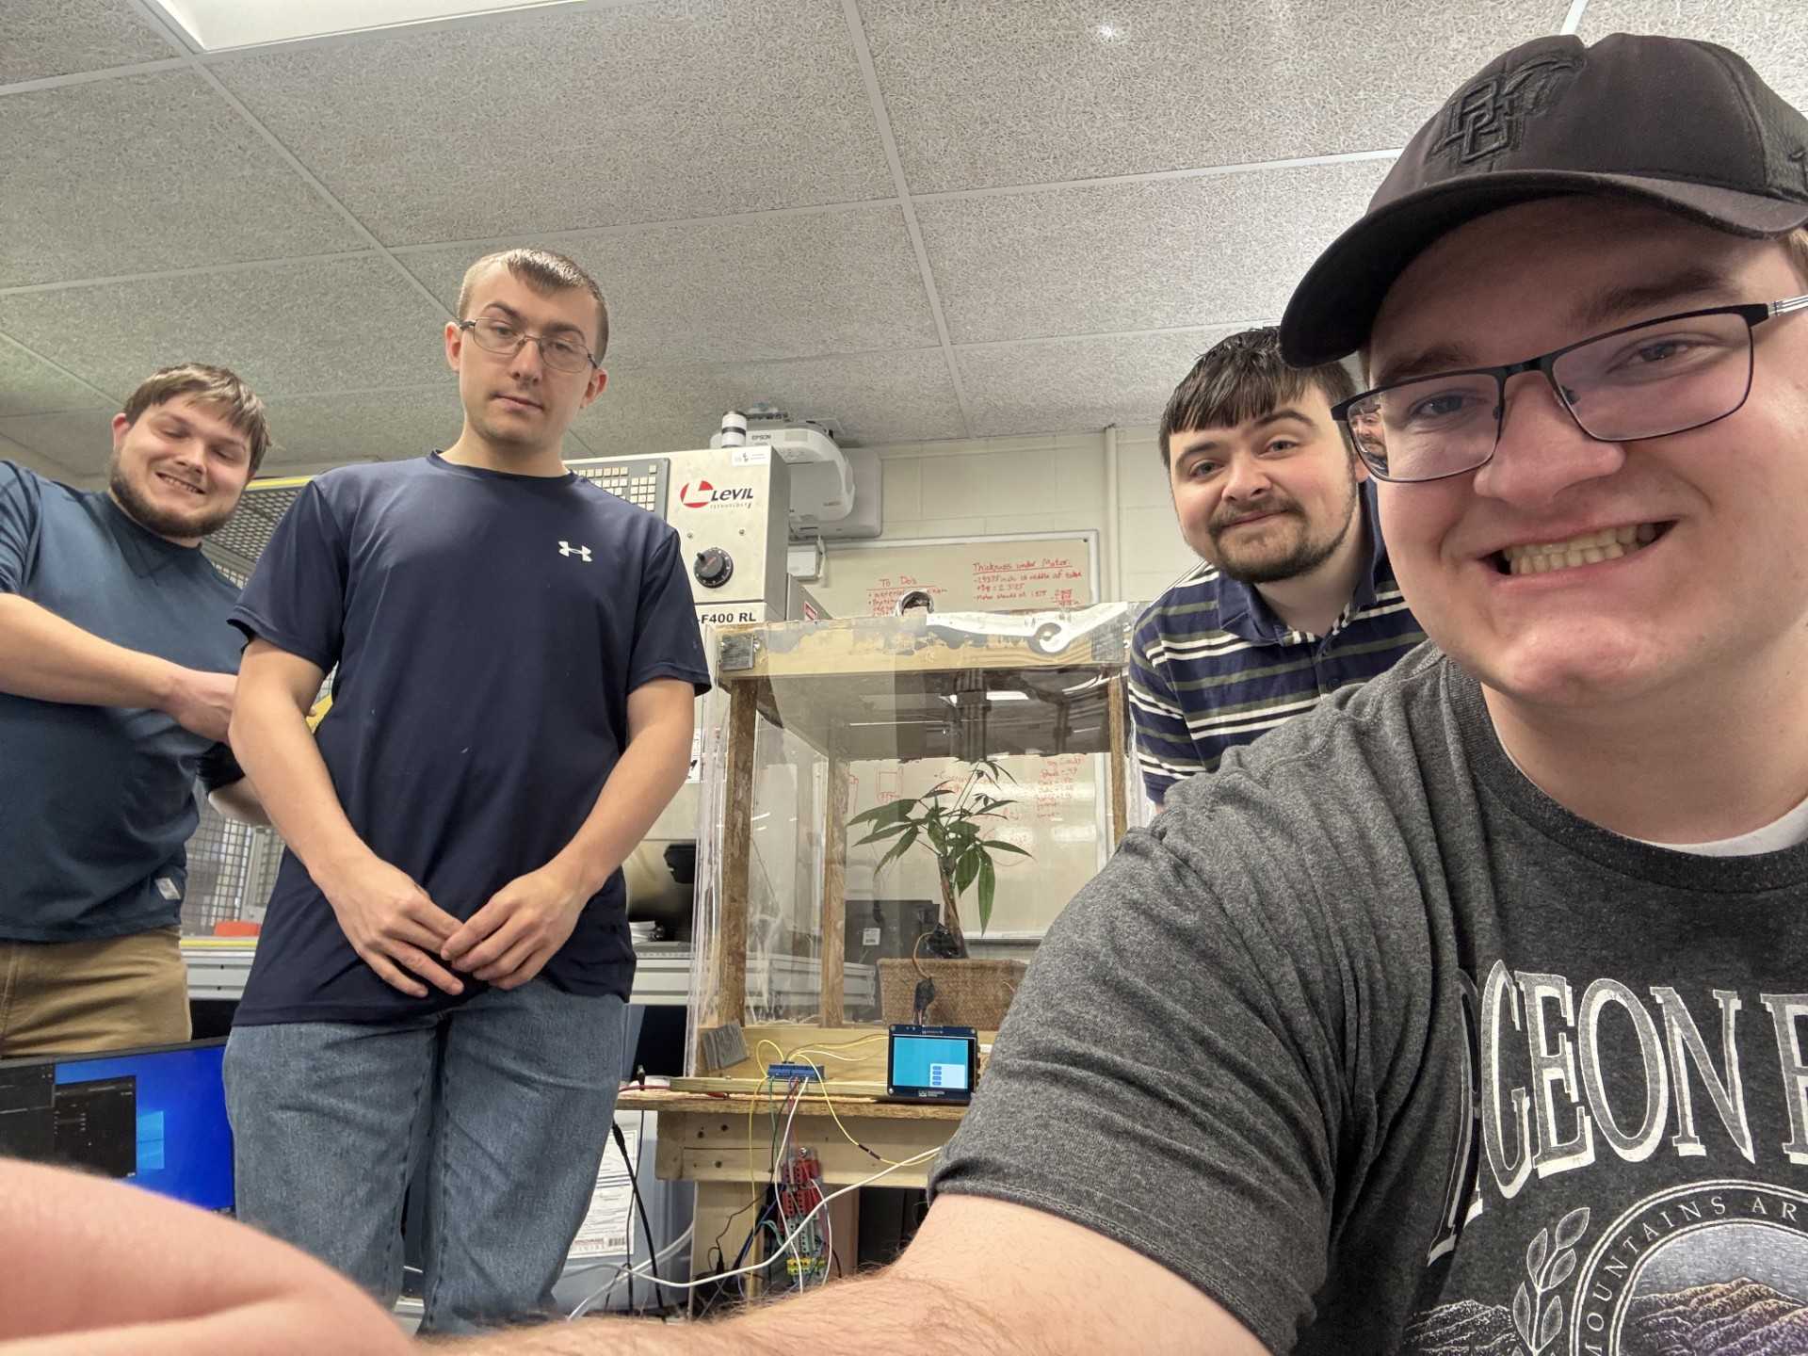
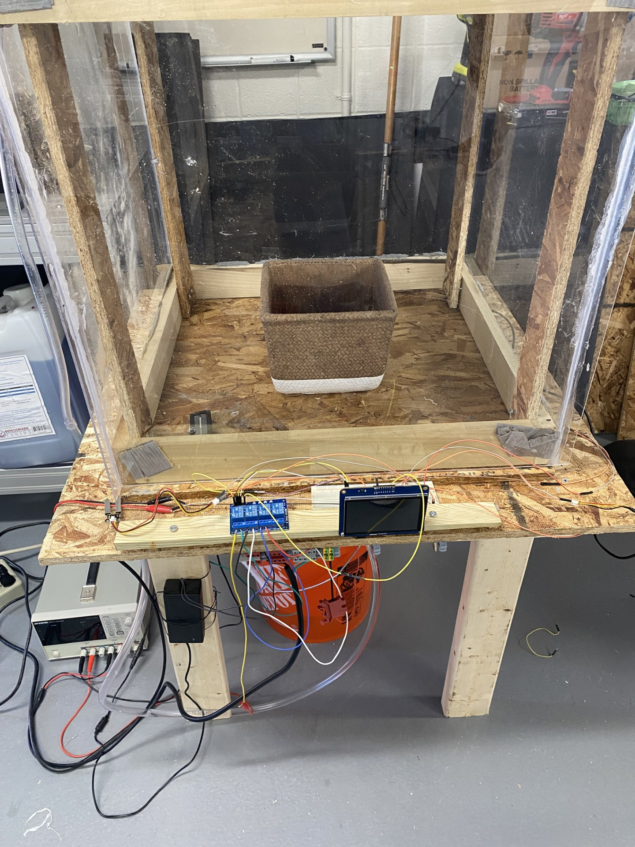
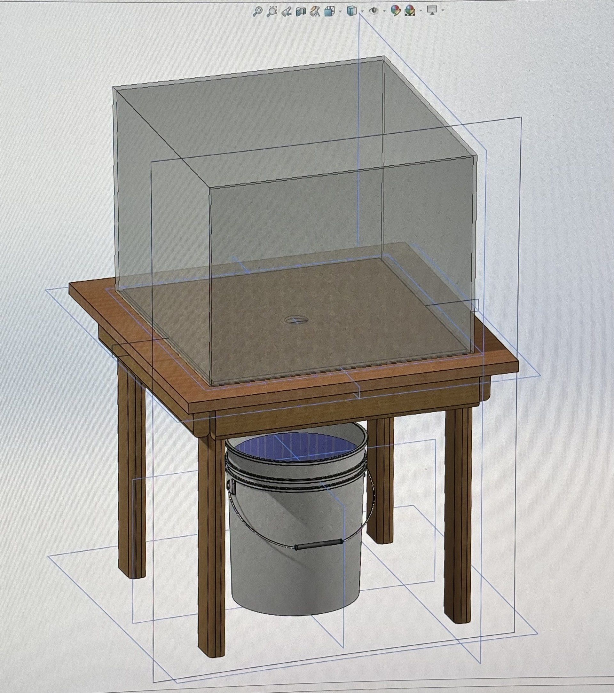
Automated Greenhouse Jonah Barrios, Eric Wodzisz, Nathan Hurst, Dakota Dukett
Abstract
Methodology and Implementation
Results and Discussion
Conclusion
When taking care of plant, there are many factors that could affect the plant's wellbeing. When inexperienced plant owners or even experienced owners have too many plants; the plant could become neglected and over time could wither and die. So, what if there is a way to have a helping hand with taking care of plants.
For the Automated Greenhouse we had to use a wide variety of different tool and technologies. For electronics we used an Arduino PLC, the Giga R1 PLC and Display. This Arduino with three different sensor, light, temperature, and moisture sensors. These sensor will send data to the Arduino and with condition IF statements, will turn on an error correction machine. To fix error we will use a pump for moisture, UV for lights, and a heater for temperature. A user will be able to select the threshold using the touch display and could switch between environments or reset the code.
For the construction portion, we initially created a design we agreed on the 3d modeling program SolidWorks. We then built that out of wood procured from home depot, using screws to bind it together. Finding it sturdy enough, we then created an acrylic case with a wooden frame. This was constructed using liquid nails in conjunction with wood screws. It was sealed with silicone epoxy. This effectively created a seal against the elements, creating a closed system. Pictured below is the initial computer model, and to the side is the table after construction.
In the end our project was a success in making an automated greenhouse that only requires human intervention to refill the water source. We created three different main environments for testing the project. The environments where temperate, desert, and tropical. All our original plans for the project were added in besides having the display show the current temperature and moisture level. This was scrapped due to all attempts to implement resulting in the Giga Display to crash. One other limitation we had was that when purchasing a UV light, we purchased one with an on/off button which resets to off when losing power making it unable to be fully automated.
In this project we set out to create a automated greenhouse that required as little human intervention as possible. In its current form it only needs its water source refilled. In the future this project could be integrated into to a water source to fix this issue. Other possible improvements for this project could be adding temp/ humidity displays and slider bars for setting desired value levels.
Introduction
Project Team
Our project is an Automated Greenhouse with environments that can be tailored to best fit numerous different plants with different needs or environmental conditions. It consists of three main working parts. The watering system, light system, and temperature control system. These are all tied into the main ECU, in this case we are using an Arduino.
Key objectives-
Have a sealed environment that keeps in warmth
Have systems that, when prompted by an Arduino, feeds water/light/heat to the plant
Have a hands-free system that provides the correct conditions with minimal supervision
Project/Prototype Image
Acknowledgements
Funding Source: Center for Undergraduate
Research and Scholarship (CURS)
Lisa Schaller – Construction/Woodworking Assistance
Dr. Sonia Chacko – Faculty Advisor

