Slide 1

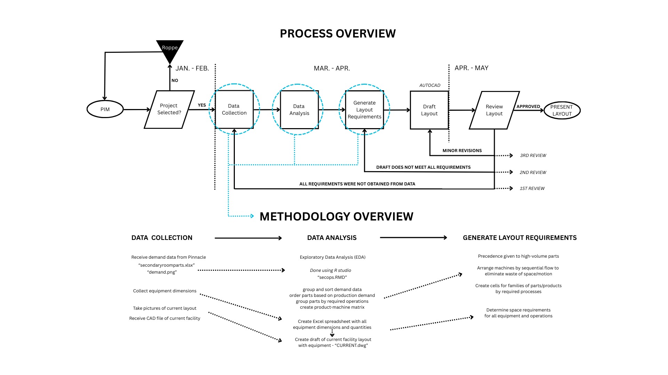
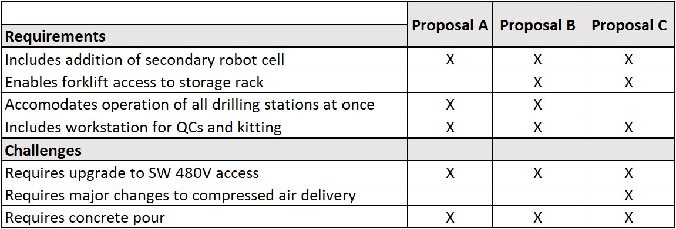
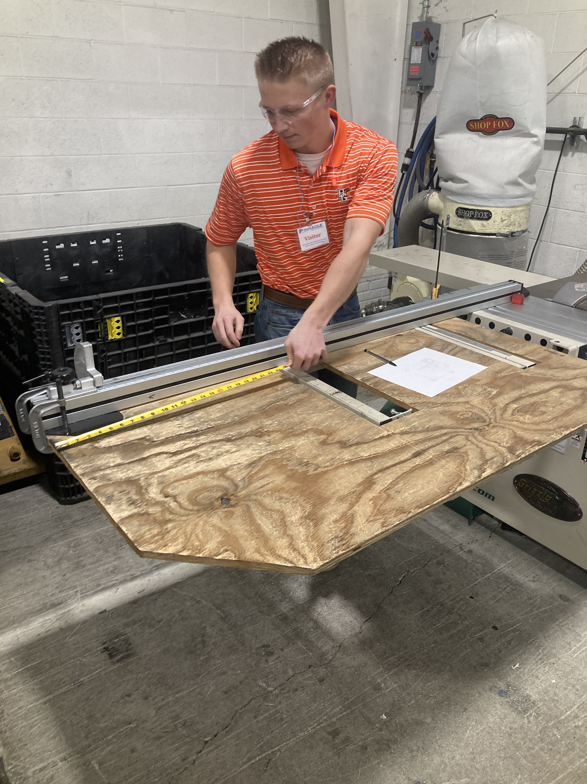
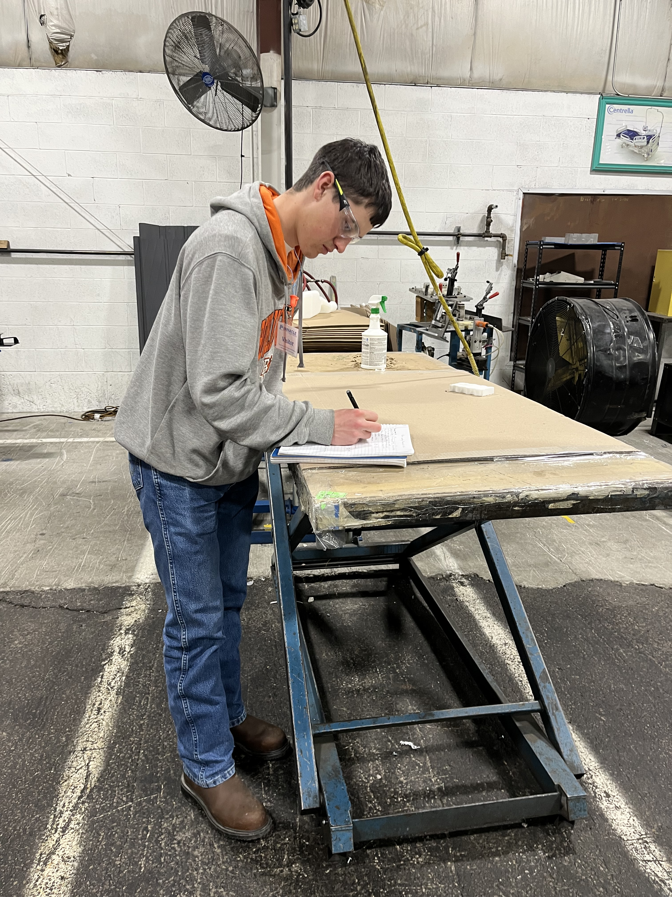
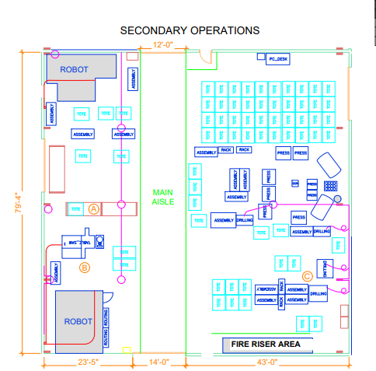
Pinnacle Plastics: Facility Layout Redesign Owen Thompson and Will Clouse
Abstract
Methodology and Implementation
Results and Discussion
Conclusion
Pinnacle Plastic Products is a manufacturer of blow molded plastic parts located in Bowling Green, OH
Their facility includes a secondary operations room for finishing operations of products
Facility layout redesign can be used to:
Reduce waste
Reduce production delays
Improve material flow
Increase throughput
Increase utilization of people and machines
The process of layout redesign includes data collection and analysis to determine the layout requirements to be met
Layout Proposal B meets the most requirements and presents the least challenges
Lessons Learned:
Real-world applications apply principles from SYE course material
Constraints faced in real-world applications are far more specific and complex than classroom examples
Application of facility layout redesign require many more iterations than typical coursework
Use the Theory of Constraints to simplify data analysis
Project Impact
Addition of second robot cell in the secondary operations room
Improved storage rack utilization due to the movement of a storage rack into a more optimal location
Improved material flow and space utilization for:
Drill fixtures
Foaming and kitting
Process Overview
Intro meeting
Project Selection
Data Collection
Data Analysis
Generate Layout Requirements
Layout Design
Review and Revisions
Review meetings after each stage of design creation/revisions
Methodology Overview
Data Collection
On-site: measurements, interviews, documentation
Off-site: file sharing
Data Analysis
Exploratory data analysis in R
Demand volumes
Required processes
Generate Layout Requirements
Proximity relationships
Space requirements
Capacity requirements
Other material handling requirements
Flow paths
Project Team
Introduction
Problem Statement:
There are currently issues with material flow and space utilization that are impacting production output in the secondary operations room at Pinnacle Plastic Products.
Motivation:
This project is an extension of our Systems Engineering coursework, providing experience with a real-world application from industry partner Pinnacle Plastic Products.
Key Objectives:
Increase productivity of the secondary operations room
Complete all required deliverables: Layout proposal drawings, Final presentation, Design Day poster, Project report
Complete the project on a shortened time frame due to project selection delays
Project/Prototype Images
Acknowledgements
Industry Partner:
Mr. Brian Hoffbauer, Pinnacle Plastic Products.
BGSU Faculty:
Dr. Sonia Chacko
Dr. MD Sarder
Dr. Imran Tusar

