Slide 1


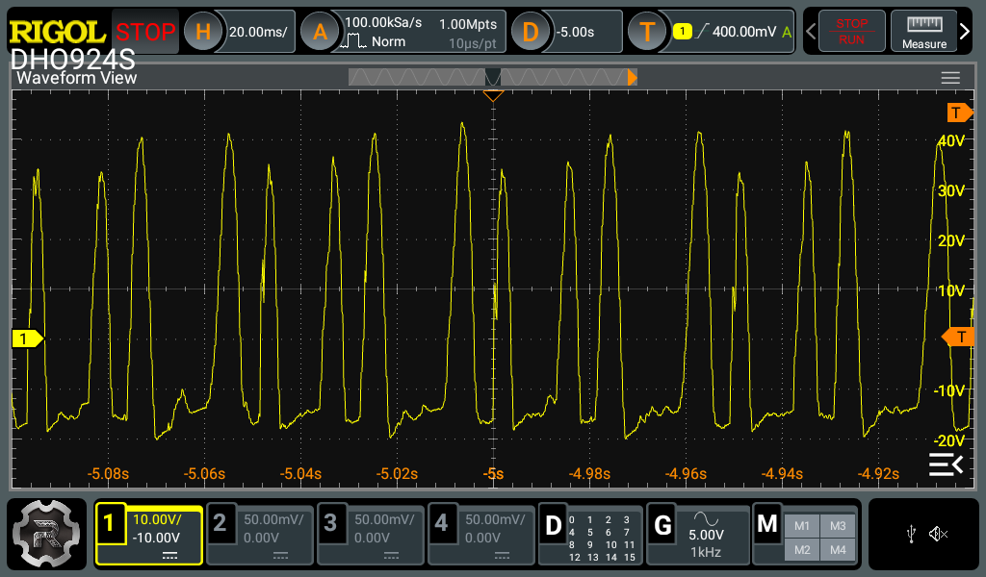
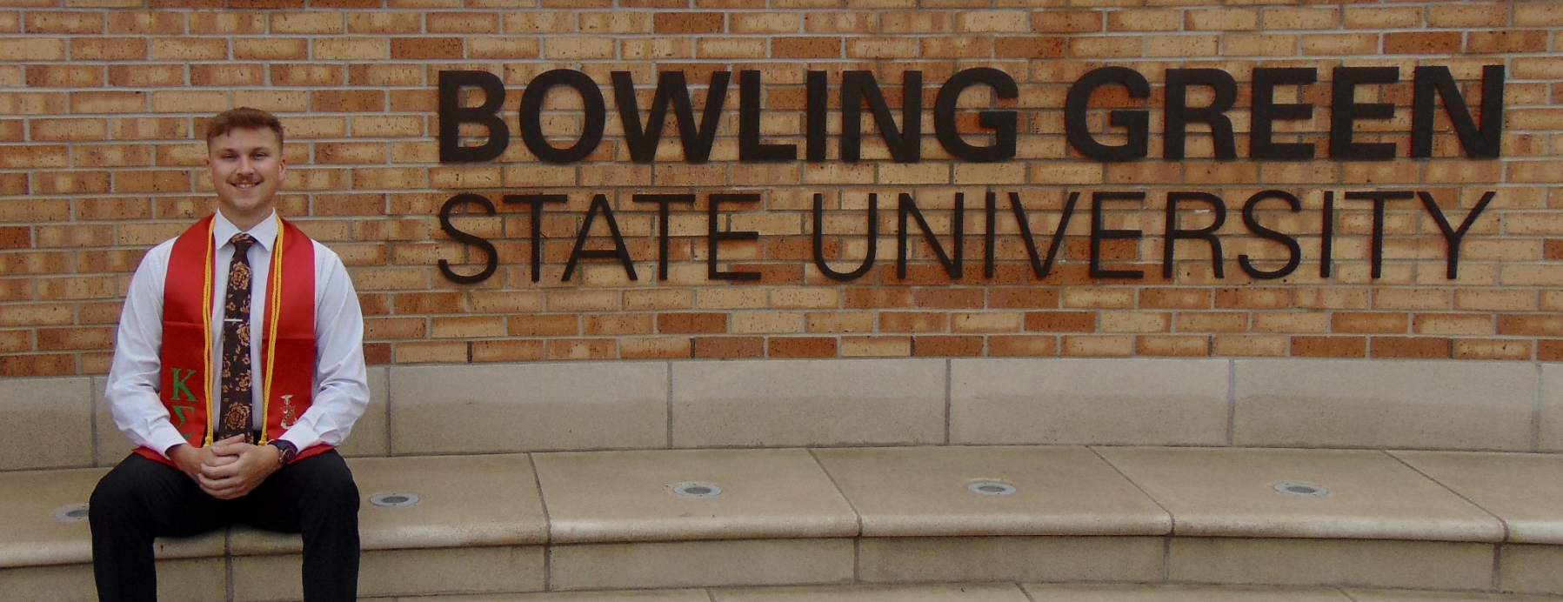
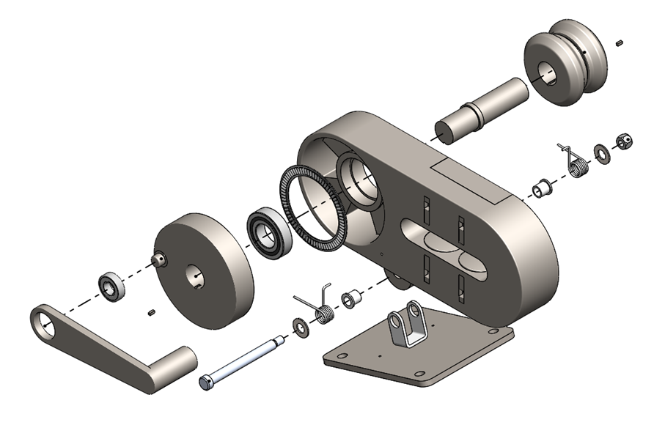
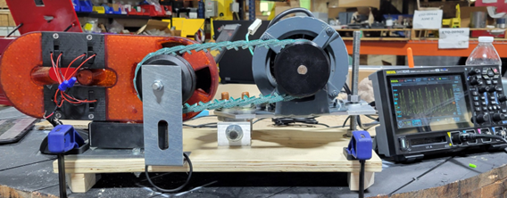
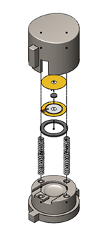
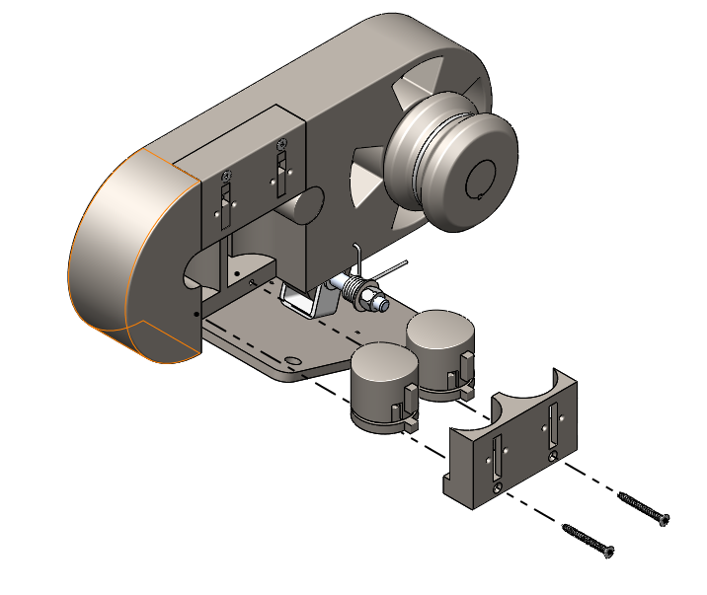
Piezoelectric Energy Harvester for
Inspection Counterweight Beeper Jake Schaefer
Abstract
Methodology and Implementation
Results and Discussion
Conclusion
Elevator counterweights play a critical role in ensuring proper balance and function within elevator systems. However, they also present a significant safety risk for maintenance personnel when working inside the hoist way. When counterweight movement goes undetected, workers face potential injury or even fatal accidents. This capstone project addresses the issue by developing the Piezoelectric Energy Harvester for Inspection Counterweight Beeper, a self-powered safety system designed to alert workers of counterweight movement using piezoelectric energy harvesting. By converting mechanical motion into electrical energy, this technology powers a flashing light and buzzer, serving as an independent warning system without requiring an external power source. This project validates the feasibility of piezoelectric energy harvesting in safety applications while contributing to advancements in green energy solutions and industrial safety. The system's ability to autonomously generate power enhances workplace safety and promotes the development of self-sustaining safety technologies.
The project focused on developing and validating a piezoelectric energy harvester capable of generating consistent electrical power for a warning system that includes a buzzer and flashing light. The methodology consisted of several key phases:
1. Design and Development
A piezoelectric harvester was designed to efficiently capture vibrational and mechanical energy generated by counterweight movement.
2. Electrical System Validation
Testing was conducted to confirm the harvester’s ability to generate a steady 9V output, sufficient to charge a battery and continuously power the safety system.
The battery system was optimized for efficiency and long-term reliability to ensure functionality across various elevator conditions.
3. Mechanical System Optimization
The system was tested under different counterweight speeds to verify its adaptability across multiple operational scenarios.
Components were reinforced to withstand harsh environments and maintain consistent energy conversion.
4. Prototype Testing
A working prototype was developed and assessed under simulated elevator conditions.
Data was collected on power output, efficiency, and activation response, providing insights for further refinement of the technology.
By carefully designing and implementing a self-sustaining energy system, this project delivers a practical safety solution that enhances workplace protection without requiring constant maintenance or external power sources.
Testing results confirmed that the piezoelectric harvester successfully produced a stable and continuous output exceeding 9V, validating its ability to autonomously power the warning system. The system remained effective across varying counterweight speeds, ensuring reliability in diverse operating conditions.
Key findings include:
Consistent voltage generation under multiple test scenarios.
Consistent produced a stable voltage output, exceeding the expected 9V requirement for battery charging.
Beyond its immediate application for elevator maintenance safety, this project opens opportunities for further development in self-powered industrial warning systems, supporting broader advancements in energy-efficient technologies.
Future improvements may focus on:
Enhancing energy storage capacity for extended functionality.
Optimizing piezoelectric materials to increase energy conversion efficiency.
Exploring integration with other elevator safety mechanisms for comprehensive hazard prevention.
Next steps:
Develop an electrical board with the necessary voltage regulation, filtering, and conversion components for efficient battery charging
The Piezoelectric Energy Harvester for Inspection Counterweight Beeper Box demonstrates the successful application of piezoelectric technology in developing a self-powered industrial safety system. By converting mechanical motion into electrical energy, the system effectively eliminates dependency on external power sources.
This innovation contributes to workplace safety by ensuring maintenance personnel receive timely alerts regarding counterweight movement, reducing the risk of injuries or fatalities. The project aligns with sustainability and energy efficiency goals, reinforcing the potential of piezoelectric energy harvesting in industrial safety applications.
As future improvements enhance its energy storage capability and efficiency, this technology has the potential to be integrated into larger-scale elevator safety systems, supporting the industry’s commitment to safer and more sustainable solutions.
References
Introduction
1. Priya, Shashank, et al. "A Review on Piezoelectric Energy Harvesting: Materials, Methods, and Circuits." *Energy Harvesting and Systems*, vol. 4, no. 1, 2017, MIT Open Access, https://dspace.mit.edu/bitstream/handle/1721.1/119839/ehs-AReviewonPiezoelectricEnergyHarvesting.pdf. 2. Ghazanfarian, Jafar, et al. "Piezoelectric Energy Harvesting: A Systematic Review of Reviews." *arXiv.org*, 2021, https://arxiv.org/pdf/2101.09312. 3. Zhou, Mengqi, et al. "Research Progress and Latest Achievements of Road Piezoelectric Vibration Energy Capture Technology Based on Intelligent Transportation Construction." *Intelligent Transportation Infrastructure*, vol. 2, 2023, Oxford Academic, https://academic.oup.com/iti/article/doi/10.1093/iti/liad014/7260582.
Elevator counterweights are essential for efficient elevator operation, as they help balance the load and minimize energy consumption. However, during maintenance, counterweights can move silently, posing serious hazards to workers who may be in close proximity. Without a clear and immediate warning system, counterweight movements can result in severe injuries or fatalities.
To mitigate these risks, this capstone project introduces the Inspection Counterweight Beeper Box, a self-powered safety alert system using piezoelectric energy harvesting. Existing warning systems only operate within limited range of elevator speeds and have limited battery life, which can be unreliable or unavailable in certain conditions. This system eliminates that limitation by capturing mechanical energy and converting it into electrical power, ensuring that maintenance personnel receive timely warnings without reliance on batteries or external electrical sources.
The project is driven by two primary motivations:
Enhancing safety standards for elevator maintenance personnel.
Integrating green energy solutions into industrial safety systems.
By combining energy-efficient innovations with workplace safety measures, the Inspection Counterweight Beeper Box supports the broader goal of developing sustainable safety technologies that improve industry standards.
Project Team
Project/Prototype Images
Acknowledgements
This project was made possible thanks to the support and expertise of Wurtec Inc. whose commitment to safety innovation continues to drive industry advancements.
Special appreciation goes to faculty advisors, industry mentors, and peers, whose guidance and insights were instrumental in shaping and refining this capstone project. Their contributions helped ensure the success of the Piezoelectric Energy Harvester for Inspection Counterweight Beeper Box in its mission to enhance safety and promote sustainable engineering solutions.
Funding Source: Wurtec Inc.

