Slide 1
Phase 1 Project

Slide 2
Agenda Style
01
Data Cleaning.
02
Exploratory data analysis
03
Recommendation to Microsoft

Slide 3
Box Office, The Numbers and The MovieDB

Slide 4
Top 10 Movies with highest domestic gross in Box Office and The numbers.
The Numbers
Box Office Mojo
Star Wars: The Force Awakens: $936,700,000.00
Black Panther: $700,100,000.00
Avengers: Infinity War: $678,800,000.00
Jurassic World: $652,300,000.00
Marvel's The Avengers: $623,400,000.00
Star Wars: The Last Jedi: $620,200,000.00
Incredibles 2: $608,600,000.00
Rogue One: A Star Wars Story: $532,200,000.00
Beauty and the Beast (2017): $504,000,000.00
Finding Dory: $486,300,000.00
Star Wars Ep. VII: The Force Awakens: $936,662,225.00
Avatar: $760,507,625.00
Black Panther: $700,059,566.00
Avengers: Infinity War: $678,815,482.00
Titanic: $659,363,944.00
Jurassic World: $652,270,625.00
The Avengers: $623,279,547.00
Star Wars Ep. VIII: The Last Jedi: $620,181,382.00
Incredibles 2: $608,581,744.00
The Dark Knight: $533,720,947.00

Slide 5
Top 10 Movies with highest foreign_gross/ worldwide_gross in Box Office and The numbers.
Box Office Mojo
The Numbers
Harry Potter and the Deathly Hallows Part 2: $960,500,000.00
Avengers: Age of Ultron: $946,400,000.00
Marvel's The Avengers: $895,500,000.00
Jurassic World: Fallen Kingdom: $891,800,000.00
Frozen: $875,700,000.00
Wolf Warrior 2: $867,600,000.00
Transformers: Age of Extinction: $858,600,000.00
Minions: $823,400,000.00
Aquaman: $812,700,000.00
Iron Man 3: $805,800,000.00
Avatar: $2,776,345,279.00
Titanic: $2,208,208,395.00
Star Wars Ep. VII: The Force Awakens: $2,053,311,220.00
Avengers: Infinity War: $2,048,134,200.00
Jurassic World: $1,648,854,864.00
Furious 7: $1,518,722,794.00
The Avengers: $1,517,935,897.00
Avengers: Age of Ultron: $1,403,013,963.00
Black Panther: $1,348,258,224.00
Harry Potter and the Deathly Hallows: Part II: $1,341,693,157.00

Slide 6
1. Recommendation based on domestic and Foreign sales.
By leveraging insights from the top 10 movies with a higher gross in Box Office and The Numbers highlighted in green and implementing strategic initiatives across content creation, marketing, partnerships, distribution, audience engagement, and data analysis, Microsoft can position itself for success in the competitive entertainment industry both domestic and world-wide.
Top movie (Domestic) - Star Wars: The Force Awakens.
For Foreign gross, The numbers has higher values as its based on a worldwide view.
Global Appeal: Develop movies with broad international appeal to maximize gross profits from global box office markets. Consider themes, characters, and storylines that resonate with diverse audiences worldwide.

Slide 7
Top 10 Movies with highest gross profit.
id | release_date | movie | production_budget | domestic_ gross | worldwide_ gross | total_gross | percentage_profit
46 | Jun 30, 1972 | Deep Throat | 25000.0 | 45000000.0 | 45000000.0 | 90000000.0 | 359900.000000
93 | Sep 25, 2009 | Paranormal Activity | 450000.0 | 107918810.0 | 194183034.0 | 302101844.0 | 67033.743111
7 | Jul 14, 1999 | The Blair Witch Project | 600000.0 | 140539099.0 | 248300000.0 | 388839099.0 | 64706.516500
80 | Jul 10, 2015 | The Gallows | 100000.0 | 22764410.0 | 41656474.0 | 64420884.0 | 64320.884000
74 | Feb 26, 1993 | El Mariachi | 7000.0 | 2040920.0 | 2041928.0 | 4082848.0 | 58226.400000
14 | Mar 21, 1980 | Mad Max | 200000.0 | 8750000.0 | 99750000.0 | 108500000.0 | 54150.000000
10 | May 7, 2004 | Super Size Me | 65000.0 | 11529368.0 | 22233808.0 | 33763176.0 | 51843.347692
47 | Aug 13, 1942 | Bambi | 858000.0 | 102797000.0 | 268000000.0 | 370797000.0 | 43116.433566
16 | Aug 9, 1995 | The Brothers McMullen | 50000.0 | 10426506.0 | 10426506.0 | 20853012.0 | 41606.024000
66 | Oct 18, 1974 | The Texas Chainsaw Massacre | 140000.0 | 26572439.0 | 26572439.0 | 53144878.0 | 37860.627143

Slide 8
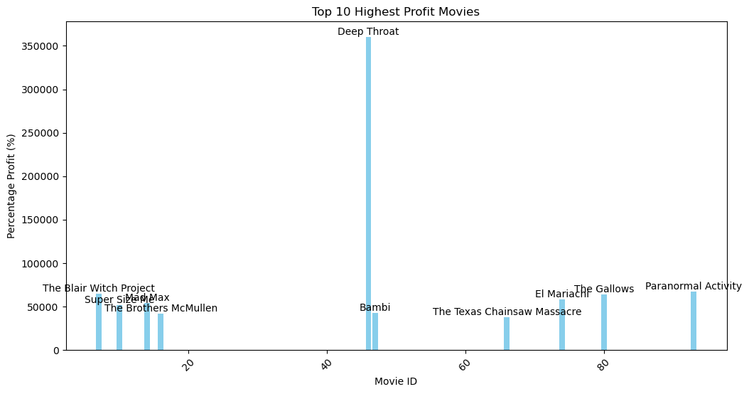
Top 10 Movies with highest gross profit.

Slide 9
2. Recommendation based gross profits.
Analyze further the top-grossing movie which is DEEP THROAT as indicated on the bar graph inorder to allocate Resources Wisely to minimize expenditure and maximize on sales: Prioritize investments in projects with high-profit potential based on historical performance and audience demand. Allocate resources towards high-quality production values, talented cast and crew, and effective marketing campaigns to maximize returns.
Strategic Release Timing: Strategically schedule movie releases to capitalize on peak box office seasons, holidays, and industry trends. Avoid overcrowded release dates where potential competition could impact box office performance.
Build Brand Recognition: Invest in building brand recognition and loyalty for Microsoft's movie studio through consistent quality, memorable storytelling, and strong marketing efforts. Establishing a recognizable brand can help attract audiences and generate repeat business.
Long-Term Sustainability: Maintain a long-term perspective and focus on building a sustainable business model for Microsoft's movie studio. Continuously evaluate performance metrics, audience feedback, and market trends to refine strategies and ensure long-term profitability.

Slide 10
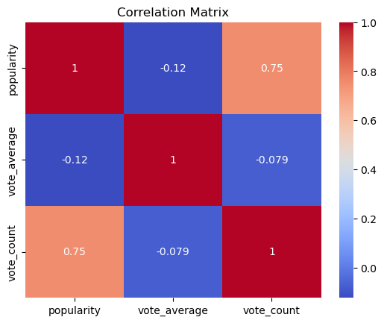

Slide 11
3. Recommendation based on Correlation Matrix
Strong Positive Correlation between Vote Count and Popularity (Corr = 0.75):
There is a strong positive correlation between the number of votes received (vote count) and the popularity of movies. This indicates that movies with higher vote counts tend to be more popular among audiences.
Microsoft should focus on strategies to increase audience engagement.
Weak Negative Correlation between Vote Average and Popularity (Corr = -0.12):
While this correlation is not very strong, it suggests that movies with higher ratings may not always be the most popular ones.Microsoft should prioritize creating movies that not only receive high ratings but also resonate with a wide audience to maximize their popularity. This may involve producing diverse content that appeals to different demographics and genres.
Very Weak Negative Correlation between Vote Average and Vote Count (Corr = -0.079):
There is a very weak negative correlation between the average rating of movies (vote average) and the number of votes they receive (vote count). This suggests that movies with higher ratings may not necessarily attract a larger number of votes.
Microsoft should focus on encouraging audience engagement and increasing the visibility of their movies to boost both vote counts and average ratings. This could involve leveraging social media platforms, collaborating with influencers, and creating interactive experiences for viewers.

Slide 12
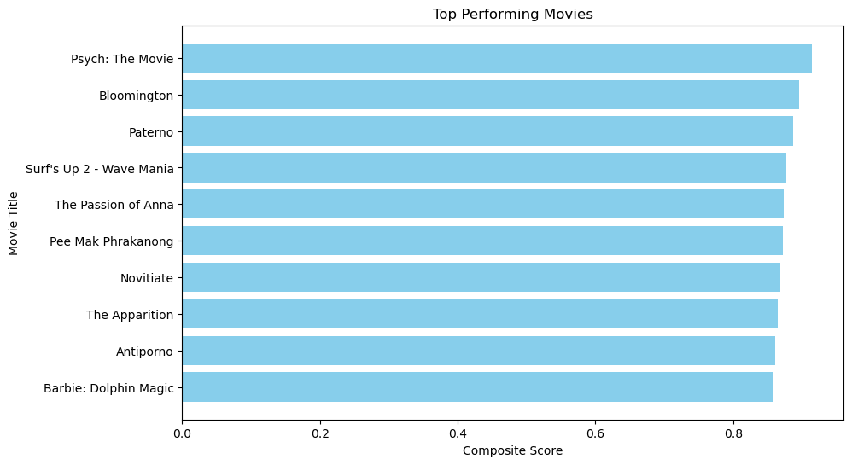
composite score

Slide 13
4. Recommendation based on composite score
High composite scores indicate that these movies have resonated well with audiences in terms of popularity, vote count, and vote average. Microsoft should focus on producing high-quality content that captivates viewers and garners positive feedback.
Release Timing Considerations:
Analyze the release timing of top-performing movies to identify patterns and trends. For example, movies like "Pee Mak Phrakanong" and "The Apparition" were released in March and September, respectively. Microsoft should consider releasing its movies during periods with historically high audience engagement and box office performance.
Movies like "Psych: The Movie" and "Barbie: Dolphin Magic" have achieved high composite scores despite being targeted towards specific demographics. Microsoft should prioritize engaging with target audiences through targeted marketing campaigns and interactive experiences.
By leveraging insights from the top-performing movies based on composite score and implementing strategic recommendations, Microsoft can increase the likelihood of success for its movie studio venture and establish a strong presence in the entertainment industry.

Slide 14
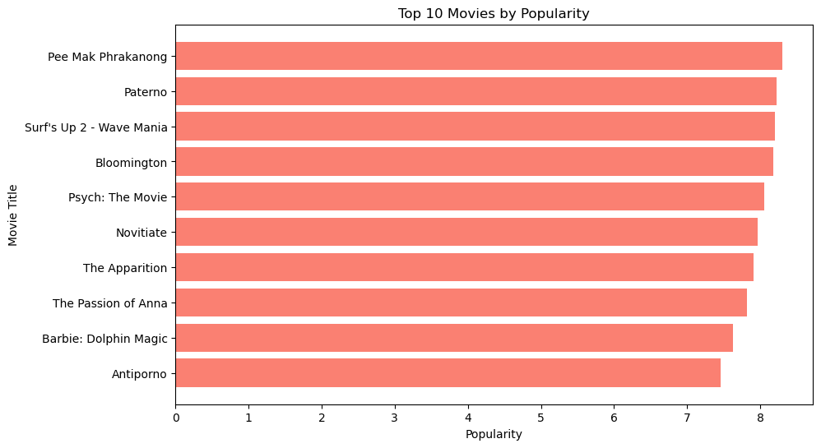
Popularity

Slide 15
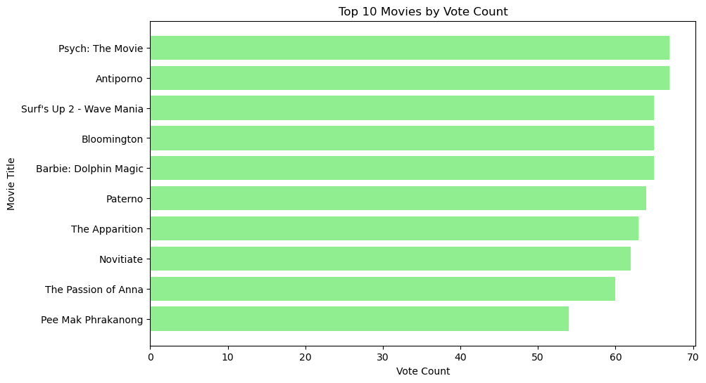
Vote Count

Slide 16
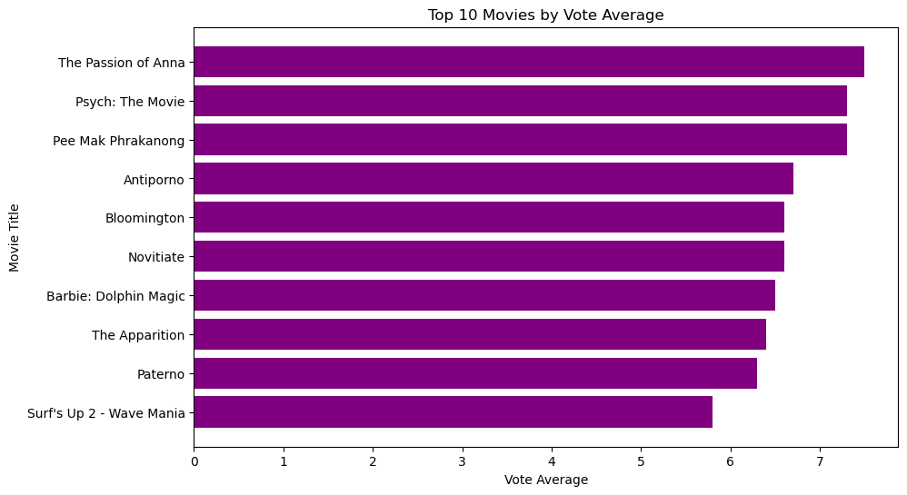
Vote Average

Slide 17
5. Recommendation based on Popularity, vote count and vote average.
Understand Audience Preferences:
Analyze the genres, themes, and characteristics of the top-performing movies to understand audience preferences and trends. Identify common elements that contribute to high popularity scores, such as engaging storytelling, relatable characters, or visually stunning cinematography.
Target Popular Genres:
Focus on producing movies within genres that have historically performed well such as the passion of Anna, Pee mak on popularity . Consider genres such as action, adventure, fantasy, science fiction, and animation, which often resonate strongly with audiences and attract widespread attention.
Invest in Marketing and Promotion:
Allocate resources towards extensive marketing and promotion campaigns to build anticipation and generate buzz around the movie release. Utilize multiple channels such as social media, digital advertising, press releases, and promotional events to reach a wide audience and maximize visibility.
Timing is Key:
Choose the release date strategically to coincide with periods of high audience engagement and box office performance. Analyze the release timing of top-performing movies to identify patterns and trends, and schedule the movie release during favorable windows for maximum impact.
Create Compelling Content:
Ensure that the movie offers compelling content that captivates viewers and keeps them engaged from start to finish. Focus on delivering high-quality storytelling, immersive visuals, memorable characters, and thrilling action sequences that resonate with audiences and encourage positive word-of-mouth.
Leverage Digital Platforms:
Take advantage of digital distribution platforms and streaming services to reach a broader audience beyond traditional theatrical releases. Explore partnerships with popular streaming platforms to ensure widespread accessibility and convenience for viewers.
Monitor Performance and Adapt:
Continuously monitor the movie's performance metrics, including audience reception, social media engagement, box office revenue, and critical reviews. Be prepared to adapt marketing strategies, release plans, and distribution channels based on real-time data and audience feedback.

Slide 18
6. Recommendation on Release Date and Original Language
Release Date Analysis: To find the month and year with the highest top ten popularity, vote count, and vote average.
Month and Year with the Highest Top Ten Popularity: (2018, April)
Month and Year with the Highest Top Ten Vote Count: (2012, December)
Month and Year with the Highest Top Ten Vote Average: (2010, June)
Recommended Month to Release a movie is April, Aim to release the movie in April or around that time to capitalize. Consider factors such as competition from other movie releases, holidays, and cultural events when scheduling the release date.
Original language Analysis: Analyze the distribution of original languages among the top-performing films to understand audience preferences regarding language.
Language with the Highest Top Ten Popularity: en
Language with the Highest Top Ten Vote Count: en
Language with the Highest Top Ten Vote Average: en
Recommended Language to Microsoft is English (en)

Slide 19
THANK YOU

