Slide 1
Letter Monitoring Task
LGNrsvpBehav instructions
Tong lab, Jan 2019

Slide 2

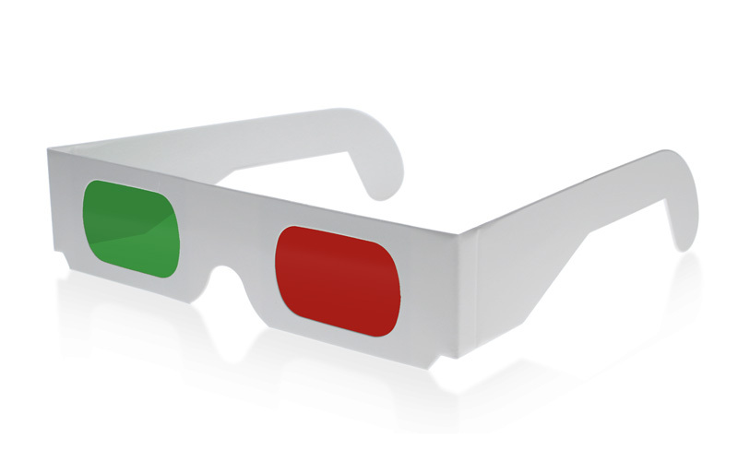
During this experiment, you will be performing a letter monitoring task. In each 4 second trial, you will see a stream of letters presented at the center fixation.
(You’ll be wearing red/green glasses during this study, so this color rendering may look strange)

Slide 3
The letter stream will change rapidly. Your job is to monitor the stream for J’s and K’s.
I
R
J
E
K
P
target
target

Slide 4
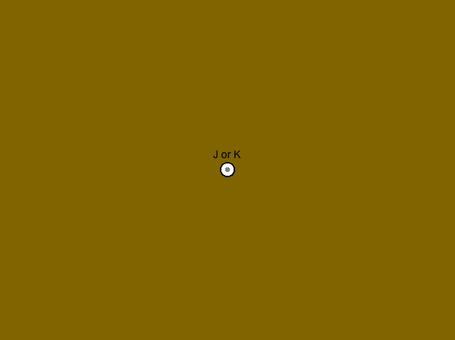
At the end of each trial, you will be asked if the last target that you saw was a J or K. Press (1) for J, and (2) for K.
In this example, the correct answer is K (2)
M
R
J
E
K
P
target
You will not know which target is the *last* one until the trial is over – some trials have only one target, and others have several. It is important to monitor the letters throughout the 4s trial.
target

Slide 5
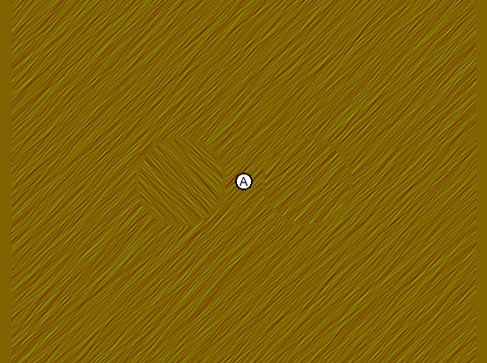
At some point during each trial, an oriented texture will appear around the letters. However, you should not move your eyes from the fixation point throughout the experiment
You may notice two circular regions of texture to the left and the right of the letter stream
On a small portion of the trials, you will also be asked to report whether the orthogonal patch appeared to the left (1) or right (2)
In this example, the orthogonal patch – the one that is different in orientation from the surrounding texture – is on the left (1)

Slide 6
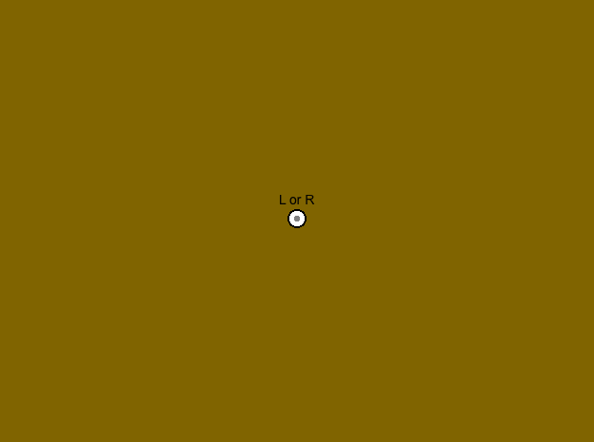
This screen is the cue to respond about the texture patches. It can occur either before the ‘J or K’ question, or after. In both cases, you have unlimited time to respond.
The letter monitoring is your primary task during this experiment – you will be asked about the letters on every trial. The rare trials about texture are meant to tell us about other information your visual system may or may not have – do your best, even if it feels like you are guessing.

Slide 7
You will complete 120 trials of this experiment, broken up into 3 blocks of 40.
Please keep your eyes fixated on the center of the screen throughout the study.
Please wear the red/green glasses (red lens over right eye) throughout the study.

