Slide 1
Spatial Frequency Experiment
Tong Lab – Perception & Neuroscience

Slide 2
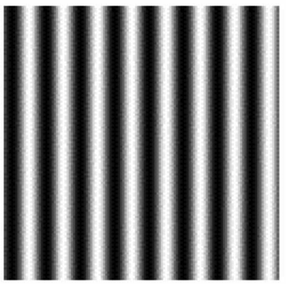
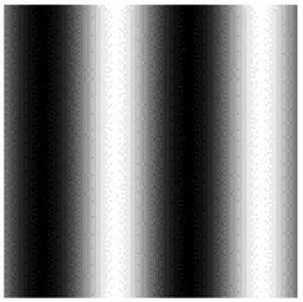
In this experiment, you will be asked to detect brief changes in spatial frequency
“Spatial frequency” tells us how many repetitions of a grating happen within a spatial window. For example:
high SF
low SF
We would say that the left square has higher spatial frequency than the right square – more, thinner stripes in the same spatial area

Slide 3
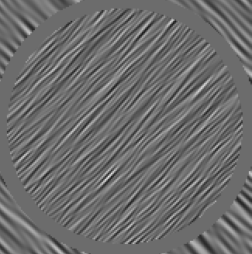
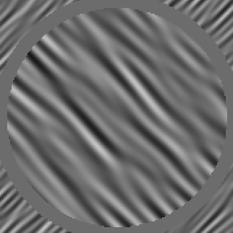
In our study, we won’t use striped gratings, but rather oriented noise. It looks like this:
high SF
low SF
You can think of this discrimination as a decision between thinner vs. wider patterns

Slide 4
On each trial, you will be looking for a brief change in spatial frequency, and you will report whether this change was a thinner or thicker pattern

Slide 5
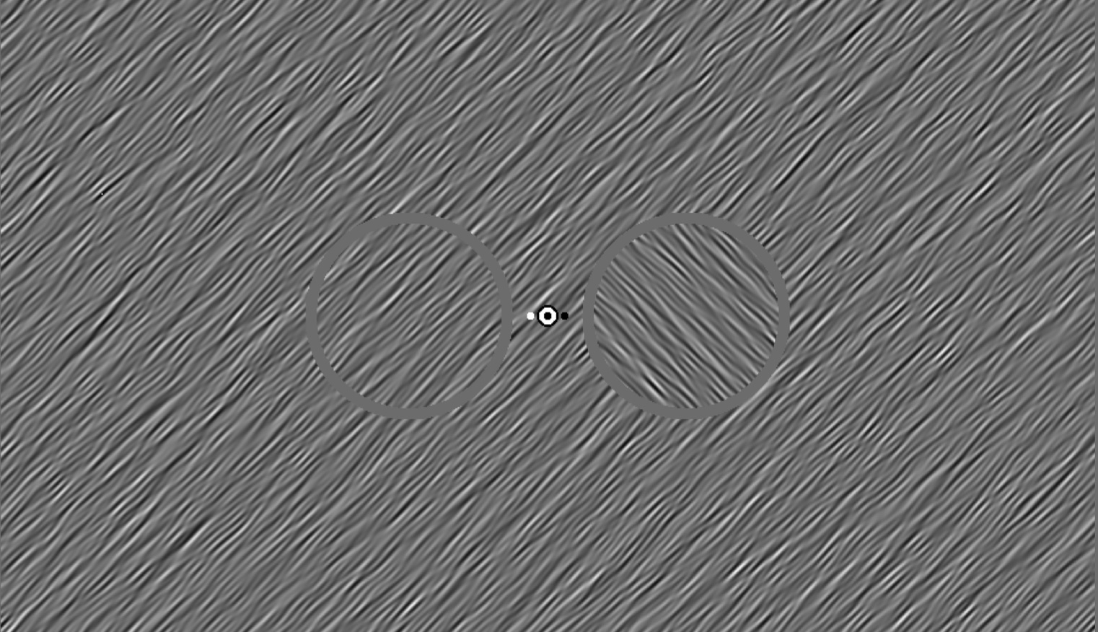
During the trial, you will see two circular patches of oriented noise embedded in a background, like this:
The display will flicker rapidly, and each trial will last for 2 seconds
Keep your eyes fixated on this center dot

Slide 6
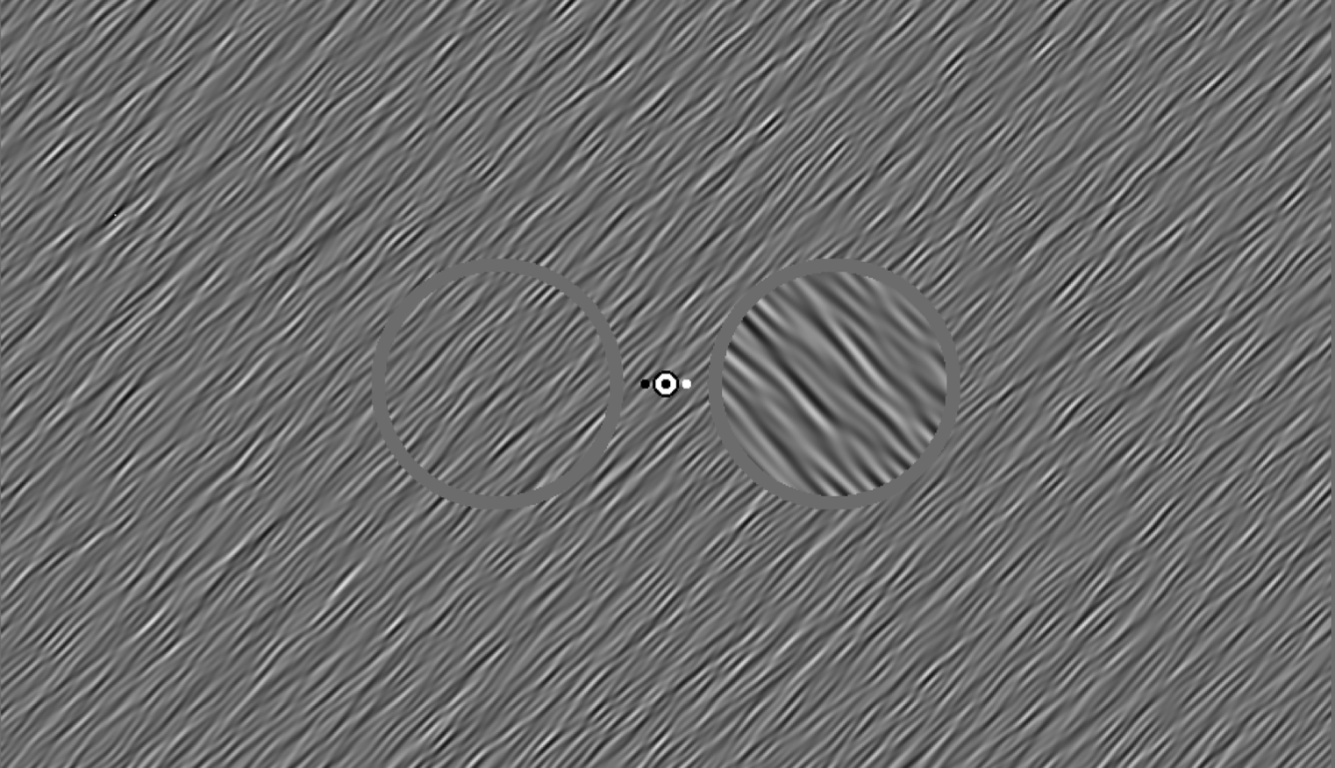
Sometime during the trial, one of the circular patches will change spatial frequency for 200ms
You need to report whether this change was a thinner patter (button 1) or thicker pattern (button 2)
In this example, the answer is 2 (thicker)

Slide 7

The black/white dots to either side of the fixation will tell you where the change is more likely to occur (80% of trials)
At the beginning of the study, you’ll be told to attend to the black or the white side. The color assigned to you will not change.
Use this cue to help you detect the change – although the change can occur on either side, the cue is informative on the vast majority of trials!

Slide 8

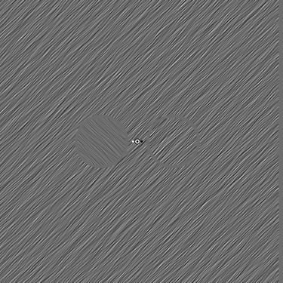

The full timing of the trials looks like this:
you can respond during the trial, or after
the dot cue appears (1sec)
You might think:
“I should attend more to the right side on this trial”
the flickering stimulus is shown (2sec)
the change occurs at some point
press 1 or 2 to make response and advance to the next trial
(no time limit)
“I think I saw the right pattern get wider for a brief moment”
“I will press 2, for wider”

Slide 9
Next, we will:
perform practice trials on a task that is easier and slower
perform practice trials on a task that is easier, but not slower
determine what your individual threshold for performing the task is (the difficulty needed to achieve ~85% correct)
run 3 blocks of 120 trials for the experiment
In both the practice and the threshold trials:
The change will always (100% of trials) be on the side indicated by the dot cue
You will get auditory feedback (high beep = correct, low beep = incorrect)

Slide 10
Remember:
Fixate on the center dot throughout experiment!
Press 1 for thinner texture, Press 2 for winder texture
“1 is thinner than 2”

