Slide 1
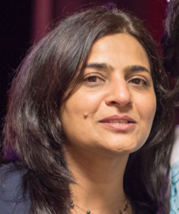
Smart Data Eye: Los Angeles Parking Citation Finding patterns and prediction in data
Archana Soni
2nd February 2019

Slide 2
Agenda
Project Scope
Problem Statement
The Data
Data Exploration & Data Preparation
Interesting Patterns
Machine learning and prediction
Tools used

Slide 3
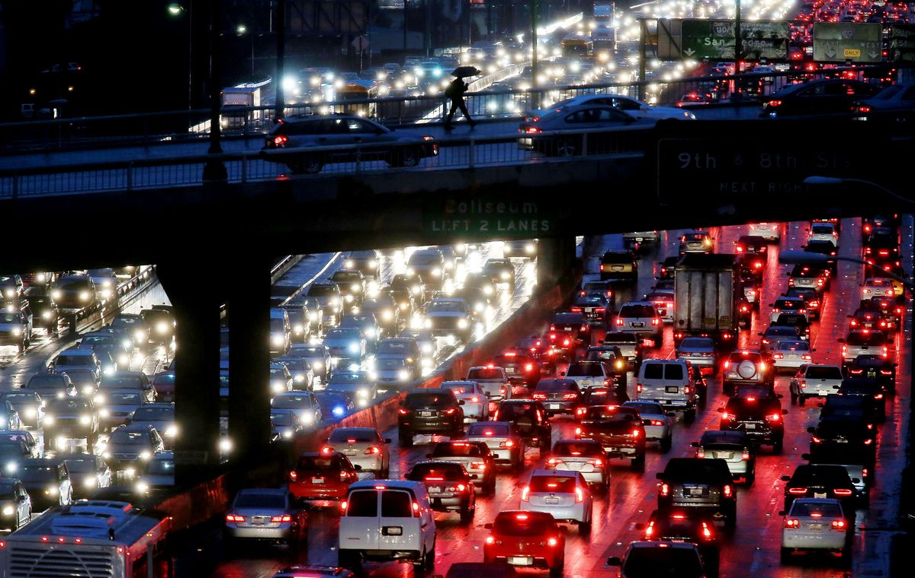
Project Scope
No surprises here! Los Angeles is the world's most traffic-clogged city
Data from Kaggle showed many revealations.
The data intrigued to find the patterns of citation and predict the citations for some features.

Slide 4
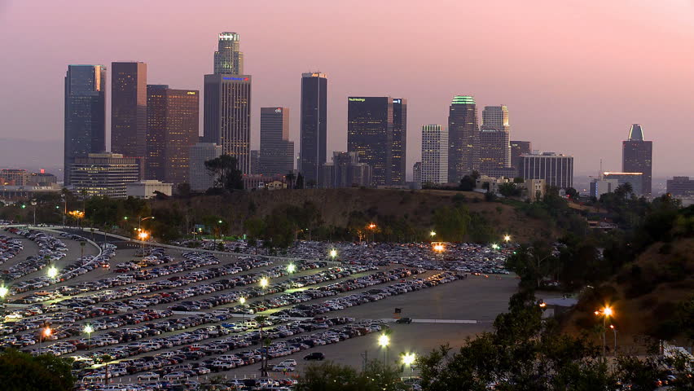
Problem Statement: LA Data Interesting Facts
Population : 11 Millions
Total Cars : 6.4 Millions
Population Density : 3999 per mile
2nd most populated metropolitan city
18.6 millions parking spaces
3.6 millions on-streets
15 millions off-streets
Famous proverb and movie “Nobody walks in LA”

Slide 5
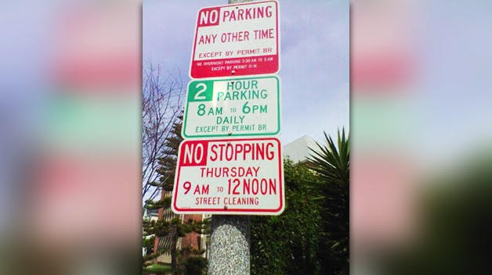
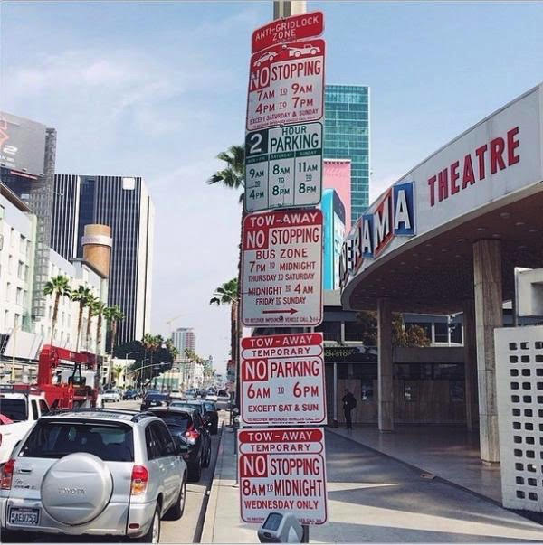
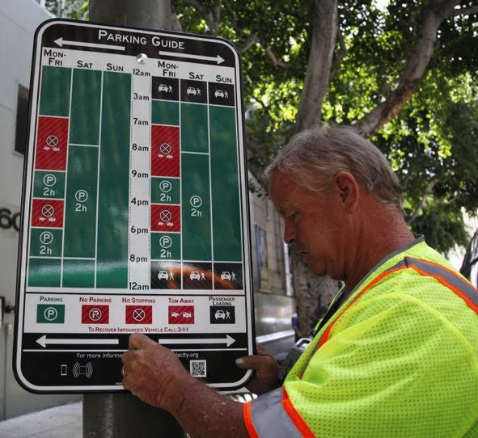
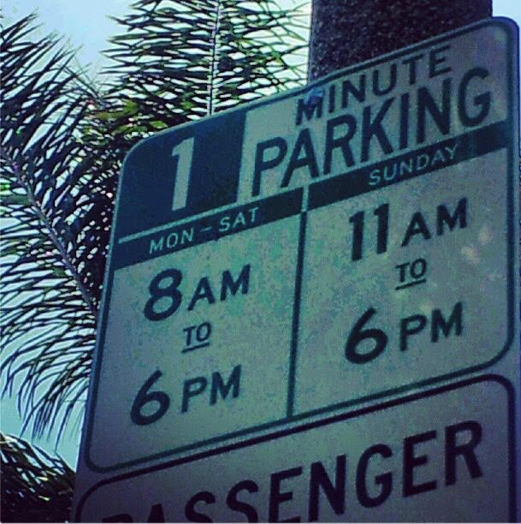
Parking Signs that confuses:

Slide 6
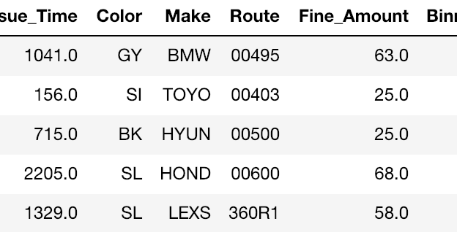
The Data
8+ Million records
6.7+ Million post cleaning
Data Sampling -10K records
To reduce complexity, make it easier to predict
Dropping Columns that had a very hig%h of missing values
Removing rows with missing data
Checking for duplications - ticket numbers.
Created new dummies columns
Cleaning Latitude and Longitude by replacing 99999.000 to NaN
Transform coordinates from custom projection to lat long - PyProj
Notes:
array(['Ticket_Number', 'Issue_Date', 'Issue_Time', 'RP_State_Plate', 'Plate_Expiry_Date', 'Make', 'Body_Style', 'Color', 'Location', 'Route', 'Agency', 'Violation_Code', 'Violation_Desc', 'Fine_Amount', 'Latitude', 'Longitude', 'Year_Issue_Date', 'Month_Issue_Date', 'Day_Issue_Date', 'DayOfWeek_Issue_Date', 'NLatitude', 'NLongitude'], dtype=object)

Slide 7
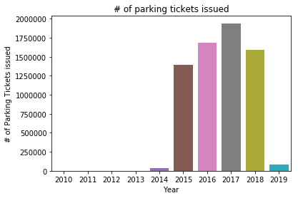
Pattern : Yearly trends
Interesting Data Patterns
Citation has increased every year till 2017
Year 2017 has maximum citations
Year 2018 citations are reduced

Slide 8
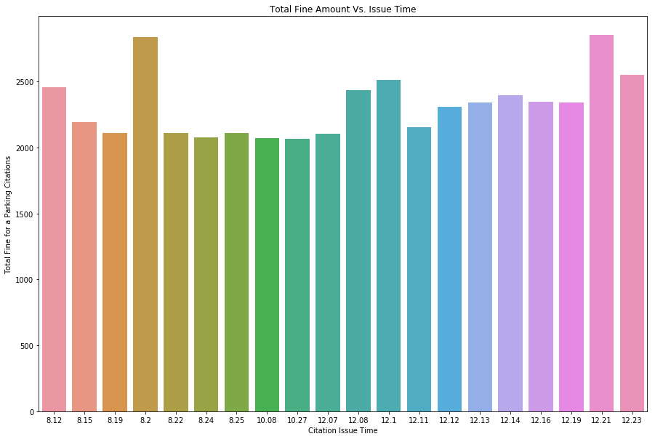
Pattern : Timing Insight
Most of Citiation happens till 1pm PST
Peak citation happen at 08:20 hrs

Slide 9
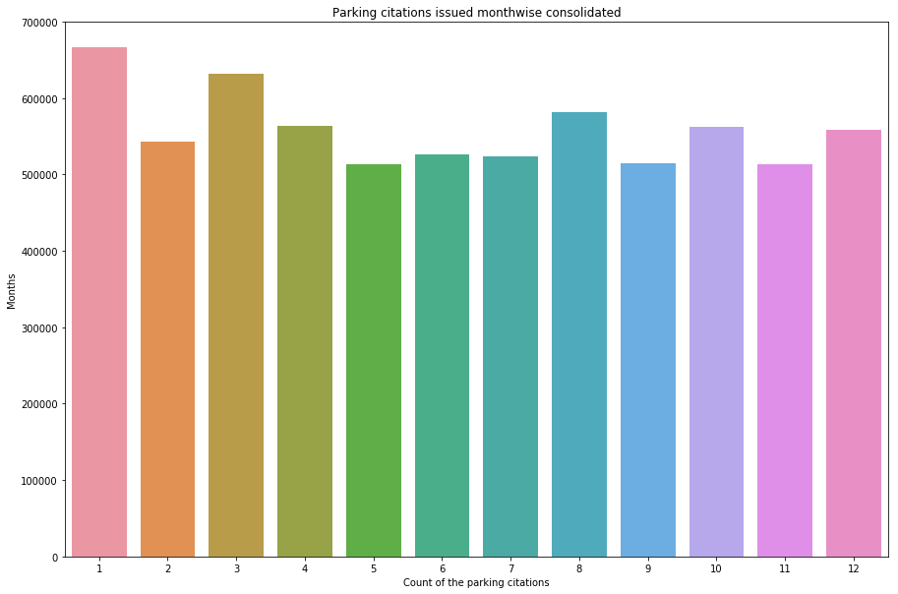
Pattern 3: Month Insight
January is the peak month for citations
May Month has least citations compared to other months

Slide 10
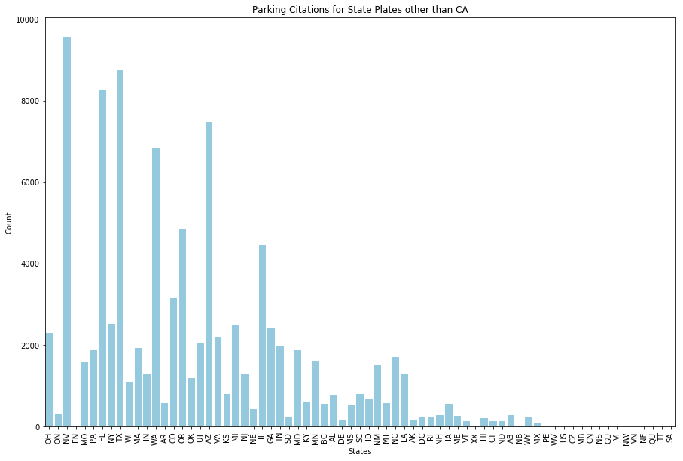
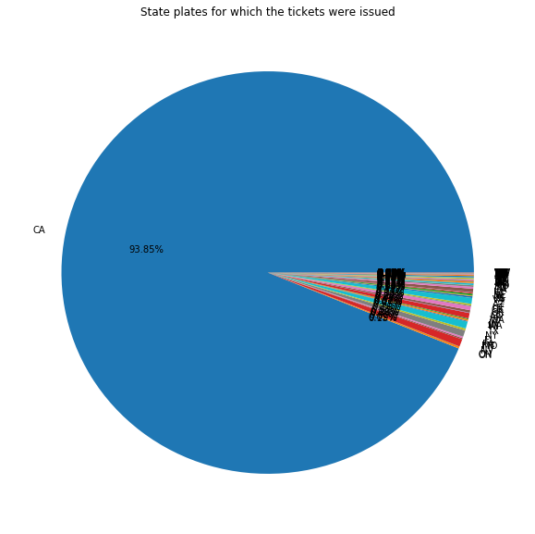
Pattern : State Number plate Insight
California plate carries maximum citations i.e. 93.85%
Interestingly others far away state (e.g. Florida, Texas, Washington) vehicles also gets thousands of citations

Slide 11
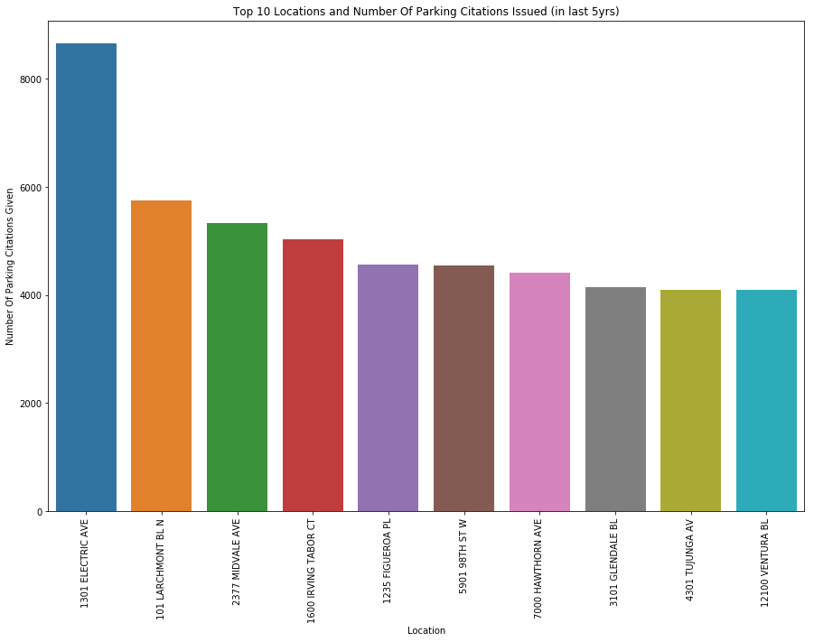
Pattern : Parking Location Insight
Some of these locations have maximum parking citations
1301 ELECTRIC AVE

Slide 12
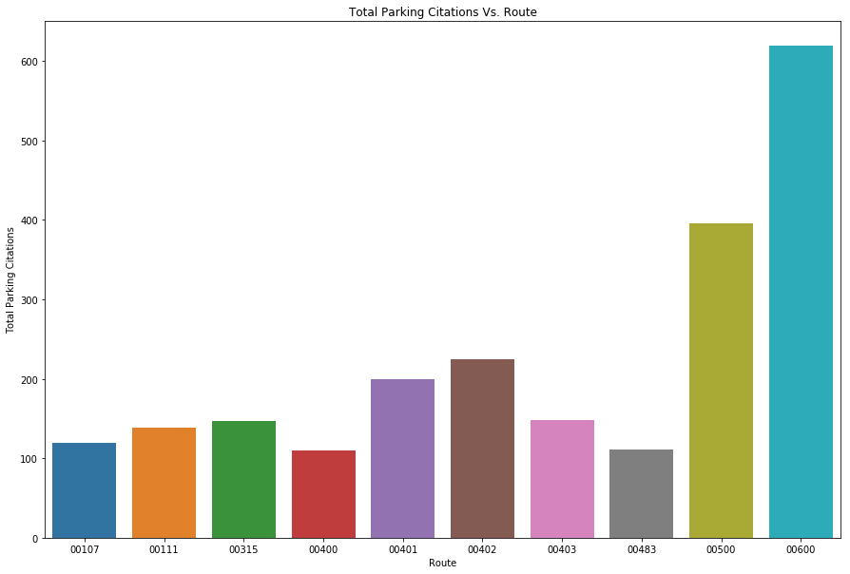
Pattern : Route Insight
Route most likely to attract citations:
# 0600 & 0500

Slide 13
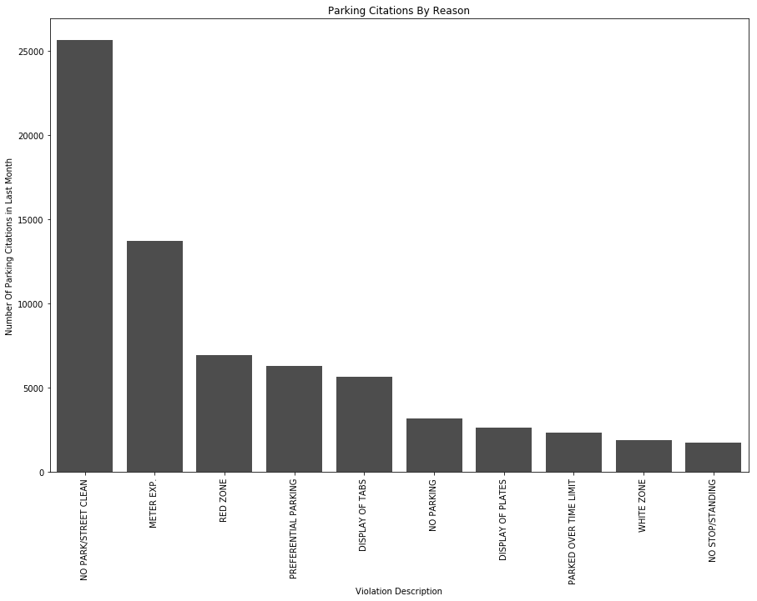
Parking Citation by Reason
Parking citations are issued for various violations but the top reason for citation is for below violation :
NO PARK/STREET CLEAN
METER EXP

Slide 14
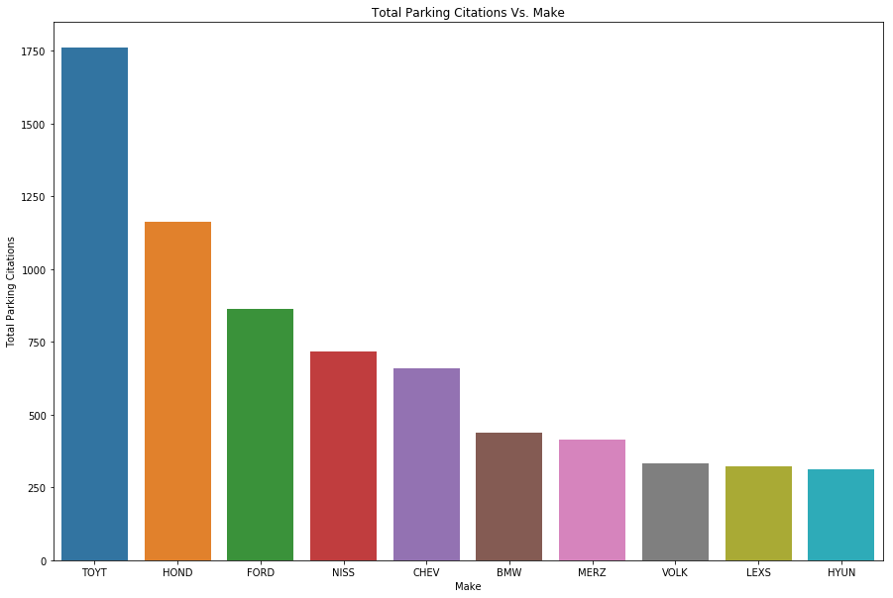
Pattern : Vehicle Make Insight
Vehicle Make most likely to attract citation:
TOYT

Slide 15
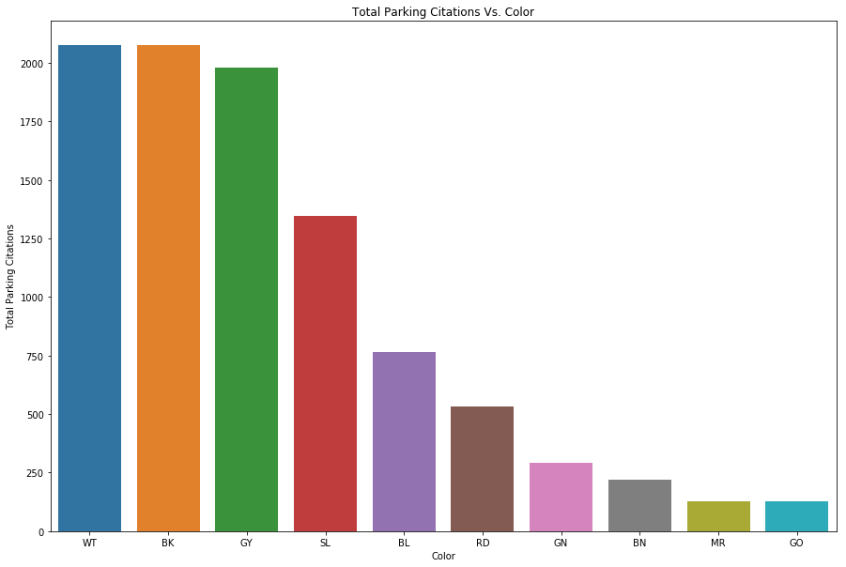
Pattern : Vehicle Color Insight
Vehicle Color likely to attract citation:
White(WT) & Black(BK)

Slide 16
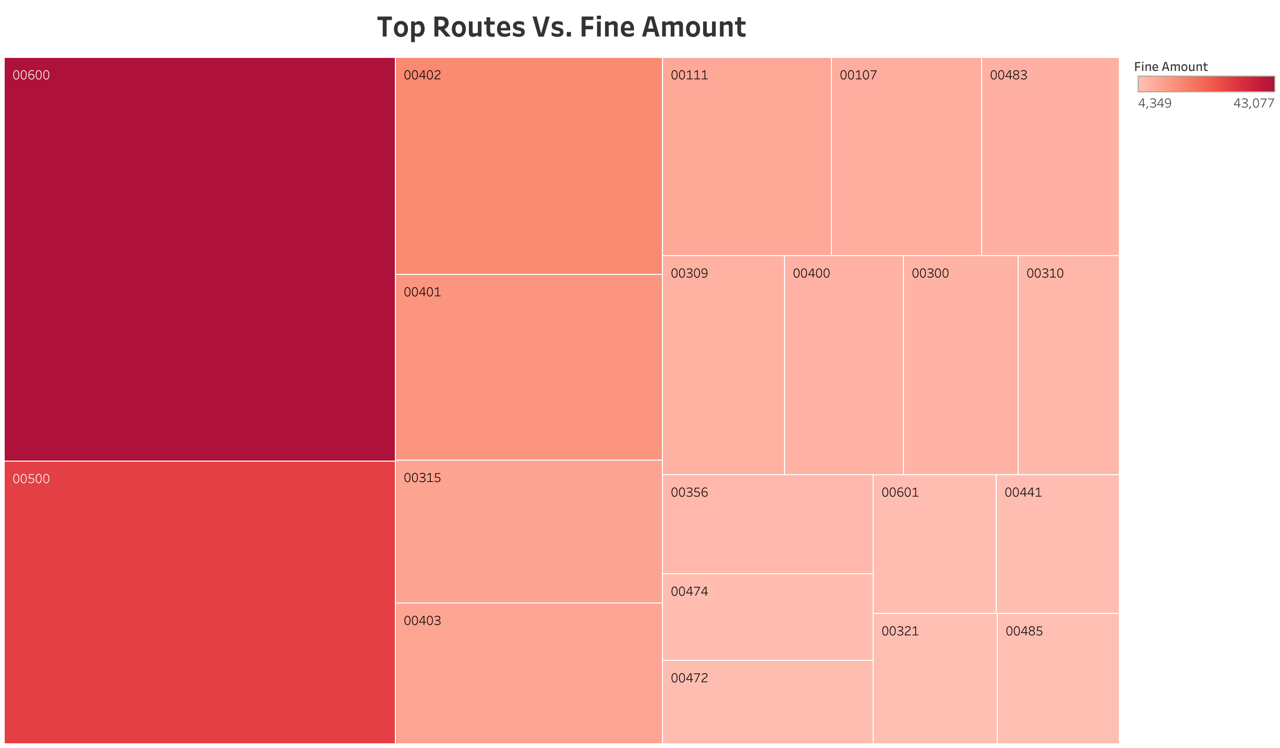
Pattern : Routes and their fine amount
Route 600 and route 500 attracts maximum fine

Slide 17
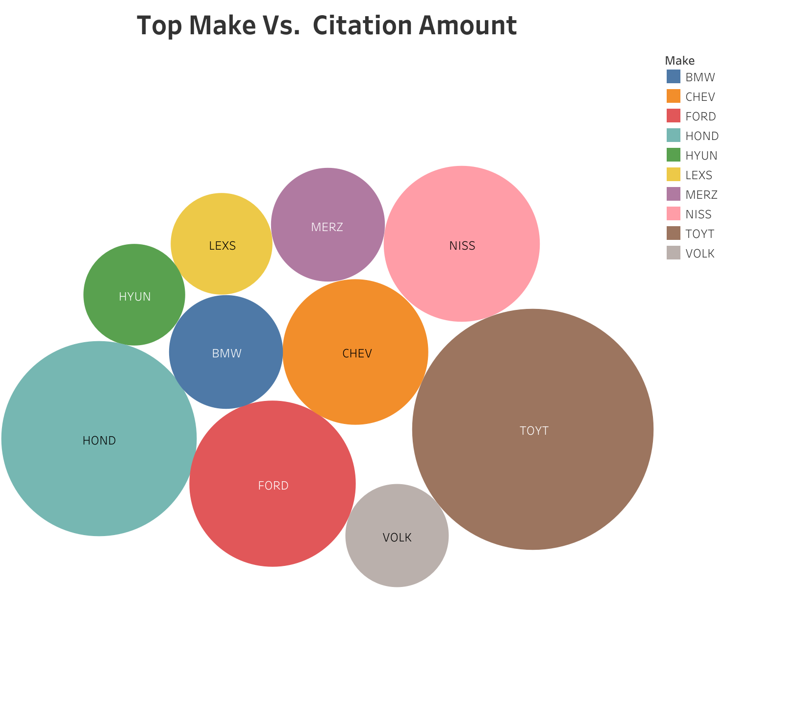
Pattern : Top Make and Amount Insight
Toyota and honda’s vehicle attracts maximum citation amount

Slide 18
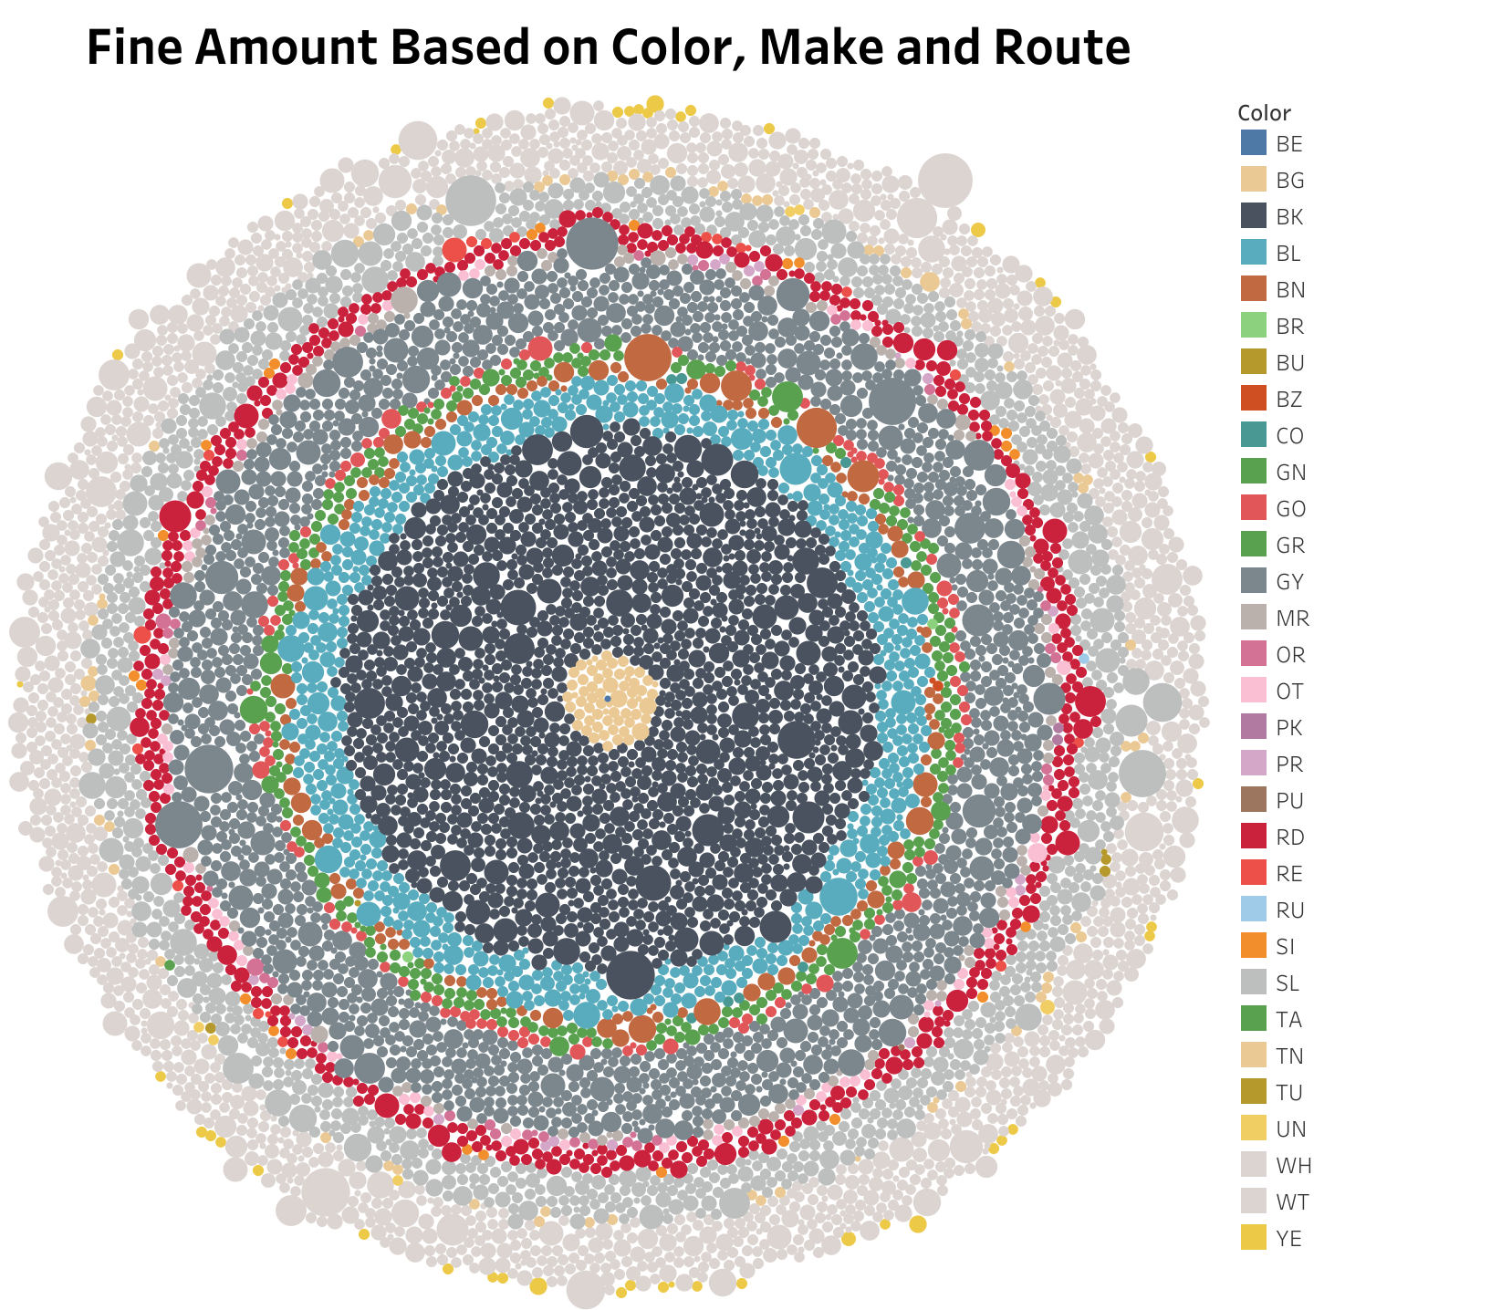
Pattern :Color, Make, Route to Amount Insight
This interactive graph shows fine amount based color, make and route

Slide 19
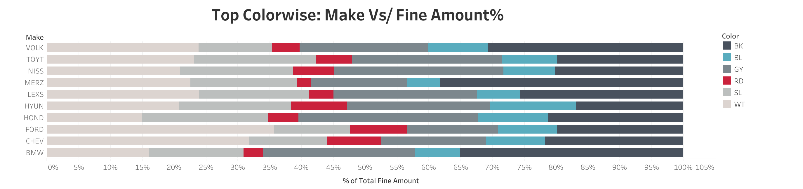
Pattern : Fine % based on Make and Color

Slide 20

Data Preparation
Feature Selection:
After few iterations of generating subset and learning findings -
Independent variables: Route, Make, Color to predict a dependent feature Fine Amount.

Slide 21
Model
Checked the data with a Linear Regression Model and forms of polynomial regression models – Lasso, Ridge, ElasticNet.
To study model’s accurancy
Training Set : 75% (7500 records)
Testing Set: 25%. (2500 records)

Slide 22
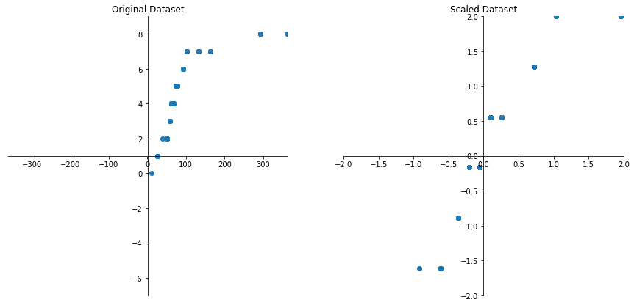
Data Scaling
Scaling/Normalize data:
Many algorithms perform better with a scaled dataset
Used: standardscaler was used assuming I do not know anything about the data
It gave MSE: 4.700. R2: -4.761
Hence decided to go with original dataset

Slide 23
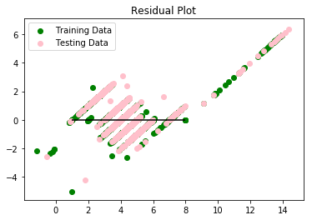
Residual Plot
Original Dataset:
Linear Regression
MSE: 0.785, R2: 0.582

Slide 24
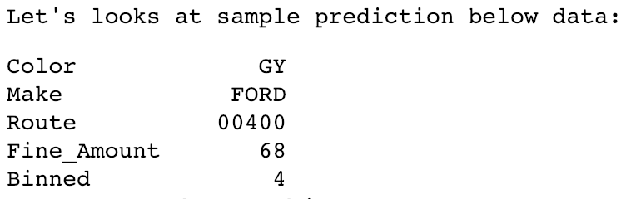
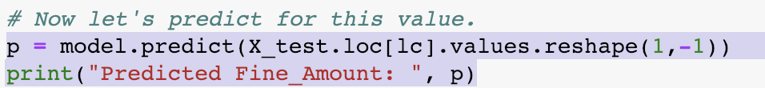
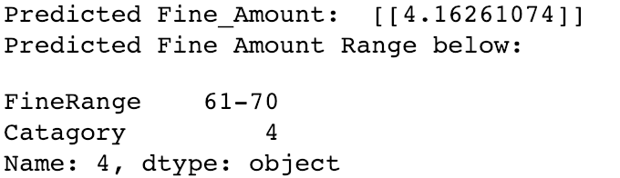
Predictions
The model is correct 58.3 % of times.

Slide 25
Score in various models
Lasso:
MSE: 0.8208012143597246, R2: 0.5639727084931294
Ridge:
MSE: 0.7846606738054929, R2: 0.5831713423837339
ElasticNet:
MSE: 0.8124092789763435, R2: 0.5684306853963077

Slide 26
Performance on different data size
Lasso:
# For 10K : MSE: 0.806681734793876, R2: 0.563030066338881
# For 100K : MSE: 0.8326234133839682, R2: 0.5615448190808616
# For 200K : MSE: 0.8639828010344125, R2: 0.5441974485805374
# For 500K : MSE: 0.8625997859021498, R2: 0.54181783694914
Ridge:
# For 10K : MSE: 0.785030025209202, R2: 0.5747585407703522
# For 100K : MSE: 0.7355864690647247, R2: 0.6126439718231756
# For 200K : MSE: 0.7476993706076469, R2: 0.6055439061869502
# For 500K : MSE: 0.7444829187495298, R2: 0.6045572933798857
ElasticNet :
# For 10K : MSE: 0.8003615147002069, R2: 0.5664536546463068
# For 100K: MSE: 0.8285549499186874, R2: 0.5636872508886372
# For 200K: MSE: 0.8595825850371509, R2: 0.5465188254365898
# For 500K: MSE: 0.8578871105007005, R2: 0.5443210416154087

Slide 27
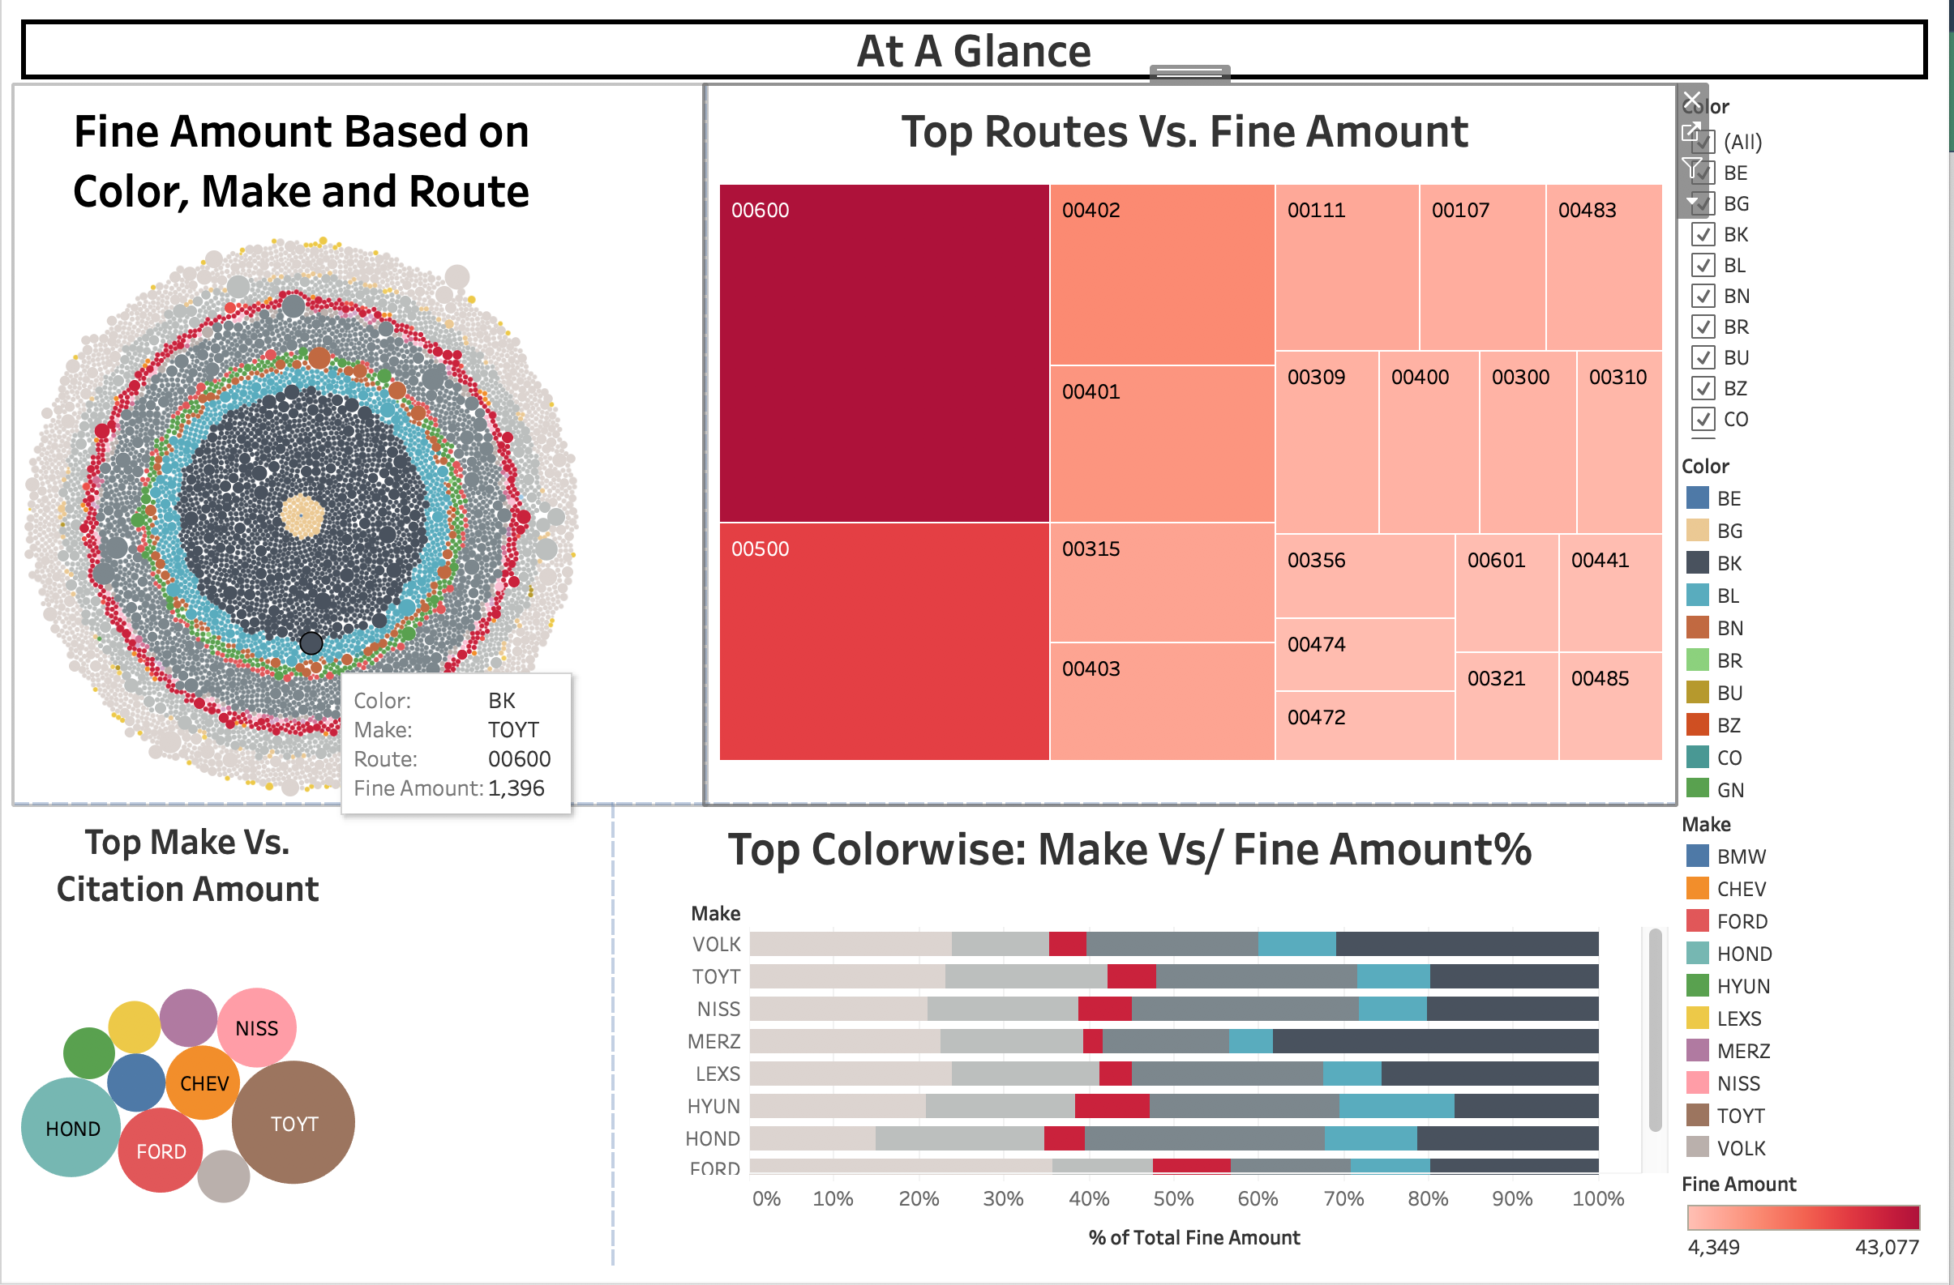
At A Glance

Slide 28
Success and Status
Machine Learning Models Predict
Project Success/Failure
The model currently predicts at ~58% accuracy
Skewed data may cause biased predictions
Further digging of data required to tune and and perfect the model.
Will continue to refining model

Slide 29
Tools Used
Python
Pandas
Matplotlib / Seaborn
Tableau
Explored pickle and pyproj

Slide 30
Conclusion
Preliminary predictive models ~58% accurate
Need more analysis to refine models and increase confidence

Slide 31
Facts and Learnings
Data Sampling
Features Extraction –Independent Variables
Data Scaling
Tried differentmodels
Linear Regression, Logistic Regression, Lasso, Ridge, ElasticNet
Regularization: Coming up with least complex model that generalizes well
Predicting results from model
Cross-Validation: Checking Accuracy of model
explained_variance_score

Slide 32
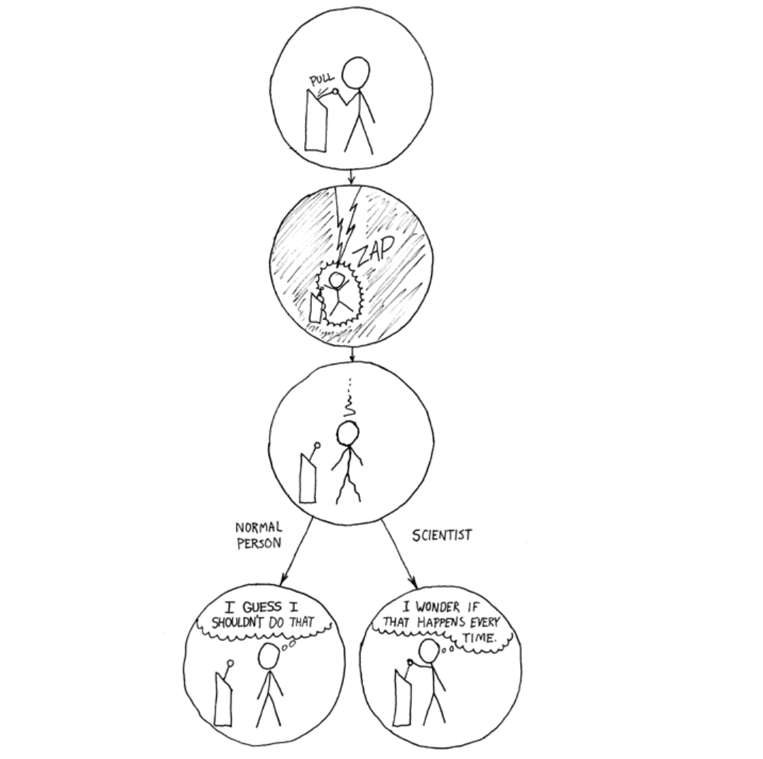
Acknowledgements
Special thanks to
Professor Hamed
TA’s – Sunny, Knishina, Bill
All my friends / colleagues
for their support, collaboration, and guidance for enriching my experience.

Slide 33
Thank you!
Now open for Q & A!

