Slide 1
Addressing Modes
Addressing modes are concerned with
how the CPU accesses the operands used
by its instructions
Addressing Modes

Slide 2
Register Direct Addressing
Register direct addressing is the simplest addressing mode in which the source or destination of an operand is a data register or an address register. The contents of the specified source register provide the source operand. Similarly, if a register is a destination operand, it is loaded with the value specified by the instruction. The following examples all use register direct addressing for source and destination operands.
MOVE.B D0,D3 Copy the source operand in register D0 to register D3
SUB.L A0,D3 Subtract the source operand in register A0 from register D3
CMP.W D2,D0 Compare the source operand in register D2 with register D0
ADD D3,D4 Add the source operand in register D3 to register D4
Addressing Modes

Slide 3
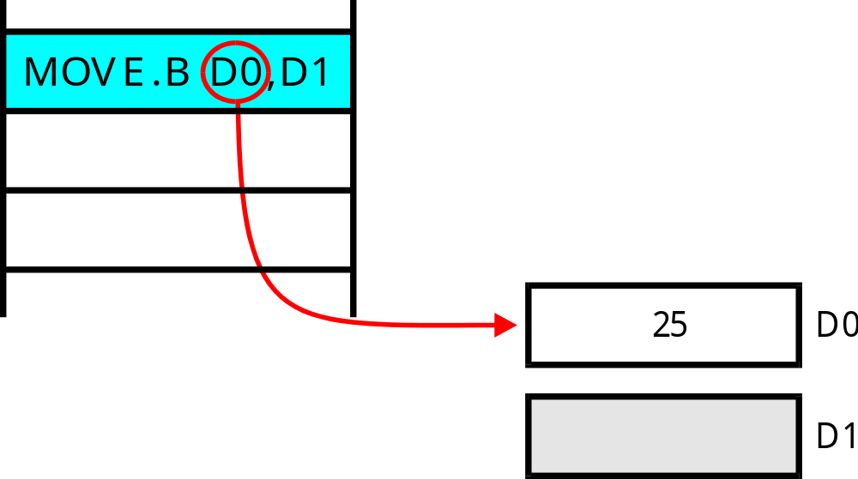
Register Direct Addressing
The instruction
indicates the data
register
The source operand
is data register D0
The MOVE.B D0,D1 instruction uses
data registers for both source and destination
operands
Addressing Modes

Slide 4
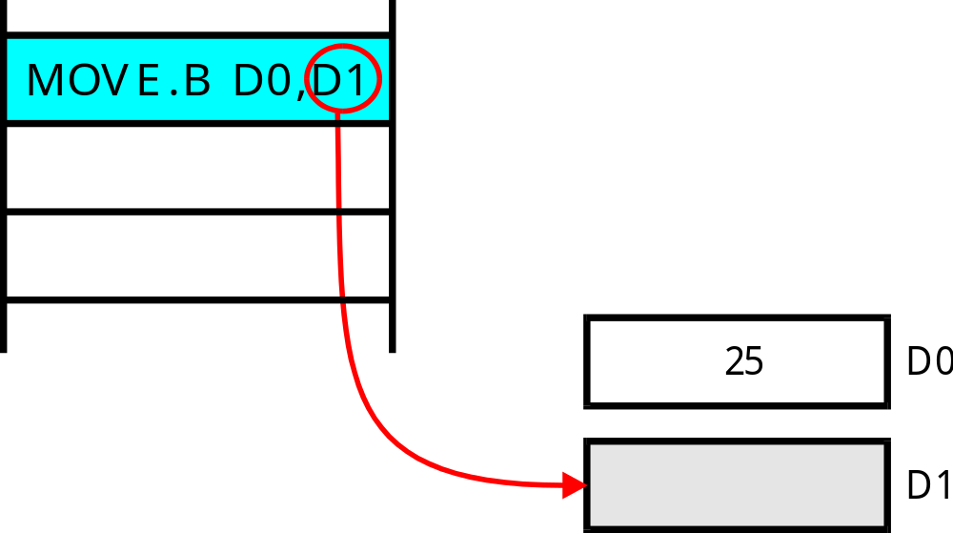
The destination operand
is data register D1
Addressing Modes

Slide 5
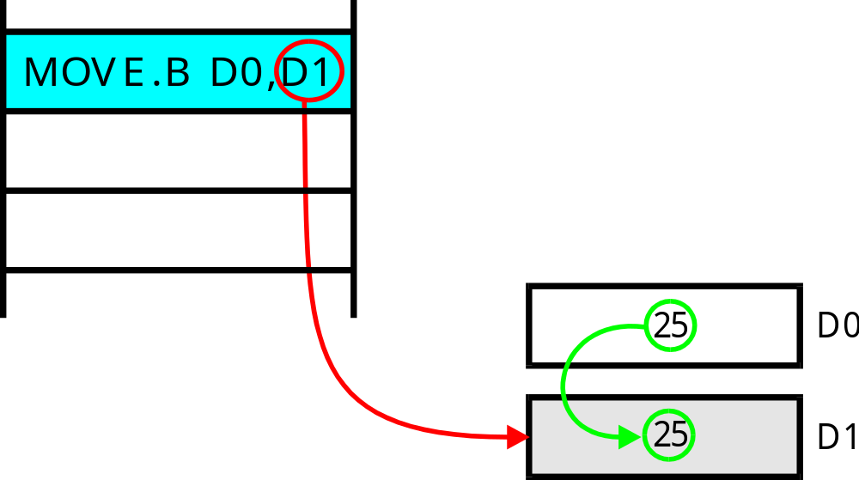
The effect of this instruction is
to copy the contents of data register
D0 in to data register D1
Addressing Modes

Slide 6
Register Direct Addressing
Register direct addressing uses short instructions because it takes only three bits to specify one of eight data registers.
Register direct addressing is fast because the external memory does not have to be accessed.
Programmers use register direct addressing to hold variables that are frequently accessed (i.e., scratchpad
storage).
Addressing Modes

Slide 7
Immediate Addressing
In immediate addressing the actual operand forms part of the instruction. An immediate operand is also called a literal operand. Immediate addressing can be used only to specify a source operand.
Immediate addressing is indicated by a # symbol in front of the source operand.
For example, MOVE.B #24,D0 uses the immediate source operand 24.
Addressing Modes

Slide 8
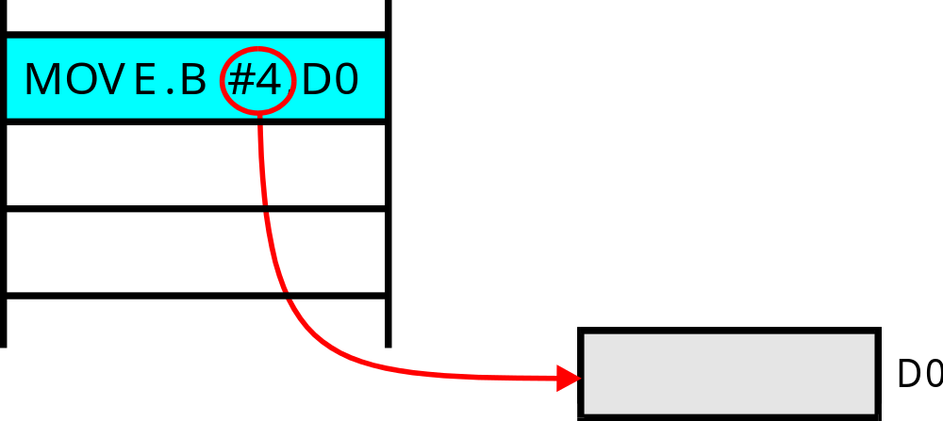
The instruction MOVE.B #4,D0
uses a literal source operand and
a register direct destination operand
Addressing Modes

Slide 9
The literal source operand,
4, is part of the instruction
Addressing Modes

Slide 10

The destination operand is
a data register
Addressing Modes

Slide 11
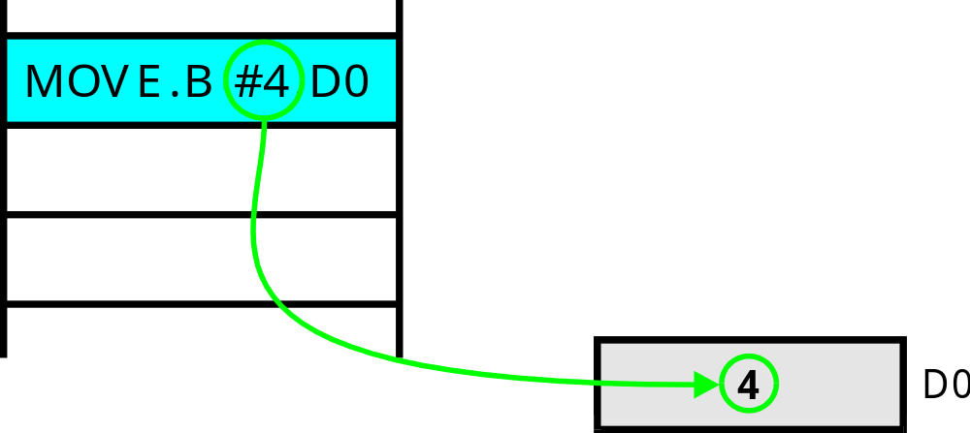
The effect of this instruction is to
copy the literal value 4 to data
register D0
Addressing Modes

Slide 12
Direct Addressing
In direct or absolute addressing, the instruction provides the address of the operand in memory.
Direct addressing requires two memory accesses. The first is to access the instruction and the second is to access the actual operand.
For example, CLR.B 1234 clears the contents of memory location 1234.
Addressing Modes

Slide 13
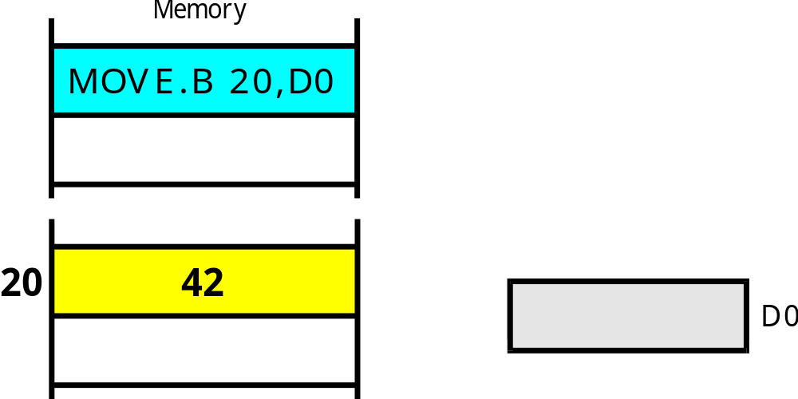
This instruction has a direct
source operand
The destination operand
uses data register direct
addressing
The source operand
is in memory
Addressing Modes

Slide 14
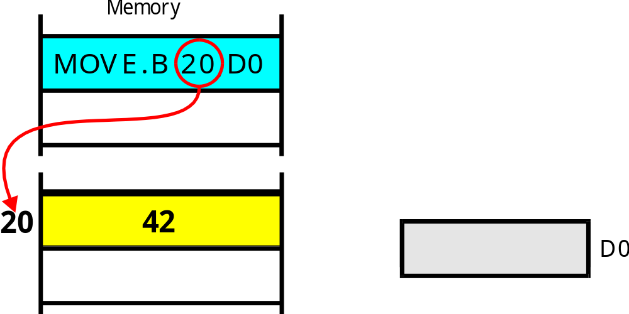
The address of the operand forms
part of the instruction
This is the actual operand
Once the CPU has read the operand
address from the instruction, the CPU
accesses the actual operand
Addressing Modes

Slide 15
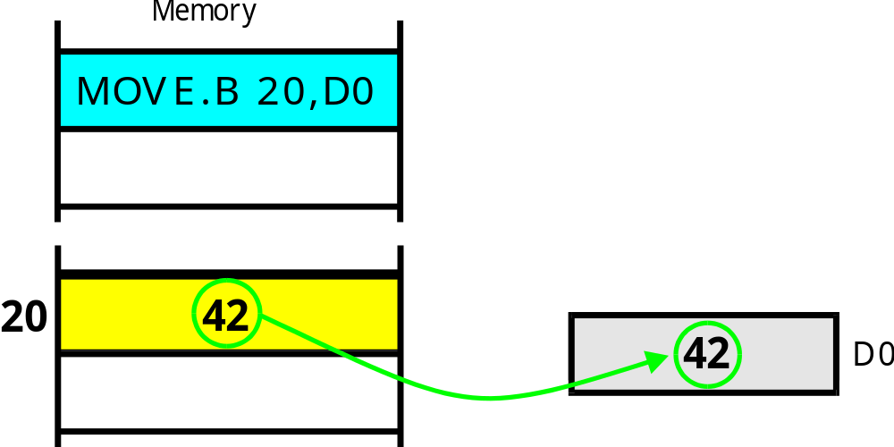
The effect of MOVE.B 20,D0
is to read the contents of memory
location 20 and copy them to D0
Addressing Modes

Slide 16
Summary of Fundamental Addressing Modes
Consider the high-level language example: Z = Y + 4
The following fragment of code implements this construct
ORG $400 Start of code
MOVE.B Y,D0
ADD #4,D0
MOVE.B D0,Z
ORG $600 Start of data area
Y DC.B 27 Store the constant 27 in memory
Z DS.B 1 Reserve a byte for Z
Addressing Modes

Slide 17
The Assembled Program
1 00000400 ORG $400
2 00000400 103900000600 MOVE.B Y,D0
3 00000406 06000018 ADD.B #24,D0
4 0000040A 13C000000601 MOVE.B D0,Z
5 00000410 4E722700 STOP #$2700
6 *
7 00000600 ORG $600
8 00000600 1B Y: DC.B 27
9 00000601 00000001 Z: DS.B 1
10 00000400 END $400
Addressing Modes

Slide 18
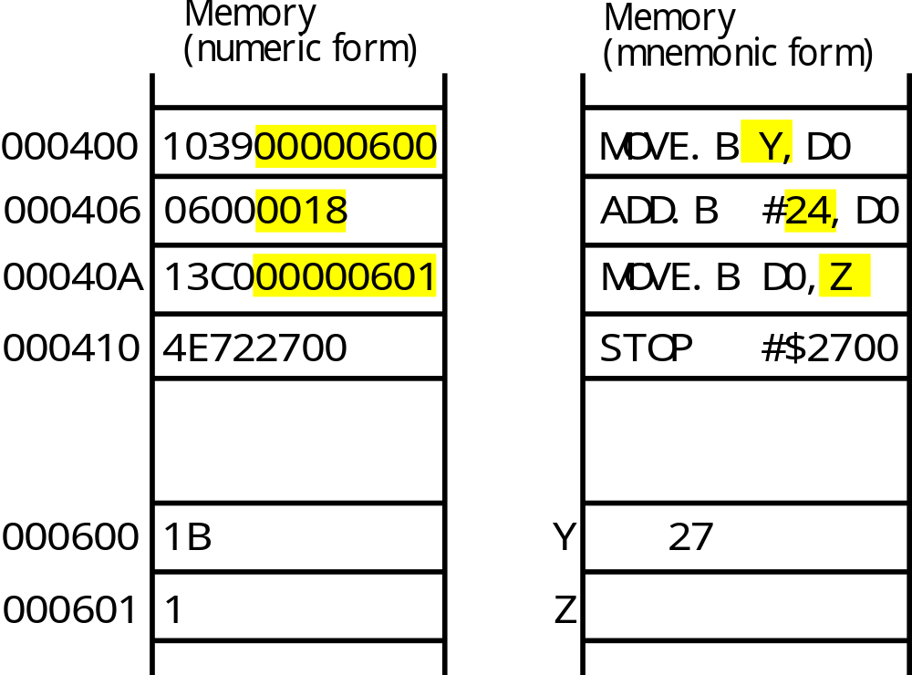
Memory map of the program
Y is a variable
accessed via the
direct address
000600
Z is a variable
accessed via the
direct address
000601
This is a literal
operand stored as
part of the instruction
Addressing Modes

Slide 19
Summary
Register direct addressing is used for variables that can be held in registers
Literal (immediate) addressing is used for constants
that do not change
Direct (absolute) addressing is used for variables that reside in memory
The only difference between register direct addressing and direct addressing is that the former uses registers to store operands and the latter uses memory
Addressing Modes

Slide 20
Address Register Indirect Addressing
In address register indirect addressing, the instruction specifies one of the 68000’s address registers; for example, MOVE.B (A0),D0.
The specified address register contains the address of the operand.
The processor then accesses the operand pointed at by the address register.
Addressing Modes

Slide 21
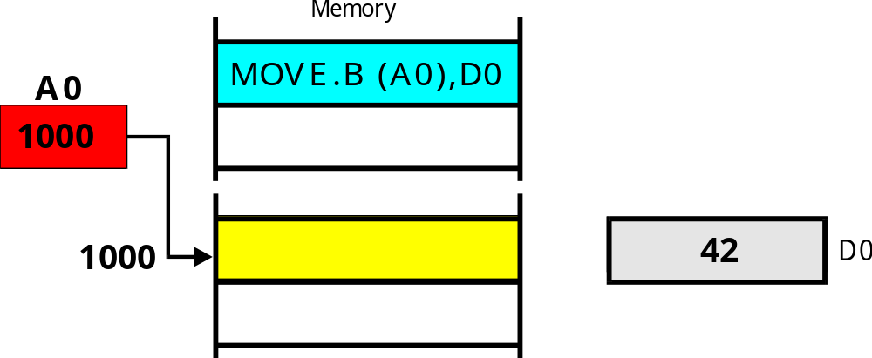
This instruction means load D0 with the contents of the location pointed at by address register A0
The instruction specifies the
source operand as (A0).
Addressing Modes

Slide 22
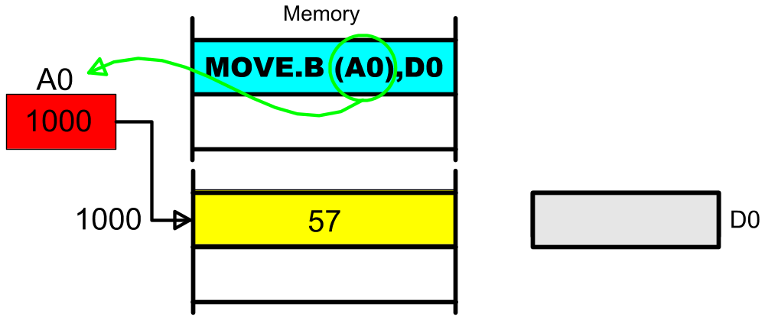
The address register in the instruction
specifies an address register that holds
the address of the operand
Addressing Modes

Slide 23
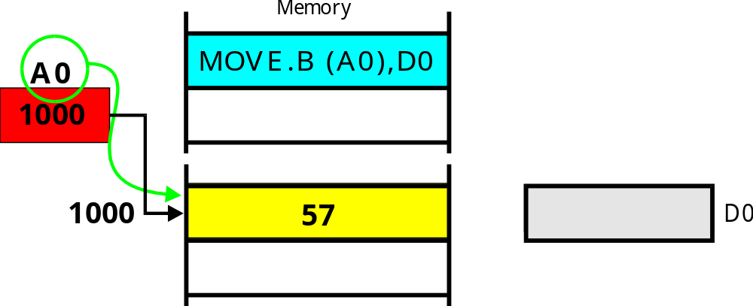
The address register is used to access
the operand in memory
Addressing Modes

Slide 24

Finally, the contents of the address register
pointed at by A0 are copied to the data register
Addressing Modes

Slide 25
Auto-incrementing
If the addressing mode is specified as (A0)+,
the contents of the address register are
incremented after they have been used.
Addressing Modes

Slide 26

The address register contains 1000
and points at location 1000
Addressing Modes

Slide 27
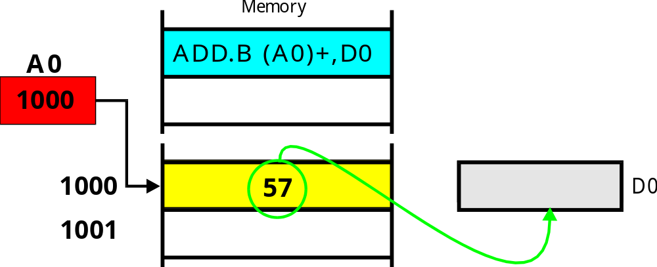
Address A0 register is used to access memory
location 1000 and the contents of this location
(i.e., 57) are added to D0
Addressing Modes

Slide 28
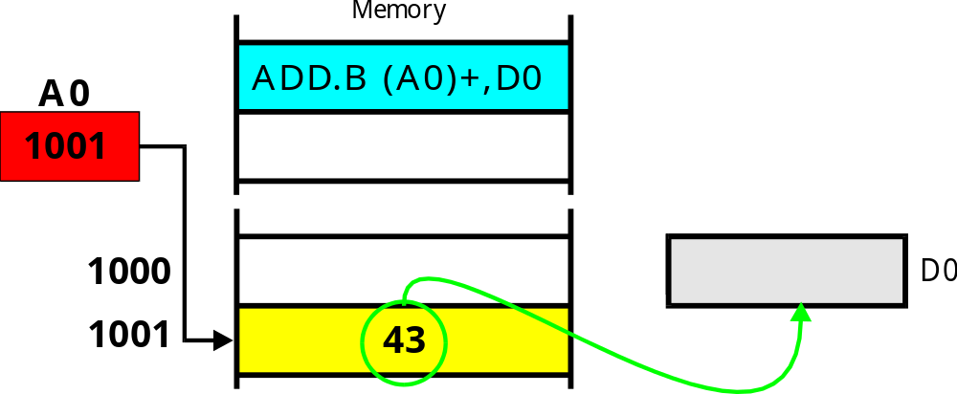
After the instruction has been executed,
the contents of A0 are incremented to
point at the next location
Addressing Modes

Slide 29
Use of Address Register Indirect Addressing
The following fragment of code uses address register indirect addressing with post-incrementing to add together five numbers stored in consecutive memory locations.
MOVE.B #5,D0 Five numbers to add
LEA Table,A0 A0 points at the numbers
CLR.B D1 Clear the sum
Loop ADD.B (A0)+,D1 REPEAT Add number to total
SUB.B #1,D0
BNE Loop UNTIL all numbers added
STOP #$2700
*
Table DC.B 1,4,2,6,5 Some dummy data
We are now going to trace through part of this program, instruction by instruction.
Addressing Modes

Slide 30
>DF
PC=000400 SR=2000 SS=00A00000 US=00000000 X=0
A0=00000000 A1=00000000 A2=00000000 A3=00000000 N=0
A4=00000000 A5=00000000 A6=00000000 A7=00A00000 Z=0
D0=00000000 D1=00000000 D2=00000000 D3=00000000 V=0
D4=00000000 D5=00000000 D6=00000000 D7=00000000 C=0
---------->MOVE.B #$05,D0
>TR
PC=000404 SR=2000 SS=00A00000 US=00000000 X=0
A0=00000000 A1=00000000 A2=00000000 A3=00000000 N=0
A4=00000000 A5=00000000 A6=00000000 A7=00A00000 Z=0
D0=00000005 D1=00000000 D2=00000000 D3=00000000 V=0
D4=00000000 D5=00000000 D6=00000000 D7=00000000 C=0
---------->LEA.L $0416,A0
Trace>
PC=00040A SR=2000 SS=00A00000 US=00000000 X=0
A0=00000416 A1=00000000 A2=00000000 A3=00000000 N=0
A4=00000000 A5=00000000 A6=00000000 A7=00A00000 Z=0
D0=00000005 D1=00000000 D2=00000000 D3=00000000 V=0
D4=00000000 D5=00000000 D6=00000000 D7=00000000 C=0
---------->CLR.B D1
The first instruction
loads D0 with the literal
value 5
D0 has been
loaded with 5
This instruction
loads A0 with the
value $0416
A0 contains $0416
Addressing Modes

Slide 31
Trace>
PC=00040C SR=2004 SS=00A00000 US=00000000 X=0
A0=00000416 A1=00000000 A2=00000000 A3=00000000 N=0
A4=00000000 A5=00000000 A6=00000000 A7=00A00000 Z=1
D0=00000005 D1=00000000 D2=00000000 D3=00000000 V=0
D4=00000000 D5=00000000 D6=00000000 D7=00000000 C=0
---------->ADD.B (A0)+,D1
Trace>
PC=00040E SR=2000 SS=00A00000 US=00000000 X=0
A0=00000417 A1=00000000 A2=00000000 A3=00000000 N=0
A4=00000000 A5=00000000 A6=00000000 A7=00A00000 Z=0
D0=00000005 D1=00000001 D2=00000000 D3=00000000 V=0
D4=00000000 D5=00000000 D6=00000000 D7=00000000 C=0
---------->SUBQ.B #$01,D0
Trace>
PC=000410 SR=2000 SS=00A00000 US=00000000 X=0
A0=00000417 A1=00000000 A2=00000000 A3=00000000 N=0
A4=00000000 A5=00000000 A6=00000000 A7=00A00000 Z=0
D0=00000004 D1=00000001 D2=00000000 D3=00000000 V=0
D4=00000000 D5=00000000 D6=00000000 D7=00000000 C=0
---------->BNE.S $040C
This instruction adds the
contents of the location
pointed at by A0 to D1
Because the operand was
(A0)+, the contents of A0
are incremented
ADD.B (A0)+,D1
adds the source operand
to D1
Addressing Modes

Slide 32
Trace>
PC=00040C SR=2000 SS=00A00000 US=00000000 X=0
A0=00000417 A1=00000000 A2=00000000 A3=00000000 N=0
A4=00000000 A5=00000000 A6=00000000 A7=00A00000 Z=0
D0=00000004 D1=00000001 D2=00000000 D3=00000000 V=0
D4=00000000 D5=00000000 D6=00000000 D7=00000000 C=0
---------->ADD.B (A0)+,D1
Trace>
PC=00040E SR=2000 SS=00A00000 US=00000000 X=0
A0=00000418 A1=00000000 A2=00000000 A3=00000000 N=0
A4=00000000 A5=00000000 A6=00000000 A7=00A00000 Z=0
D0=00000004 D1=00000005 D2=00000000 D3=00000000 V=0
D4=00000000 D5=00000000 D6=00000000 D7=00000000 C=0
---------->SUBQ.B #$01,D0
Trace>
PC=000410 SR=2000 SS=00A00000 US=00000000 X=0
A0=00000418 A1=00000000 A2=00000000 A3=00000000 N=0
A4=00000000 A5=00000000 A6=00000000 A7=00A00000 Z=0
D0=00000003 D1=00000005 D2=00000000 D3=00000000 V=0
D4=00000000 D5=00000000 D6=00000000 D7=00000000 C=0
---------->BNE.S $040C
On the next cycle
the instruction
ADD.B (A0)+,D1
uses A0 as a source
operand and then
increments the contents
of A0
Addressing Modes

Slide 33
Problem
Identify the source addressing mode used by each of the
following instructions.
ADD.B (A5),(A4)
MOVE.B #12,D2
ADD.W TIME,D4
MOVE.B D6,D4
MOVE.B (A6)+,TEST
Address register indirect addressing. The address
of the source operand in in A5.
Literal addressing. The source operand is the
literal value 12.
Memory direct addressing. The source operand is the
contents of the memory location whose
symbolic name is “TIME”.
Data register direct. The source operand is the
contents to D6.
Address register indirect with post-incrementing.
The address of the source operand is in A6. The
contents of A6 are incremented after the instruction.
Addressing Modes

Slide 34
Problem
If you were translating the following fragment of pseudocode into assembly language, what addressing modes are you most likely to use?
SUM is a temporary variable. You can put it in a
register and use register direct addressing
SUM = 0
FOR J = 5 TO 19
SUM = SUM + X(J)*Y(J)
END FOR
J is a temporary variable that would normally be
located in a register.
J is initialized to the literal value 5.
X(J) is an array element that
would be accessed via address
register indirect addressing.
Addressing Modes

