Slide 1
Computer Architecture
Floating-Point Arithmetic

Slide 2
Why do we need floating point?
Several reasons:
  Many numeric applications need numbers over a huge range
    e.g., nanoseconds to centuries
  Most scientific applications require real numbers (e.g. π)
But so far we only have integers. What do we do?
  We could implement the fractions explicitly
    e.g.: ½, 1023/102934
  We could use bigger integers
    e.g.: 64-bit integers
  Floating-point representation is often better
    has some drawbacks too!

Slide 3

Recall Scientific Notation
Recall scientific notation from high school
  Numbers represented in parts:
    42 = 4.200 x 10¹
    1024 = 1.024 x 10³
    -0.0625 = -6.250 x 10⁻²
Arithmetic is done in pieces
  1024 1.024 x 10³
  - 42 -0.042 x 10³
  = 982 0.982 x 10³
  = 9.820 x 10²
Significant Digits
Exponent
Before adding, we must match the exponents, effectively “denormalizing” the smaller magnitude number
We then “normalize” the final result so there is one digit to the left of the decimal point and adjust the exponent accordingly.

Slide 4

Multiplication in Scientific Notation
Is straightforward:
  Multiply together the significant parts
  Add the exponents
  Normalize if required
Examples:
  1024 1.024 x 10³
  x 0.0625 6.250 x 10⁻²
  = 64 6.400 x 10¹
  42 4.200 x 10¹
  x 0.0625 6.250 x 10⁻²
  = 2.625 26.250 x 10⁻¹
  = 2.625 x 10⁰ (Normalized)
In multiplication, how far is the most you will ever normalize?
In addition?

Slide 5
Binary Flotaing-Point Notation
IEEE single precision floating-point format
  Example: (0x42280000 in hexadecimal)
Three fields:
  Sign bit (S)
  Exponent (E): Unsigned “Bias 127” 8-bit integer
    E = Exponent + 127
    Exponent = 10000100 (132) – 127 = 5
  Significand (F): Unsigned fixed binary point with “hidden-one”
    Significand = “1”+ 0.01010000000000000000000 = 1.3125
  Final value: N = -1^{S} (1+F) x 2^{E-127} = -1⁰(1.3125) x 2⁵ = 42
0
1 | 0 | 0 | 0 | 0 | 1 | 0 | 0
0 | 1 | 0 | 1 | 0 | 0 | 0 | 0 | 0 | 0 | 0 | 0 | 0 | 0 | 0 | 0 | 0 | 0 | 0 | 0 | 0 | 0 | 0
“S”
Sign
Bit
“E”
Exponent + 127
“F”
Significand (Mantissa) - 1

Slide 6
Example Numbers
One
  Sign = +, Exponent = 0, Significand = 1.0
    1 = -1⁰ (1.0) x 2⁰
    S = 0, E = 0 + 127, F = 1.0 – ‘1’
    0 01111111 00000000000000000000000 = 0x3f800000
One-half
  Sign = +, Exponent = -1, Significand = 1.0
    ½ = -1⁰ (1.0) x 2⁻¹
    S = 0, E = -1 + 127, F = 1.0 – ‘1’
    0 01111110 00000000000000000000000 = 0x3f000000
Minus Two
  Sign = -, Exponent = 1, Significand = 1.0
    -2 = -1¹ (1.0) x 2¹
    1 10000000 00000000000000000000000 = 0xc0000000

Slide 7
Zeros
How do you represent 0?
  Sign = ?, Exponent = ?, Significand = ?
    Here’s where the hidden “1” comes back to bite you
    Hint: Zero is small. What’s the smallest number you can generate?
      Exponent = -127, Signficand = 1.0
      -1⁰ (1.0) x 2⁻¹²⁷ = 5.87747 x 10⁻³⁹
IEEE Convention
  When E = 0 (Exponent = -127), we’ll interpret numbers differently…
    0 00000000 00000000000000000000000 = 0 not 1.0 x 2⁻¹²⁷
    1 00000000 00000000000000000000000 = -0 not -1.0 x 2⁻¹²⁷
Yes, there are “2” zeros. Setting E=0 is also used to represent a few other small numbers besides 0. In all of these numbers there is no “hidden” one assumed in F, and they are called the “unnormalized numbers”. WARNING: If you rely these values you are skating on thin ice!

Slide 8
Infinities
IEEE floating point also reserves the largest possible exponent to represent “unrepresentable” large numbers
  Positive Infinity: S = 0, E = 255, F = 0
    0 11111111 00000000000000000000000 = +∞
    0x7f800000
  Negative Infinity: S = 1, E = 255, F = 0
    1 11111111 00000000000000000000000 = -∞
    0xff800000
  Other numbers with E = 255 (F ≠ 0) are used to represent exceptions or Not-A-Number (NAN)
    √-1, -∞ x 42, 0/0, ∞/∞, log(-5)
  It does, however, attempt to handle a few special cases:
    1/0 = + ∞, -1/0 = - ∞, log(0) = - ∞

Slide 9
Low-End of the IEEE Spectrum
denorm
gap
2^{-bias}
2^{1-bias}
2^{2-bias}
0
normal numbers with hidden bit
“Denormalized Gap”
  The gap between 0 and the next representable normalized number is much larger than the gaps between nearby representable numbers
  IEEE standard uses denormalized numbers to fill in the gap, making the distances between numbers near 0 more alike
    Denormalized numbers have a hidden “0” and…
    … a fixed exponent of -126
    X = -1^{S} 2⁻¹²⁶ (0.F)
      Zero is represented using 0 for the exponent and 0 for the mantissa. Either, +0 or -0 can be represented, based on the sign bit.

Slide 10
Floating point AIN’T NATURAL
It is CRUCIAL for computer scientists to know that Floating Point arithmetic is NOT the arithmetic you learned since childhood
1.0 is NOT EQUAL to 10*0.1 (Why?)
  1.0 * 10.0 == 10.0
  0.1 * 10.0 != 1.0
  0.1 decimal == 1/16 + 1/32 + 1/256 + 1/512 + 1/4096 + … ==
    0.0 0011 0011 0011 0011 0011 …
  In decimal 1/3 is a repeating fraction 0.333333…
  If you quit at some fixed number of digits, then 3 * 1/3 != 1
Floating Point arithmetic IS NOT associative
  x + (y + z) is not necessarily equal to (x + y) + z
Addition may not even result in a change
  (x + 1) MAY == x

Slide 11
Floating Point Disasters
Scud Missiles get through, 28 die
  In 1991, during the 1st Gulf War, a Patriot missile defense system let a Scud get through, hit a barracks, and kill 28 people. The problem was due to a floating-point error when taking the difference of a converted & scaled integer. (Source: Robert Skeel, "Round-off error cripples Patriot Missile", SIAM News, July 1992.)
$7B Rocket crashes (Ariane 5)
  When the first ESA Ariane 5 was launched on June 4, 1996, it lasted only 39 seconds, then the rocket veered off course and self-destructed. An inertial system, produced a floating-point exception while trying to convert a 64-bit floating-point number to an integer. Ironically, the same code was used in the Ariane 4, but the larger values were never generated (http://www.around.com/ariane.html).
Intel Ships and Denies Bugs
  In 1994, Intel shipped its first Pentium processors with a floating-point divide bug. The bug was due to bad look-up tables used to speed up quotient calculations. After months of denials, Intel adopted a no-questions replacement policy, costing $300M. (http://www.intel.com/support/processors/pentium/fdiv/)

Slide 12
Floating-Point Multiplication
Step 1:
Multiply significands
Add exponents
E_{R} = E₁ + E₂ -127
(do not need twice
the bias)
Step 2:
Normalize result
(Result of
[1,2) *[1.2) = [1,4)
at most we shift
right one bit, and
fix exponent
S
E
F
S
E
F
×
24 by 24
Small
ADDER
Subtract 127
Control
round
Add 1
Mux
(Shift Right by 1)
S
E
F

Slide 13
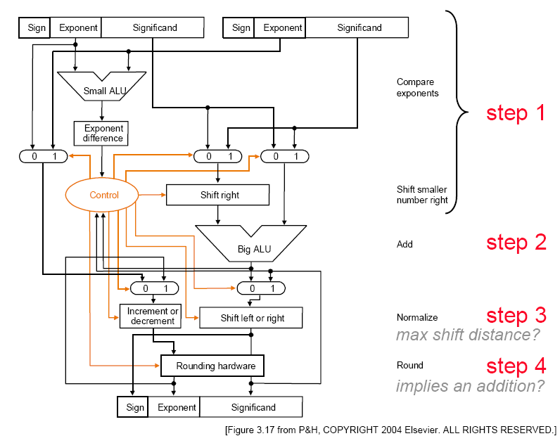
Floating-Point Addition

Slide 14
Chapter Three Summary
From bits to numbers:
  Computer arithmetic is constrained by limited precision
  Bit patterns have no inherent meaning but standards do exist
    two’s complement
    IEEE 754 floating point
  Instructions determine “meaning” of the bit patterns
Performance and accuracy
  … are important so there are many complexities in real machines (i.e., algorithms and implementation).
  Accurate numerical computing requires methods quite different from those of the math you learned in grade school.

