Slide 1
Pipelining

Slide 2
Overview
Pipelining is widely used in modern processors.
Pipelining improves system performance in terms of throughput.
Pipelined organization requires sophisticated compilation techniques.

Slide 3
Basic Concepts

Slide 4
Making the Execution of Programs Faster
Use faster circuit technology to build the processor and the main memory.
Arrange the hardware so that more than one operation can be performed at the same time.
In the latter way, the number of operations performed per second is increased even though the elapsed time needed to perform any one operation is not changed.

Slide 5
Traditional Pipeline Concept
Laundry Example
Ann, Brian, Cathy, Dave
each have one load of clothes
to wash, dry, and fold
Washer takes 30 minutes
Dryer takes 40 minutes
“Folder” takes 20 minutes
A
B
C
D

Slide 6
Traditional Pipeline Concept
6 PM
7
8
9
10
11
Midnight
Time
30
40
20
30
40
20
30
40
20
30
40
20
Sequential laundry takes 6 hours for 4 loads
If they learned pipelining, how long would laundry take?
A
B
C
D

Slide 7
Traditional Pipeline Concept
6 PM
7
8
9
10
11
Midnight
T
a
s
k
O
r
d
e
r
Time
30
40
40
40
40
20
A
Pipelined laundry takes 3.5 hours for 4 loads
B
C
D

Slide 8
Traditional Pipeline Concept
6 PM
7
8
9
Pipelining doesn’t help latency of single task, it helps throughput of entire workload
Pipeline rate limited by slowest pipeline stage
Multiple tasks operating simultaneously using different resources
Potential speedup = Number pipe stages
Unbalanced lengths of pipe stages reduces speedup
Time to “fill” pipeline and time to “drain” it reduces speedup
Stall for Dependences
Time
T
a
s
k
O
r
d
e
r
30
40
40
40
40
20
A
B
C
D

Slide 9
Use the Idea of Pipelining in a Computer
Fetch + Execution
T
ime
I
1
I
2
I
3
T
ime
Clock cycle
1
2
3
4
F
1
E
1
F
2
E
2
F
3
E
3
Instruction
(a) Sequential execution
I
1
F
1
E
1
I
2
F
2
E
2
Interstage buffer
B1
I
3
F
3
E
3
Instruction
Ex
ecution
fetch
unit
(c) Pipelined execution
unit
(b) Hardware organization
Figure 8.1. Basic idea of instruction pipelining.

Slide 10
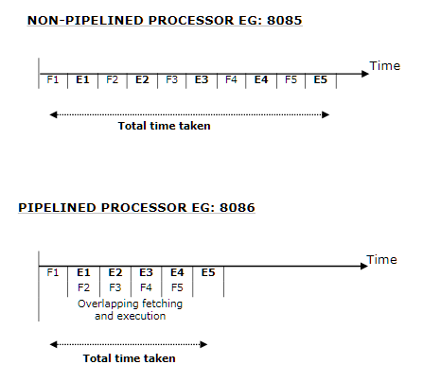
Stages of Pipelining
2 Stage pipelining- 8086

Slide 11
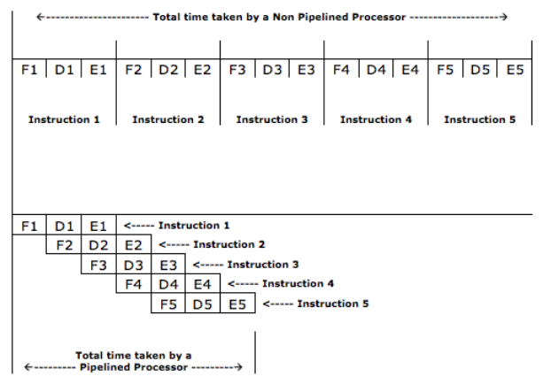
Stages of Pipelining
3 Stage pipelining- 80386/ARM7

Slide 12
Stages of Pipelining
4 Stage pipelining- Fetch, decode, execute, store.
5 Stage pipelining- Fetch, decode, address generation, execute, store.
6 Stage pipelining- Fetch (IF), decode (ID), address generation (AG), Operand Fetch (OF), execute (Ex), Write Back/store (WB).

Slide 13
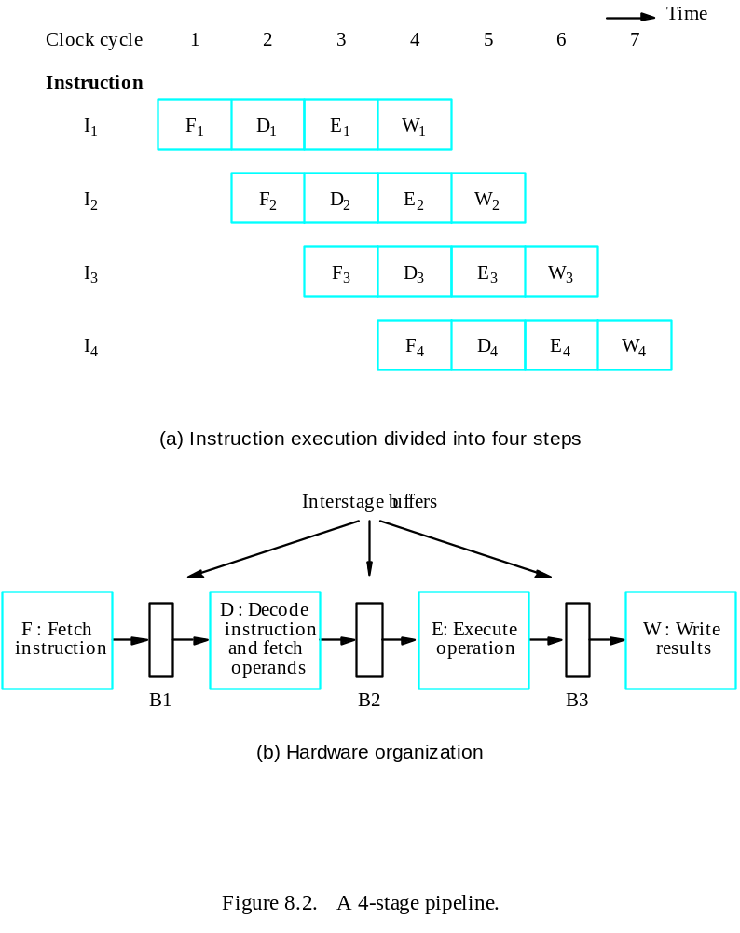
Use the Idea of Pipelining in a Computer
Fetch + Decode
+ Execution + Write
Textbook page: 457

Slide 14
Role of Cache Memory
Each pipeline stage is expected to complete in one clock cycle.
The clock period should be long enough to let the slowest pipeline stage to complete.
Faster stages can only wait for the slowest one to complete.
Since main memory is very slow compared to the execution, if each instruction needs to be fetched from main memory, pipeline is almost useless.
Fortunately, we have cache.

Slide 15
Pipeline Performance
The potential increase in performance resulting from pipelining is proportional to the number of pipeline stages.
However, this increase would be achieved only if all pipeline stages require the same time to complete, and there is no interruption throughout program execution.
Unfortunately, this is not true.

Slide 16
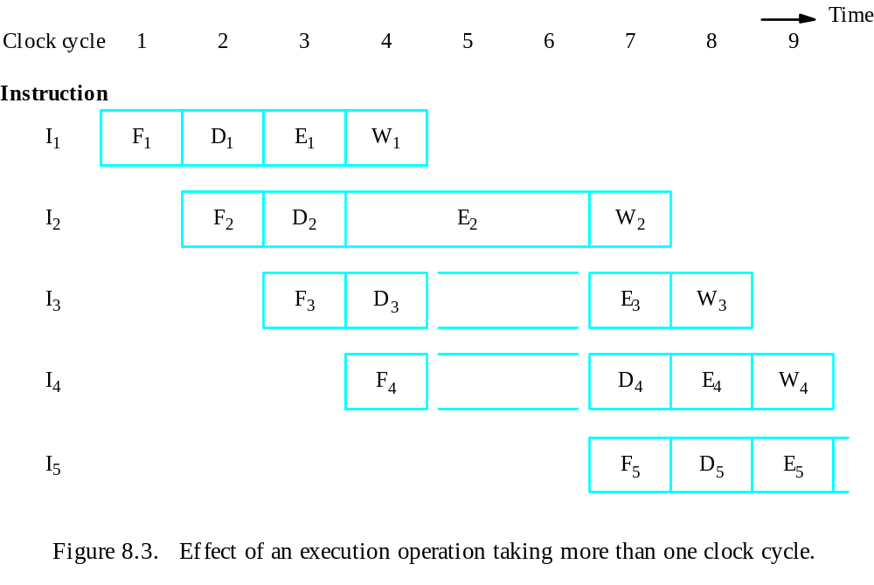
Pipeline Performance

Slide 17
Pipeline Performance
The previous pipeline is said to have been stalled for two clock cycles.
Any condition that causes a pipeline to stall is called a hazard.
Data hazard – any condition in which either the source or the destination operands of an instruction are not available at the time expected in the pipeline. So some operation has to be delayed, and the pipeline stalls.
Instruction (control) hazard – a delay in the availability of an instruction causes the pipeline to stall.
Structural hazard – the situation when two instructions require the use of a given hardware resource at the same time.

Slide 18
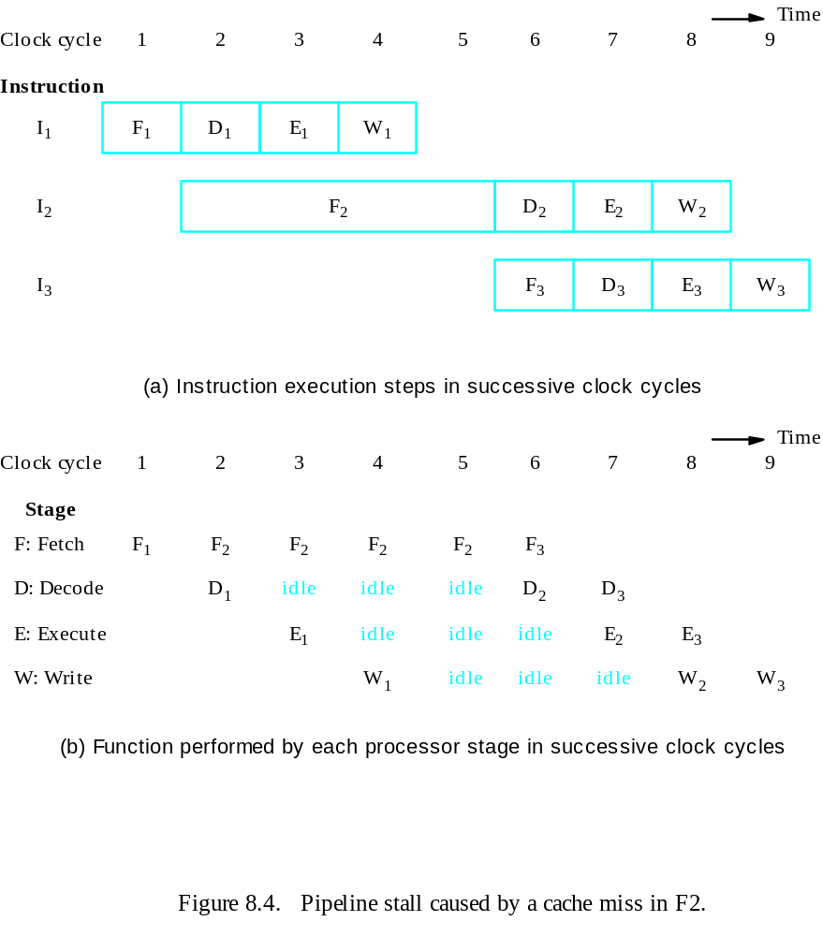
Pipeline Performance
Instruction hazard
Idle periods – stalls (bubbles)

Slide 19
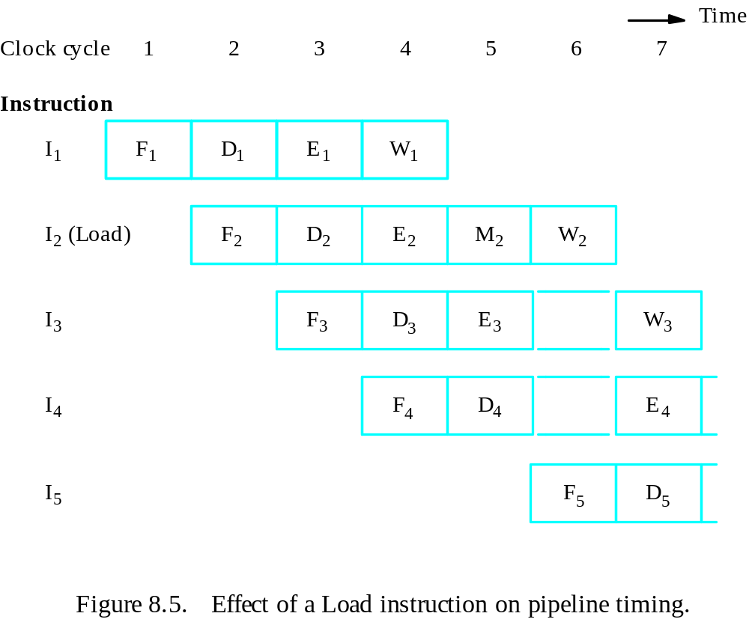
Pipeline Performance
Structural hazard
Load X(R1), R2

Slide 20
Pipeline Performance
Again, pipelining does not result in individual instructions being executed faster; rather, it is the throughput that increases.
Throughput is measured by the rate at which instruction execution is completed.
Pipeline stall causes degradation in pipeline performance.
We need to identify all hazards that may cause the pipeline to stall and to find ways to minimize their impact.

Slide 21
Data Hazards

Slide 22
Data Hazards
We must ensure that the results obtained when instructions are executed in a pipelined processor are identical to those obtained when the same instructions are executed sequentially.
Hazard occurs
A ← 3 + A
B ← 4 × A
No hazard
A ← 5 × C
B ← 20 + C
When two operations depend on each other, they must be executed sequentially in the correct order.
Another example:
Mul R2, R3, R4
Add R5, R4, R6

Slide 23
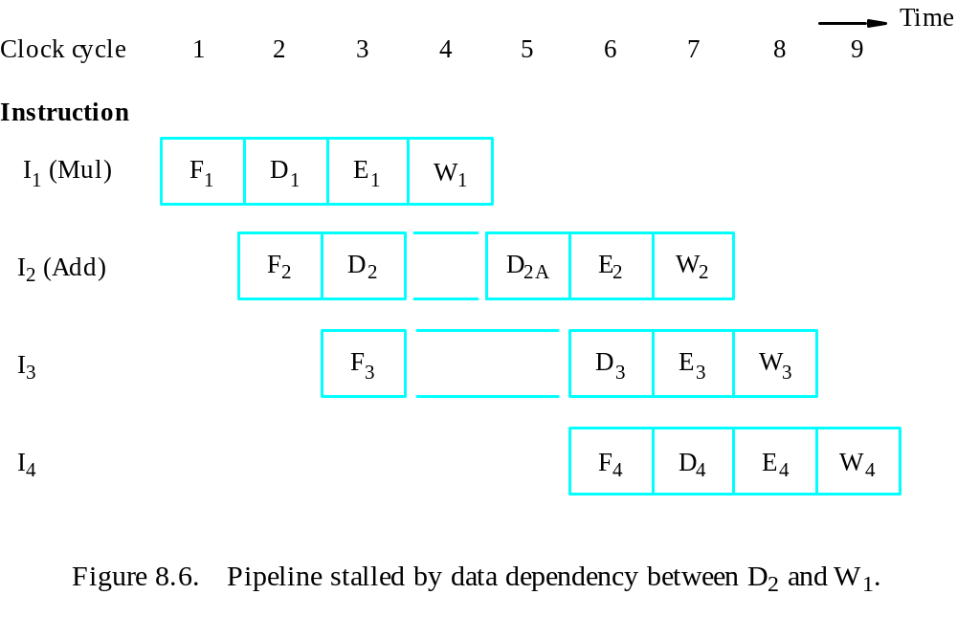
Data Hazards
Figure 8.6. Pipeline stalled by data dependency between D₂ and W₁.

Slide 24
Operand Forwarding
Instead of from the register file, the second instruction can get data directly from the output of ALU after the previous instruction is completed.
A special arrangement needs to be made to “forward” the output of ALU to the input of ALU.

Slide 25
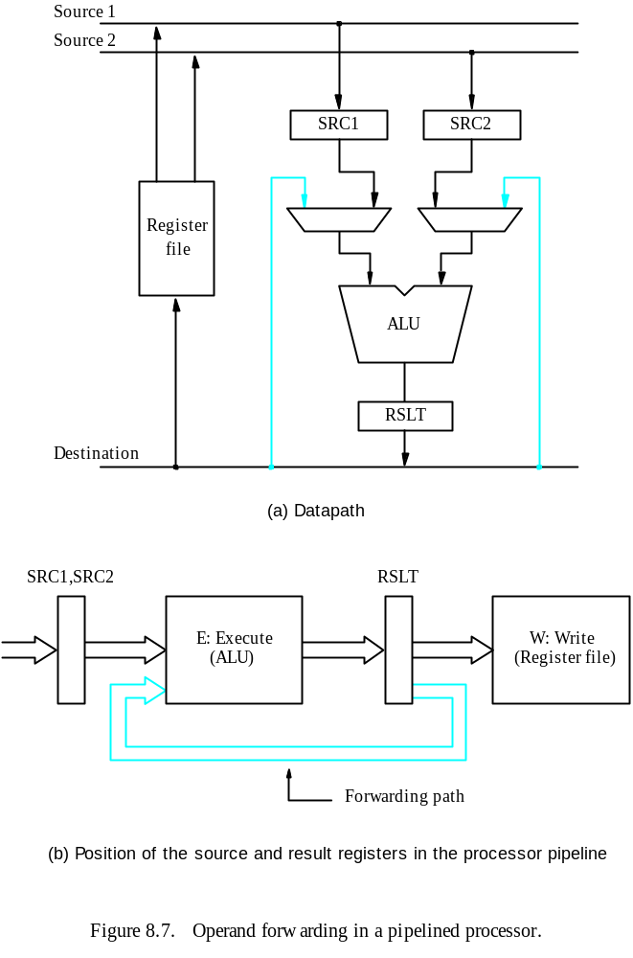

Slide 26
Handling Data Hazards in Software
Let the compiler detect and handle the hazard:
I1: Mul R2, R3, R4
NOP
NOP
I2: Add R5, R4, R6
The compiler can reorder the instructions to perform some useful work during the NOP slots.

Slide 27
Side Effects
The previous example is explicit and easily detected.
Sometimes an instruction changes the contents of a register other than the one named as the destination.
When a location other than one explicitly named in an instruction as a destination operand is affected, the instruction is said to have a side effect. (Example?)
Example: conditional code flags:
Add R1, R3
AddWithCarry R2, R4
Instructions designed for execution on pipelined hardware should have few side effects.

Slide 28
Instruction Hazards

Slide 29
Overview
Whenever the stream of instructions supplied by the instruction fetch unit is interrupted, the pipeline stalls.
Cache miss
Branch

Slide 30
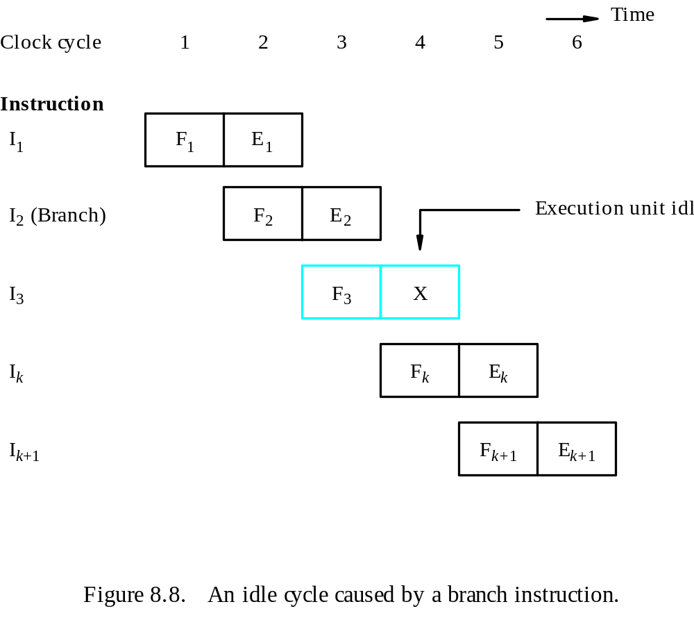
Unconditional Branches

Slide 31
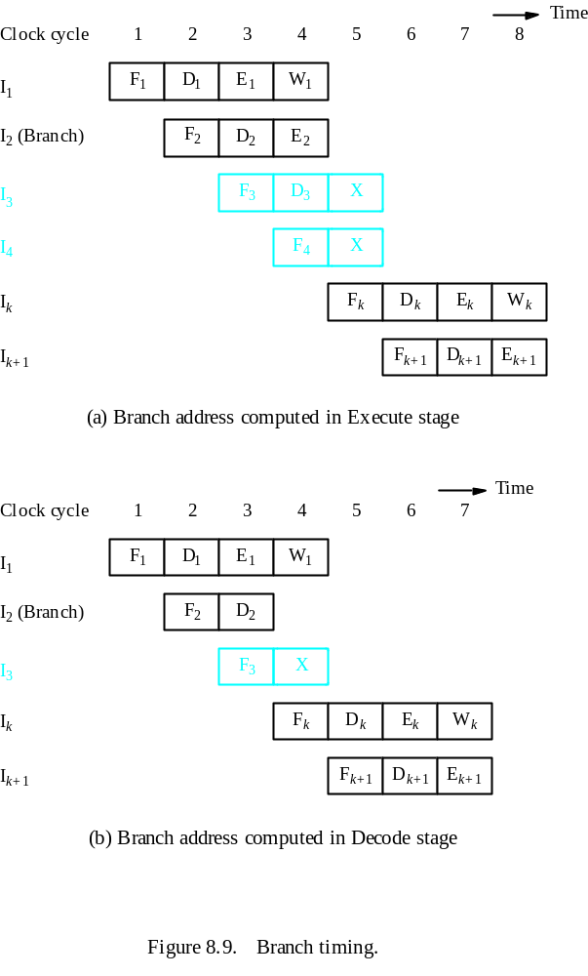
Branch Timing
- Branch penalty
- Reducing the penalty

Slide 32
Instruction Queue and Prefetching
Instruction fetch unit
Instruction queue
F : Fetch
instruction
D : Dispatch/
E : Ex
ecute
W : Write
Decode
instruction
results
unit
Figure 8.10. Use of an instruction queue in the hardware organization of Figure 8.2b.

Slide 33
Conditional Braches
A conditional branch instruction introduces the added hazard caused by the dependency of the branch condition on the result of a preceding instruction.
The decision to branch cannot be made until the execution of that instruction has been completed.
Branch instructions represent about 20% of the dynamic instruction count of most programs.

Slide 34
Delayed Branch
The instructions in the delay slots are always fetched. Therefore, we would like to arrange for them to be fully executed whether or not the branch is taken.
The objective is to place useful instructions in these slots.
The effectiveness of the delayed branch approach depends on how often it is possible to reorder instructions.

Slide 35
Delayed Branch
LOOP
Shift_left
R1
Decrement
R2
Branch=0
LOOP
NEXT
Add
R1,R3
(a) Original program loop
LOOP
Decrement
R2
Branch=0
LOOP
Shift_left
R1
NEXT
Add
R1,R3
(b) Reordered instructions
Figure 8.12. Reordering of instructions for a delayed branch.

Slide 36
Delayed Branch
T
ime
Clock c
ycle
1
2
3
4
5
6
7
8
Instruction
Decrement
F
E
Branch
F
E
Shift (delay slot)
F
E
Decrement (Branch tak
en)
F
E
Branch
F
E
Shift (delay slot)
F
E
Add (Branch not tak
en)
F
E
Figure 8.13. Execution timing showing the delay slot being filled
during the last two passes through the loop in Figure 8.12.

Slide 37
Branch Prediction
To predict whether or not a particular branch will be taken.
Simplest form: assume branch will not take place and continue to fetch instructions in sequential address order.
Until the branch is evaluated, instruction execution along the predicted path must be done on a speculative basis.
Speculative execution: instructions are executed before the processor is certain that they are in the correct execution sequence.
Need to be careful so that no processor registers or memory locations are updated until it is confirmed that these instructions should indeed be executed.

Slide 38
Incorrectly Predicted Branch
T
ime
Clock cycle
1
2
3
4
5
6
Instruction
I
1
(Compare)
F
1
D
1
E
1
W
1
I
2
(Branch>0)
F
2
D
2
/P
2
E
2
I
3
F
3
D
3
X
I
4
F
4
X
I
k
F
k
D
k
Figure 8.14. Timing when a branch decision has been incorrectly predicted
as not taken.

Slide 39
Branch Prediction
Better performance can be achieved if we arrange for some branch instructions to be predicted as taken and others as not taken.
Use hardware to observe whether the target address is lower or higher than that of the branch instruction.
Let compiler include a branch prediction bit.
So far the branch prediction decision is always the same every time a given instruction is executed – static branch prediction.

Slide 40
Influence on Instruction Sets

Slide 41
Overview
Some instructions are much better suited to pipeline execution than others.
Addressing modes
Conditional code flags

Slide 42
Addressing Modes
Addressing modes include simple ones and complex ones.
In choosing the addressing modes to be implemented in a pipelined processor, we must consider the effect of each addressing mode on instruction flow in the pipeline:
Side effects
The extent to which complex addressing modes cause the pipeline to stall
Whether a given mode is likely to be used by compilers

Slide 43
Recall
Load X(R1), R2
Load (R1), R2

Slide 44
Complex Addressing Mode
Load (X(R1)), R2
T
ime
Clock c
ycle
1
2
3
4
5
6
7
Load
F
D
X
+
[R1]
[X
+
[R1]]
[[X
+
[R1]]]
W
F
orw
ard
Ne
xt instruction
F
D
E
W
(a) Complex addressing mode

Slide 45
Simple Addressing Mode
Add #X, R1, R2
Load (R2), R2
Load (R2), R2
Add
F
D
X
+
[R1]
W
Load
F
D
[X
+
[R1]]
W
Load
F
D
[[X
+
[R1]]]
W
Ne
xt instruction
F
D
E
W
(b) Simple addressing mode

Slide 46
Addressing Modes
In a pipelined processor, complex addressing modes do not necessarily lead to faster execution.
Advantage: reducing the number of instructions / program space
Disadvantage: cause pipeline to stall / more hardware to decode / not convenient for compiler to work with
Conclusion: complex addressing modes are not suitable for pipelined execution.

Slide 47
Addressing Modes
Good addressing modes should have:
Access to an operand does not require more than one access to the memory
Only load and store instruction access memory operands
The addressing modes used do not have side effects
Register, register indirect, index

Slide 48
Conditional Codes
If an optimizing compiler attempts to reorder instruction to avoid stalling the pipeline when branches or data dependencies between successive instructions occur, it must ensure that reordering does not cause a change in the outcome of a computation.
The dependency introduced by the condition-code flags reduces the flexibility available for the compiler to reorder instructions.

Slide 49
Conditional Codes
Add
R1,R2
Compare
R3,R4
Branch=0
. . .
(a) A program fragment
Compare
R3,R4
Add
R1,R2
Branch=0
. . .
(b) Instructions reordered
Figure 8.17. Instruction reordering.

Slide 50
Conditional Codes
Two conclusion:
To provide flexibility in reordering instructions, the condition-code flags should be affected by as few instruction as possible.
The compiler should be able to specify in which instructions of a program the condition codes are affected and in which they are not.

Slide 51
Datapath and Control Considerations

Slide 52
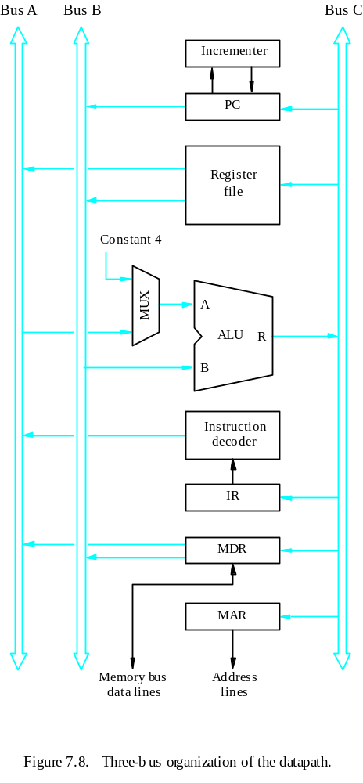
Original Design

Slide 53
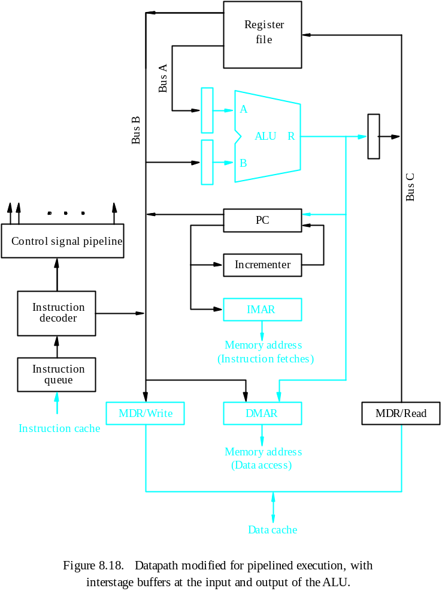
Pipelined Design
- Separate instruction and data caches
- PC is connected to IMAR
- DMAR
- Separate MDR
- Buffers for ALU
- Instruction queue
- Instruction decoder output
- Reading an instruction from the instruction cache
- Incrementing the PC
- Decoding an instruction
- Reading from or writing into the data cache
- Reading the contents of up to two regs
- Writing into one register in the reg file
- Performing an ALU operation

Slide 54
Superscalar Operation

Slide 55
Overview
The maximum throughput of a pipelined processor is one instruction per clock cycle.
If we equip the processor with multiple processing units to handle several instructions in parallel in each processing stage, several instructions start execution in the same clock cycle – multiple-issue.
Processors are capable of achieving an instruction execution throughput of more than one instruction per cycle – superscalar processors.
Multiple-issue requires a wider path to the cache and multiple execution units.

Slide 56
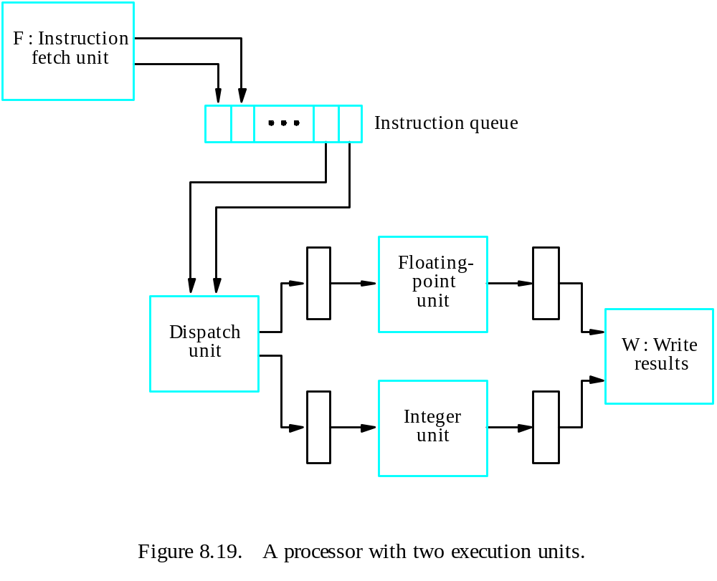
Superscalar

Slide 57
Timing
T
ime
Clock c
ycle
1
2
3
4
5
6
7
I
1
(F
add)
F
D
E
E
E
W
1
1
1A
1B
1C
1
I
2
(Add)
F
D
E
W
2
2
2
2
I
3
(Fsub)
F
D
E
E
E
W
3
3
3
3
3
3
I
4
(Sub)
F
D
E
W
4
4
4
4
Figure 8.20. An example of instruction execution flow in the processor of Figure 8.19,
assuming no hazards are encountered.

Slide 58
Out-of-Order Execution
Hazards
Exceptions
Imprecise exceptions
Precise exceptions
T
ime
Clock c
ycle
1
2
3
4
5
6
7
I
1
(F
add)
F
1
D
1
E
1A
E
1B
E
1C
W
1
I
2
(Add)
F
2
D
2
E
2
W
2
I
3
(Fsub)
F
3
D
3
E
3A
E
3B
E
3C
W
3
I
4
(Sub)
F
4
D
4
E
4
W
4
(a) Delayed write

Slide 59
Execution Completion
It is desirable to used out-of-order execution, so that an execution unit is freed to execute other instructions as soon as possible.
At the same time, instructions must be completed in program order to allow precise exceptions.
The use of temporary registers
Commitment unit
T
ime
Clock c
ycle
1
2
3
4
5
6
7
I
1
(F
add)
F
1
D
1
E
1A
E
1B
E
1C
W
1
I
2
(Add)
F
2
D
2
E
2
TW
2
W
2
I
3
(Fsub)
F
3
D
3
E
3A
E
3B
E
3C
W
3
I
4
(Sub)
F
4
D
4
E
4
TW
4
W
4
(b) Using temporary registers

Slide 60
Performance Considerations

Slide 61
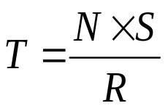
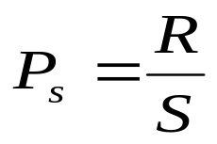
Overview
The execution time T of a program that has a dynamic instruction count N is given by:
where S is the average number of clock cycles it takes to fetch and execute one instruction, and R is the clock rate.
Instruction throughput is defined as the number of instructions executed per second.

Slide 62
Overview
An n-stage pipeline has the potential to increase the throughput by n times.
However, the only real measure of performance is the total execution time of a program.
Higher instruction throughput will not necessarily lead to higher performance.
Two questions regarding pipelining
How much of this potential increase in instruction throughput can be realized in practice?
What is good value of n?

Slide 63
Number of Pipeline Stages
Since an n-stage pipeline has the potential to increase the throughput by n times, how about we use a 10,000-stage pipeline?
As the number of stages increase, the probability of the pipeline being stalled increases.
The inherent delay in the basic operations increases.
Hardware considerations (area, power, complexity,…)

