Slide 1
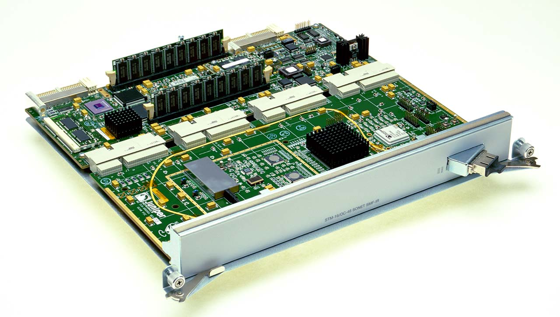
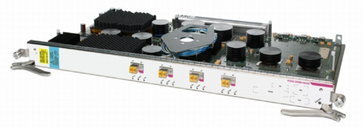
Data Plane
Advanced Computer Networks

Slide 2
Data Plane
Streaming algorithms that act on packets
  Matching on some bits, taking a simple action
  … at behest of control and management plane
Wide range of functionality
  Forwarding
  Access control
  Mapping header fields
  Traffic monitoring
  Buffering and marking
  Shaping and scheduling
  Deep packet inspection
Notes:
Question to keep in mind: is there a common way to think about all of these data-plane operations

Slide 3
Packet Forwarding

Slide 4
Packet Forwarding
Control plane computes a forwarding table
  Maps destination address(es) to an output link
Handling an incoming packet
  Match: destination address
  Action: direct the packet to
  the chosen output link
Switching fabric
  Directs packet from
  input link to output link
Processor
Switching
Fabric

Slide 5
Switch: Match on Destination MAC
MAC addresses are location independent
  Assigned by the vendor of the interface card
  Cannot be aggregated across hosts in the LAN
mac1
mac2
mac3
host
host
...
host
mac1
mac2
mac3
mac4
mac5
host
switch
mac4
Implemented using a hash table or a content addressable memory.
host
mac5

Slide 6
IP Routers: Match on IP Prefix
IP addresses grouped into common subnets
  Allocated by ICANN, regional registries, ISPs, and within individual organizations
  Variable-length prefix identified by a mask length
1.2.3.4
1.2.3.7
1.2.3.156
5.6.7.8
5.6.7.9
5.6.7.212
host
host
...
host
host
host
...
host
LAN 1
LAN 2
router
router
router
WAN
WAN
1.2.3.0/24
Prefixes may be nested. Routers identify the longest matching prefix.
5.6.7.0/24
forwarding table

Slide 7
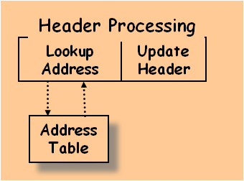
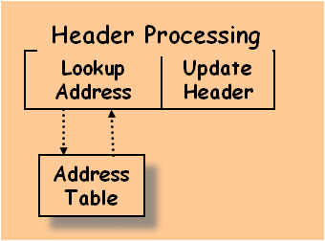
Switch Fabric: From Input to Output
Data
1
1
Hdr
Queue
Packet
Buffer
Memory
Data
2
2
Hdr
Queue
Packet
Buffer
Memory
Data
Hdr
N
N
Queue
Packet
Buffer
Memory

Slide 8
Access Control

Slide 9
Access Control: Packet Filtering
“Five tuple” for access control lists (ACLs)
  Source and destination IP addresses
  TCP/UDP source and destination ports
  Protocol (e.g., UDP vs. TCP)
Can be more
sophisticated
  E.g., block all
  TCP SYN packets
  from outside
  hosts
  E.g., stateful
Should arriving packet be allowed in? Departing packet let out?

Slide 10
Applying Access Control Lists
Ordered list of “accept/deny” clauses
  A clause can have wild cards
  Clauses can overlap
  … so order matters
Packet classification
  Given all of the fields
  … identify the match
  with the highest priority
Two approaches
  Clever algorithms for multi-dimensional classification
  Ternary Content Addressable Memories (TCAMs)
Src=1.2.3.4, Dest=5.6.7.8 | Deny
Dest=1.2.3.* | Allow
Dest=1.2.3.8, Dport!=53 | Deny
Src=1.2.3.7, Dport=100 | Allow
Dport=100 | Deny

Slide 11
Mapping Header Fields

Slide 12


Network Address Translation (NAT)
138.76.29.7
10.0.0.1
outside
NAT
inside
10.0.0.2

Slide 13
Mapping Addresses and Ports
Remap IP addresses and TCP/UDP port numbers
  Addresses: between end-host and NAT addresses
  Port numbers: to ensure each connection is unique
Create table entries as packets arrive
  Src 10.0.0.1, Sport 1024, Dest 1.2.3.4, Dport 80
    Map to Src 138.76.29.7, Sport 1024, Dest 1.2.3.4, Dport 80
  Src 10.0.0.2, Sport 1024, Dest 1.2.3.4, Dport 80
    Map to Src 138.76.29.7, Sport 1025, Dest 1.2.3.4, Dport 80
Challenges
  When to remove the entries
  Running services behind a NAT
  What if both ends of a connection are behind NATs

Slide 14
Traffic Monitoring

Slide 15
Observing Traffic Passing Through
source
dest
input
output
source
prefix
dest
prefix
source AS
intermediate AS
dest AS
Applications of traffic measurement
  Usage-based billing
  Network engineering
  Detecting anomalous traffic

Slide 16
Passive Traffic Monitoring
Counting the traffic
  Match based on fields in the packet header
  … and update a counter of #bytes and #packets
Examples
  Link
  IP prefixes
  TCP/UDP ports
  Individual “flows”
Challenges
  Identify traffic aggregates in advance vs. reactively
  Summarizing other information (e.g., time, TCP flags)
  Not knowing if you see all packets in a connection
Dest Prefix | #Packets | #Bytes
1.2.3.0/24 | 3 | 1500
7.8.0.0/16 | 10 | 13000
8.0.0.0/8 | 100 | 85020
7.7.6.0/23 | 1 | 40

Slide 17
Resource Allocation: Buffering, Scheduling, Shaping, and Marking

Slide 18
Buffering
Drop-tail FIFO queue
  Packets served in the order they arrive
  … and dropped if queue is full
Random Early Detection (RED)
  When the buffer is nearly full
  … drop or mark some packets to signal congestion
Multiple classes of traffic
  Separate FIFO queue for each flow or traffic class
  … with a link scheduler to arbitrate between them

Slide 19
Link Scheduling
Strict priority
  Assign an explicit rank to the queues
  … and serve the highest-priority backlogged queue
Weighted fair scheduling
  Interleave packets from different queues
  …in proportion to weights
50% red, 25% blue, 25% green

Slide 20
Traffic Shaping
Force traffic to conform with a profile
  To avoid congesting downstream resources
  To enforce a contract with the customer
Leaky-bucket shaping
  Can send at rate r and intermittently burst
  Parameters: token rate r and bucket depth d
Tokens arrive (rate r)
Max # of tokens
(d tokens)
tokens
A leaky-bucket shaper for each flow or traffic class
packets

Slide 21
Traffic Classification and Marking
Mark a packet to influence handling downstream
  Early Congestion Notification (ECN) flag
  Type-of-Service (ToS) bits
Ways to set the ToS bits
  End host sets the bits based on the application
    But, then the network must trust (or bill!) the end host
  Network sets the bits based on traffic classes
    But, then the network needs to know how to classify packets
Identifying traffic classes
  Packet classification based on the “five tuple”
  Rate limits, with separate mark for “out of profile” traffic

Slide 22
Generalizing the Data Plane
Software-Defined Networking (SDN)

Slide 23
Many Boxes, But Similar Functions
Router
  Forward on destination IP address
  Access control on the “five tuple”
  Link scheduling and marking
  Monitoring traffic
  Deep packet inspection
Switch
  Forward on destination MAC address
Firewall
  Access control on “five tuple” (and more)
NAT
  Mapping addresses and port numbers
Shaper
  Classify packets
  Shape or schedule
Packet sniffer
  Monitoring traffic

Slide 24

Match
  Match on a subset of bits in the packet header
  E.g., key header fields (addresses, port numbers, etc.)
  Well-suited to capitalize on TCAM hardware
Action
  Perform a simple action on the matching packet
  E.g., forward, flood, drop, rewrite, count, etc.
srcip=1.2.*.*, dstip=3.4.5.* → drop
srcip=*.*.*.*, dstip=3.4.*.* → forward(2)
3. srcip=10.1.2.3, dstip=*.*.*.* → send to controller

Slide 25




(Logically) Centralized Controller
Controller Platform

Slide 26
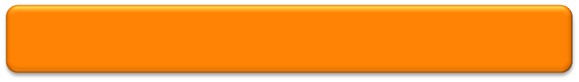
Protocols → Applications
Controller Application
Controller Platform

Slide 27
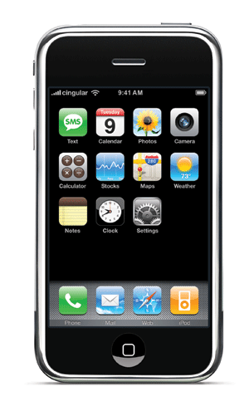


Seamless Mobility
See host sending traffic at new location
Modify rules to reroute the traffic

Slide 28
Server Load Balancing
Pre-install load-balancing policy
Split traffic based on source IP
10.0.0.1
src=0*,
dst=1.2.3.4
10.0.0.2
src=1*,
dst=1.2.3.4

Slide 29
Programmable Data Plane
Programmable data plane
  Arbitrary customized packet-handling functionality
  Building a new data plane, or extending existing one
Speed is important
  Data plane in hardware or in the kernel
  Streaming algorithms the handle packets as they arrive
Two open platforms
  Click: software data plane in user space or the kernel
  NetFPGA: hardware data plane based on FPGAs
Lots of ongoing research activity…

Slide 30
An Observation…
Click is widely used
  And the paper on Click is widely cited
Click elements are created by others
  Enabling an ecosystem of innovation
Take-away lesson
  Creating useful systems that others can use and extend has big impact in the research community
  And brings tremendous professional value
  Compensating amply for the time and energy ☺

Slide 31
Discussion
Trade-offs between customizability and performance?
What data-plane model would be “just enough” for most needs, but still fast and inexpensive?
Ways the Internet architecture makes data-plane functionality more challenging?

Slide 32
Click Modular Router
Backup Slides

Slide 33
Click Motivation
Flexibility
  Add new features and enable experimentation
Openness
  Allow users/researchers to build and extend
  (In contrast to most commercial routers)
Modularity
  Simplify the composition of existing features
  Simplify the addition of new features
Speed/efficiency
  Operation (optionally) in the operating system
  Without the user needing to grapple with OS internals

Slide 34
Router as a Graph of Elements
Large number of small elements
  Each performing a simple packet function
  E.g., IP look-up, TTL decrement, buffering
Connected together in a graph
  Elements inputs/outputs snapped together
  Beyond elements in series to a graph
  E.g., packet duplication or classification
Packet flow as main organizational primitive
  Consistent with data-plane operations on a router
  (Larger elements needed for, say, control planes)

Slide 35
Click Elements: Push vs. Pull
Packet hand-off between elements
  Directly inspired by properties of routers
  Annotations on packets to carry temporary state
Push processing
  Initiated by the source end
  E.g., when an unsolicited packet arrives (e.g., from a device)
Pull processing
  Initiated by the destination end
  E.g., to control timing of packet processing (e.g., based on a timer or packet scheduler)

Slide 36
Click Language
Declarations
  Create elements
Connections
  Connect elements
Compound elements
  Combine multiple smaller elements, and treat as single, new element to use as a primitive class
Language extensions through element classes
  Configuration strings for individual elements
  Rather than syntactic extensions to the language
src :: FromDevice(eth0);
ctr :: Counter;
sink :: Discard;
src -> ctr;
ctr -> sink;

Slide 37
Handlers and Control Socket
Access points for user interaction
  Appear like files in a file system
  Can have both read and write handlers
Examples
  Installing/removing forwarding-table entries
  Reporting measurement statistics
  Changing a maximum queue length
Control socket
  Allows other programs to call read/write handlers
  Command sent as single line of text to the server
  http://read.cs.ucla.edu/click/elements/controlsocket?s=llrpc

Slide 38
Example: EtherSwitch Element
Ethernet switch
  Expects and produces Ethernet frames
  Each input/output pair of ports is a LAN
  Learning and forwarding switch among these LANs
Element properties
  Ports: any # of inputs, and same # of outputs
  Processing: push
Element handlers
  Table (read-only): returns port association table
  Timeout (read/write): returns/sets TIMEOUT
http://read.cs.ucla.edu/click/elements/etherswitch

