Slide 1
Transport Layer: Part I
Transport Layer Services
  connection-oriented vs. connectionless
  multiplexing and demultplexing
UDP: Connectionless Unreliable Service
TCP: Connection-Oriented Reliable Service
  connection management: set-up and tear down
  reliable data transfer protocols (Part II)
  flow and congestion control (Part II)

Slide 2





Transport Services and Protocols
provide logical communication between app processes running on different hosts
transport protocols run in end systems
  send side: breaks app messages into segments, passes to network layer
  rcv side: reassembles segments into messages, passes to app layer
more than one transport protocol available to apps
  Internet: TCP and UDP
application
transport
network
data link
physical
network
data link
physical
network
data link
physical
network
data link
physical
logical end-end transport
network
data link
physical
network
data link
physical
application
transport
network
data link
physical

Slide 3
Transport vs.
Application and Network Layer
application layer: application processes and message exchange
network layer: logical communication between hosts
transport layer: logical communication support for app processes
  relies on, enhances, network layer services
Household analogy:
12 kids sending letters to 12 kids
processes = kids
app messages = letters in envelopes
hosts = houses
transport protocol = Ann and Bill
network-layer protocol = postal service

Slide 4
End to End Issues
Transport services built on top of (potentially) unreliable network service
  packets can be corrupted or lost
  Packets can be delayed or arrive “out of order”
Do we detect and/or recover errors for apps?
  Error Control & Reliable Data Transfer
Do we provide “in-order” delivery of packets?
  Connection Management & Reliable Data Transfer
Potentially different capacity at destination, and potentially different network capacity
  Flow and Congestion Control

Slide 5
Internet Transport Protocols
TCP service:
connection-oriented: setup required between client, server
reliable transport between sender and receiver
flow control: sender won’t overwhelm receiver
congestion control: throttle sender when network overloaded
UDP service:
unreliable data transfer between sender and receiver
does not provide: connection setup, reliability, flow control, congestion control
Both provide logical communication between app processes
running on different hosts!
Notes:
Internet protocol stack provides two types of end to end transport services corresponding to two protocols. TCP is transmission control protocol and UDP is user datagram protocol.
TCP provides, connection oriented reliable transport between sender and receiver. It also does flow control such that sender wont transmit faster than receiver can consume. It also reduces the sending rate when the network is loaded.
UDP on the other hand provides unreliable connectionless datagram service. It provides demultiplexing and error checking beyond what is provided by the IP. IP knows how to deliver the packet to a host but not to a specific application on the host.
TCP service is the most commonly used one since many applications want reliable transport. Why then UDP. There are cases where you have only one request and short response. In that case it is too much of overhead to setup and tear down a connection. You might have noticed that there are some applications that use UDP.

Slide 6
Multiplexing/Demultiplexing
Demultiplexing at rcv host:
Multiplexing at send host:
delivering received segments
to correct application process
gathering data from multiple
app processes, enveloping data
with header (later used for
demultiplexing)
= API (“socket”)
= process
application
application
application
P4
P3
P1
P2
P1
transport
transport
transport
network
network
network
link
link
link
physical
physical
physical
host 1
host 2
host 3

Slide 7
How Demultiplexing Works
host receives IP datagrams
  each datagram has source IP address, destination IP address
  each datagram carries 1 transport-layer segment
  each segment has source, destination port number
  (recall: well-known port numbers for specific applications)
host uses IP addresses & port numbers to direct segment to appropriate app process (identified by “socket’)
32 bits
source port #
dest port #
other header fields
application
data
(message)
TCP/UDP segment format

Slide 8
UDP: User Datagram Protocol [RFC 768]
“no frills,” “bare bones” Internet transport protocol
“best effort” service, UDP segments may be:
  lost
  delivered out of order to app
connectionless:
  no handshaking between UDP sender, receiver
  each UDP segment handled independently of others
Why is there a UDP?
no connection establishment (which can add delay)
simple: no connection state at sender, receiver
small segment header
no congestion control: UDP can blast away as fast as desired

Slide 9
UDP (cont’d)
often used for streaming multimedia apps
  loss tolerant
  rate sensitive
other UDP uses
  DNS
  SNMP
reliable transfer over UDP: add reliability at application layer
  application-specific error recovery!
32 bits
Length, in
bytes of UDP
segment,
including
header
source port #
dest port #
length
checksum
Application
data
(message)
UDP segment format

Slide 10
UDP Checksum
Goal: detect “errors” (e.g., flipped bits) in transmitted segment
Sender:
treat segment contents as sequence of 16-bit integers
checksum: addition (1’s complement sum) of segment contents
sender puts checksum value into UDP checksum field
Receiver:
compute checksum of received segment
check if computed checksum equals checksum field value:
  NO - error detected
  YES - no error detected. But maybe errors nonetheless? More later ….

Slide 11
Checksum: Example (from book)
arrange data segment
in sequences of
16-bit words
0110011001100000
0101010101010101
1000111100001100
binary addition,
with overflow
wrapped around
+
sum: 0100101011000010
checksum(1’s complement):
1011010100111101
verify by adding:
1111111111111111

Slide 12
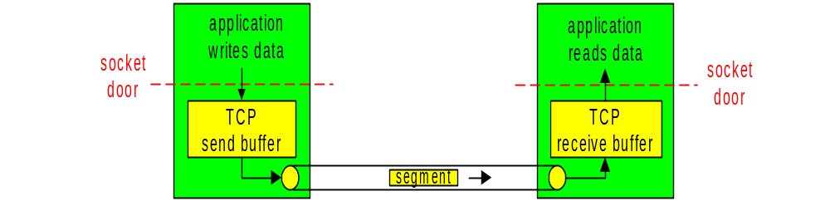
TCP: Overview
point-to-point:
  one sender, one receiver
reliable, in-order byte steam:
  no “message boundaries”
pipelined:
  TCP congestion and flow control set window size
send & receive buffers
full duplex data:
  bi-directional data flow in same connection
  MSS: maximum segment size
connection-oriented:
  handshaking (exchange of control msgs) init’s sender, receiver state before data exchange
flow controlled:
  sender will not overwhelm receiver
Notes:
Now lets look at the most popular transport layer protocol Transmission Control Protocol (TCP). It provides connection-oriented, reliable, in-order, byte stream service. TCP uses sliding window mechanism for flow/congestion control.

Slide 13
TCP Segment Structure
32 bits
source port #
dest port #
counting
by bytes
of data
(not segments!)
URG: urgent data
(generally not used)
sequence number
ACK: ACK #
valid
acknowledgement number
head
len
not
used
U
rcvr window size
A
P
R
S
F
PSH: push data now
(generally not used)
checksum
ptr urgent data
# bytes
rcvr willing
to accept
Options (variable length)
RST, SYN, FIN:
connection estab
(setup, teardown
commands)
application
data
(variable length)
Internet
checksum
(as in UDP)
Notes:
A TCP packet is referred to as TCP segment. This shows the structure of a TCP segment. The port numbers identify the end points of the connection. The sequence number refers to the byte number starting from the initial sequence number of the connection. The acknowledgement number corresponds to the data in the other direction. It is the next byte this side is expecting from its peer.
There are several flags. The ACK flag validates the acknowledgement number field. The SYN and FIN flags are used to establish and terminate a connection. The RST flag signifies that the receiver has become confused with some unexpected condition and so wants to abort the connection.
The receiver window size meant for data in the other direction. It specifies the amount of buffer available for reception on this side. The checksum covers both the header and the data.

Slide 14
TCP Seq. #’s and ACKs
Host A
Host B
Seq. #’s:
byte stream “number”of first byte in segment’s data
ACKs:
seq # of next byte expected from other side
User
types
‘C’
Seq=42, ACK=79, data = ‘C’
host ACKs
receipt of
‘C’, echoes
back ‘C’
Seq=79, ACK=43, data = ‘C’
host ACKs
receipt
of echoed
‘C’
Seq=43, ACK=80
time
red: A-to-B green: B-to-A
simple telnet scenario
Notes:
There are several things to note about TCP sequence numbers and acknowledgements. First, they refer to bytes not packets. Second, acknowledgements are cumulative and also refer to the next byte expected.
Lets look at a simple telnet example. The first segment shown gives the sequence number as 42 and acknowledge number as 79. This means that host A is sending bytes starting at 42. It also says that it has received all bytes up to and including 78 and it is expecting bytes from 79 onwards from host B. For this host B responds with bytes starting at seq 79 and ACK 43 since 43 is the next byte it is expecting from host A.

Slide 15
TCP: Error Scenarios
Host A
Host B
Questions for you:
How to detect lost packets?
How to “recover” lost packets?
Potential consequence of retransmission?
How to detect duplicate packets?
“State” maintained at sender & receiver?
Seq=92, 8 bytes data
X
timeout
loss
Seq=92, 8 bytes data
ACK=100
time
lost data scenario
Notes:
Lets look at couple of scenarios with retransmissions. The first case, packet reached successfully and ACK is lost. Host A retransmits and host B recognizes that it is a duplicate and repeats the same ACK. Note that ACK is for 100, i.e., the next byte expected by B from A, since host B received bytes up to 99 (8 bytes starting at 92).
The second case is a premature timeout. Host A repeats the segment with seq 92 and host B realizes that it is duplicate and repeats the ACK 120. Note that this cumulative acknowledgement is saying that the next byte expected by B is 120. It is important to set the retransmission timer correctly to avoid such duplicate transmissions.

Slide 16
TCP: Error Scenarios (cont’d)
Host A
Host B
Host A
Host B
Seq=92, 8 bytes data
Seq=92, 8 bytes data
timeout
ACK=100
X
timeout
loss
ACK=100
Seq=92, 8 bytes data
Seq=92, 8 bytes data
ACK=100
ACK=100
time
time
lost ACK scenario
duplicate packets
Notes:
Lets look at couple of scenarios with retransmissions. The first case, packet reached successfully and ACK is lost. Host A retransmits and host B recognizes that it is a duplicate and repeats the same ACK. Note that ACK is for 100, i.e., the next byte expected by B from A, since host B received bytes up to 99 (8 bytes starting at 92).
The second case is a premature timeout. Host A repeats the segment with seq 92 and host B realizes that it is duplicate and repeats the ACK 120. Note that this cumulative acknowledgement is saying that the next byte expected by B is 120. It is important to set the retransmission timer correctly to avoid such duplicate transmissions.

Slide 17
A Simple Reliable Data Transfer Protocol
“Stop & Wait” Protocol (aka “Alternate Bit” Protocol)
Sender algorithm:
Send Phase: send data segment (n bytes) w/ seq=x, buffer data segment, set timer
Wait Phase: wait for ack from receiver w/ ack= x+n
  if received ack w/ ack=x+n,
  set x:=x+n, and go to sending phase with next data segment
  if time out, resend data segment w/ seq=x.
  if received ack w/ ack != x+n, ignore (or resend data segment w/ seq=x)
Receiver algorithm:
Wait-for-Data:
wait for data packet with the (expected) next-seq = x
if received Data packet w/ seq. =x and of size n bytes: send ACK pkt w/ ack = x+n; set next-seq:= x+n; go back to “Wait-for-Data”;
If received Data packet w/ seq != x, (re-)send ACK pkt w/ ack= next-seq; go back to “Wait-for-Data”;
Q: what is the “state” information maintained at the sender & receiver, resp.?
Notes:
TCP is connection-oriented protocol. The connection has to be established before exchanging any data. During the connection setup, peers exchange sequence numbers, buffer sizes etc. Let us see how TCP does connection management. In the rest of the discussion we use the convention that client is the connection initiator and server is the responder.
TCP uses three-way handshake described earlier for establishing connection. A client initiates connection with a SYN segment (SYN flag is set) that includes the initial sequence number x chosen by the client. The server responds with SYN-ACK segment (both SYN and ACK flags are set). This segment includes the acknowledgement number x+1 and also the server’s initial sequence number y. The client responds with ACK segment that acknowledges the server’s sequence number by setting acknowledgment number to y+1. This way after exchanging three segments, SYN, SYN-ACK, ACK, both client and server establish the connection.

Slide 18
SRDTP: Finite State Machine
event
: state
action
: transition
Receiver FSM?
Sender FSM
Upper layer:
send data (n bytes)
make data sgt, seq = x, set timer
pass data sgt to lower layer
?
receive Ack w/ ack != x+n
?
Send
phase
Wait
phase
no op, or resend data sgt
time out
resend data sgt
receive Ack w/ ack = x+n
x: = x+n, stop timer
info (“state”) maintained at sender:
phase it is in (send, or wait), ack expected, data sgt sent (seq #), timer
Notes:
TCP is connection-oriented protocol. The connection has to be established before exchanging any data. During the connection setup, peers exchange sequence numbers, buffer sizes etc. Let us see how TCP does connection management. In the rest of the discussion we use the convention that client is the connection initiator and server is the responder.
TCP uses three-way handshake described earlier for establishing connection. A client initiates connection with a SYN segment (SYN flag is set) that includes the initial sequence number x chosen by the client. The server responds with SYN-ACK segment (both SYN and ACK flags are set). This segment includes the acknowledgement number x+1 and also the server’s initial sequence number y. The client responds with ACK segment that acknowledges the server’s sequence number by setting acknowledgment number to y+1. This way after exchanging three segments, SYN, SYN-ACK, ACK, both client and server establish the connection.

Slide 19
TCP Connection Set Up
Three way handshake:
Step 1: client sends TCP SYN control segment to server
  specifies initial seq #
Step 2: server receives SYN, replies with SYN+ACK control segment
  ACKs received SYN
  specifies server → receiver initial seq. #
Step 3:client receives SYN+ACK,
replies with ACK segment (which may contain 1st data segment)
TCP sender, receiver establish “connection” before exchanging data segments
initialize TCP variables:
  seq. #s
  buffers, flow control info
client: end host that initiates connection
server: end host contacted by client
Notes:
TCP is connection-oriented protocol. The connection has to be established before exchanging any data. During the connection setup, peers exchange sequence numbers, buffer sizes etc. Let us see how TCP does connection management. In the rest of the discussion we use the convention that client is the connection initiator and server is the responder.
TCP uses three-way handshake described earlier for establishing connection. A client initiates connection with a SYN segment (SYN flag is set) that includes the initial sequence number x chosen by the client. The server responds with SYN-ACK segment (both SYN and ACK flags are set). This segment includes the acknowledgement number x+1 and also the server’s initial sequence number y. The client responds with ACK segment that acknowledges the server’s sequence number by setting acknowledgment number to y+1. This way after exchanging three segments, SYN, SYN-ACK, ACK, both client and server establish the connection.

Slide 20
TCP 3-Way Hand-Shake
client
server
Question:
a. What kind of “state” client and server need to maintain?
b. What initial sequence # should client (and server) use?
initiate
connection
SYN, seq=x
SYN
received
SYN+ACK, seq=y, ack=x
connection
established
ACK, seq=x, ack=y
connection
established
(1st data segment)
Notes:
Now lets look at the connection termination procedure. TCP connections are full duplex and can be thought of as two simplex connections. Each simplex connection can be terminated independently. When a client wants to close the connection, it sends a FIN segment (FIN flag set) and server responds with ACK. When server is ready to close the connection it will also send a FIN segment. The client responds with an ACK and server can then delete the state.

Slide 21
3-Way Handshake: Finite State Machine
Client FSM?
Server FSM?
Upper layer:
initiate connection
sent SYN w/ initial seq =x
?
?
SYN
sent
?
?
closed
?
?
SYN+ACK received
sent ACK
?
conn
estab’ed
?
info (“state”) maintained at client?
Notes:
TCP is connection-oriented protocol. The connection has to be established before exchanging any data. During the connection setup, peers exchange sequence numbers, buffer sizes etc. Let us see how TCP does connection management. In the rest of the discussion we use the convention that client is the connection initiator and server is the responder.
TCP uses three-way handshake described earlier for establishing connection. A client initiates connection with a SYN segment (SYN flag is set) that includes the initial sequence number x chosen by the client. The server responds with SYN-ACK segment (both SYN and ACK flags are set). This segment includes the acknowledgement number x+1 and also the server’s initial sequence number y. The client responds with ACK segment that acknowledges the server’s sequence number by setting acknowledgment number to y+1. This way after exchanging three segments, SYN, SYN-ACK, ACK, both client and server establish the connection.

Slide 22
Connection Setup Error Scenarios
Lost (control) packets
  What happen if SYN lost? client vs. server actions
  What happen if SYN+ACK lost? client vs. server actions
  What happen if ACK lost? client vs. server actions
Duplicate (control) packets
  What does server do if duplicate SYN received?
  What does client do if duplicate SYN+ACK received?
  What does server do if duplicate ACK received?
Notes:
Just the source/destination addresses and port numbers are not sufficient to uniquely identify a connection and the packets belonging to that connection. It is possible that a connection is opened and closed, and another new connection is opened with the same four fields. Since the network can delay packets, it is possible that packets from the old connection still linger in the network. When such old packets arrive at the receiver and it may not be to realize that they don’t belong to this connection causing it to malfunction. So we need a way to distinguish between packets of old and new connections.

Slide 23
Connection Setup Error Scenarios (cont’d)
Importance of (unique) initial seq. no.?
  When receiving SYN, how does server know it’s a new connection request?
  When receiving SYN+ACK, how does client know it’s a legitimate, i.e., a response to its SYN request?
Dealing with old duplicate (aka “ghost”) packets from old connections (or from malicious users)
  If not careful: “TCP Hijacking”
How to choose unique initial seq. no.?
  randomly choose a number (and add to last syn# used)
Other security concern:
  “SYN Flood” -- denial-of-service attack
Notes:
Just the source/destination addresses and port numbers are not sufficient to uniquely identify a connection and the packets belonging to that connection. It is possible that a connection is opened and closed, and another new connection is opened with the same four fields. Since the network can delay packets, it is possible that packets from the old connection still linger in the network. When such old packets arrive at the receiver and it may not be to realize that they don’t belong to this connection causing it to malfunction. So we need a way to distinguish between packets of old and new connections.

Slide 24
TCP: Closing Connection
Remember TCP duplex connection!
Client wants to close connection:
Step 1: client end system sends TCP FIN control segment to server
client
server
client
closing
FIN
half
closed
Step 2: server receives FIN, replies with ACK. half closed
ACK
Step 3: client receives FIN.
half closed, wait for server to close
half
closed
server
closing
FIN
Server finishes sending data, also ready to close:
Step 4: server sends FIN.
Notes:
Now lets look at the connection termination procedure. TCP connections are full duplex and can be thought of as two simplex connections. Each simplex connection can be terminated independently. When a client wants to close the connection, it sends a FIN segment (FIN flag set) and server responds with ACK. When server is ready to close the connection it will also send a FIN segment. The client responds with an ACK and server can then delete the state.

Slide 25
TCP: Closing Connection (cont’d)
Step 5: client receives FIN, replies with ACK. connection fully closed
client
server
client
closing
FIN
Step 6: server, receives ACK. connection fully closed
half
closed
ACK
half
closed
server
closing
FIN
Well Done!
full
closed
ACK
Problem Solved?
full
closed
Notes:
While the server can delete the state soon after receiver the ACK for its FIN, the client has to wait for a while before clearing the connection state. Why?
The reason for this is that while the client has sent an ACK in response to server’s FIN segment, it does not know that the ACK was successfully delivered. As a consequence, the other side might retransmit its FIN segment, and this second FIN segment might be delayed in the network.
If the connection were allowed to move directly to the CLOSED state, then another pair of application processes may open the same connection (i.e., use the same pair of port numbers and sequence numbers), and the delayed FIN segment from the earlier incarnation of the connection would immediately initiate the termination of the later incarnation of that connection.

Slide 26
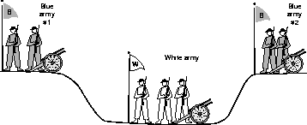
Two-Army Problem

Slide 27
TCP: Closing Connection (revised)
client
server
Two Army Problem!
client
closing
FIN
Step 5: client receives FIN, replies with ACK.
  Enters “timed wait” - will respond with ACK to received FINs
half
closed
ACK
half
closed
server
closing
FIN
Step 6: server, receives ACK. connection fully closed
ACK
X
FIN
timeout
timed wait
Step 7: client, timer expires, connection fully closed
ACK
full
closed
full closed
Notes:
While the server can delete the state soon after receiver the ACK for its FIN, the client has to wait for a while before clearing the connection state. Why?
The reason for this is that while the client has sent an ACK in response to server’s FIN segment, it does not know that the ACK was successfully delivered. As a consequence, the other side might retransmit its FIN segment, and this second FIN segment might be delayed in the network.
If the connection were allowed to move directly to the CLOSED state, then another pair of application processes may open the same connection (i.e., use the same pair of port numbers and sequence numbers), and the delayed FIN segment from the earlier incarnation of the connection would immediately initiate the termination of the later incarnation of that connection.

Slide 28
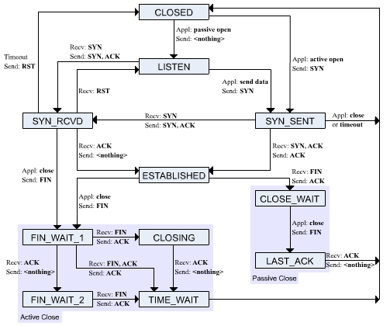
TCP Full State Machine

Slide 29

TCP Connection Management FSM
TCP client lifecycle
TCP client
lifecycle
Notes:
This shows the life cycle of a connection from the client side. You can see how connection is established after sending SYN and receiving SYN-ACK. Also, how the connection enters CLOSED state after sending and receiving FINs and ACKs. We have already explained why we need to have TIME_WAIT state. This waiting period depends on implementation and it could be 120 seconds instead of 30 seconds.

Slide 30

TCP Connection Management FSM
TCP server lifecycle
TCP server
lifecycle
Notes:
On the server side, the connection is ESTABLISHED after receiving a SYN and another ACK for SYN-ACK segment. Then connection moves to CLOSED state after receiving a FIN and an ACK for the FIN segment sent.
How come no TIME_WAIT state on the server side. Once the server receives the LAST ACK, it can safely close the connection. It is not expecting any more segments from the client side. Also even if there are any delayed duplicate ACKs in the network, they wouldn’t do any harm to a later incarnation of the connection.

Slide 31
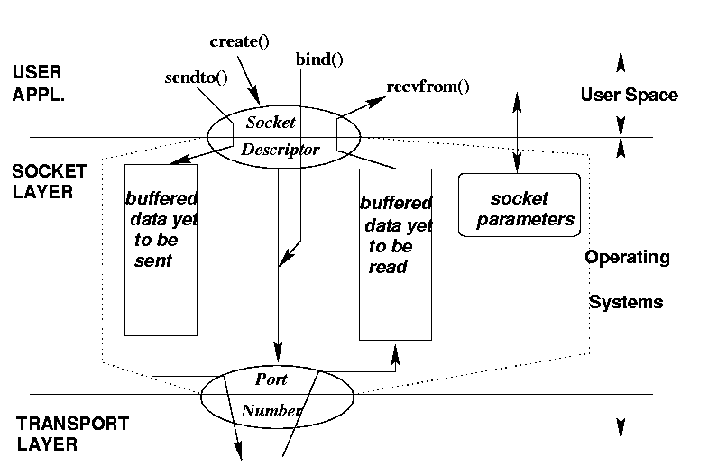
Socket: Conceptual View
socket()

Slide 32
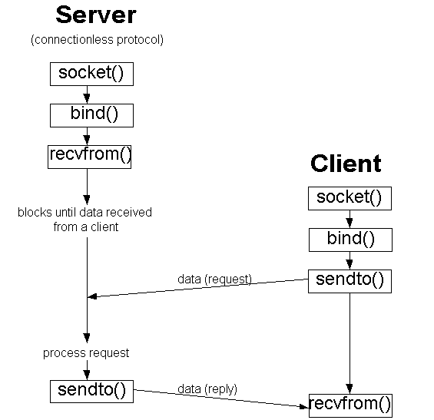
BSD Socket Programming (connectionless)

Slide 33
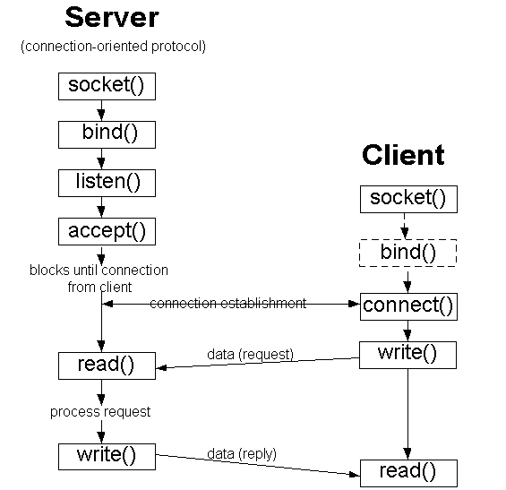
BSD Socket Programming Flows (connection-oriented)

Slide 34
Transport Layer: Part I Summary
Transport Layer Services
  Issues to address
  Multiplexing and Demultiplexing
  Connectionless vs. Connection-Oriented
UDP: Unreliable, Connectionless
TCP: Reliable, Connection-Oriented
  Packet (“Segment”) Format: Sequence #, ACK, flags, …
  A “Simple Reliable Data Transfer Protocol”
  Connection Management: 3-way handshake, closing connection
Preview of Part II:
  more efficient reliable data transfer protocols
  round-trip time estimation and flow/congestion control

