Slide 1
Software Requirements
Specification

Slide 2
Software Requirements Specification: A Contract Document
Requirements document is a reference document.
SRS document is a contract between the development team and the customer.
  Once the SRS document is approved by the customer,
    any subsequent controversies are settled by referring the SRS document.

Slide 3
SW Requirements Specification
Purpose of SRS
  Interface (communication) between the Customer, Analyst, designers, system developers, testers, maintainers, ...
  agreement between Purchaser and Supplier
  firm foundation for the design phase
  support system testing activities
  support project management activities
  controlling the evolution of overall system

Slide 4
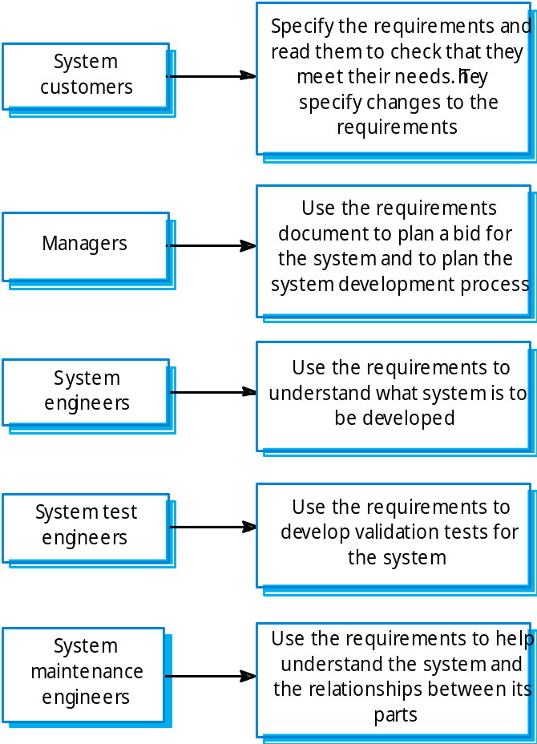
Users of a requirements document

Slide 5
Example- ATM stakeholders
Bank customers
Bank managers
Counter staff
Database administrators
Security managers
Marketing department
Hardware and software maintenance engineers
Banking regulators
Representatives of other banks

Slide 6
Problems of requirements analysis
Stakeholders don’t know exactly, that what they really want.
Stakeholders express requirements in their own terms.
Different stakeholders may have conflicting requirements.
Organisational and political factors may influence the system requirements.
The requirements may change during the analysis process. New stakeholders may emerge and the business environment can also change.

Slide 7
SRS Document (CONT.)
The SRS document is known as black-box specification:
  the system is considered as a black box whose internal details are not known.
  only its (system’s) visible external (i.e. input/output) behaviour is documented.
Input Data
S
Output Data

Slide 8
SRS Document (CONT.)
SRS document concentrates on:
  what needs to be done
  carefully avoids the solution (“how to do”) aspects.
The SRS document serves as a contract
  between development team and the customer.
  Should be carefully written

Slide 9
SRS Document (CONT.)
The requirements at the first stage:
  written using end-user terminology.
  later a formal requirement specification may be developed from it.

Slide 10
Software Requirements Specification (SRS)
Defines the customer’s requirements in terms of :
  Functional (all required functions)
  Non functional:
  Performance (efficiency, load etc.)
  External interfaces
  Design constraints
The SRS is the basis of bonding between the purchaser and supplier

Slide 11
Specification Principles
Separates functionality from implementation
Develops model of desired behavior of the system
Define the environment in which system operates
Specifications must be open to incompleteness
Content & structure of a specifications should be open to change

Slide 12
What is not included in an SRS ?
Project requirements
  cost, delivery schedules, staffing, reporting procedures (All are included in a separate contract document and not in SRS)
Design solutions
  partitioning of SW into modules, choosing data structures
Product assurance plans
  Quality Assurance procedures, Configuration Management procedures, Verification & Validation procedures

Slide 13
Benefits of SRS
Forces the users to consider their specific requirements carefully.
Enhances communication between the Purchaser and System developers.
Provides a firm foundation for the system design phase.
Enables planning of validation, verification, and acceptance procedures.
Enables project planning e.g. estimates of cost and time, resource scheduling (Feasibility, SPM activity)
Usable till/during maintenance phase

Slide 14
Types of Requirements
Functional requirements
Non functional requirements
  Performance requirements
  Interface requirements
  Design constraints
  Other requirements

Slide 15
Functional Requirements
Transformations (inputs, processing, outputs)
Requirements for sequencing and parallelism (dynamic requirements)
Data
  Inputs and Outputs
  Stored data
Exception handling
Nature of function: Mandatory/ Desirable/ Optional

Slide 16
Performance Requirements
Capacity
  no. of simultaneous users, processing requirements for normal and peak loads, storage capacity, spare capacity. (e.g. bandwidth, os etc) (scalability)
Response time,
System priorities for users (e.g. administrator or simple user)
System efficiency,
Availability and Fault recovery,
Best case, average case and worst case analysis,
Dead lines / maximum limits
E.g. ATM, Defense applications, Medical applications, any web based application and RTS etc.
All these requirements should be stated in measurable terms so that they can be verified.

Slide 17
External Interface Requirements
User interfaces
  E.g. if display terminal used, specify required screen formats, menus, report layouts, function keys
Hardware interfaces
  characteristics of the interface between the SW product and HW components of the system
Software interfaces
  specify the use (connectivity) of other SW products eg. OS, DBMS, other SW packages

Slide 18
Design Constraints
SW design constraints
  standards for design, coding, naming, etc.
  SW interfaces (to OS, DBMS, other SW)
  use a specific application package
  constraints on program size, data size etc.
HW design constraints
  specific type of HW, reliability requirements
  HW interfaces
  requirements for spare capacity or spare performance

Slide 19
Design Constraints (contd..)
User-interface design constraints
  features of operator/user with details of working environment
  any special features required

Slide 20
Other Requirements
Security requirements
Safety requirements
Environmental aspects
Reusability
Training
...

Slide 21
SRS Standards
ANSI/IEEE SRS Standard 830-1984
BS 6719: 1986
European Space Agency Standards
(ESA PSS-05-0, Jan 1987)
US DoD-Std-7935A
...

Slide 22
SRS Prototype Outline
Introduction
General description
Specific Requirements
Appendices
Index

Slide 23
SRS Prototype Outline…
[ IEEE SRS Standard ]
1. Introduction
1.1 Purpose
1.2 Scope
1.3 Definitions, Acronyms and Abbreviations
1.4 References
1.5 Overview

Slide 24
SRS - Introduction Section
Purpose
  define the purpose of the particular SRS
  specify the intended audience for the SRS
Scope
  identify the SW products to be produced by name
  explain what the SW product will do, and if necessary, what it will not do
  describe the application of the SW being specified. ie. benefits, objectives, goals as precisely as possible
Overview
  describe what the rest of the SRS contains
  how the SRS is organized

Slide 25
SRS Prototype Outline…
[ IEEE SRS Standard ]
2. General description
2.1 Product perspective
2.2 Product function summary
2.3 User characteristics
2.4 General constraints
2.5 Any Assumptions and dependencies

Slide 26
Product Perspective
State whether the product is independent and totally self contained, or
If the product is component of a larger system then:
  describe the functions of each component of the larger system and identify interfaces
  overview of the principal external interfaces of this product
  overview of HW and peripheral equipment to be used
Give a block diagram showing the major components of the product, interconnections, and external interfaces.

Slide 27
Product Functions
Provide a summary of functions the SW will perform
The functions should be organized in such a way that they are understandable by the user
User Characteristics
Describe the general characteristics of the eventual users of the product. (such as educational level, experience and technical expertise )

Slide 28
General Constraints
Regulatory policies
HW limitations
Interfaces to other applications
Parallel operation
Audit functions
Control functions
Criticality of the application
Safety and security considerations

Slide 29
SRS Prototype Outline…
[ IEEE SRS Standard ]
3. Specific Requirements
- Functional requirements
- External interface requirements
- Performance requirements
- Design constraints
- Attributes eg. security, availability, maintainability.
- Other requirements
Appendices
Index

Slide 30
Functional Requirements
Introduction
  describe purpose of the function and the approaches and techniques employed
Inputs and Outputs
  sources of inputs and destination of outputs
  quantities, units of measure, ranges of valid inputs and outputs
  timing

Slide 31
Functional Requirements
Processing
  validation of input data
  exact sequence of operations
  responses to abnormal situations
  any methods (eg. equations, algorithms) to be used to transform inputs to outputs

Slide 32
External Interface Requirements
User interfaces,
Hardware interfaces,
Software interfaces,
Communications/interfaces between software and hardware
Other requirements
  database: frequency of use, accessing capabilities, static and dynamic organization, retention requirements for data
  operations: periods of interactive and unattended operations, backup, recovery operations
  site adaptation requirements

Slide 33
Performance Requirements
Capacity
  no. of simultaneous users, processing requirements for normal and peak loads, storage capacity, spare capacity. (e.g. bandwidth, os etc) (scalability)
Response time,
System priorities for users (e.g. administrator or simple user)
System efficiency,
Availability and Fault recovery,
Best case, average case and worst case analysis,
Dead lines / maximum limits
E.g. ATM, Defense applications, Medical applications, any web based application and RTS etc.
All these requirements should be stated in measurable terms so that they can be verified.

Slide 34
Appendices
Not always necessary
It may include:
  sample I/O formats
  DFD, ERD documents
  results of user surveys, cost analysis studies
  supporting documents to help readers of SRS

Slide 35
Characteristics of a Good SRS
Unambiguous
Complete
Verifiable
Consistent
Modifiable
Traceable
Usable till/during the Operation and Maintenance phase

Slide 36
Examples of Bad SRS Documents
Unstructured Specifications:
  Narrative essay --- one of the worst types of specification document:
    Difficult to change,
    difficult to be precise,
    scope for contradictions, etc.

Slide 37
Examples of Bad SRS Documents…
Noise:
  Presence of text containing information irrelevant to the problem. (less imp things are given more emphasis)
Silence:
  aspects important to proper solution of the problem are omitted. (important things are not properly covered)

Slide 38
Examples of Bad SRS Documents…
Overspecification:
  Addressing “how to” aspects
  For example, “Library member names should be stored in a sorted descending order”
  Overspecification restricts the solution space for the designer.
Contradictions:
  Contradictions might arise
    if the same thing described at several places in different ways.

Slide 39
Examples of Bad SRS Documents
Ambiguity:
  Literary expressions
  Unquantifiable aspects, e.g. “good user interface”
Forward References:
  References to aspects of problem
    defined only later on in the text.
Wishful Thinking:
  Descriptions of aspects
    for which realistic solutions will be hard to find.

Slide 40
Complete
All significant requirements should be included.
Definition of responses of the SW to all realizable classes of input data in all situations.
Conformity to a standard.
Full labeling and referencing of all figures, tables etc. and definition of all terms and units of measure

Slide 41
Verifiable / testable
A requirement is verifiable if and only if there exists some finite cost effective process with which a person or machine can check that the SW meets the requirement.

Slide 42
Modifiable
Structure and style of SRS is such that changes to requirements can be made easily, completely and consistently.
  SRS organisation -- table of contents, index, explicit cross-referencing
  no redundancy
Consistent
No two requirements are in conflict

Slide 43
Traceable
An SRS is traceable if the origin of each requirement is clear and it facilitates the referencing of each requirement in future.
Backward traceability
  requirement explicitly referencing its source in previous documents
Forward traceability
  each requirement has a unique name or reference number and it can be traced to design documents, program implementation.

Slide 44
SRS Review
Formal Review done by Users, Developers, Managers, Operations personnel
To verify that SRS confirms to the actual user requirements
To detect defects early and correct them.
Review typically done using checklists.

Slide 45
Sample SRS Checklist
Are all HW resources defined ?
Have response times been specfied for functions ?
Have all the HW, external SW and data interfaces been defined ?
Is each requirement testable ?
Is the initial state of the system defined ?
Are the responses to exceptional conditions specified ?
Are possible future modifications specified ?

