Slide 1

Introduction to UML
Notes:
Introduce myself

Slide 2
Modeling
Describing a system at a high level of abstraction
  A model of the system (drawings)
  Used for requirements specifications
It is necessary to model software systems?
Notes:
1.
Describing the system at abstract level to comprehend its complexity
2.
Necessary to manage complexity
Good for quick understanding of the systems
Less chances of conflicting views b/w end-user and system designers

Slide 3
Why do we model?
Provide structure for problem solving
Experiment to explore multiple solutions
Furnish abstractions to manage complexity
Reduce time-to-market for business problem solutions
Decrease development costs
Manage the risk of mistakes
Software Engineering

Slide 4
What is UML?
UML stands for “Unified Modeling Language”
It is an industry-standard graphical language for specifying, visualizing, constructing, and documenting the artifacts of software systems
The UML uses mostly graphical notations to express the OO analysis and design of software projects.
Simplifies the complex process of software design
Notes:
. What does UML stand for?
. Industry standard
. Graphical notation
. Modeling tool … simplifies software design process

Slide 5
What is UML?
The UML is a graphical language for
  specifying
  visualizing
  constructing
  documenting
the artifacts of software systems
Added to the list of OMG (object management group) adopted technologies in November 1997 as UML 1.1 (Current Version is 2.5 -- http://www.uml.org/ )
To end the OO method wars
  Lack of standardization
Has become the formal and de facto industry standard (accepted by all)
Software Engineering

Slide 6
Why UML for Modeling
Use graphical notation to communicate more clearly than natural language (inaccurate) and code (too detailed).
Help acquire an overall view of a system.
UML is not dependent on any programming language or technology.
Notes:
. More precise than natural language … less detailed than source code
. Not dependent on any language
. Standardized by various groups

Slide 7
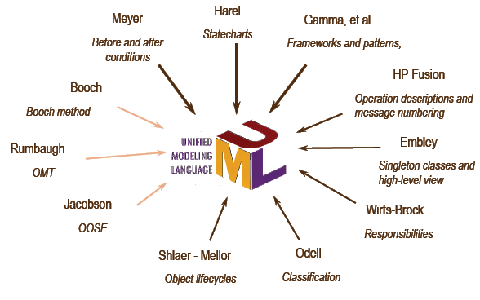
UML is ... unified
Software Engineering

Slide 8
Parts of UML
  Views - shows different aspects of the system that are modeled, links the modeling language to the method/process chosen for development
  Diagrams - graphs that describe the contents in a view
  Model elements - concepts used in a diagram
Software Engineering

Slide 9
Views in UML
Use Case
View
Use-case view : A view showing the functionality of the system as perceived by the external actors
Software Engineering

Slide 10
Views in UML
Structural
View
Use Case
View
Structural view: A view showing how the basic structure of the system is designed.
Software Engineering

Slide 11
Views in UML
Structural
View
Component
View
Use Case
View
Component view: A view showing the organization of the core components
Software Engineering

Slide 12
Views in UML
Structural
View
Component
View
Use Case
View
Behavioral
View
Behavioral view: A view showing the overall behavior of the system
Software Engineering

Slide 13
Views in UML
Structural
View
Component
View
Use Case
View
Deployment
View
Behavioral
View
Deployment view: A view showing the deployment of the system in terms of the physical architecture
Software Engineering

Slide 14
Introduction to UML…
Model elements (artifacts):
  Class
  Object
  State
  Use case
  Interface
  Association
  Link
  Package ….
Software Engineering

Slide 15
UML defines the notation and semantics for the following domains:
-The User Interaction or Use Case Model - describes the boundary and interaction between the system and users. Corresponds in some respects to a requirements model.
-The Interaction or Communication Model - describes how objects in the system will interact with each other to get work done.
-The State or Dynamic Model - State charts describe the states or conditions that classes assume over time. Activity graphs describe the workflows the system.
-The Structural or Class Model - describes the classes and objects that will make up the system.
-The Component Model - describes the software (and sometimes hardware components) that make up the system.
-The Physical Deployment Model - describes the physical architecture and the deployment of components on that hardware architecture.

Slide 16
Model and Views of UML
Implementation
View
Class Diagram
Object Diagram
Component
Diagrams
Structural
View
User View
Use Case Diagrams
Sequence Diagram
Collaboration Diagram
State-chart Diagram
Activity Diagram
Deployment
Diagram
Behavioral
View
Environment
View

Slide 17
UML diagrams
Use Case diagram: External interaction with actors
Class/Object Diagram : captures static structural aspects, objects and relationships.
State-chart Diagram: Dynamic state behavior
Sequence diagram: models object interaction over time
Collaboration diagram: models component interaction and structural dependencies
Software Engineering

Slide 18
More UML diagrams
Activity diagram : models object workflow of activities
Deployment diagram : models physical architecture
Component diagram : models software architecture
Software Engineering

Slide 19
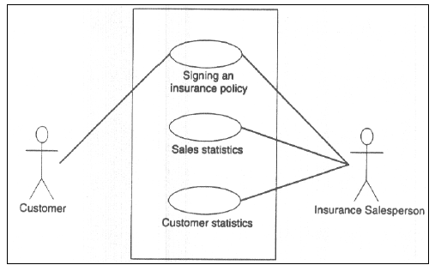
Use-Case Diagram
(e.g. insurance system)
Software Engineering

Slide 20
Use Case Diagram
Used for describing a set of user scenarios
Mainly used for capturing user requirements
Work like a contract between end user and software developers

Slide 21
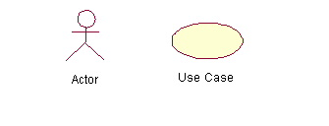
Use Case Diagram (core components)
Actors: A role that a user plays with respect to the system, including human users and other systems. e.g. physical objects (e.g. robot); an external system that needs some information from the current system.
Use case: A set of scenarios that describing an interaction between a user and a system, including alternatives.
System boundary: rectangle diagram representing the boundary between the actors and the system.

Slide 22
Use Case Diagram (core relationship)
Association: communication between an actor and a use case; Represented by a solid line.
Generalization: relationship between one general use case and a special use case (used for defining special alternatives)
Represented by a line with a triangular arrow head toward the parent use case.

Slide 23
Use Case Diagram (core relationship)
Include: a dotted line labeled <<include>> beginning at base use case and ending with an arrows pointing to the include use case. The include relationship occurs when a chunk of behavior is similar across more than one use case. Use “include” in stead of copying the description of that behavior.
<<include>>
Extend: a dotted line labeled <<extend>> with an arrow toward the base case. The extending use case may add behavior to the base use case if required. The base class declares “extension points” and is optional.
<<extend>>

Slide 24
Use Case Diagrams
Use Case
Boundary
Actor
Library System
Borrow
Employee
Student
Order Title
Fine Remittance
Librarian
A generalized description of how a system will be used.
Provides an overview of the intended functionality of the system

Slide 25
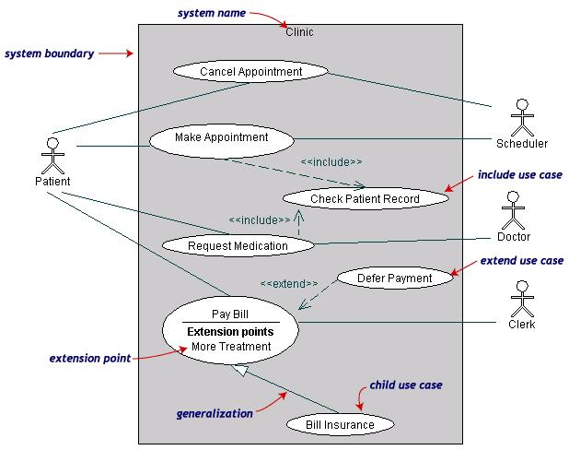
Use Case Diagrams(cont.)
(clinic mgt system)

Slide 26
Use Case Diagrams (cont.)
Pay Bill is a parent use case and Bill Insurance is the child use case. (generalization)
Both Make Appointment and Request Medication include Check Patient Record as a subtask (include)
The extension point is written inside the base case
Pay bill; the extending class Defer payment adds the behavior of this extension point. (extend)

Slide 27
Class diagram
Used for describing structure and behavior in the use cases
Provide a conceptual model of the system in terms of entities and their relationships
Used for requirement capture, end-user interaction
Detailed class diagrams are used for developers

Slide 28
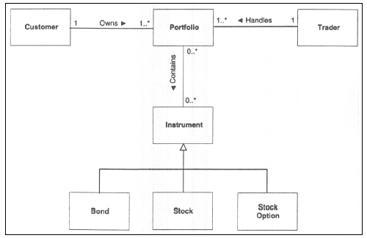
Conceptual Class Diagram
Software Engineering

Slide 29
UML Class Diagram
Multiplicity
Customer
1
Simple
Aggregation
Class
Class name
Rental Invoice
Rental Item
1..*
1
0..1
Composition
(Dependency)
Simple
Association
Generalization
Checkout Screen
DVD Movie
VHS Movie
Video Game
Notes:
This class diagram shows examples of associations, aggregations, and generalizations. All of these topics are discussed in greater detail on later slides.
In general, associations describe the relationships between classes or objects. They start as simple connectors, to show that some relationship exists. As design progress (and often during development), the natures of the relationships become clearer, and the associations are modified to reflect the new knowledge. For example, direction (not shown above, but discussed later) and cardinality are usually added later in design. The diagram above shows that each Rental Contract is associated with exactly one Checkout Screen, whereas a Checkout Screen may be associated with zero or one Rental Contracts. Likewise, a business rule states that a customer may rent no more than six items per visit, so that cardinality is shown.
The diagram above shows a generalization relationship between several kinds of objects. Generalization means essentially the same thing in a class diagram that it does in a use case diagram. Here, the specializations (DVD Movie, VHS Movie, and N64 Game) of Rentable Item are fully consistent with Rentable Item and may be used wherever Rentable Item is allowed. Notice also that Rentable Item is {abstract}. This means that objects cannot be created from it, because one or more of its methods is not implemented. Abstract objects must be specialized. It is not necessary for a general object to be abstract; this is done (most commonly) when the general object serves to define an interface, and the specializations provide the meaningful implementation. Here, Rentable Item may not know how to calculate the rental fee -- each specialization is required to do that.
What is a Class Diagram?

Slide 30
Class representation
Each class is represented by a rectangle subdivided into three compartments
  Name
  Attributes
  Operations
Modifiers are used to indicate visibility of attributes and operations.
  ‘+’ is used to denote Public visibility (everyone)
  ‘#’ is used to denote Protected visibility (friends and derived)
  ‘-’ is used to denote Private visibility (no one)
By default, attributes are hidden and operations are visible.

Slide 31
An example of Class
Name
Account_Name
- Customer_Name
- Balance
Attributes
+addFunds( )
+withDraw( )
+transfer( )
Operations

Slide 32
UML First Pass: Class Diagrams
Class
Multiplicity
Association
SimpleWatch
1
1
1
1
2
1
2
1
PushButton
state
push()
release()
LCDDisplay
Battery
load()
Time
now()
blinkIdx
blinkSeconds()
blinkMinutes()
blinkHours()
stopBlinking()
referesh()
Attributes
Operations
Class diagrams represent the structure of the system

Slide 33
OO Relationships
There are two kinds of Relationships
  Generalization (parent-child relationship)
  Association ()
Associations can be further classified as
  Aggregation
  Composition

Slide 34
OO Relationships: Generalization
Supertype
Example:
Customer
Regular
Customer
Loyalty
Customer
Subtype1
Subtype2
or:
Customer
- Generalization expresses a parent/child relationship among related classes.
- Used for abstracting details in several layers
Regular
Customer
Loyalty
Customer

Slide 35
OO Relationships: Association
Represent relationship between instances of classes
  Student enrolls in a course
  Courses have students
  Courses have exams
  Etc.
Association has two ends
  Role names (e.g. enrolls)
  Multiplicity (e.g. One course can have many students)
  Navigability (unidirectional, bidirectional)

Slide 36
Association: Multiplicity and Roles
student
1
*
University
Person
0..1
*
employer
teacher
Role
Multiplicity
Symbol Meaning
1 One and only one
0..1 Zero or one
M..N From M to N (natural language)
* From zero to any positive integer
0..* From zero to any positive integer
1..* From one to any positive integer
Role
“A given university groups many people; some act as students, others as teachers. A given student belongs to a single university; a given teacher may or may not be working for the university at a particular time.”

Slide 37
Association is a relationship where all objects have their own lifecycle and there is no owner.
An example is of Teacher and Student. Multiple students can associate with single teacher and single student can associate with multiple teachers, but there is no ownership between the objects and both have their own lifecycle. Both can create and delete independently

Slide 38
OO Relationships: Aggregation
Container Class
Class C
Aggregation: expresses a relationship among instances
of related classes. It is a specific kind of Container-Containee
relationship.
“is-part-of” “has –a”
It expresses a relationship where an instance of the
Container-class has the responsibility to hold and maintain
instances of each Containee-class that have been created
outside the auspices of the Container-class.
Aggregation should be used to express a more informal
relationship than composition expresses. That is, it is an
appropriate relationship where the Container and its
Containees can be manipulated independently.
Aggregation is appropriate when Container and Containees have no special access privileges to each other.
AGGREGATION
Class E₁
Class E₂
Containee Classes
Example
Bag
Apples
Bananas

Slide 39
Aggregation can occur when a class is a collection or container of other classes, but the contained classes do not have a strong lifecycle dependency on the container.
The contents of the container are not automatically destroyed when the container is destroyed.

Slide 40
OO Relationships: Composition
Composition: expresses a relationship among instances
of related classes. It is a specific kind of Whole-Part
relationship.
It expresses a relationship where an instance of the
Whole-class has the responsibility to create and initialize
instances of each Part-class.
It may also be used to express a relationship where instances
of the Part-classes have privileged access or visibility to
certain attributes and/or behaviors defined by the
Whole-class.
Composition should also be used to express relationship where
instances of the Whole-class have exclusive access to and
control of instances of the Part-classes.
Composition should be used to express a relationship where
the behavior of Part instances is undefined without being
related to an instance of the Whole. And, conversely, the
behavior of the Whole is ill-defined or incomplete if one or
more of the Part instances are undefined.
Whole Class
Class W
Class P₁
Class P₂
Part Classes
Example
Automobile
Engine
Transmission

Slide 41
Composition is a specialised form of Aggregation and we can call this as a “death” relationship.
It is a strong type of Aggregation. Child object does not have its lifecycle and if parent object is deleted, all child objects will also be deleted.
An example of relationship between House and Rooms. House can contain multiple rooms - there is no independent life of room and any room can not belong to two different houses. If we delete the house - room will automatically be deleted.
Another example relationship between Questions and Options. Single questions can have multiple options and If we delete questions, options will automatically be deleted.

Slide 42
Aggregation vs. Composition
  Composition is really a strong form of aggregation (strong bonding)
    components have only one owner
    components cannot exist independent of their owner
    components live or die with their owner
    e.g. Each car has an engine that can not be shared with other cars.
  Aggregations may form "part of" or ‘uses’ the aggregate, but may not be essential to it. They may also exist independent of the aggregate.
  e.g. Apples may exist independent of the bag. (loose bonding)

Slide 43
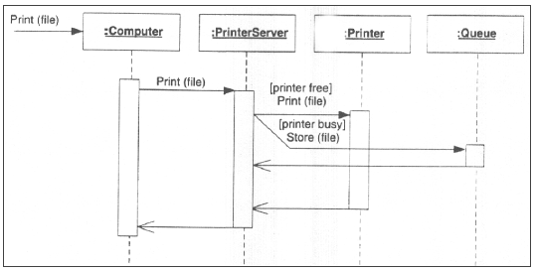
Sequence Diagram
Software Engineering

Slide 44
Sequence Diagram (make a phone call)
Caller
Phone
Recipient
Picks up
Dial tone
Dial
Ring notification
Ring
Picks up
Hello

Slide 45
Sequence Diagram
Object
:WatchUser
:SimpleWatch
:LCDDisplay
:Time
pressButton1()
blinkHours()
pressButton1()
blinkMinutes()
pressButton2()
incrementMinutes()
refresh()
pressButtons1And2()
commitNewTime()
stopBlinking()
Message
Activation
Sequence diagrams represent the behavior as interactions

Slide 46
Sequence Diagrams – Object Life Spans
Creation
  Create message
  Object life starts at that point
Activation
  Symbolized by rectangular stripes
  Place on the lifeline where object is activated.
  Rectangle also denotes when object is deactivated.
Deletion
  Placing an ‘X’ on lifeline
  Object’s life ends at that point
A
Create
B
Activation bar
X
Return
Deletion
Lifeline

Slide 47
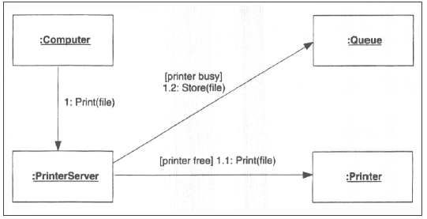
Collaboration Diagram
Software Engineering

Slide 48
State Diagrams
(Billing Example)
State Diagrams show the sequences of states an object goes through during its life cycle in response to stimuli, together with its responses and actions; an abstraction of all possible behaviors.
Start
End
Unpaid
Paid
Invoice created
paying
Invoice destroying

Slide 49
State Diagrams
(Traffic light example)
Traffic Light
Start
State
Red
Transition
Yellow timer expires
Car trips sensor
Yellow
Green timer expires
Green
Event

Slide 50
Statechart Diagrams (digital watch)
State
Event
Initial state
button1&2Pressed
button2Pressed
Blink
Increment
Hours
Hours
Transition
button1Pressed
button1&2Pressed
Blink
button2Pressed
Increment
Minutes
Minutes
button1Pressed
button2Pressed
Stop
Blink
Increment
Blinking
Seconds
Seconds
Final state
button1&2Pressed

