Slide 1

Malviya National Institute of Technology Jaipur
Topic: Learning for Quality Inspection of Different Sugarcane Varieties
Submitted to:
Ashish Kumar TrIPATHI
Submitted BY:
ASHUTOSH SONI

Slide 2
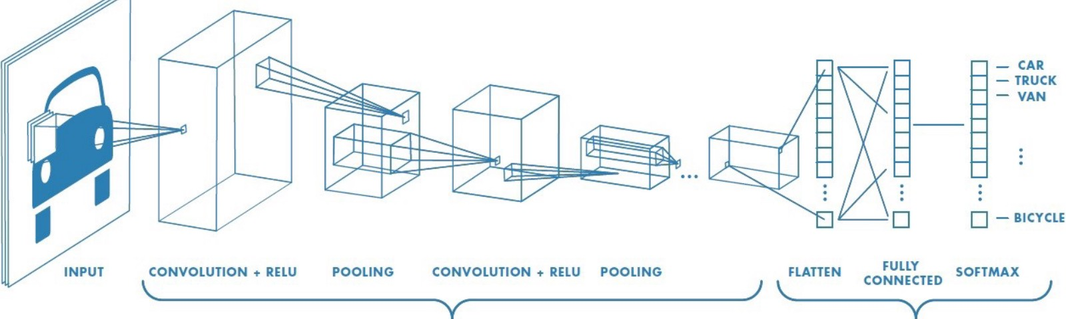
Convolutional Neural Network
A Convolutional Neural Network (ConvNet/CNN) is a Deep Learning algorithm which can take in an input image, assign importance (learnable weights and biases) to various aspects/objects in the image and be able to differentiate one from the other.

Slide 3
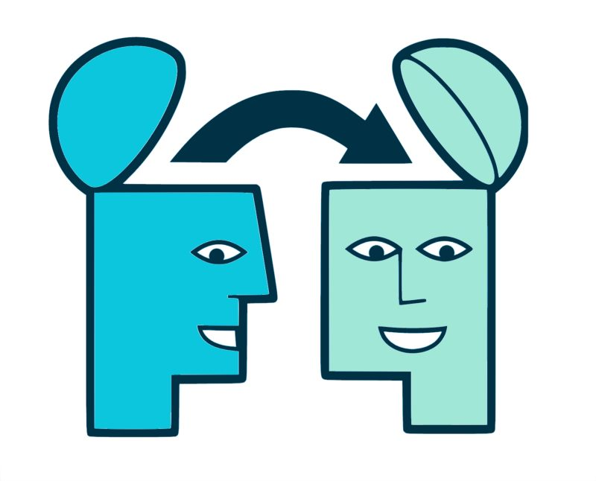
Transfer Learning
Transfer learning is a machine learning technique where a model trained on one task is re-purposed on a second related task. Transfer learning is a machine learning technique where a model trained on one task is re-purposed on a second related task.
In transfer learning, we first train a base network on a base dataset and task, and then we repurpose the learned features, or transfer them, to a second target network to be trained on a target dataset and task. This process will tend to work if the features are general, meaning suitable to both base and target tasks, instead of specific to the base task.

Slide 4
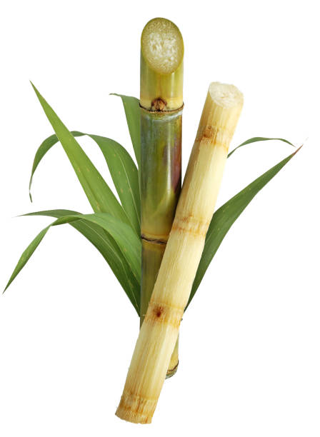
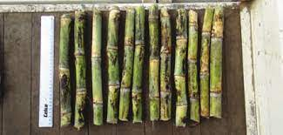
Learning for Quality Inspection of Different Sugarcane Varieties
Methods for seed cane for sugarcane
Use whole sugarcane stalks, which are harvested earlier manually or mechanically by cutting the cane slightly above grade
Sugarcane stalks
Use large chopper harvesters that serve the cane at the base and then use a series of rollers and blades to cut each stalk into shorter segments called billets.
Sugarcane billets

Slide 5
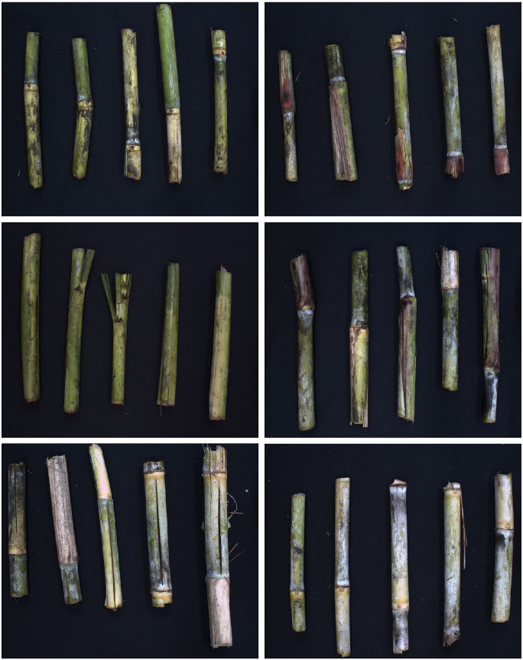
Problem with sugarcane Production
Because of
Cracked
Crushed
Two Buds (one good and one bad)
Damaged bud
Good buds
The cultivation of sugarcane is not good. Approximately farmer have to seed twice the number of billets in order to get that much amount of production.
Sometimes if billet damage is high and seed distribution is excessively variable, stand density during the growing season can be poor that the farmer may decide to plow the field as total loss.
Row 1 -> Variety HoCP 09-804: Damaged (left) Good (right)
Row 2 -> Variety HoCP 96-540: Damaged (left) Good (right)
Row 3 -> Variety L01-299: Damaged (left) Good (right)

Slide 6
Because of Above Problem
Computer Vision
Deep Learning
Came into picture
This helps in Identifying good and damaged billets so that number of good billets seeded are high and results in homogenous density as well as the number of billets need for seeding are also less and results in increase the efficiency of sugarcane cultivation
Damaged billets are send to Industries for Sugar processing or other for other task

Slide 7
Why CNN over CCV
By research we got that CNN models outperforms CCV (Classical Computer Vision) Model by large margin and if we use Transfer Learning It will give really good accuracy and good model for this purpose.
Dataset
Dataset Consisting of 3 varieties of Sugarcane
L 01-299
HoCP 09-804
HoCP 96-540
We have images of good and damaged billets of each of the above mentioned types
Link for the Dataset: https://github.com/The77Lab/SugarcaneDeepLearning

Slide 8
Comparison between different CNN Architectures and CVV Model
Models Used for Comparison
CCV (Classical computer Vision)
AlexNet
CGG-16
GoogLeNet
ResNet101
CCV method have lowest Performance whereas ResNet101 and AlexNet are the ones with the best results for different sugarcane Varieties However ResNet101 took too much processing time (around 10 to 20 times longer).
Hence AlexNet is model selected for the above task.

Slide 9
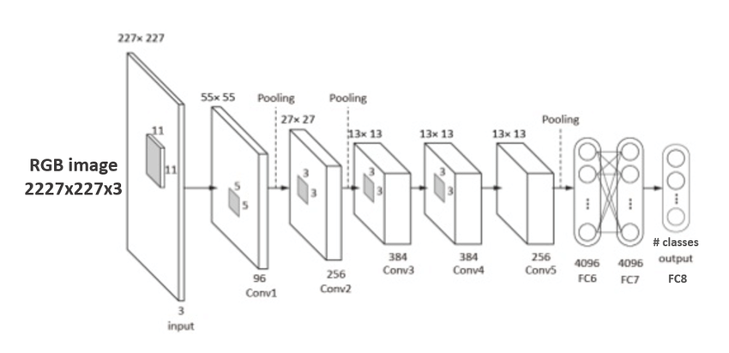
AlexNet Architecture

Slide 10
AlexNet Model: 1
Algorithm:
Step 1: Read Images from the directory for HoCP09-804 and change it to grey Image.
Step 2: Resize the image .
Step 3: Make a list of image and tag related with it for training.
Step 4: Shuffle the training dataset.
Step 5: Make X_train and y_train for training the model.
Step 6: Make the Alexnet Model as per Architecture.
Step 7: Compile the model with loss as binary cross entropy, with optimizer as adam and metrics as accuracy.
Step 8: Fit the model with choosing smart number of epochs so that model does not get overfit and make 20% data for validation.
Step 9: Read Images from the directory for left varieties of Sugarcane.
Step 10: Test the dataset from those data.
Link for the Model:
After Learning for 25 epochs, I get
Training accuracy : 91.94%
Validation accuracy: 56.79%
Testing accuracy: 61.85%

Slide 11
AlexNet Model: 2
Algorithm:
Step 1:Read the Images from directory for all varieties of sugarcane.
Step 2: Make list for all the three varieties containing the image and the category assigned to it and change the image to grey scale.
Step 3: Shuffle all the list so that training get better.
Step 4: Split all the list in proportion of 80% to 20% so that 80% will be used for training and validation whereas 20% for testing.
Step 5: Make list for training and testing by merging all the categories spitted earlier.
Step 6: Make the Alexnet Model as per Architecture.
Step 7: Compile the model with loss as binary cross entropy, with optimizer as RMSprop with learning rate of 0.001 and metrics as accuracy.
Step 8: Fit the model with choosing smart number of epochs so that model does not get overfit and make 20% data for validation.
Step 9: Test the model from test list.
After Learning for 25 epochs, with batch size of 32 I get
Training accuracy : 99.95%
Validation accuracy: 64.78%
Testing accuracy: 68.12%

Slide 12
THANKS

