Slide 1
1.
Who Returns to SYEP?
Participant, Placement, and Provider Correlates of Reapplication
Sonia Tyburczy

Slide 2

Introduction
Sonia
A bit about me:
Rising junior; math major at Baruch
Interested in evaluation methodology (how do we define whether something works/"is good" or not)

Slide 3
Project Motivation
Why it matters:
Among CB × OY survey respondents, ~42% first heard about it through having participated in a past year.
Nearly all the rest heard about it through a person a friend, a family member, program staff (~48% combined).
Reapplication rose from 55.6% in 2022 to 62.8% in 2024; 59.4% pooled across index years.
Who comes back shapes who applies next year, and who the program ends up serving.

Slide 4
Research Question
Among SYEP Older Youth Community-Based participants, what factors are associated with applying again the following year?

Slide 5
Narrowing the Question
What does "returning" mean?
Returned = reapplied the following year to any SYEP service option (not necessarily reenrolled or in the same service option)
Who are we looking at?
Older Youth, Community-Based SYEP participants, eligible to return the following year (ages 16–23 at program start)
What time frame?
2022–2024 participation→ 2023–2025 application

Slide 6
We'll cover...
Building the analysis frame
Descriptive statistics
Regression
Findings & limitations

Slide 7
Data Sourcing
1.03M → 130K
SYEP applications, 2021–2025
Frame A — administrative
130,417 person-years
1,028,110 rows × 185 columns
index years 2022–2024
SYEP surveys, 2022–2025
Frame B — survey
151,475 rows × 634 columns
5,844 participants
151K → 5.8K
pre/post matched
+ hashed-SSN → participant-ID crosswalk

Slide 8
The Identity Problem
There is no unique ID per participant, only ID per application.
Problem: Without a person key, the research question is unanswerable.
Solution: Adam generated a hashed-SSN → participant-ID crosswalk, allowing for a unique ID column to be applied.
Same problem at the worksite level. worksite_id is reassigned each cycle.
Problem: A site running every summer looks like a new site each year and would render provider clustering and any site-level variation meaningless.
Solution: Built a cross-year worksite bridge: normalize names → block to avoid all-pairs comparison → fuzzy match within block → assign a stable worksite_cluster_id.

Slide 9
Data Work — Frame A
Placeholder worksites
Many "worksites" aren't sites (NO SHOW, NOT PLACED, etc.). Classified by pattern, no-shows collapsed out of the provider structure.
Kept as participant flags: is_no_show, worksite_matched`.
Year
Built numeric year column from Cycle ("SYEP 2025").
Borough
Free-text field; people typed neighborhoods. Fuzzy-matched against an NYC neighborhood → borough reference table.

Slide 10
Data Work — Frame B
One row per person, at their first observed year
Survey record attached to each person's earliest administrative year in 2022–2025.
Year & Wave
Parsed SurveyType ("Pre 2023") it into a year and a wave, enabling matching.
Drops (8,882 → 5,844 → 4,785)
1,327 match no record in Frame A.
1,038 surveyed after their first program year.
1,059 missing provider.
Respondents are not a random sample
Return rate 69.6% vs 56.1% for non-responders.
1.2% of responders worked zero hours vs 20.0% of non-responders.
Frame B describes completers, not SYEP participants.

Slide 11
Survey Features
Instrument to variables
Hand-selected items from the pre- and post-program instruments, mapped to the research question.
One question shows up as many columns — each answer option gets its own, so a question can span 5–15.
Collapsed those back into 12 items across three blocks.
The three blocks
cf_* — what they'd have done otherwise (4 items)
expect_* — pre-program expectations (2 items) + was SYEP first choice (1 item)
benefit_* — self-reported benefits (5 items)
Non-response ≠ not selected
Skipping a whole question looks the same as checking none of the boxes.
Each block carries an _answered flag to keep those apart.

Slide 12
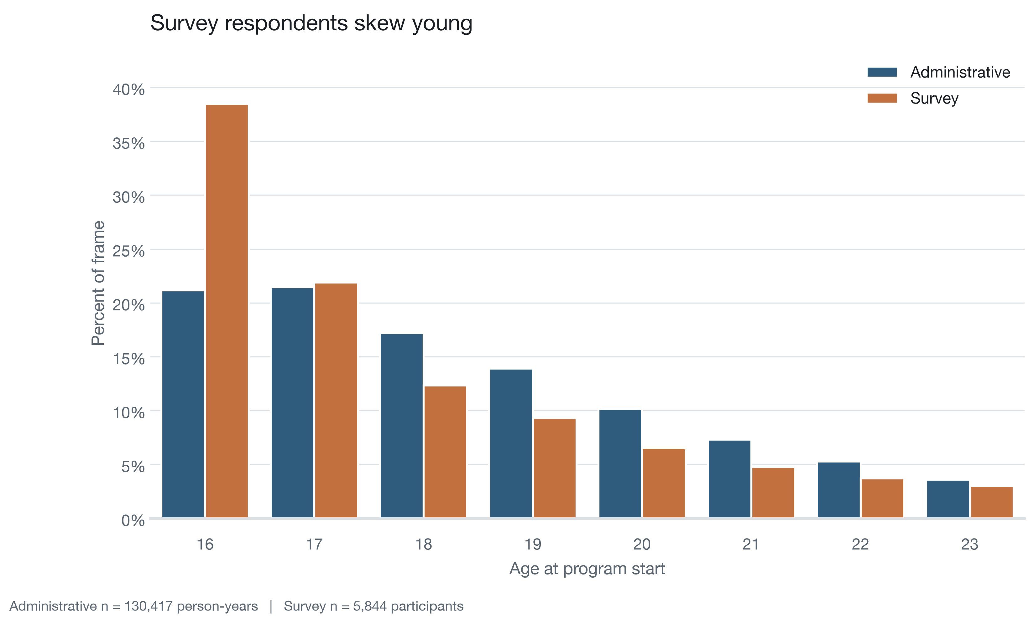

Slide 13
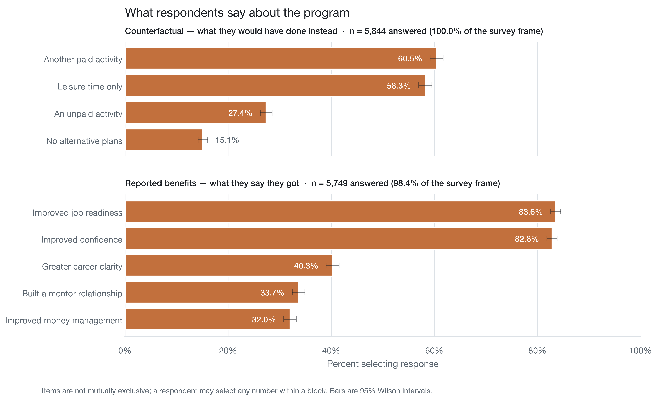

Slide 14
Logistic Regression
The setup
What we adjust for
Outcome: applied again the following year (yes / no)
Unit: one row per participant per program year, 2022–2024
Method: logistic regression
Standard errors clustered by provider — participants at the same provider aren't independent
Hours worked (6 bands)
Age (flexible curve, not a straight line)
Year, borough
No-show, worksite match
Race, gender

Slide 15
Outcome: reapplied next year
Question
Frame / model
Analytic n
01
Who comes back?
Administrative
114,625
person-years
02
Does it hold for survey respondents?
Same model,
their rows only
4,785
03
Do attitudes add anything?
+ 12 survey
items
4,785
04
Does the provider matter?
+ provider
114,625
We never pool the survey with the administrative frame.
Row three exists only because row two does.

Slide 16
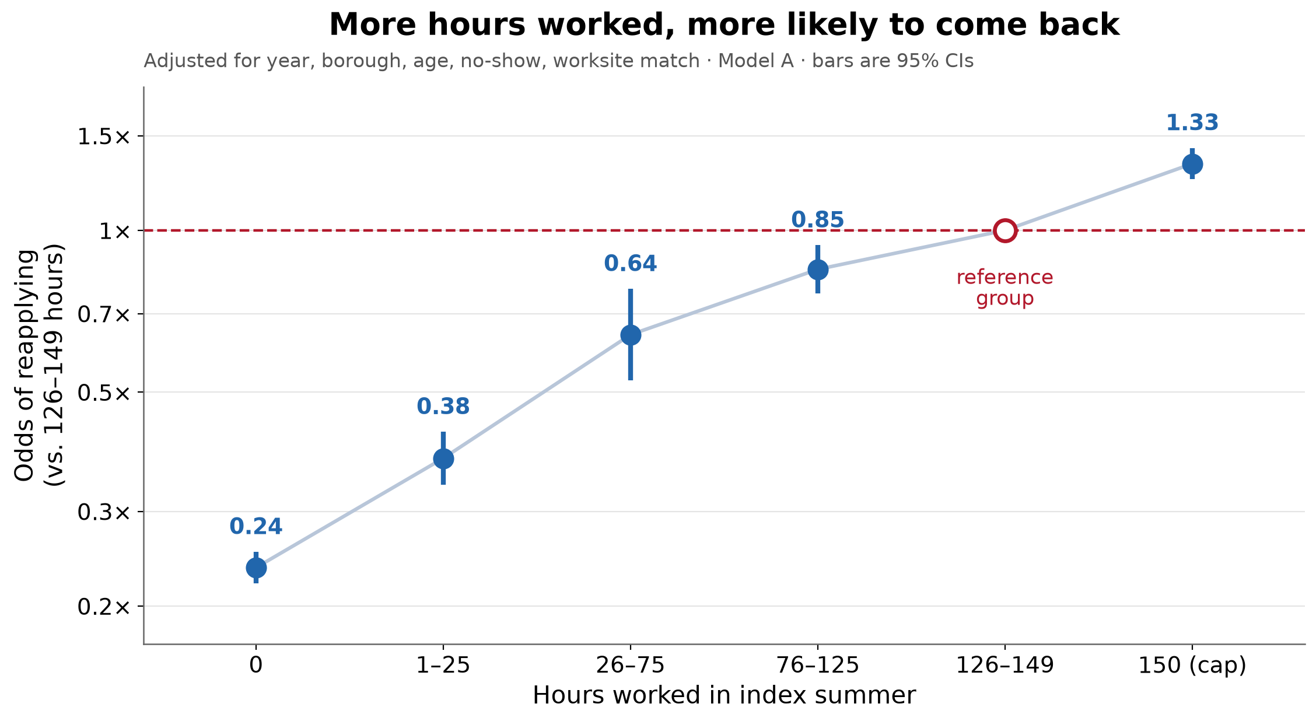

Slide 17
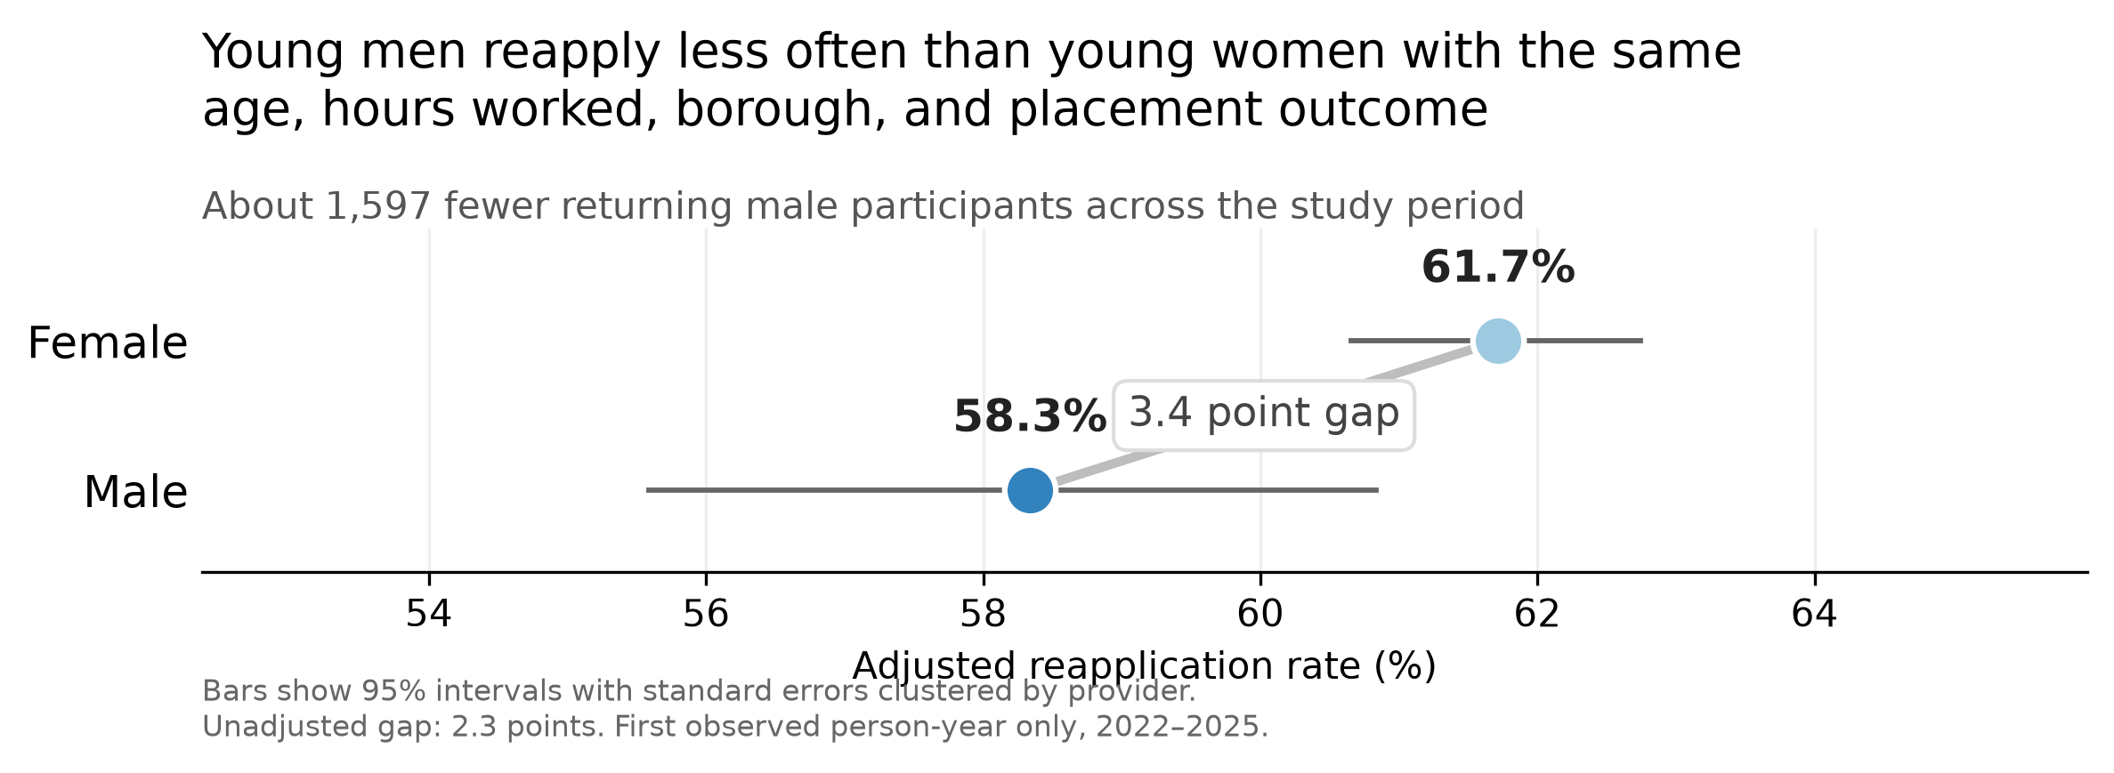

Slide 18
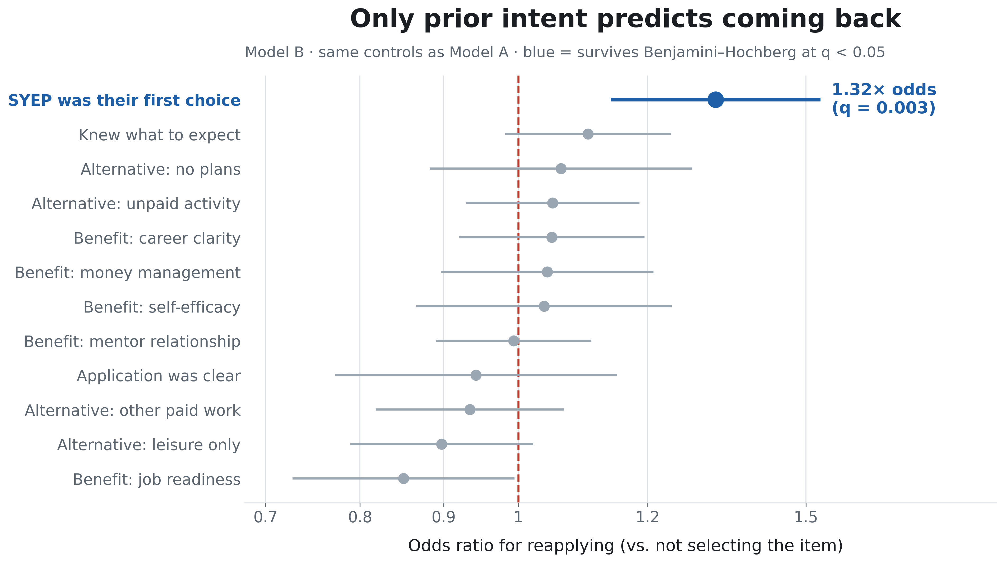

Slide 19
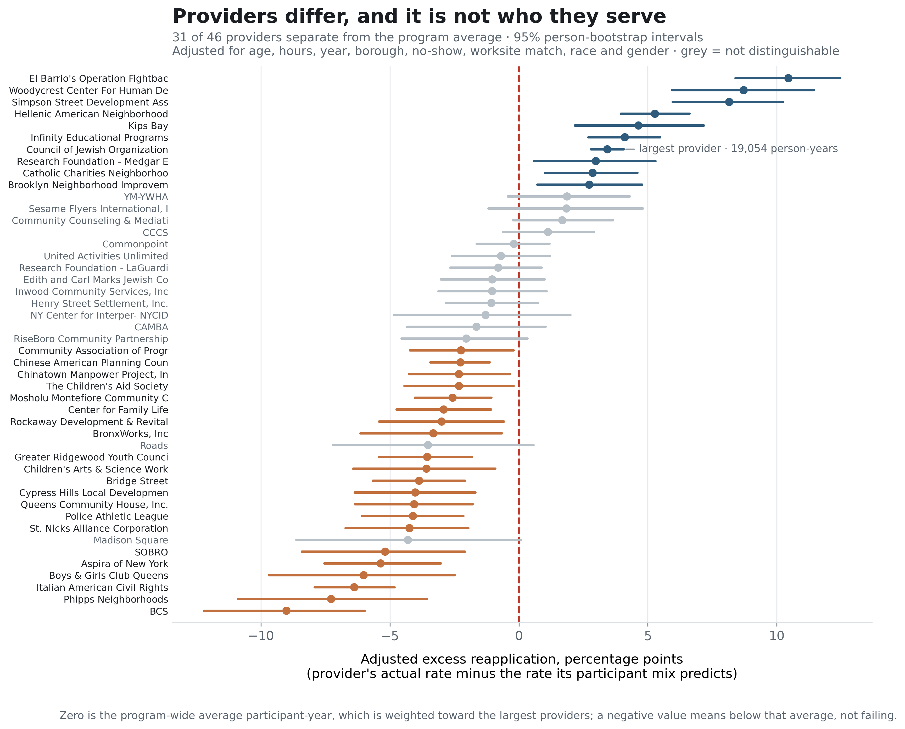

Slide 20
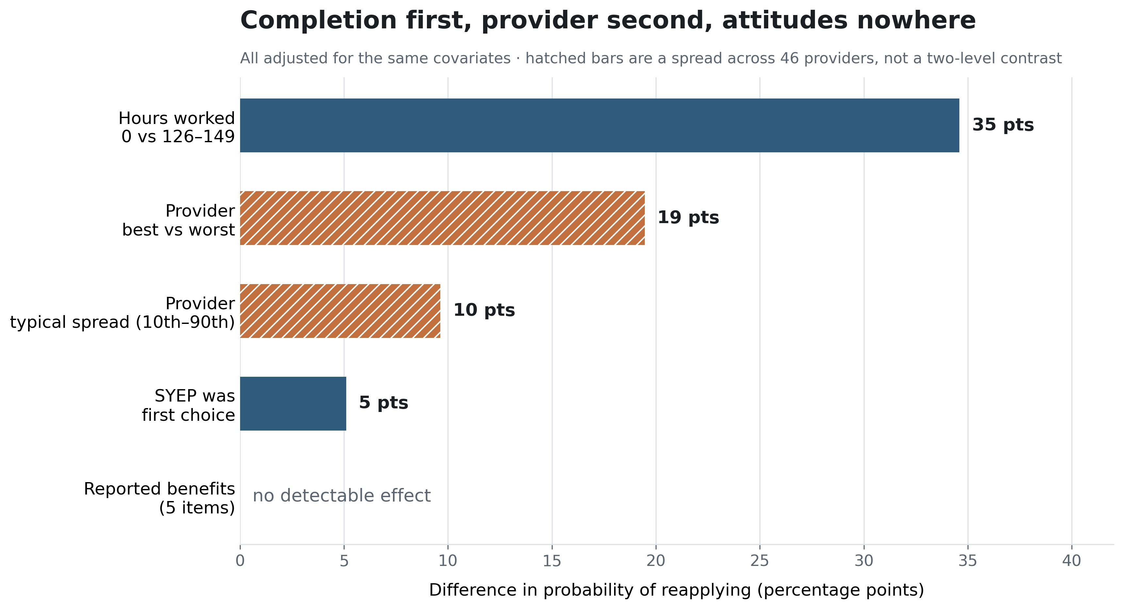

Slide 21
How much of the program a young person completed — and which provider delivered it — predict whether they come back. What they said about the experience (based on selected questions) does not.

Slide 22
Limitations & Caveats
Return is revealed demand, not demonstrated benefit.
and...
Association, not causation.
One binary item is a thin measure of intent
Where, not why — we can locate attrition early in the placement but not explain any individual's decision.
The survey describes completers.
Missingness issues — provider unrecorded for 37.8% of 2022.
Provider position is not yet shown to be stable year to year
Need people to participate — you can't find out anything about people who don't participate in SYEP.

Slide 23
What I'd do next
Look at more of the survey The design here (one row per person, first observed year) is what made most items unusable. A cross-sectional question wouldn't have that issue.
Fix two administrative fields A stable worksite ID that persists across cycles. An industry code for the specific placement, not the worksite in general.
Point it at attrition This is a model of who leaves early, and that's where it's useful (+where the recommendation holds regardless of what we consider "success" in SYEP).

