Slide 1
SQL PROJET
Music Store Data Analysis

Slide 2




Slide 3



Slide 4


Slide 5
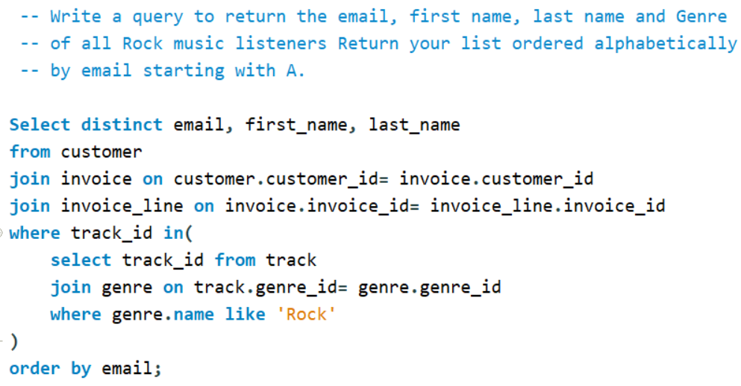

Slide 6
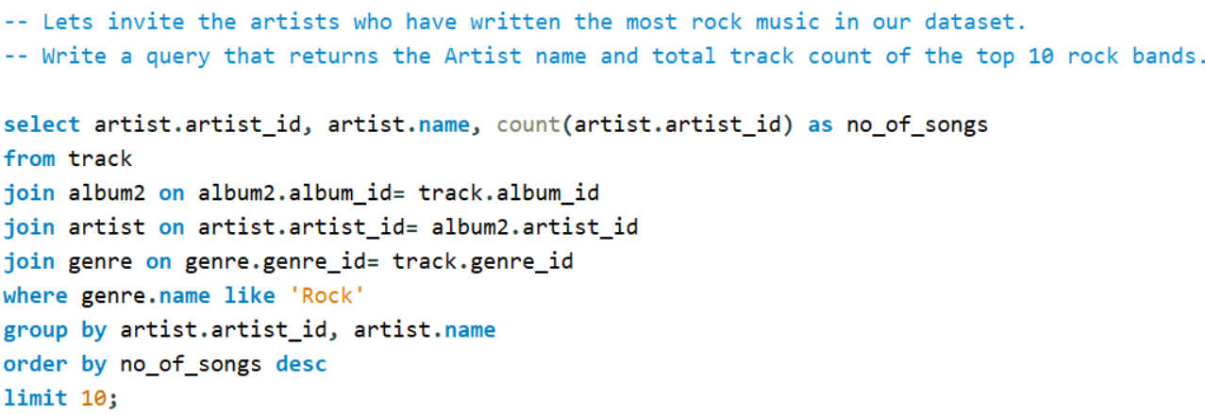

Slide 7


Slide 8
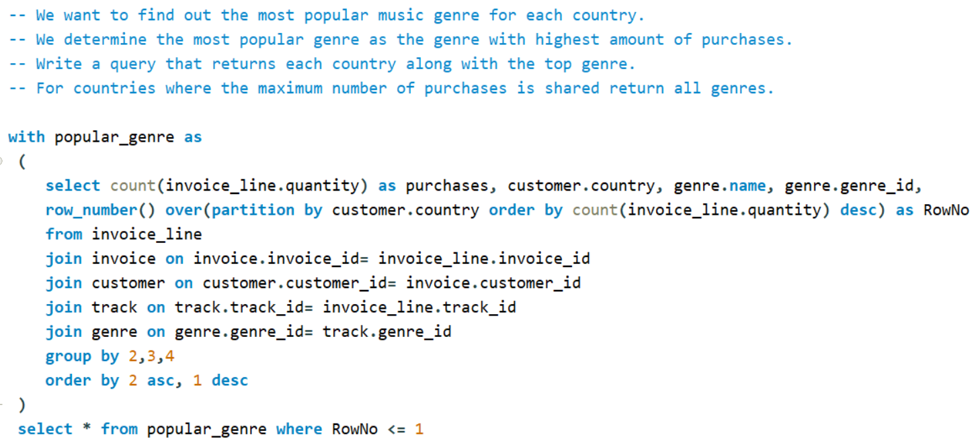

Slide 9
