Slide 1
CVL YANG as NB YANG

Slide 2
CVL YANG
CVL YANG background
These native YANG models are simple and very close mapping of ABNF schema.
YANG models written based on ABNF schema along with various constraints.
Custom YANG extension (annotation) are used for custom validation purpose
Specific YANG extensions (rather metadata) are used to translate ABNF data to YANG data.
Additions for NB YANG
Add state data into CVL YANG as needed (example in subsequent slide)
Custom YANG extension won’t be used for Northbound purposes (i.e. Only for CVL consumption.)
Annotations and specific YANG extensions

Slide 3
Sample CVL NB YANG (with state nodes)
container sonic-acl {
list ACL_TABLE {
key "aclname";
leaf aclname {
type string;
}
......
}
list ACL_RULE {
key "aclname rulename";
leaf aclname {
type leafref {
path "../../ACL_TABLE/aclname";
}
}
leaf rulename {
type string;
}
......
container state {
config false;
leaf matched-packets {
type yang:counter64;
}
leaf matched-octets {
type yang:counter64;
}
}
}
}

Slide 4
CVL YANG for NBI
Framework will automatically generate OpenAPI spec, REST Server handlers, REST Client SDK and YGOT Bindings from the CVL YANG.
These will co-exist with OpenConfig or any other NB yang generated artifacts.
Framework will support gNMI based on CVL YANG
Transformer
Transformer spec generated out of CVL YANG
As CVL YANG maps one-to-one w/ Redis schema for a feature, so, transfer spec should be zero touch
Transformer common code should handle translation from YANG to ABNF and vice versa
No need for any custom code

Slide 5


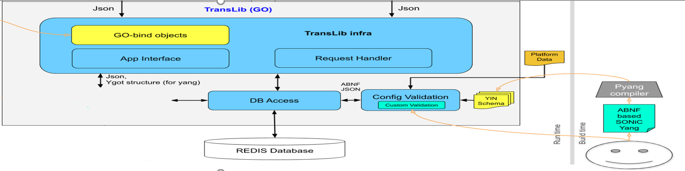






CVL YANG Transformer
Spec
Generator
Transformer
In the context of CVL Yang, these components are not needed.

Slide 6
CVL YANG for Klish CLI code generation
Auto-generation of CLI XML spec from CVL YANG is possible
Create custom pyang plugin to generate CLI XML Spec from YANG (PoC pending, September)
Where auto-generation cannot be done:
Klish CLI structure tightly coupled to YANG data model structure
Ex: CLI keywords are derived from YANG object names: leaf, leaf-list etc,
Developers must write actioner script per command
Construct the RESTCONF request with a payload

Slide 7
BACKUP

Slide 8
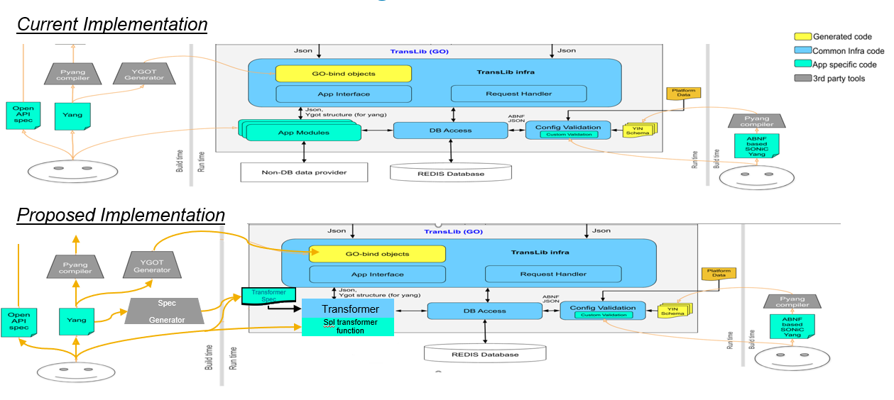
Design: TransLib

Slide 9
CVL - Sample schema
container sonic-acl {
scommon:db-name "CONFIG_DB";
list ACL_TABLE {
key "aclname";
scommon:key-delim "|";
scommon:key-pattern "ACL_TABLE|{aclname}";
leaf aclname {
type string;
}
leaf-list ports {
type leafref {
path "/prt:sonic-port/prt:PORT/prt:ifname";
}
}
......
}
list ACL_RULE {
key "aclname rulename";
scommon:key-delim "|";
scommon:key-pattern "ACL_RULE|{aclname}|{rulename}";
scommon:pf-check “ACL_CheckAclRuleLimit”;
leaf aclname {
type leafref {
path "../../ACL_TABLE/aclname";
}
}
leaf rulename {
type string;
}
leaf MIRROR_ACTION {
type leafref {
path "/sms:sonic-mirror-session/sms:MIRROR_SESSION/sms:name";
}
}
......
}
}
ABNF JSON:
"ACL_RULE": {
"TestACL1|Rule1": {
"PACKET_ACTION": "FORWARD",
"SRC_IP": "10.1.1.1/32",
"L4_SRC_PORT": "10078",
"IP_PROTOCOL": "103",
"DST_IP": "20.2.2.2/32",
"L4_DST_PORT_RANGE": "9000-12000"
}
}
}
YANG XML:
<sonic-acl xmlns="http://github.com/Azure/sonic-acl">
<ACL_RULE>
<aclname>TestACL1</aclname>
<rulename>Rule1</rulename>
<DST_IP>20.2.2.2/32</DST_IP>
<IP_PROTOCOL>1</IP_PROTOCOL>
<L4_DST_PORT_RANGE>9000-12000</L4_DST_PORT_RANGE>
<L4_SRC_PORT>8080</L4_SRC_PORT>
<PACKET_ACTION>FORWARD</PACKET_ACTION>
<SRC_IP>10.1.1.1/32</SRC_IP>
</ACL_RULE>
</sonic-acl>

