Slide 1
SONiC Management Framework - PoC Demo
BROADCOM and DELL
06/26/19

Slide 2
Scope of PoC
Use cases considered
Openconfig ACL
Get, Create, Delete
OpenAPI Spec for sample VLAN configuration (For REST)
Get, Create, Delete
Management applications for these use cases
REST (YANG, OpenAPI Spec)
gNMI (YANG based)
CLI - Klish framework based
Legacy Click based CLI

Slide 3
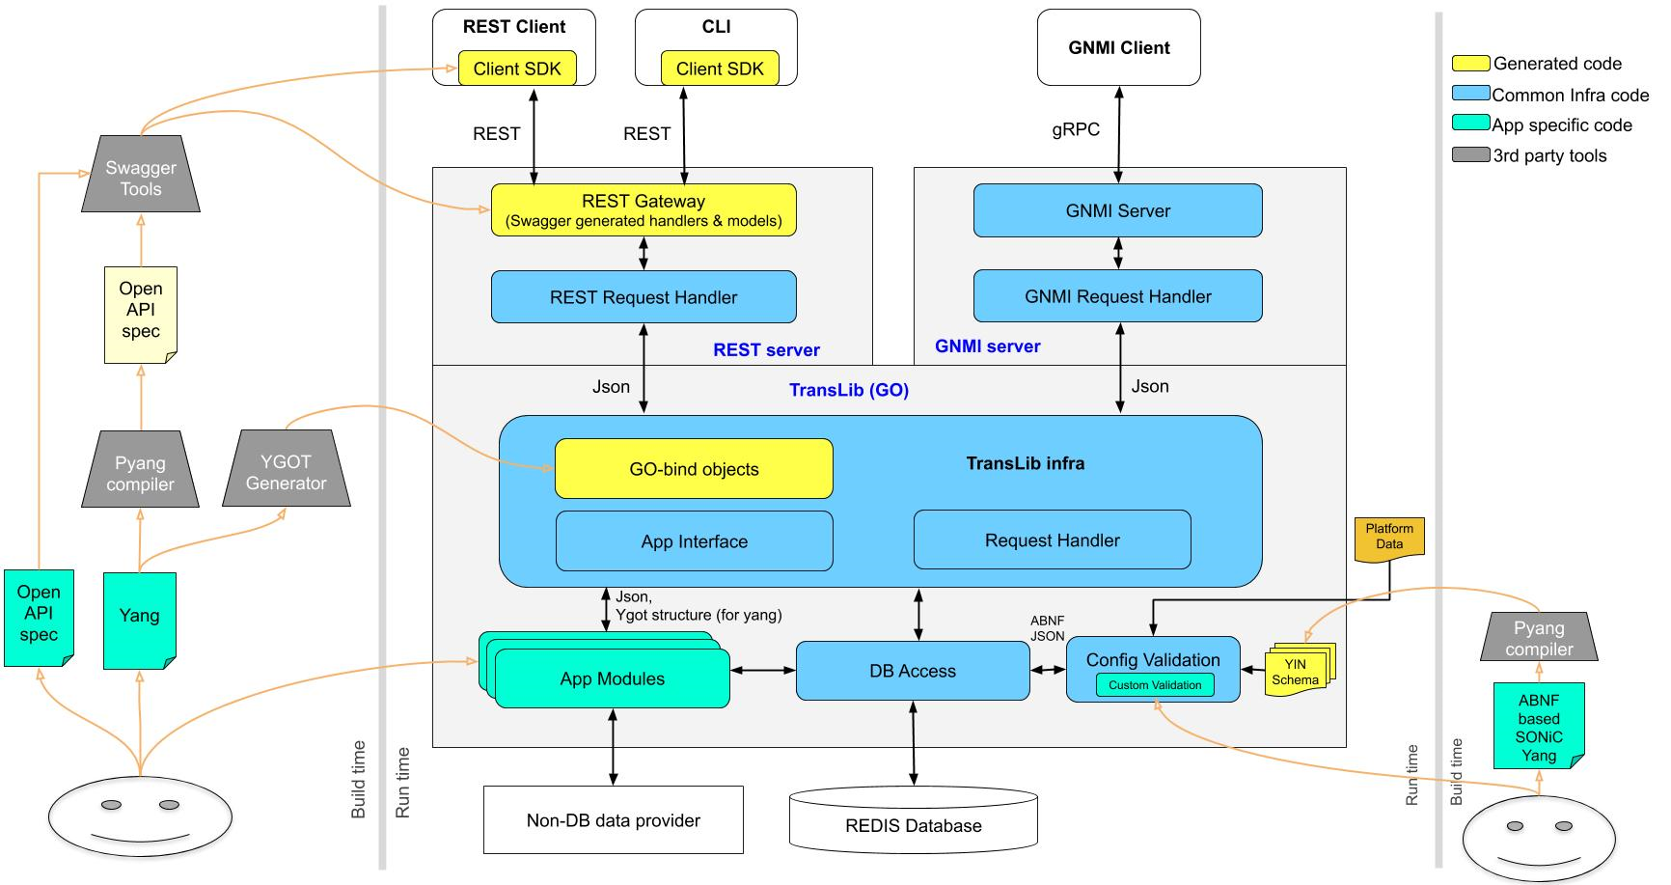
PoC - Detailed View
Klish CLIs
- ACL create/delete
- Add/remove rule to ACL
- Bind ACL on interface
Standard gNMI client
Swagger UI
curl
A demo OpenAPI spec for VLAN get, create, delete and add/rem members
CVL Schema models for ACL, ACL Rule, vlan and vlan member tables
OpenConfig ACL yang -- create/del ACLs, rules and bind/unbind interface
Demo apps:
1) OpenConfig ACL app
2) Demo VLAN configs app

Slide 4
Demo Set up / Procedure
HW - x86_64 Quanta-IX8-56X
Verify CONFIG_DB
Verify IETF JSON
Management-framework
container
Get/Create/Delete
-YANG/OpenAPI
Spec
CONFIG DB
REST Client(Curl)
APP DB
CLI
Verify IETF JSON
ASIC DB
GNMI Client (Set/Get)
Get/Create/Delete
-YANG
Telemetry container
sairedis
sswssyncd
SAI API
Linux Host
User Space
ASIC SDK
Kernel
ASIC PCI Driver
ASIC
Detailed steps at: https://drive.google.com/open?id=1wfwZ73nh0u28sXTxrw8PIXRwrgr8QXApduK1JinqYX0

Slide 5
Next Steps
Management Framework supporting ACL to be available in 201908 Community Release
ACL is OpenConfig Yang based, including CLI, gNMI, REST and Config validation
Community Milestones:
Design PR submission: Mid July
Code PR submission: Late August
WIP code is available at: https://github.com/project-arlo/sonic-mgmt-framework

Slide 6
BACK UP

Slide 7
gNMI Server Integration
gNMI Collector (Client)
sonic-telemetry
gNMI Server
gRPC Dial-in Server
Dial-out Client
Request Handler
Existing path for non-YANG based request
Get
Subscribe
Capability
Set
New path for YANG based request
Existing common code
DB / Non-DB Client
TransL Data Client
New common code
Existing service extended based on YANG model
TransL Utils
New service based on YANG model
TransLib
App specific code
App Modules
Non-DB data provider
Redis database

Slide 8
CLI for SONiC

Slide 9
Overview
Use Open Source Klish to support industry standard CLI
Extend Klish parser with patches to allow advanced cases like recursive parameter etc.
Use Swagger client SDK to execute CLI commands
Template Rendering with Python Jinja
Provide the reference XML files for CLI command tree to allow SONiC community to easily customize CLI commands

Slide 10
CLI modules
CLI
CLI command Tree
REST
API
Rest Server
Actioner
3
1
2
Klish
6
Render
5
4

Slide 11
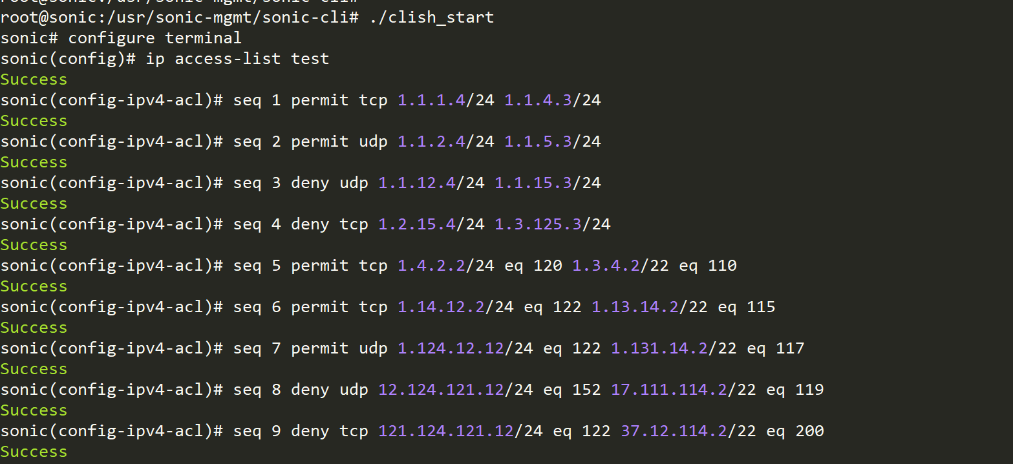
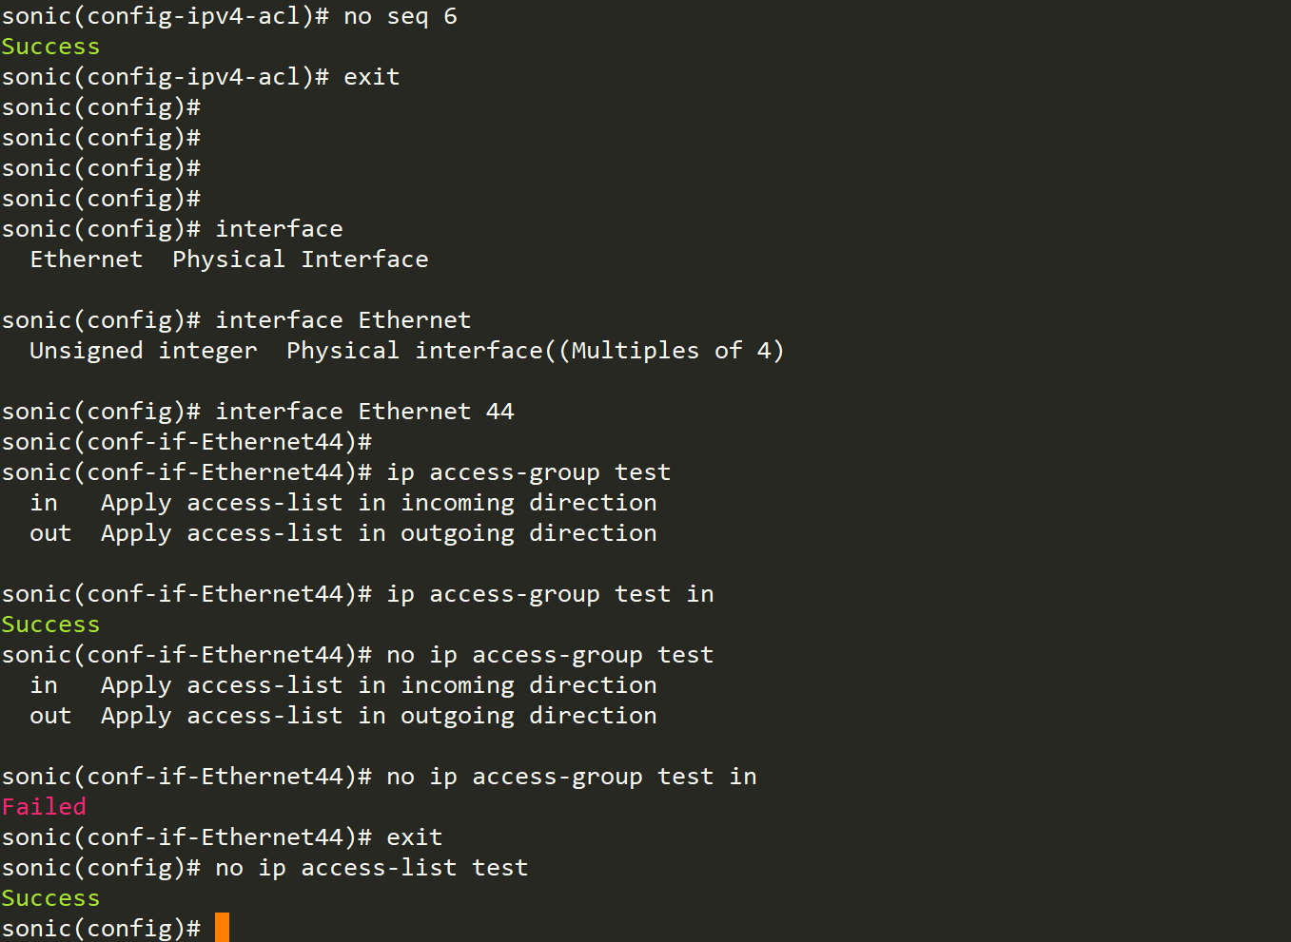
CLI examples – ACL

