Slide 1
Design Proposal for SONiC Management Framework – Deep dive
Aviz Networks, Inc.

Slide 2

Vision – Simplify and Standardize SONiC management
API Service:
Provide Comprehensive API services, SONiC users can access any state and configure any properties on the SONiC switch.
Flexible and simplified language agnostic SDK to integrate into any existing infrastructure providing either on-box or off-box scripting.
Stable API services for future versions of SONiC allowing customers to develop critical applications without compromising their ability to upgrade to newer SONiC releases.
Inline with SONiC micro services architecture.
Secure with basic and advanced authentication.
Industry Standard CLI:
Industry standard CLI for SONiC features with validations, error handling and platform specific enhancements.

Slide 3
Discussion Topics
REST & CLI Architecture Proposals
RESTful Server & Approach
Config Validations & Error handling
API service (Ruby & Python) support
Industry Standard CLI based on CliXon framework
PoC
Scope
Use Cases
RESTful & CLI API’s
Backend API’s

Slide 4

SONiC REST API Architecture Proposal
REST API Container
SONiC Containers
Request handler
Validate and Apply
SDK
SNMP
Community Collaboration
Work with community for defining, developing and standardizing models widely deployed SONiC topologies. We can follow the OpenConfig standards to start with, but can customize based on SONiC use cases.
Design and implement validations and error checking for SONiC configuration. Aviz has already implemented some validations for REST API support which can be leveraged or modified to fit into the unified proposal from community.
HTTP Server (CherryPy)
Backend APIs
LAG
BGP
Response handler
LLDP
DB
HTTP Server:
Light weight HTTP Server based on CherryPy providing authentication and supports JSON
Request/Response Handler:
Python based APIs to decode/encode JSON payloads.
Validate & Apply:
Python based APIs to validate the configuration parameters and apply using existing (and new APIs) to the various containers.
SDK:
Ruby, Python classes and methods to simplify REST API and integrate with existing DEVOPS.

Slide 5
Approach
Comprehensive API Services
Defined REST API based on SONiC Config_db
Industry standard CLI
Config Validations
REST Server, API Handlers, Backend API – Python
Serialization/Deserialization – python API
Config Validations – python API
CLI developed CliXon framework

Slide 6
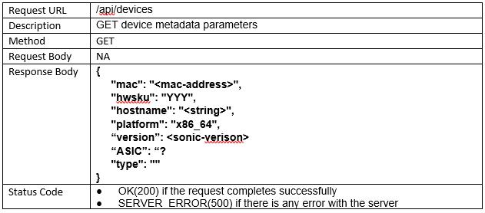
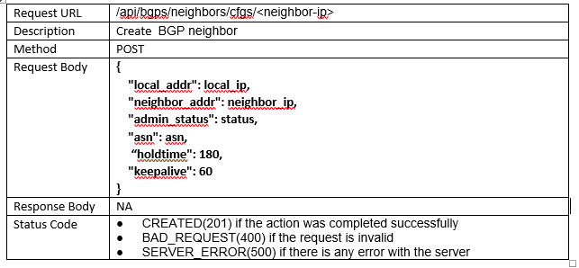
Features Supported via REST API - Today
Feature | Functions | Operation
System | Device Information | GET, PUT
Environment | Device Environment | GET
Config | Startup Config | GET, POST
Interfaces | Physical Interface Config Physical interface show Tranceivers Statistics | GET, POST
Port Channel | Configuration (Create, Delete, Member Update) Get Information | GET, POST, PUT, DELETE
VLAN | Configuration (Create, Delete, Membership) Get Information | GET, POST, PUT, DELETE
LLDP | Get Information | GET
IP | Configuration (Create, Set and Delete IP interface) Get IP information | GET, POST, DELETE
BGP | Configuration (Create, Delete neighbor, Set BGP globals) Get information (Neighbor, config, stats) | GET, POST, DELETE
Authentication | Basic Authentication | NA
SDK Support:
Python and Ruby SDK available for all the REST APIs supported.
DevOps Integration:
Ansible Playbooks and Chef cookbooks available for Leaf/Spine deployments.

Slide 7
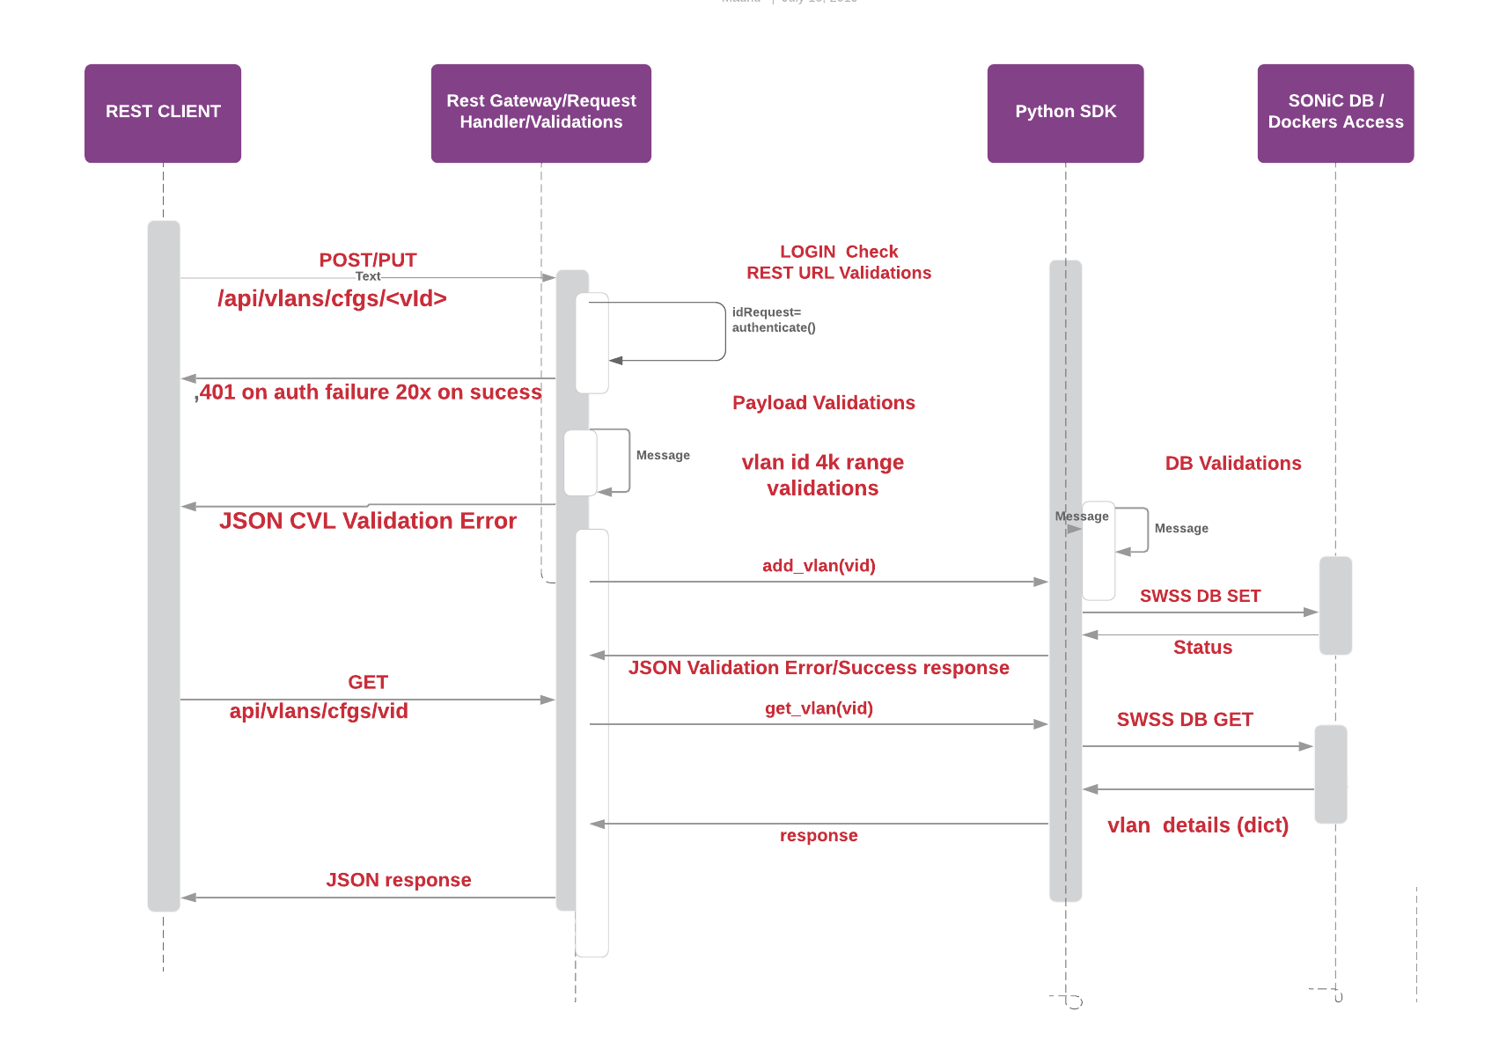
REST CRUD workflow

Slide 8
CLI using Cligen (CliXon)
Vlan API Definitions (vlan_cli.cli)
Syntax & Semantic validations
Config Validations.
DB Interface - developed in C/C++
CLI Backend API - developed in C/C++

Slide 9
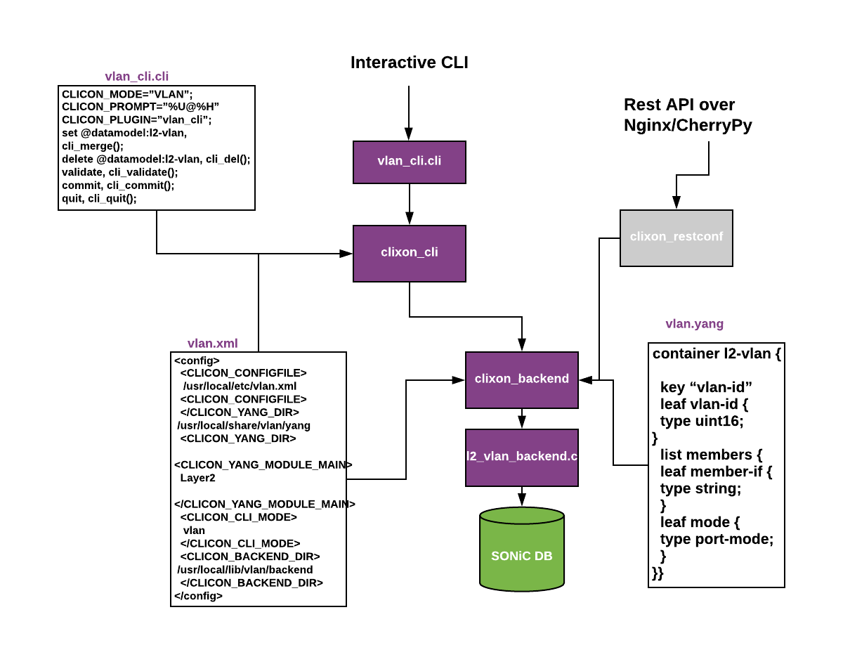
CLI Framework

Slide 10
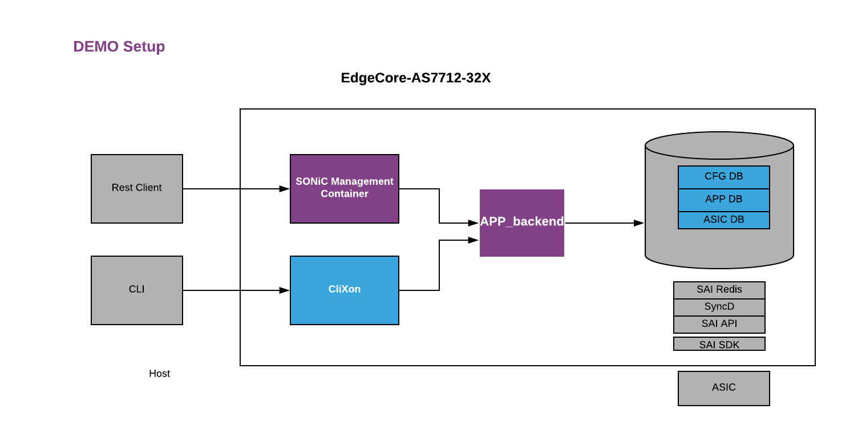

Slide 11
Backup Slides

Slide 12
Cligen - Command Line Interface Generator
● Actually, cligen is not really a generator
● It is more a run-time system.
● You need to specify the CLI syntax and callbacks in C
● Then you link a library with your application and load the syntax
Licensing
3.1 is out.
3.2 on its way
cligen comes as GPL2 or commercial license

Slide 13
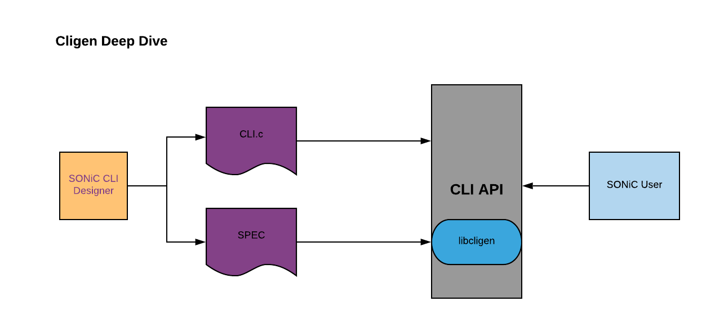

Slide 14
REST Server
CherryPy HTTP server.
Basic, token and advanced authentication
request routing
Syntax & Semantics validations
Config validations
Serialize/de-serialize payloads
API definitions
REST API’s based on SONiC Config_db
Request routing
RESTCONF complaint REST API support
Python Backend SDK
Client SDK support
Client PySDK
Client RubySDK

Slide 15
SONiC CLI Architecture Proposal
CLI Shell
App.cli
CLI Parser
App.XML
CLI Backend
Community Collaboration
Evaluate Klish and Clixon on various aspects and come up with a proposal with pros and cons (Currently we are doing the evaluation …..)
Fit in micro-services architecture
Single config manager to provide CLI/RESTConf/Netconf interface
Create Schema for various applications based on use case deployments.
Help develop the backend API based on our previous slide.
Validations and Backend APIs
SONiC Containers
ConfigDB
BGP
Custom
LLDP
LAG

