Slide 1
YANG-2-Redis Transformer

Slide 2
Purpose
Problem
Every APP module must implement methods to convert YANG to REDIS schema and vice versa
Proposal
Introduce generic transformer library to convert YANG to REDIS schema and vice versa using developer defined Transformer specification
Skeleton transformer specification is auto-generated from YANG
Generic APP module for standard cases – including data conversion, validation (via CVL), locking, and DB operations
Extensions support to handle special cases or conversions
Notifications support for gNMI, REST, and CLI
Plug-in concept – existing APP modules can be updated to use plugin or continue with current approach

Slide 3
Scope of Proof of Concept
Showcase transformer spec, special transformer function portion of the transformer library.
Supports only ACL Table and rules create request.
Reuses the YGOT structure update and DB access layer calls from existing app module.
Show case code reduction on the translation function, by using the transformer spec.

Slide 4
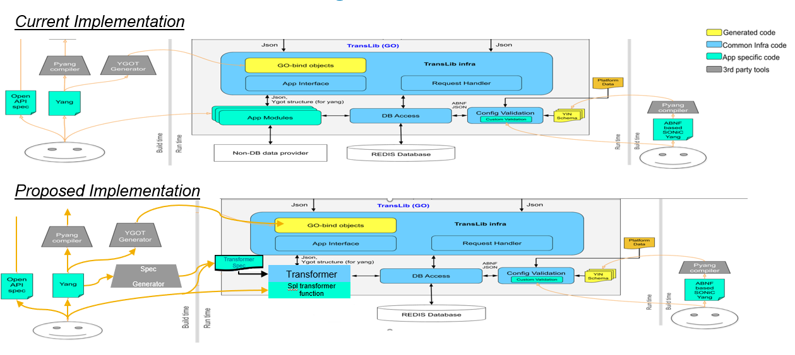
Design: TransLib

Slide 5
Overview Transformer Library
The transformer library provides standard infrastructure for transformation, validation and configuration.
The transformer spec can be used to programmatically define the rules on how to translate between heterogeneous data models in simple JSON.
Transformation Specification Defines translation between YANG path based dataset to REDIS schema and vice versa
Transformer class:
Built-in default transformer methods can support simple translation.
Transformer methods can be overloaded by developer to perform complex translation.
Notification spec (for unsolicited message): to define the observed tables/fields, test and notify the events to subscribed clients like REST server.
Notifier class: default notifier, subscribe method
Transformer spec can be extended by introducing a new JSON notation(e.g. to support db/table watchkeys, non-db data provider api etc).

Slide 6
Example 1: Transformer Spec: Simple case
Using Transformer Spec:
{
" MODULE-NAME ": "sonic",
" PREFIX-NAME ": "so",
" TRANSFORM-SPEC ": {
" YOBJECTS ": [
{ " YOBJECT": "config
"YCHILDOBJECTS": [
{ " YOBJECT ": "vrouter",
" TABLE-NAME ": "VNET",
" KEY ": {
" YLEAFY ": [ "vnet-id“
]
},
" FIELDS": [ {
" YLEAFY ": "vni",
" FIELD-NAME ": "MYvni"
},
{
" YLEAFY ": "vxlan-tunnel"
} ]
} ]
}
}
Input Yang json:
{ "sonic:config": {
"vrouter" : [
{ "vnet-id" : "Vnet1", "vni": 1000, "vxlan-tunnel" : "tunnel_v4"
} ]
}
}
Yang data from app-interface to transformer
Output DB json:
{
"VNET": {
"Vnet1": {
“MYvni": "1000",
"vxlan_tunnel": "tunnel_v4“
}
}
}
DB data from transformer to app-interface after converstion

Slide 7
Example 2: Transformer Spec: special transformer function case
Using Transformer Spec:
"MODULE-NAME": "openconfig-acl",
"PREFIX-NAME": "op-acl",
"TRANSFORM-SPEC": {
"YOBJECTS": [ {
"YOBJECT": "acl",
"YCHILDOBJECTS": [ {
"YOBJECT": "acl-sets",
"YCHILDOBJECTS": [ {
"YOBJECT": "acl-set",
"TABLE-NAME": "ACL_TABLE",
"KEY": {
"YLEAFY": [
"name",
"type"
],
"TRANSFORMER": "xfmr_acl_table_key"
}
"YCHILDOBJECTS": [ {
"YOBJECT": "config",
"FIELDS": [ {
"YLEAFY": [
"description"
],
"FIELD-NAME": "policy_desc"
},
{
"YLEAFY": [
"type"
]
}
]
}
}
}
Input Yang json:
{
"acl-sets": {
"acl-set": [ {
"name": "MyACL1",
"type": "ACL_IPV4",
"config": {
"name": "MyACL1",
"type": "ACL_IPV4",
"description": "Description for MyACL1"
}
}
]
}
}
Yang data from app-interface to transformer
Output DB json: {
"ACL_TABLE": {
"MyACL1_ACL_IPV4": {
"type": "L3",
"policy_desc": "Description for MyACL1",
}
}
}
DB data from transformer to app-interface after converstion

Slide 8
Developer Workflow
Without transformer
Implement feature YANG and generate YGOT bindings.
Simple case:
Implement the translib library app interface (app module)
Write conversion routines to translate between YANG schema to REDIS schema and vice versa
Invoke the db access layer for validation and configuration
Special function case:
Implement the translib library app interface (app module)
Write conversion routines to translate between YANG schema to REDIS schema and vice versa
Invoke the db access layer for validation and configuration
With transformer
Implement feature YANG and generate YGOT bindings.
Simple case:
Generate skeleton transformer-spec from YANG.
Update transformer-spec with REDIS table mapping.
Special function case:
Generate skeleton transformer-spec from YANG.
Update transformer-spec with REDIS table mapping.
Write transformer function for special handling cases.

Slide 9
Benefits
Transformer library infra code will take care of data conversion, validation (via CVL), locking, and DB operations.
No coding is required for simple case(one to one mapping between yang and redis schema).
Common transformer functions can be reused across app modules.
Only fields requiring special handling, require specific transformer handling functions.
Evaluating multiple language option support, for transformer functions.
Simplifies developer effort and reduces possibility of introducing bugs.
Diff on acl_app.go with the introduction of transformer library. https://github.com/project-arlo/sonic-mgmt-framework/commit/7bf80422eecbd012e48b5286019d813e76ad5a3d#diff-96fd08d6059562c8b508db1d1002a5f7L1065

Slide 10
Backup

Slide 11



Transformer spec
transformer-lib
openconfig-specs
Redis DB map info
openconfig-acl
.
.
.
.
.
.
acl_spec.json
Yang to Spec generator
xfmr
Openconfig Yang
Transformer Spec
openconfig-system
system_spec.json
spec creation
Generate transformer-spec from openconfig yang.
Input redis-db mapping details in the transformer-spec.
Create a directory for openconfig yang module in transformer-lib dir and place the transformer-spec & user defined handlers in it.

Slide 12
Transformer in-detail
APP
Transformer
App specific DB data modifiers(xfmr)
Init (Yang to DB spec module): Load transformer-specs of all openconfig yang models and create lookup table with yang to redis-db mapping.
Yang to DB converter
Yang to DB Spec Module
NBI request
Yang data (json)
Data converstion:
Interface to app: receives yang data from apps.
Yang to DB converter:
* Table lookup to get redis db info.
* Interact with app-specific db data modifiers(transformers) if needed.
* Convert yang to redis-db data.
App 1
Interface to app
Transformer
Spec
App N
DB data (json)
Transformer
App developer input
Transformer infra

Slide 13
Transformer Spec: Developer quick reference
Yang | If the REDIS DB field mapping criteria is … | Then developer input to transformer-spec is …
root | - | table name
leaf | same as yang leaf | None
 | different from yang leaf name | field name
 | requires user defined handling | transformer function name in spec and corresponding function handler
 | same table as parent object | None
 | different table than the parent object | table name
key | one yang leaf | None
 | multiple yang leaves with default delimiters | None
 | one or more yang leaves requiring user defined handling | transformer function name in spec and corresponding function handler
object (container/list) | same member fields as yang | None
 | requires user defined handling | transformer function name in spec and corresponding function handler
 | different table than the parent object | table name

