Slide 1
Build limitless network with Smart Switch
Introduction to Smart Switch in Data Centers

Slide 2


Build limitless network with Smart Switch
Networking
NETWORKING
Lihua Yuan, VP Engineering, Microsoft
Guohan Lu, Partner Software Engineer, Microsoft
Prince Sunny, Principal Software Engineer, Microsoft

Slide 3
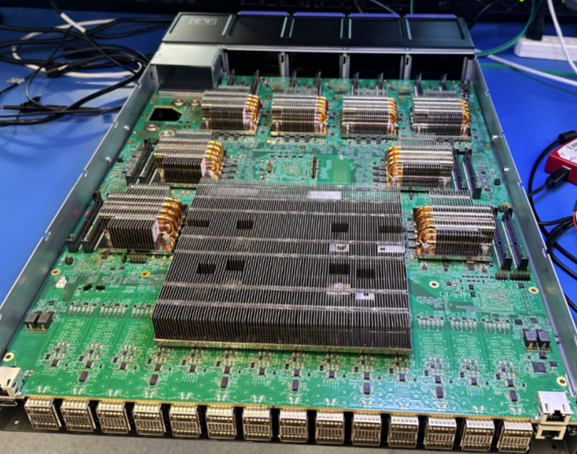
Smart Switch - Hardware Concept
BO - Content
2RU Switch
Switching
32 x 400G port Switching ASIC
28 x 400G Front Panel
8 x 200G or 4 x 400G to DPU/IPUs
DPU
8 x DPUs
Control Plane
128GB RAM
DPU
DPU
DPU
12.8T ASIC
4x400G/8x200G

Slide 4
Smart Switch - Motivation
BO - Content
Why Smart Switch as compared to SmartNIC?
Resource Pooling - SmartSwitch is augmenting the SmartNIC capability, enabling cloud providers to leverage SmartSwitch for highly scalable resource allocation and utilizing the NPU capabilities for High Availability and packet redirections.
Powerful - SmartSwitch that accommodates a powerful NPU and highly scalable, high memory DPUs enable building limitless network by providing a powerful resource pool. DPUs are programmable to fit custom pipeline and can be used for offloading Internet routes, SDN policies to name a few.
Speed and Reliability - SmartSwitch provides an in-band packet processing solution without any bounce back, thus reducing additional latencies. For SmartNIC deployment, the packets first lands on the SmartNIC, does the processing and then forwarded to VM. This flow can cross cluster boundaries. By having SmartSwitch in the same cluster as the VMs, there are no additional hops and network functions can be applied in the same path as to VM.
Cost Savings - SmartSwitch provides a solution that does not require additional space within a datacenter. Also enabling savings on power usage and overall cost of product.

Slide 5
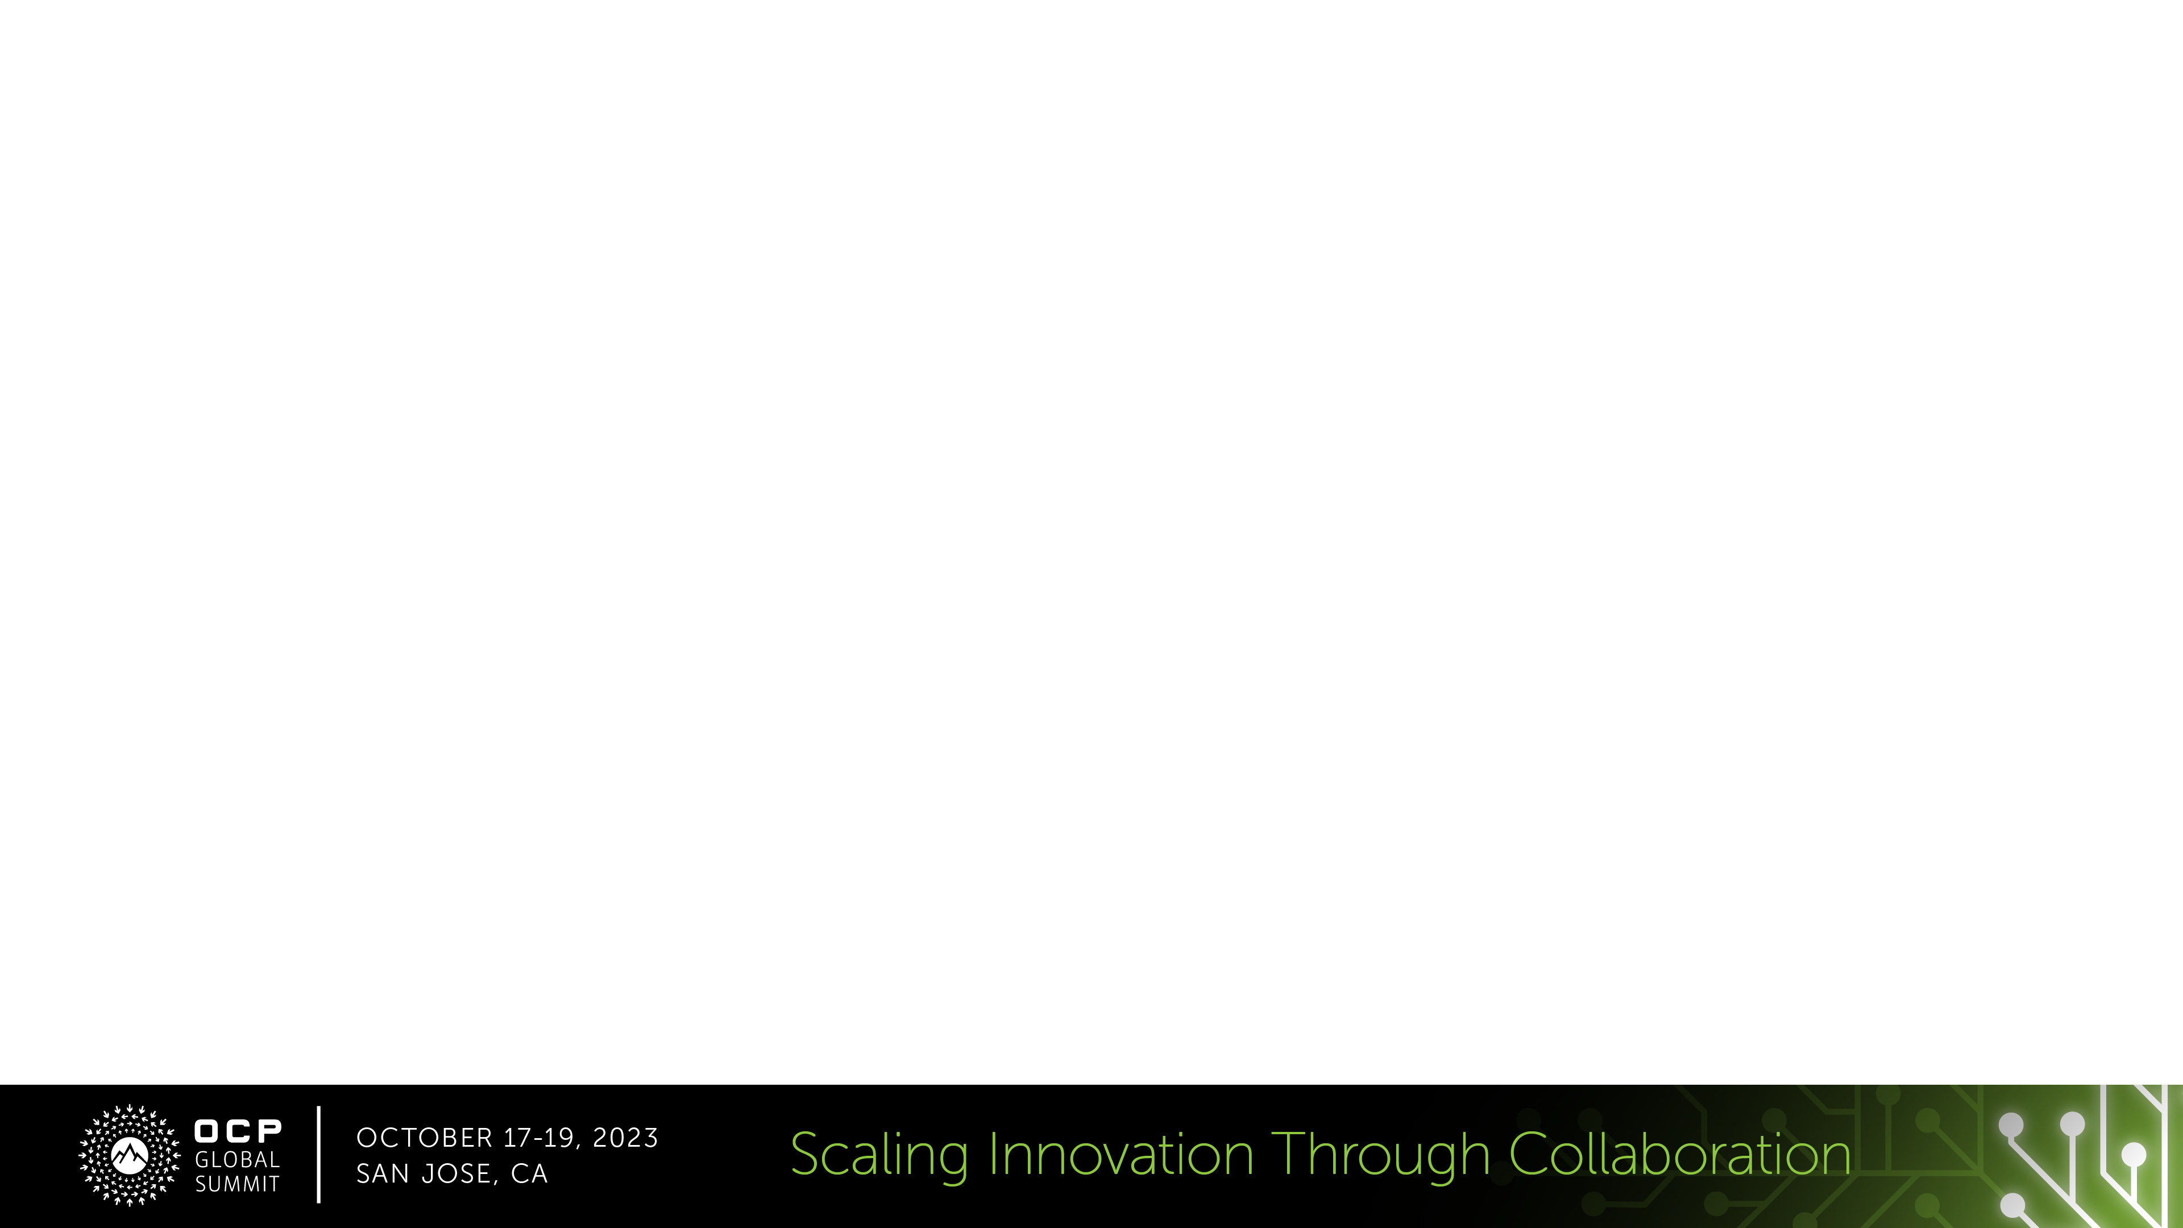

Smart Switch – Placement proposal
Tier 3 - Regional Hub
T3-1
T3-2
T3-3
T3-4
…
…
…
Tier 2 - Spine
T2-1-1
T2-1-2
T2-1-8
T2-4-1
T2-4-2
T2-4-4
Smart Switch
…
…
…
T1-1
T1-2
T1-7
T1-8
T1-1
T1-2
T1-7
T1-8
Smart Switch T1
Tier 1 – MoR
T1-1
T1-2
T1-7
T1-8
SONIC
SONIC
SONIC
SONIC
SONIC
SONIC
SONIC
SONIC
SONIC
SONIC
SONIC
SONIC
…
…
…
Tier 0/ToR - Rack
T0-1
T0-2
T0-20
T0-1
T0-2
T0-20
T0-1
T0-2
T0-20
Smart Switch ToR
SONIC
SONIC
SONIC
SONIC
SONIC
SONIC
SONIC
SONIC
SONIC
Servers
Servers
Servers
Server or Appliance
Notes:
Can live on any tier Representative diagram
https://github.com/sonic-net/DASH/blob/main/documentation/general/dash-high-level-design.md#example-of-network-representation

Slide 6


Smart Switch - Use Case - Powered by DASH
SDN policies evaluation
TOR
Hyper-V Switch
VFP
Offload SDN policies evaluation to disaggregated switch/appliance
FPGA/ASIC
Smart Switch
Lower power, lower latency
Hyper-V Switch
VFP
Higher throughput and IO
DASH
DPUs
FPGA/ASIC
TOR
Notes:
This is the problem we are trying to solve. Disaggregate the DPUs from the host.
Pulled them into an appliance or switch (pooling / disaggregating).
We tunnel VXLan from the VM to the Appliance/Switch for policy management.
10’s of M of CPS to keep up with demands of the VMs

Slide 7
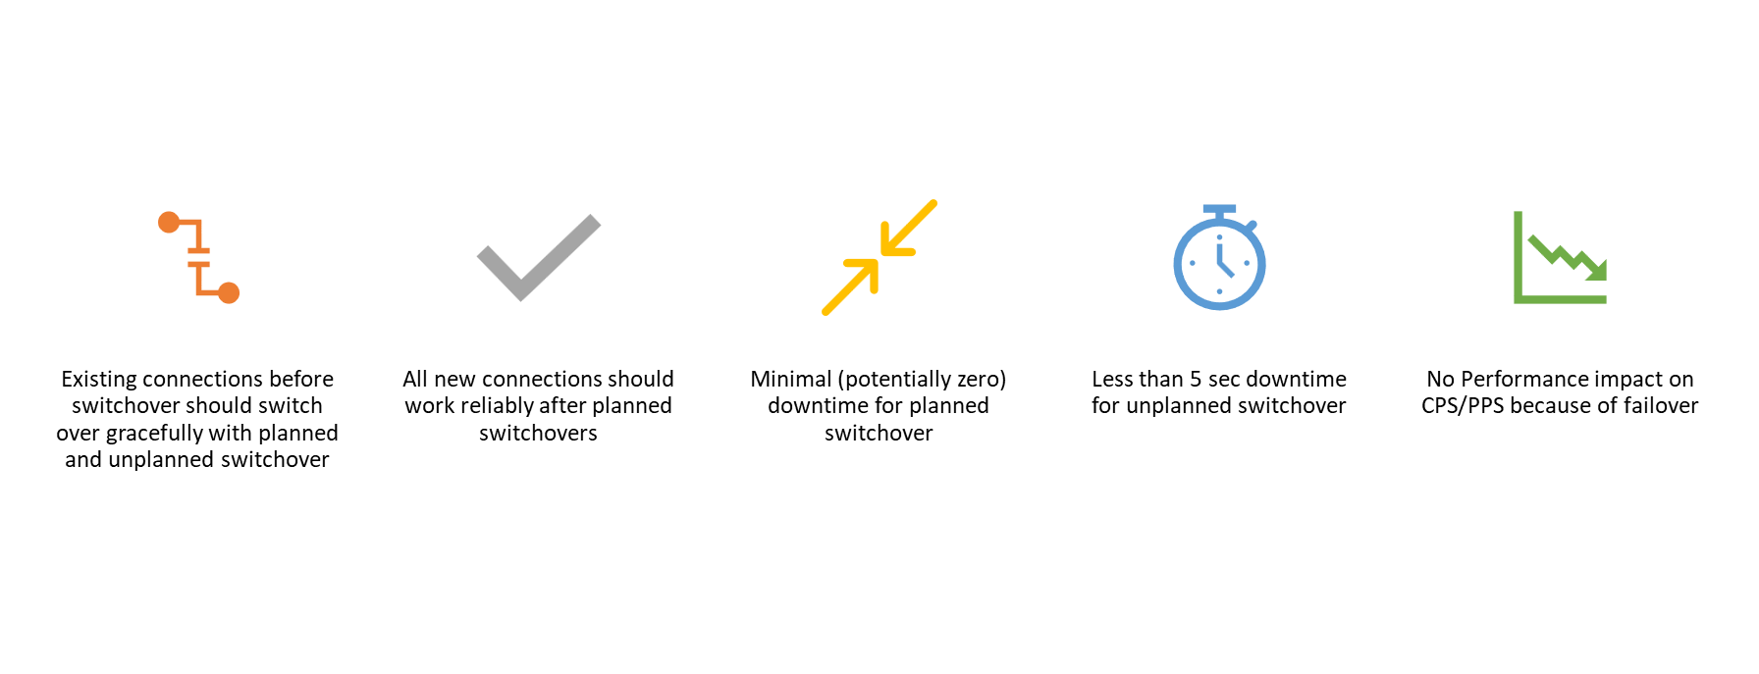
Smart Switch – High Availability
What is HA?
Enabling a Single SmartSwitch or DPU going down not causing interruption or traffic impact to the service hosted on the DPUs
Achieved by programming policies across the HA pair (Active/Standby or Active/Active) and performing Flow-Sync
SmartSwitch NPUs can detect DPU failures in fraction of a second, using BFD or similar keep-alive mechanism, thus redirecting traffic to peer DPU.
HA Goals
Notes:
This is the problem we are trying to solve. Disaggregate the DPUs from the host.
Pulled them into an appliance or switch (pooling / disaggregating).
We tunnel VXLan from the VM to the Appliance/Switch for policy management.
10’s of M of CPS to keep up with demands of the VMs

Slide 8
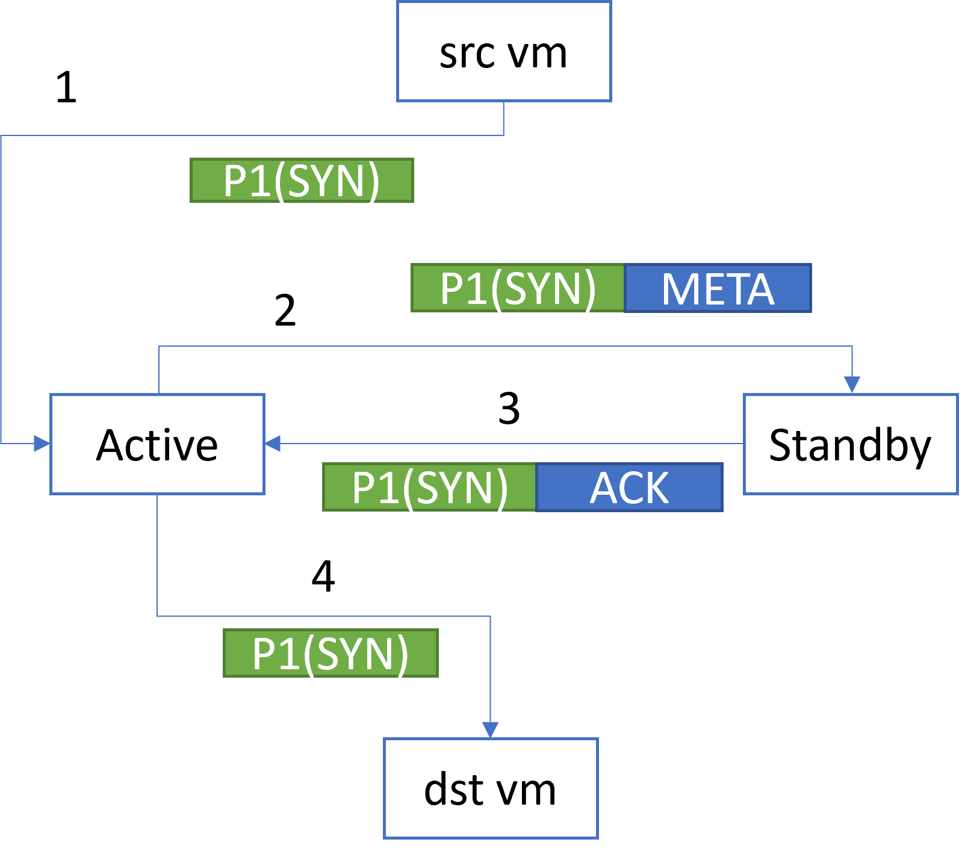
Smart Switch – High Availability
Flow-Sync
Active/Standby resource allocation on two DPUs from two different SmartSwitch forming HA pair
One DPU serves as active and making flow decisions, while the other DPU serves as standby, only accepting flows from active.
In steady state, all flows shall be inline sync-ed from active to standby. When a DPU joins the HA pair, initiate flow bulk-sync
During active DPU failover, switchover from standby to new active
Notes:
This is the problem we are trying to solve. Disaggregate the DPUs from the host.
Pulled them into an appliance or switch (pooling / disaggregating).
We tunnel VXLan from the VM to the Appliance/Switch for policy management.
10’s of M of CPS to keep up with demands of the VMs

Slide 9
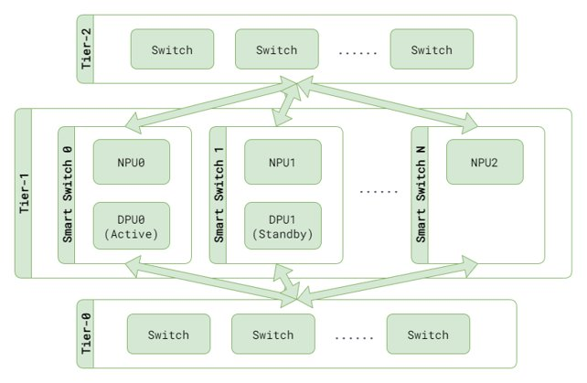
Smart Switch – High Availability
Smart Switch deployed as Tier–1 Switches
When a T1 NPU receives a packet destined to a resource allocated on a DPU, it forwards the packet to the active DPU using a Vxlan tunnel.

Slide 10
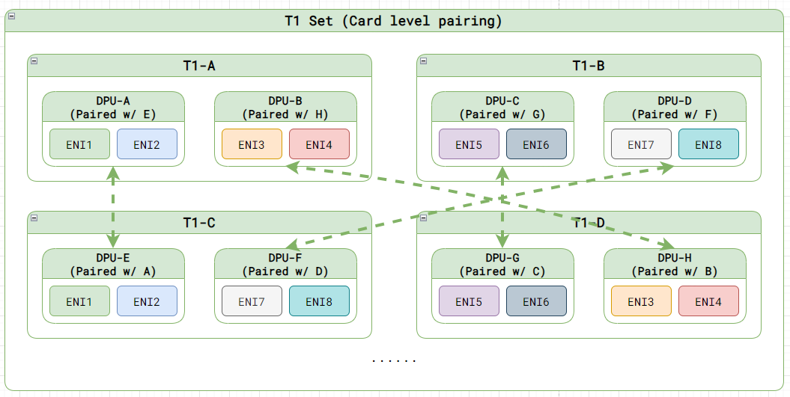
Smart Switch – High Availability
In the diagram below, DPUs are running ENI workloads (ENIs are representations of VMs)
Leveraging Card-level ENI pairing

Slide 11
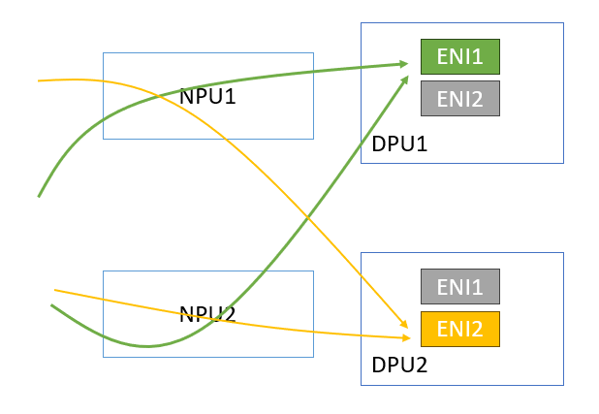
Smart Switch – High Availability
Active/Standby per ENI
NPU encaps all traffic for an ENI to the DPU hosting the active ENI

Slide 12
Smart Switch – NPU Requirements
Decap vxlan packet (Optional Decap if Dst IP is NPU loopback)
ACL Match Capabilities and Redirect to local or remote DPU
Encap with Vxlan
HW offloaded BFD to monitor remote and local DPUs

Slide 13
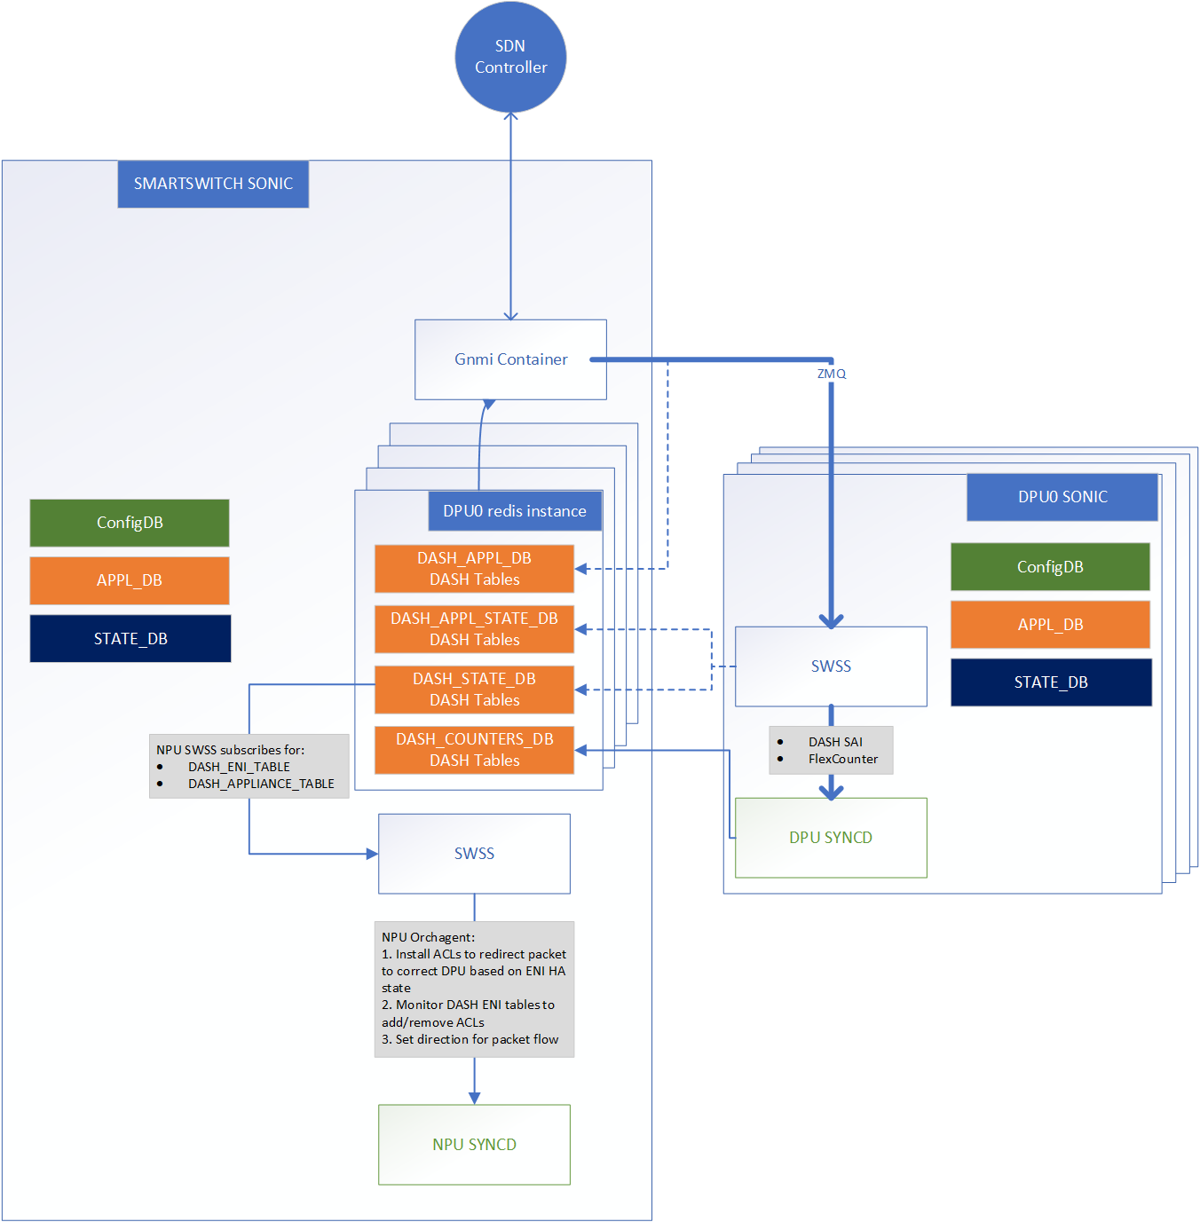
Smart Switch – Software Architecture on SONiC

Slide 14
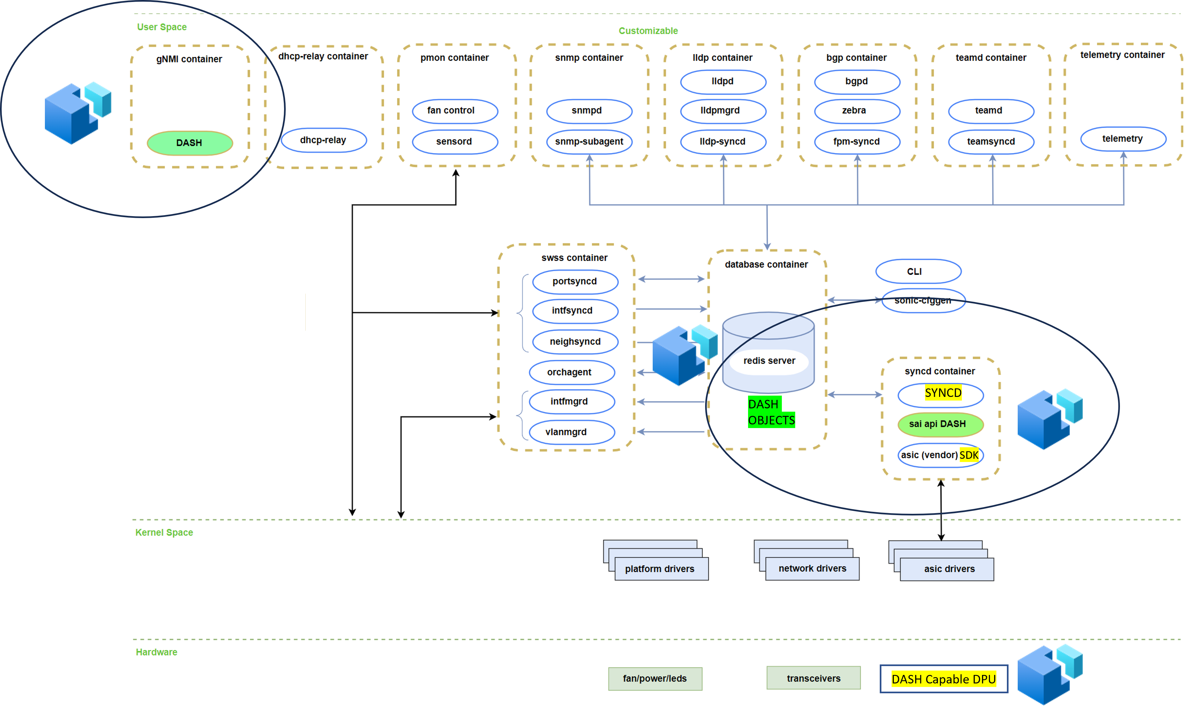
Smart Switch – Extending SONiC/SAI to support DPU

Slide 15
Acknowledgments
Dave Maltz | Technical Fellow, CVP
Deepak Bansal | Technical Fellow, CVP
Lihua Yuan | VP Engineering
Rishab Tiwari | Partner Software Engineer
Guohan Lu | Partner Software Engineer
Xin Liu | Principal Program Manager
Yanzhao Zhang | Principal TPM
Gerald Grace | Principal TPM Manager
Kristina Moore | Principal TPM Manager
Michal Zygmunt | Principal Software Engineer​
Avijit Gupta | Principal Software Engineer​
Sushant Sharma | Principal Software Engineer​
Pranjal Shrivastava | Principal Software Engineer​
Neeraj Motwani | Principal Software Engineer​
Abhijeet Kumar | Principal Software Engineer
Riff Jiang | Principal Software Engineer
Prince Sunny | Principal Software Engineer
& Smart Switch Working Group

Slide 16
[Call to Action] [MANDATORY]
BO - Content
SmartSwitch forum - https://lists.sonicfoundation.dev/g/sonic-smartswitch
Inviting contributions for DASH SAI for more use-cases - Join sonic-dash@googlegroups.com
Timeline for Contribution by Dec’2023
Link to Contribution - https://github.com/sonic-net/SONiC/wiki/Becoming-a-contributor
Where to find additional information (URL links)
https://lists.sonicfoundation.dev/g/sonic-smartswitch/topics
Calendar: https://lists.sonicfoundation.dev/g/sonic-smartswitch/calendar
Mailing list: https://lists.sonicfoundation.dev/g/sonic-dev

