Slide 1
Centralized Chassis SONiC Platform
A Centralized Architecture for Chassis-Based Systems Cisco Systems March 2026

Slide 2
Context and Motivation

Slide 3
SONiC Chassis Landscape Today
Distributed Architecture for Modular Chassis Systems, in either VOQ (chassis-voq) or Packet Fabric (chassis-packet)
Multi-NPU
Each NPU has its own SONiC network stack/services
Full-Mesh iBGP among switch NPUs to share their external routing information
Distributed Chassis is the established SONiC architecture for modular systems
Each line card runs a full SONiC instance with independent control plane
Strengths: fault isolation per LC, independent scaling, proven in production
However, it requires that every line-cards have the resources to run full SONiC instance, and the operators have the capability to manage all the SONiC instances in a chassis.
Hence, the case for Centralized Architecture!
© 2025 Cisco and/or its affiliates. All rights reserved.
Notes:
However, different chassis platforms have different hardware profiles and operational needs
Not all platforms have the resources to run full SONiC instances on every line card

Slide 4
When Does a Centralized Architecture Make Sense?
Platform Characteristics
Operational Benefits
• Line cards with limited CPU/memory
• Chassis with fewer slots (4–8 LCs)
• Platforms where LC resources are
dedicated to data-plane forwarding
• Single configuration for the chassis
• Single SSH/CLI/gNMI/SNMP endpoint
• Single routing/BGP instance
• Reduce operational complexity
• Simpler image management
© 2025 Cisco and/or its affiliates. All rights reserved.

Slide 5
What will be supported in Centralized Architecture?
Single SSH/CLI/gNMI/SNMP for chassis management
Single routing/BGP/teamd/lldp instance for all ports in a chassis
Single SONiC image for all Supervisor/Route-Processor and Line-cards in a chassis
Interested protocol packets punted to a remote Ethernet MAC. SAI API Enhancement and SONiC Orchestration is in-progress.
In the 1st phase (mainly for T2 deployment)
L3 features
Single Supervisor/Route-Processor
(*) Limited line-card OIR
© 2025 Cisco and/or its affiliates. All rights reserved.
Notes:
(*) since system-port list is immutable after create_switch SAI API is called, OIR is limited to replacing the like-kind line-card in a slot.

Slide 6
What will be supported in Centralized Architecture? (cont)
SONiC Virtual Output Queue (VOQ) Forwarding (only)
SONiC Virtual Output Queue (VOQ) forwarding (system ports, fabric, encap indices, cross-ASIC semantics) remains governed by VOQ-SAI and the distributed VOQ design.
The Centralized architecture changes where SONiC services run and how selected databases are shared across the chassis, not the fundamental VOQ forwarding model.
© 2025 Cisco and/or its affiliates. All rights reserved.
Notes:
(*) since system-port list is immutable after create_switch SAI API is called, OIR is limited to replacing the like-kind line-card in a slot.

Slide 7
Centralized Architecture - Design Principles
"Centralize what you can, distribute what you must"
Generally: centralized producers, distributed consumers
Keep the design consistent with fixed-system SONiC as much as possible
Build on the existing VOQ data-plane foundation
Opt-in: a build-time feature configuration flag, disabled by default — zero impact to existing deployments
© 2025 Cisco and/or its affiliates. All rights reserved.
Notes:
Rationales for Opt-In: (1) feature code isolation during initial deployment/development, and (2) upgrade to Centralized Chassis architecture does not requires EEPROM reprogram

Slide 8
Architecture Overview

Slide 9
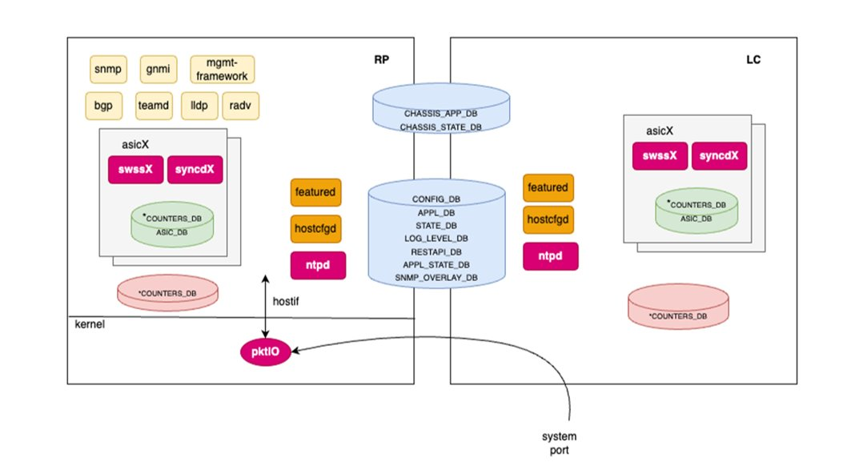
Centralized VOQ Chassis Architecture:
Centralized-chassis as a SONiC platform environment
Centralized services in Supervisor
Distributed per-namespace services in line-cards (and in Supervisor for CPU-less FC NPUs)
database-chassis
swss-central
database-central
© 2025 Cisco and/or its affiliates. All rights reserved.

Slide 10
Centralized-Chassis Platform Boot/Initialization
rc.local if the onie_platform supports Centralized Chassis architecture, set onie_platform to “centralized-chassis”, and save the original onie_platform value to onie_base_platform
Setup is_centralized_chassis, slot and npu_id for service creation/differentiation
© 2025 Cisco and/or its affiliates. All rights reserved.

Slide 11
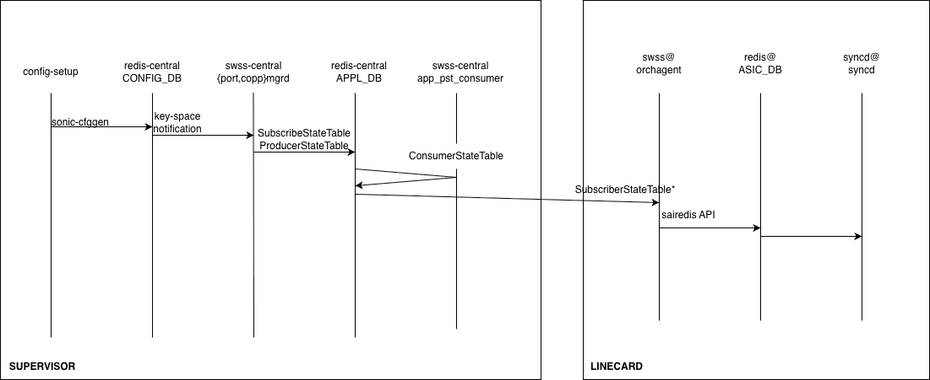
Sample Orchestration Flow: Port Orchestration
config-setup:
In supervisor, load configuration, or if existing configuration is not available, generate default configuration
In line-cards, wait until CONFIG_DB_INITALIZED is set to “1”
© 2025 Cisco and/or its affiliates. All rights reserved.
Notes:
Add a plugin in config-setup that allows platform to generate the default configuration for the chassis if existing configuration is not found. It is up to the platform to decide how the chassis configuration is generated, and this will affect how OIR will be handled.

Slide 12
Centralized Chassis Architecture Building Blocks
Hierarchical Port Naming: port name is chassis-wide unique
Split Database Model: new chassis-wide accessible database-central service
Feature/Service Placement: where different SONiC services run
Hybrid ZMQ+Redis State Distribution: replicate state from Supervisor to per-namespace orchagent swsw@
Manageability: Yang model changes, CLI, gnmi/snmp and sonic config utilities
Host Datapath Orchestration: how it is being done currently, and future SAI API enhancement
Chassis Management: manage line-card OIR and software version
© 2025 Cisco and/or its affiliates. All rights reserved.

Slide 13
Next Steps?
Centralized Chassis Architecture HLD link is here.
Reviewing HLD for each of Centralized Chassis Building Blocks? Using PR or present to (various) Workgroups (Routing, SWSS, UMF/Manageability)?
Release candidate/timeline
© 2025 Cisco and/or its affiliates. All rights reserved.

Slide 14
Thank You
Questions & Discussion

Slide 15
Technical Deep Dives

Slide 16
Split Database Model
(New) database-central service in Supervisor — chassis-wide accessible from Supervisor and line-cards in a chassis
Database hosted in database-central: CONFIG_DB, APPL_DB, STATE_DB, APPL_STATE_DB, CHASSIS_COUNTER_DB
Per-namespace database@ service still hosts: ASIC_DB, COUNTER_DB
Database in the existing database-chassis remain unchanged
Design Rationale: placing data close to its active client, minimize cross-chassis database traffic
© 2025 Cisco and/or its affiliates. All rights reserved.

Slide 17
Service Placement: Supervisor vs Line-Card Split
Supervisor/Route-Processor (Centralized)
Line Card (Distributed)
• database-central (chassis-wide DBs): CONFIG_DB, APPL_DB, STATE_DB
• Manageability: gNMI, SNMP, CLI, REST
• Network Protocols: BGP, LACP, LLDP
• swss-central: *mgrd, config distribution
• Chassis management (pmon): OIR, install, Card-Monitor
• Host path orchestration (ciscoPktIOMgr)
• Telemetry aggregation (statsCollectord)
• database@<ns> (ASIC_DB, COUNTER_DB)
• swss@<ns>: orchagent, portsyncd, portmgrd
• syncd / SAI / SDK
• Platform services (PMON, card agent)
Each LC identified by SLOT + NPU ID
environment parameters
© 2025 Cisco and/or its affiliates. All rights reserved.

Slide 18
Service Placement
Service | Location | Notes
database-central | Supervisor | CONFIG_DB, APPL_DB, STATE_DB, APPL_STATE_DB, CHASSIS_COUNTER_DB
database@<ns> | FC/LC | ASIC_DB, COUNTER_DB per NPU namespace
gNMI / SNMP / CLI / REST | Supervisor | Single management endpoint for the chassis
BGP / LACP / LLDP / RADV | Supervisor | Single routing/protocol instance
swss-central | Supervisor | *mgrd, distributord, config distribution
swss@<ns> | FC/LC | orchagent, portsyncd, portmgrd, swssconfig
syncd@<ns> | FC/LC | SAI/SDK per NPU
PMON / card agent | All | Platform monitoring on RP and each LC
CMON / install mgr | Supervisor | LC state machine, OIR, image/firmware install
© 2025 Cisco and/or its affiliates. All rights reserved.

Slide 19
Hybrid ZMQ+Redis State Distribution
Overview: SONiC Redis Pub/Sub Primitives in swsscommon
IPC Performance: Redis vs Hybrid
Route Distribution Flow
ZMQ+Redis Hybrid Approach
© 2025 Cisco and/or its affiliates. All rights reserved.

Slide 20
Manageability -
Yang Model Changes
Centralized-Chassis Default Configuration
SNMP
Telemetry
SONiC config utilities
CLI
© 2025 Cisco and/or its affiliates. All rights reserved.

Slide 21
Host Data-Path Orchestration
© 2025 Cisco and/or its affiliates. All rights reserved.

Slide 22
Chassis Management
© 2025 Cisco and/or its affiliates. All rights reserved.

Slide 23
Serviceability: Logs, Core Dumps, Show Tech (Pradeep)
Syslog & Core Dumps
Show Tech Support
• Logs stored in local file system
• Auto-rotation and compression
• Namespace-aware configuration and
show CLIs
• Core files stored locally on crash
• Backtrace generated and logged to syslog
• Configurable disk usage for core retention
• Tech support dumps stored in
distributed fashion
• Namespace and location-based execution
from RP
• Collection at RP or LC level
• Support for component-specific
dump collection
• Show tech auto-collected on core
dump detection
© 2025 Cisco and/or its affiliates. All rights reserved.

Slide 24
Status and Summary

Slide 25
Current Status
Area | Status | Details
Database placement | Completed | database-central service and all DB configuration
Centralized manageability | Completed | gNMI, SNMP, mgmt-framework on RP
Network protocol services | Completed | BGP, LACP, LLDP, RADV on RP
SONiC YANG models | Completed | Single-Instance VOQ chassis model
VOQ data plane | Completed | Switching validated across NPUs and LCs
Host data path | Completed | Punt/inject for control-plane traffic
Chassis management | Completed | LC state machine, OIR, auto-upgrade, sensors
Feature/host service config | Completed | Centralized configuration
SAI/SDK punt to remote CPU | In Progress
Version mismatch handling | In Progress | Software version mismatch and error handling
Telemetry | In Progress | CHASSIS_COUNTER_DB, statsCollectord
ZMQ-based state distribution | In Progress | Hybrid IPC for route/state distribution
© 2025 Cisco and/or its affiliates. All rights reserved.

