Slide 1
Sonic Visualiser
A program for inspecting and annotating the contents of music audio recordings
A testbed and framework for audio feature extraction methods (provided as Vamp plugins)
A visualiser and analyser, with spectrograms, time-stretcher, segment looping, auto-alignment between tracks, and other helpful inspection utilities

Slide 2
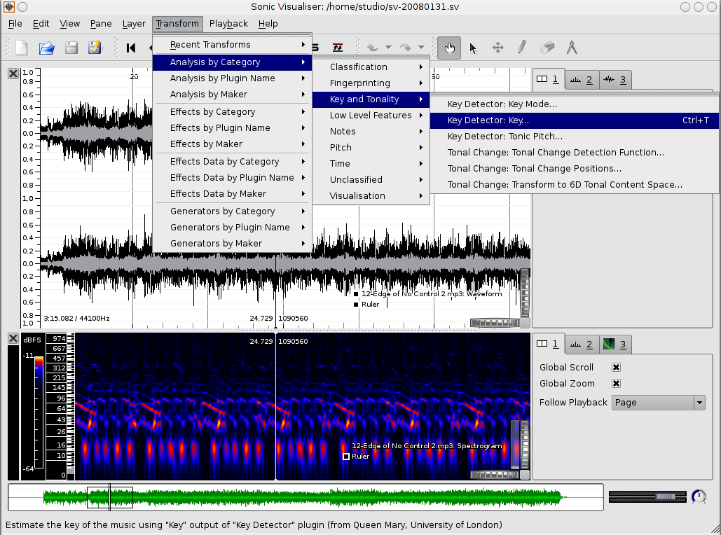
Visualisation using SV
Waveform
Spectrogram
Audio-to-
feature
transforms
using Vamp
feature
extraction
plugins

Slide 3
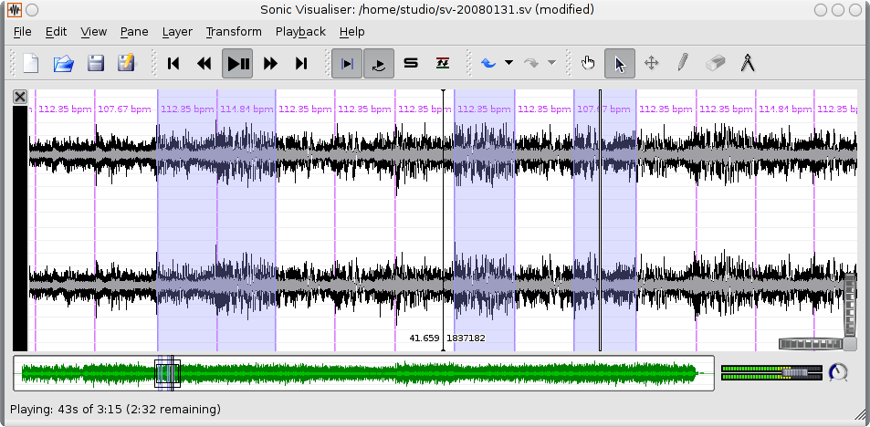
Annotation and Creation
Manual annotation of points
Flexible multi-selection by snapping to automated or manual feature positions
Play, loop,
time-stretch,
export
multi-select
regions

Slide 4
More information
Sonic Visualiser website:
http://www.sonicvisualiser.org/
About Vamp audio analysis plugins:
http://www.vamp-plugins.org/
Developed at the Centre for Digital Music, Queen Mary, University of London:
http://www.elec.qmul.ac.uk/digitalmusic/

