Slide 1
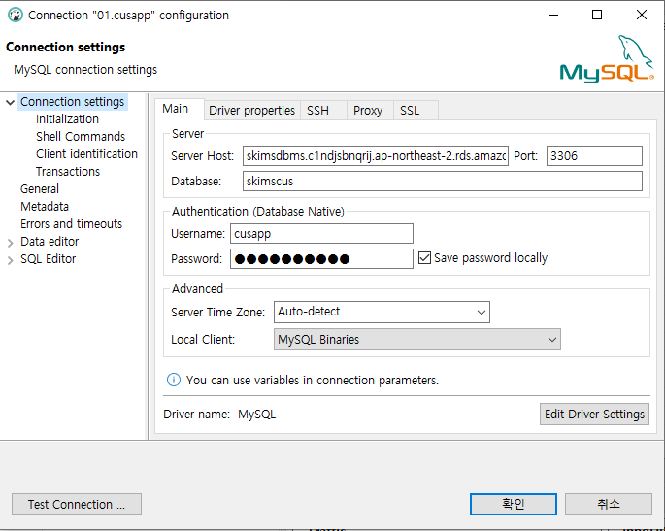
1
Server Host : skimsdbms.c1ndjsbnqrij.ap-northeast-2.rds.amazonaws.com
2
3
담당 업무별 Database 사용
Database명: skimspay, USER: payapp, PW: payapp1234
Database명: skimscnr, USER: cnrapp, PW: cnrapp1234
Database명: skimscus, USER: cusapp, PW: cusapp1234
Database명: skimsfin, USER: finapp, PW: finapp1234
Database명: skimsigd, USER: igdapp, PW: igdapp1234
Database명: skimsudw, USER: udwapp, PW: udwapp1234
Database명: skimspln, USER: plnapp, PW: plnapp1234

Slide 2
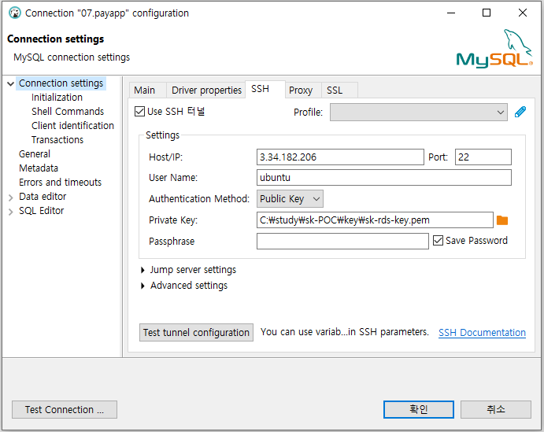
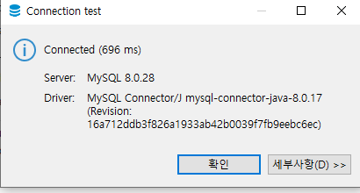
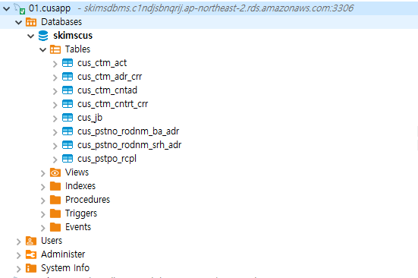
4
Bastion서버
IP : 3.34.182.206
User : ubuntu
Public key 선택 후 첨부된
sk-rds-key.pem 경로 지정
5
7
좌측 메뉴에서 접속된 Database 확인
8
6

