Slide 1
G.l.a.s.s. B.r.e.a.k.e.r.
Made by
Jeremy Therrien, Mark Aversa,
Evan Slaughter, Ryan Michaels, James deWitt

Slide 2
Game Philosophy
Ever feel frustrated with the new EMPAC building?
Well now you can take out your frustration on EMPAC in the game G.l.a.s.s. B.r.e.a.k.e.r. and break the windows of that annoying building.

Slide 3
Predecessor
A very popular game that is similar in gameplay is Rampage. Rampage is a 1980's arcade game in which the player controls various gigantic monsters and smashes, rips apart, and reduces buildings to rubble. Distinctive factors include fast paced, time-trial style levels where the character is pressured to complete by various enemies. Also, the game has a bit of strategy, where if they make wrong moves and smash the wrong windows, they can essential lock themselves in a corner with no escape.

Slide 4
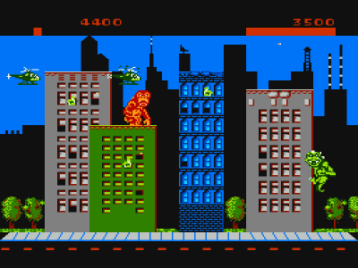
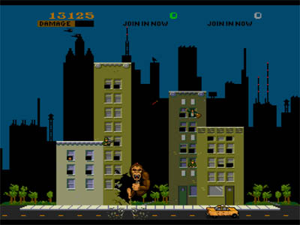
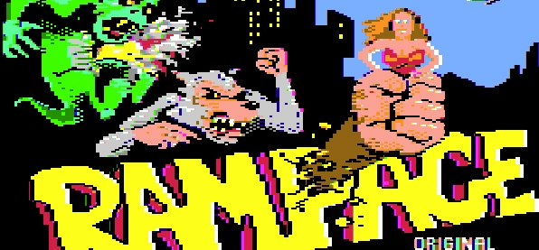

Slide 5
Target Audience
The target audience is RPI students. Specifically any who have made the observation that EMPAC’s windows would be a target for rock throwers or just want to vent their frustration about the perceived waste of money spent on EMPAC.

Slide 6
Story
In G.l.a.s.s. B.r.e.a.k.e.r. you play as an RPI student whose goal is to climb and break the windows of EMPAC. With tuition rates constantly rising what better way to take out your frustration then breaking some windows.

Slide 7
Project Impact
The immediate impact the game will have on society is the visible dissatisfaction with the EMPAC complex.
Long term impact may be much more devastating to the actual EMPAC building. Games sometimes give already disturbed people bad ideas and this may be the case. On the other hand, if the game becomes popular among students, RPI administrators may ask for student input in future construction projects to avoid the backlash that they have faced.

Slide 8
Delivery System
The game requires the Pygame ending (1.8.1 Release) and Python (version 2.5-2.6).

Slide 9
Interface
The interface of G.l.a.s.s. B.r.e.a.k.e.r. is very minimal. There is a HUD which displays the amount of money you are costing the school in window repair and replacement. A weapon bar is placed in the upper left hand corner, which displays which weapon you have equipped and also if and what other weapons you are carrying. Your health is indicated by ring around your weapon bar.

Slide 10
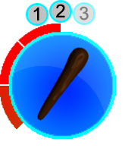
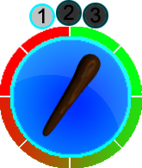
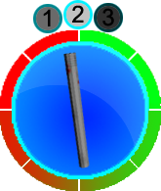
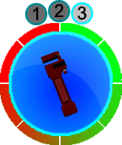
Example:
Losing Health
Weapon 1
Weapon 2
Weapon 3
The weapon numbers are darkened out if they are unavailable, grayed out if they are not equipped but available, and fully visible if equipped.

Slide 11
User Interaction
The player moves around using the W, A, S, D keys to move up, left, down, and right accordingly. Up, down, left and right attack the corresponding windows.
Space bar+W, A, S, D will cause the player to jump over one mirror in the corresponding direction.

Slide 12
The World Layout
The background shows EMPAC from the side. This is all the player can go to. Different levels incorporate the background to different goals but the location remains the same.

Slide 13
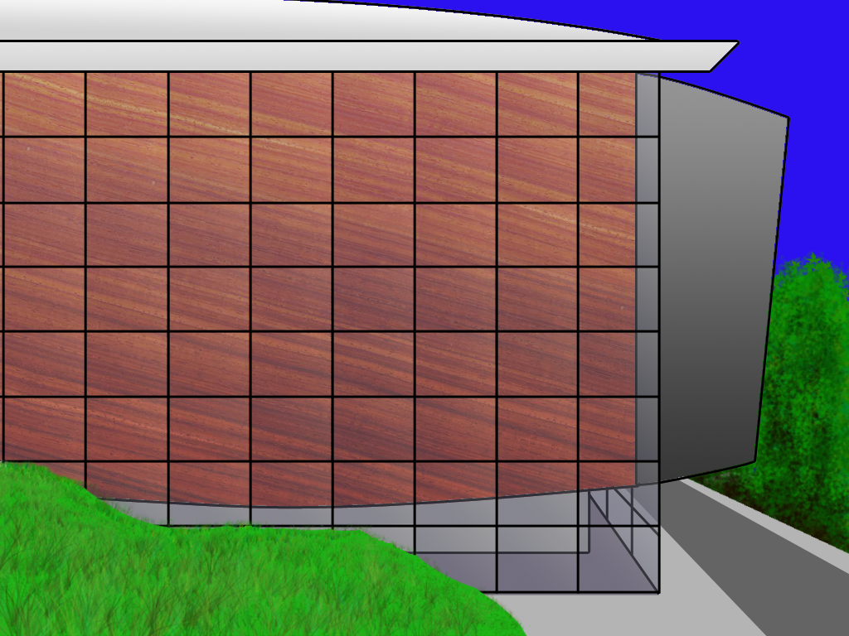
Background

Slide 14
Level Design
The main space that the player can travel on is the glass face of EMPAC. They can only travel on the window panes. The police/public safety officers travel only on the ground and on the roof of the building.
The interesting part about the level design is that the building is built on a slope, making movement more difficult .

Slide 15
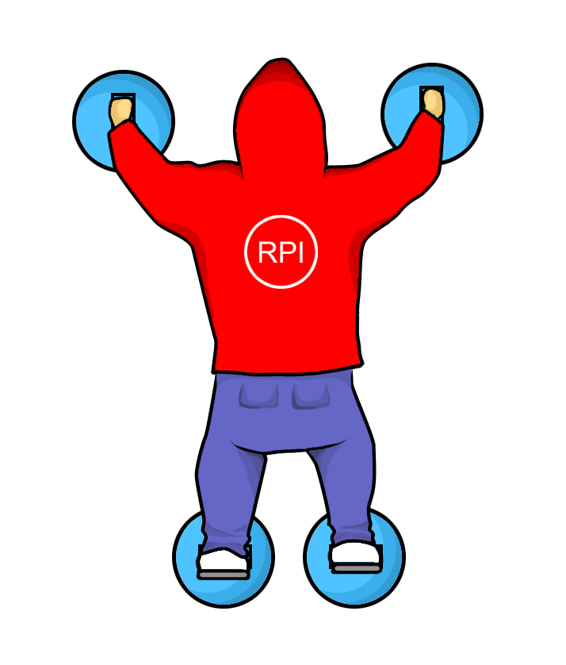
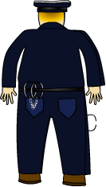
Characters
Player
Public Safety

Slide 16

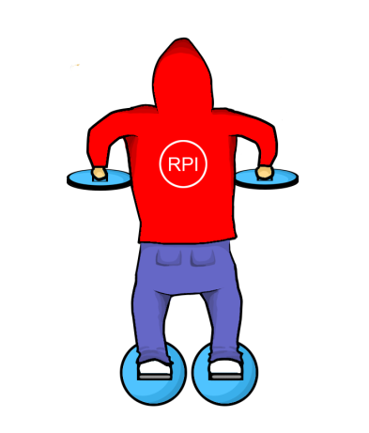
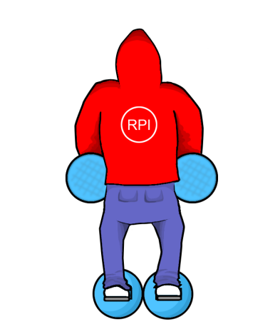
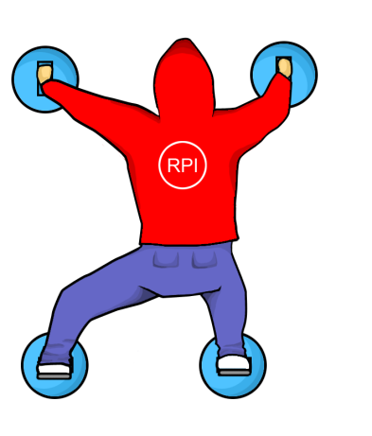

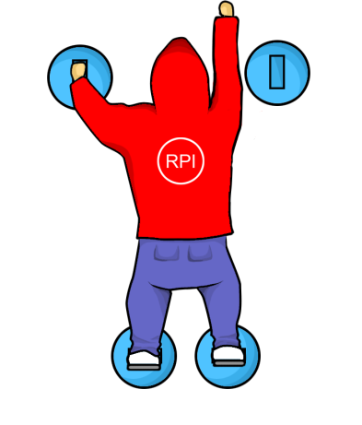
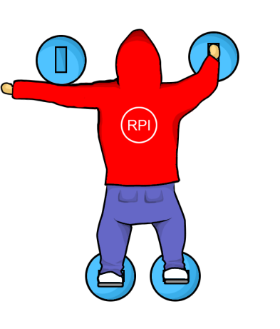
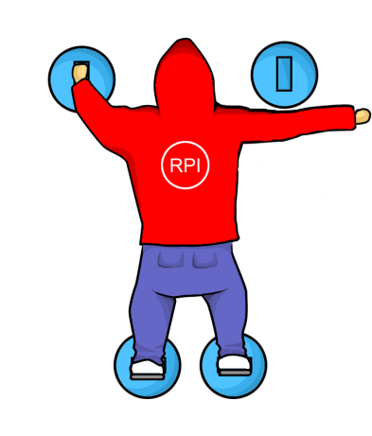
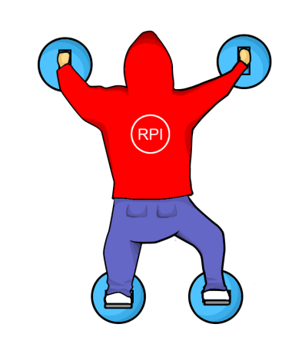
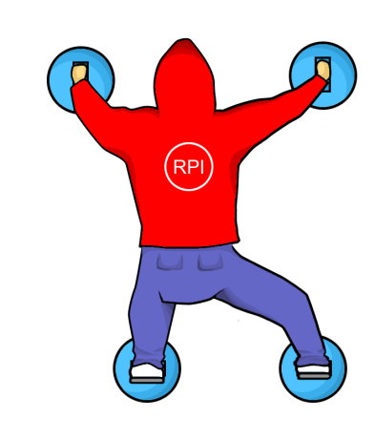
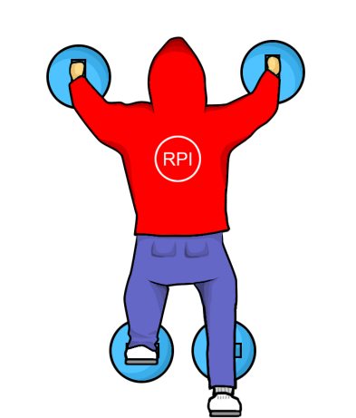
Animations
Jump
Move Left
Attacks:
Up
Move Right
Left
Right
Down

Slide 17
Music/Sound Design
The main sounds are:
suction cup popping sounds
glass breaking
tinkling sounds when a window is broken
whooshing sounds when a projectile is thrown
police sirens
The game could also have a generic ambient music loop in the background.

Slide 18
Gameplay – A: Setup
The player’s starting position is a randomly selected window.

Slide 19
Gameplay – B: Gameplay
The goal of the game is to move around from window to window while avoiding public safety as they try to stop the player. The more windows the player breaks the higher their score will be. If a player gets trapped or public safety hits them enough times, the game ends.

Slide 20
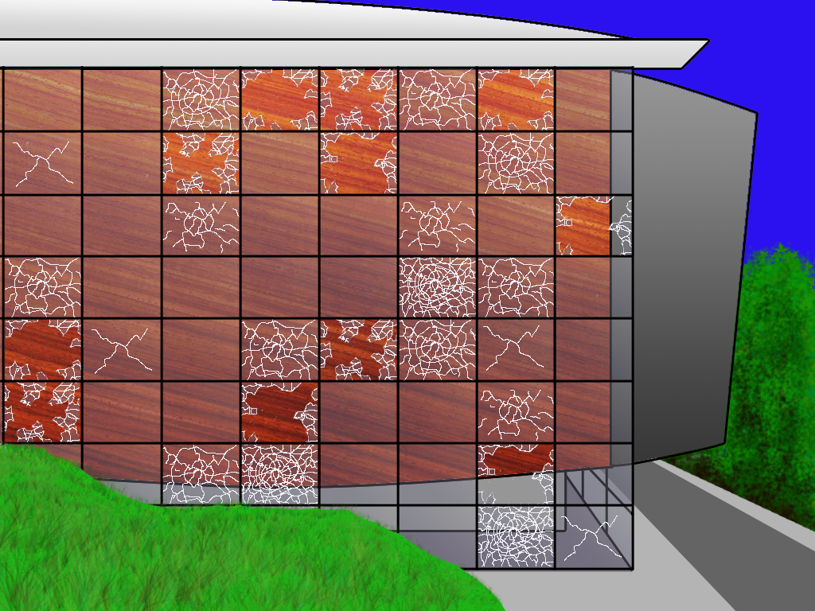



Screenshot

Slide 21
Gameplay – C: Scoring
The players score is the cost to replace a window x percent damage done.

Slide 22
Program Structure
Written in python. Screens organized in a stack. Each Screen is a Layer and is managed by a layer manager. Each Screen calls the creation of classes that are placed onto that screen. Each class contains: HandleEvent?, Update, and Render functions to be called by the screen. Every different entity will have its own file and class.

Slide 23
Implementation
This game has a simple implementation: 2D world, 4-way movement, and simple AI.

Slide 24
Production Timeframe
The timeframe to complete this game would be between 1 and 2 months. Basic prototype in 2 weeks, cleaned-up Beta in 1 month, then anywhere between 1-2 weeks of play-testing and balancing. Basic art assets would be completed by the 2-week mark, with full animations completed within 4-6 week mark.

Slide 25
Contributions
Jeremy - temporary art, game framework, player control and movement, background
Mark - enemy AI, temporary art
James - Background and window design
Ryan - player character animations
Evan - balloon and enemy animations
All members contributed to the Game Design Document

Slide 26
Disclaimer
This game does not actually reflect the views of the developers.

