Slide 1

2017
CloudIDE
Sales Deck
2017.2.12
ICT Development

Slide 2
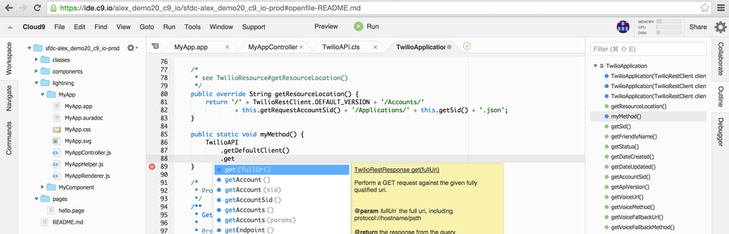
Cloud9
an intuitive, modern, cloud-based development environment
for Apex, Visualforce, and Lightning

Slide 3
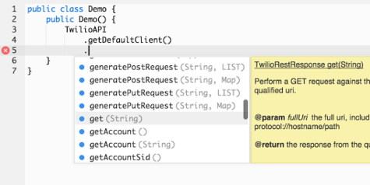
Cloud9
Optimize productivity
Cloud9 brings advanced editing tools to Apex, Visualforce, and Lightning development. It's the level of quality and power you're accustomed to in other programming languages. Inline function lookup, autocomplete, code analysis and error-detection make your code clean and easy to maintain.

Slide 4
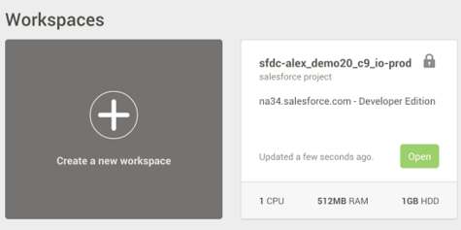
Cloud9
Eliminate annoyances
Use your dashboard as a unified hub for all your Salesforce projects, accounts and orgs. Automatically keep your code in sync with the Force.com website and push to GitHub and Bitbucket for source control, so you can stay focused on development, not reconciling changes.

Slide 5
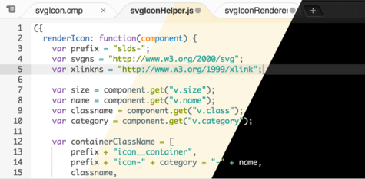
Cloud9
Customize everything
Personalize your development environment however you like with Cloud9's robust configuration tools. Choose bright or dark interface colors, fine-tune colors for syntax highlighting, configure custom key bindings, organize code snippets, and customize tab layouts to match your own style and workflow.

Slide 6
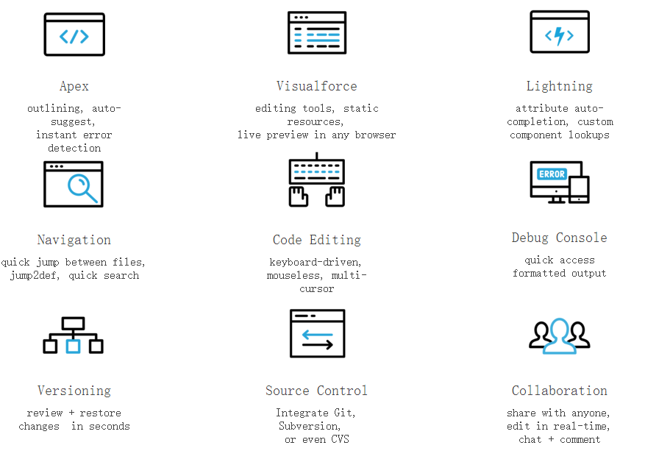
Cloud9
Powerful features

Slide 7
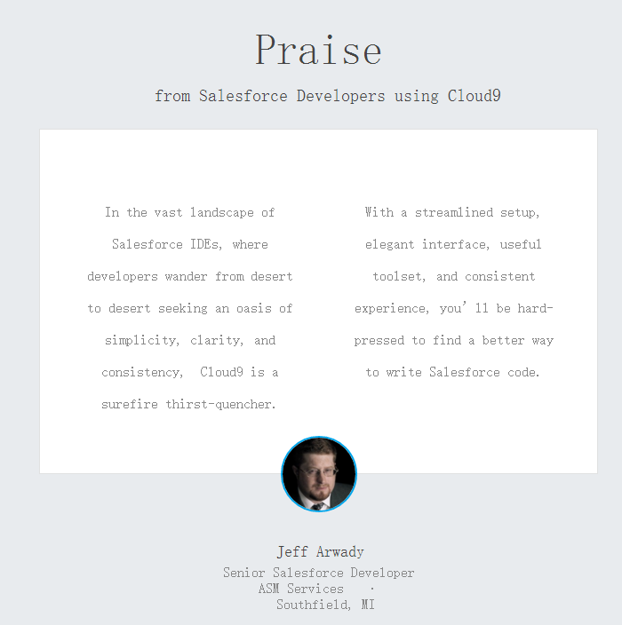
Cloud9

Slide 8
Explore Codenvy
Quick install, multi-machine workspaces.
Simplify how you onboard development teams.
Install Codenvy behind a proxy or even offline. Run multiple machines in your workspace with a compose file. Mount your desktop IDE to a portable Codenvy workspace.
Cloud developer workspaces that are accessible from any browser or local IDE. Roles and permissions allow you to control who and how users access workspaces.
Better collaboration and team development with JIRA.
Eclipse Che for enterprises, making software development better.
Codenvy seamlessly integrates with JIRA issue management, allowing anyone to work on any issue without having to install software first.
Codenvy builds upon Eclipse Che to deliver workspaces for development teams, and a scalable workspace management platform for DevOps.

Slide 9




Codenvy Customers
TIAA-CREF is revolutionizing how they develop and deploy software, and Codenvy is at the heart of the improvements.
Red Hat embeds Codenvy in the Open Shift workflow to make developing, debugging and deploying apps simple.
SAP uses Eclipse Che as the workspace server underlying all the developer tooling for their Hana Cloud.
Youth Digital marries its teaching software and Codenvy's IDE to make learning Java fun for thousands of kids.

Slide 10
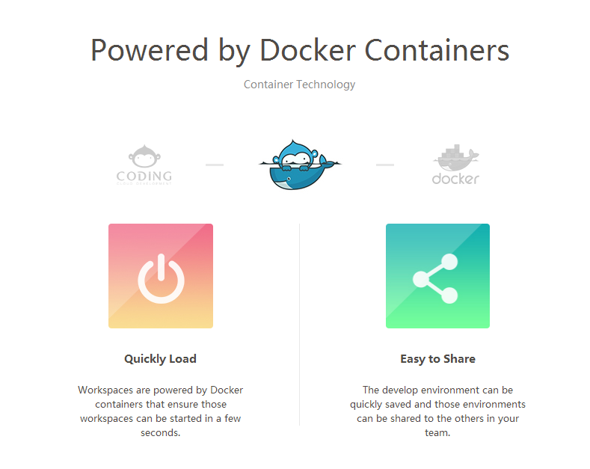
Coding WebIDE
Coding WebIDE is a cloud-based IDE developed by Coding Team.You can create your own workspace and develop projects here.WebIDE works fine with Git. You can use Coding、GitHub、BitBucket、Git@OSC as your Git repository. Workspaces are powered by Docker Ubuntu containers.The development environment can be saved and shared to your team member.

Slide 11
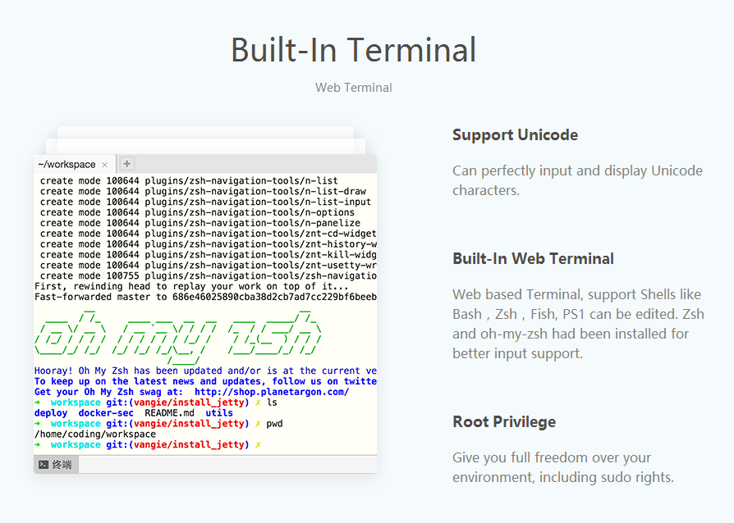
Coding WebIDE

Slide 12
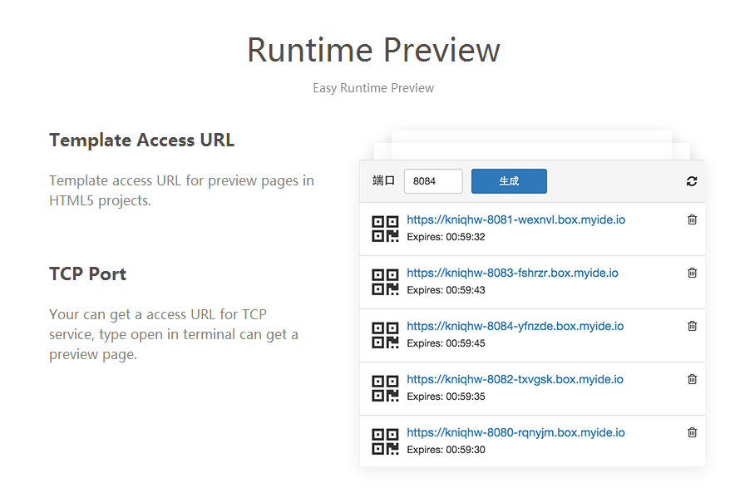
Coding WebIDE

Slide 13
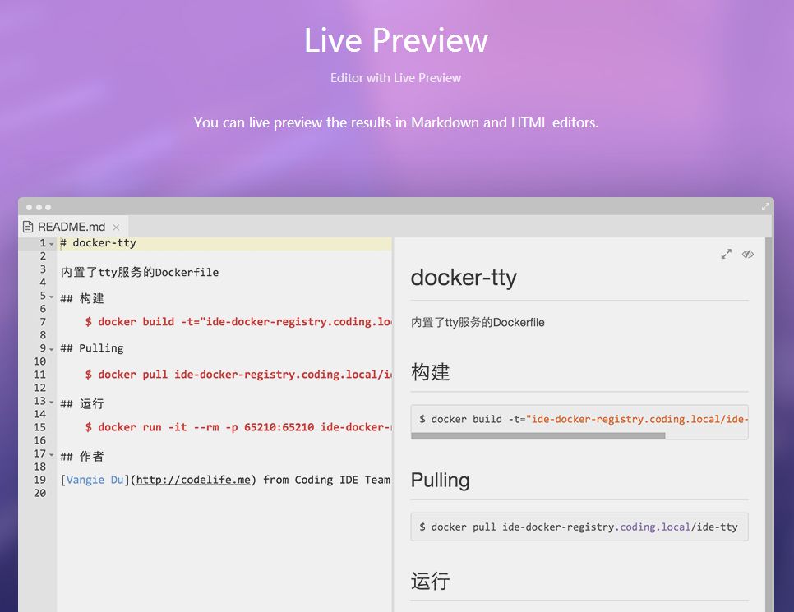
Coding WebIDE

Slide 14
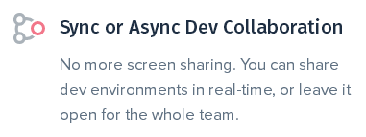
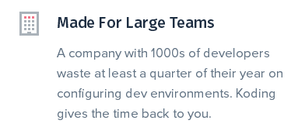

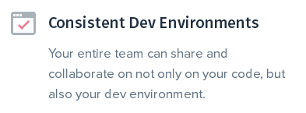
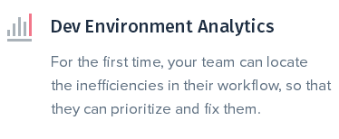
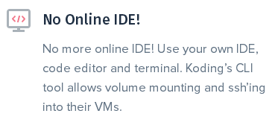
Koding

Slide 15

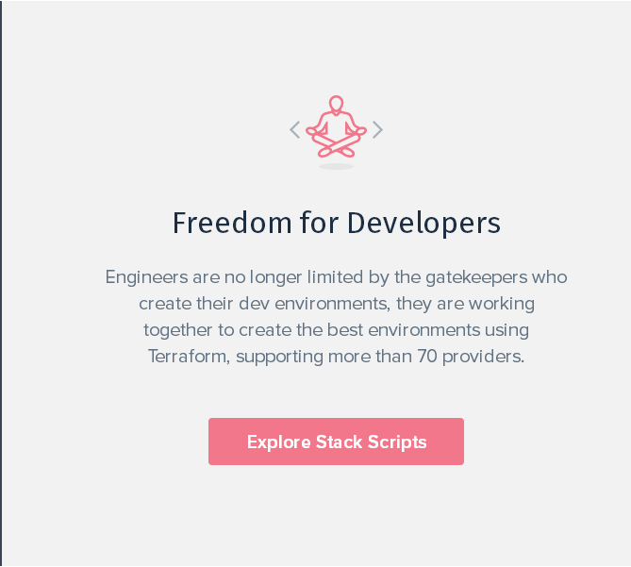
Koding

Slide 16
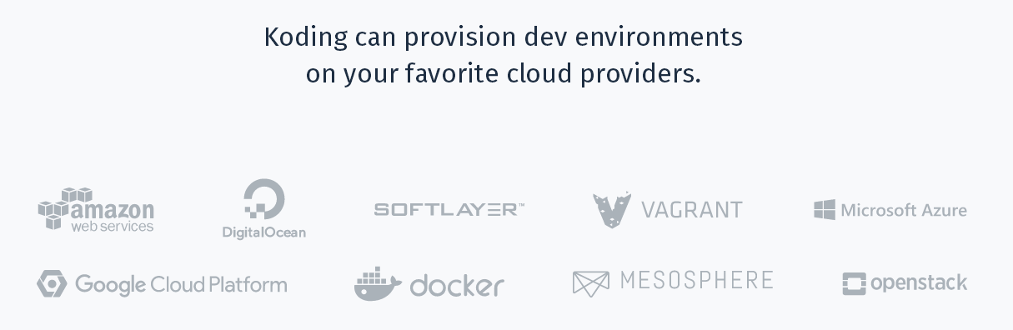
Koding

Slide 17
Koding
WHAT PEOPLE ARE SAYING ABOUT KODING
“Koding provides every developer with access to information and data on the best practices used by your entire team.”
- Michael Girouard, Senior Engineer at CloudFlare
“Using Koding helps developers get up-to-speed in a matter of minutes so they can focus on their code. As for our customers, I'm personally trying to guide us through a redesign of our platform experience which would hopefully alleviate the need for complicated dev environments, We are evaluating Koding to bridge the gap between local development and production environments.”
- Collin Donahue-Oponski, UX Lead, Platform UI/UX Team at DigitalGlobe
Client
Finance
Internal
“We are doing internal training at Accenture, when I setup my classes on Koding, no one needs to do any setup anymore.”
- Arkadi Shishlov, Software Engineer at Accenture
“GitLab+Koding means you can ship code faster, and contribute to more projects in a collaborative environment.”
- Sid Sijbrandij, Co-founder, CEO at GitLab
Development
XXXX
XXXX
XXXX
XXXX

