Slide 1


















NotesHub
A Git-Inspired Version-Controlled Knowledge Management System
3CP08 – Design Engineering
23CP050 – Het Soni
23CP054 – Meet Patel

Slide 2
Core Problem
Academic Knowledge is fragmented across:
Messaging apps
PDFs
Online explanations
Personal notebooks
Observed Issues
No centralized control
No history tracking
No conceptual linking
Difficult revision

Slide 3
Primary Stakeholders
Students
Secondary Stakeholders
Professors
Academic institutions
User Pain Points:
Losing previous note versions
Scattered materials
Lack of structured revision

Slide 4
Students need a structured system that organizes, tracks, and connects academic knowledge to improve revision and conceptual clarity.

Slide 5
Ideation
A simple Notes app, lacks versioning also cannot share notes or have multiple medium of notes
Inspired by Git – A git like version control for Notes
Public and Private Notes analogous to public and private repository of git
Knowledge evolves – notes should too

Slide 6
Solution :-
NotesHub
SubjecNotes (repo-like containers)
Snapshot-based versioning
Restore mechanism
Concept Linking
Notes Linking
Search Public notes using tags
Forking (get a copy of a public note)

Slide 7



TECH STACK

Slide 8
Versioning – Data Integrity + Traceability
Why Versioning?
Overwrite content, when changes are made
NotesHub
Immutable snapshots
Safe editing
Restoring support

Slide 9
Restore – Fail-Safe architecture
Restore does not delete history
Creates a new version
Maintains audit trail

Slide 10
Linking – Interconnected knowledge modeling
Notes reference each other
For example, in some notes there are some topics that have their own stand alone notes, user can link them and visit when they want to dive deep into the topic

Slide 11
Database Design Decisions
Why PostgreSQL?
Strong relational integrity
Clear entity relationships
Efficient foreign key constraints
Design decisions:
UUID for scalability
Snapshot storage
Unidirectional relationships (to avoid system complexity)

Slide 12
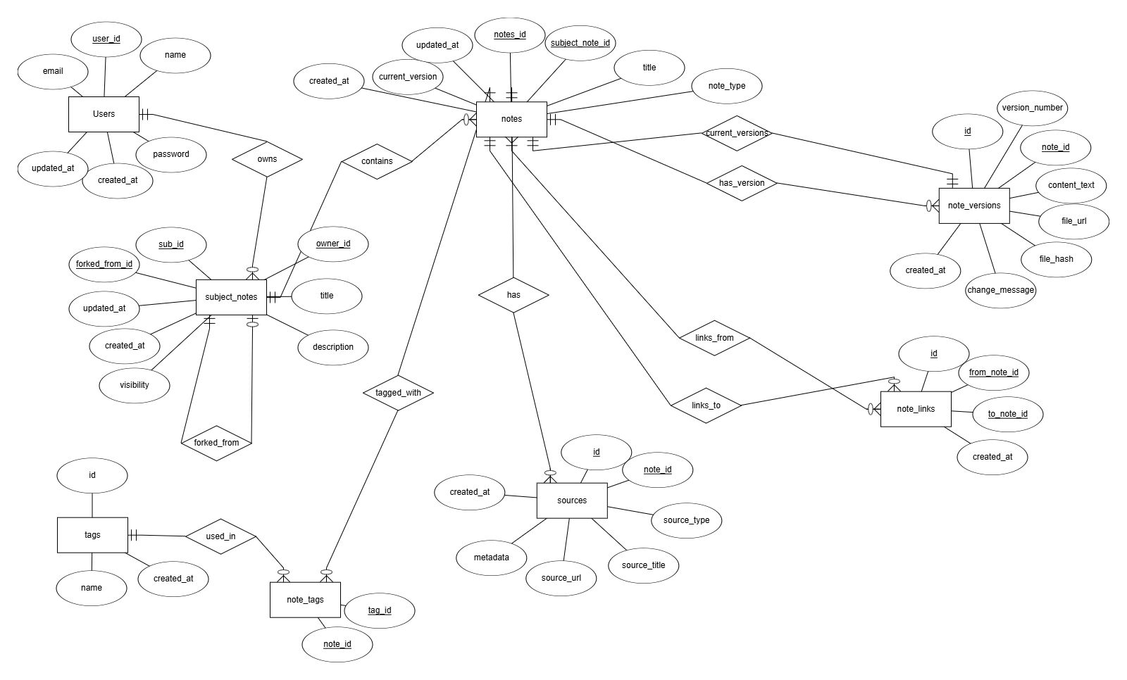

Slide 13
What’s Done?
We have implemented Backend, in which we have implemented the following end points:
/users : to create users
/subject-notes : To create a subject
/notes : to create a note inside a subject
/versions : to save a version
Frontend:
NoteEditor
Dashboard
Signup/Login
Datebase design

Slide 14
What’s to be Done?
Tag-based organization
AI-assisted summarization
External source integration
Rest of the frontend pages

Slide 15
Conclusion
Identified fragmentation in academic knowledge management
Designed a version-controlled note system inspired by Git principles
Implemented snapshot-based versioning for data integrity
Enabled structured linking for conceptual learning
Built a modular and scalable architecture using Spring Boot and PostgreSQL

Slide 16
THANK YOU

