Slide 1
CLAIMS ANALYSIS
Big Data Analytics
10/18/2017
By: Shravya Maroli
Piyusha Biswas
Sonika
Clay

Slide 2
Challenges with data wrangling
Many observations with “NULL” variables
observations with “NULL” age values were removed
Two columns in the two transaction datasets ServiceToDate and ServiceFromDate were classified differently in part 1 and 2.
These variables were removed before appending the tables together and merging the transaction data with the claims data
Unusual observations removed
Aggregate variables created for number of transactions performed per claimant, sum of payment amount, and total incurred cost per claim

Slide 3
Inferences from Analysis
When we plotted the first graph, to know total claims year wise, we observed that after 2002 we had seen an increase but there was a sudden drop in 2014.
We thought of concentrating on the potential reasons of why this could be possible and what areas needs to be concentrated on.
Following is a story to tell about it

Slide 4
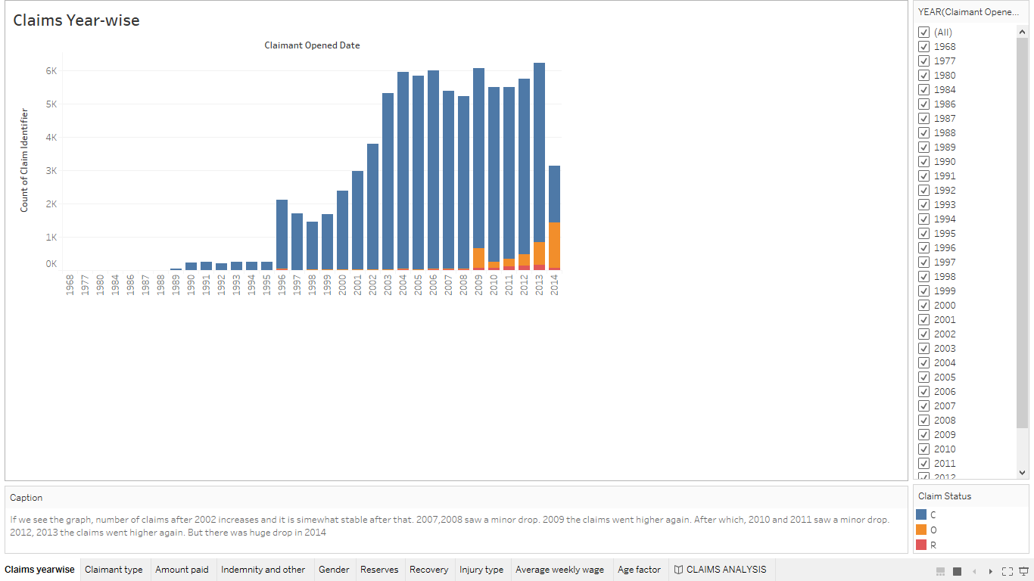

Slide 5
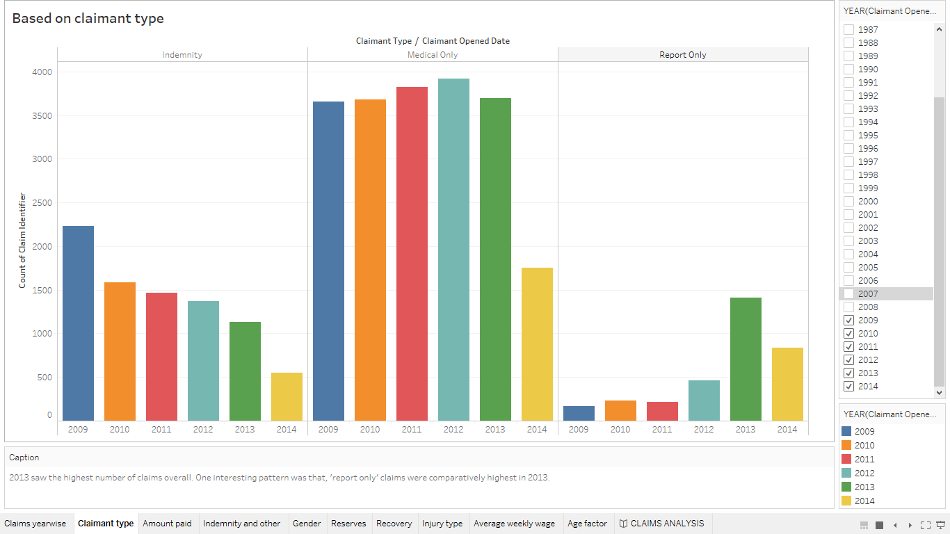

Slide 6
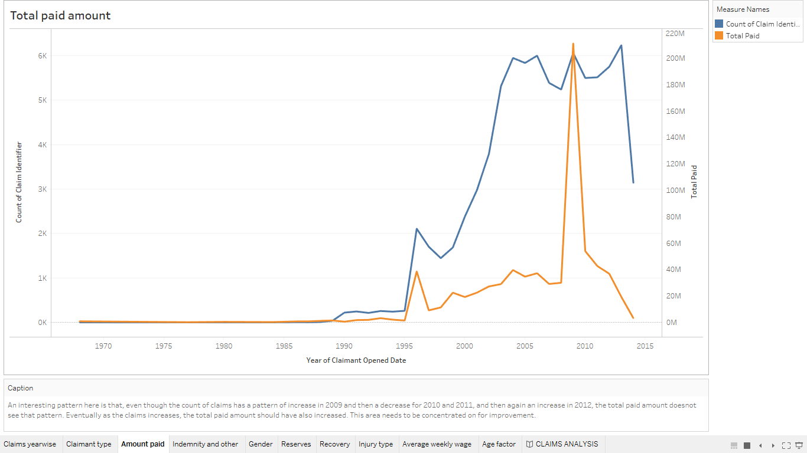

Slide 7
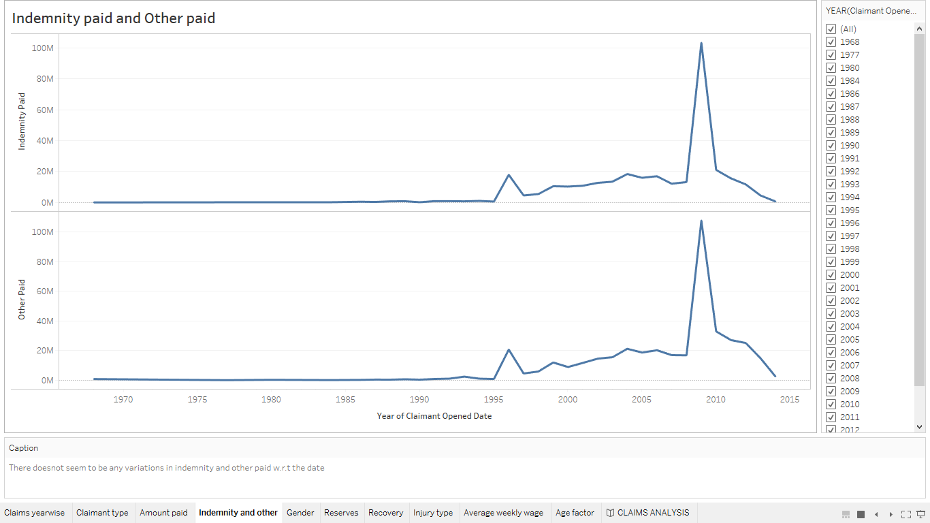

Slide 8
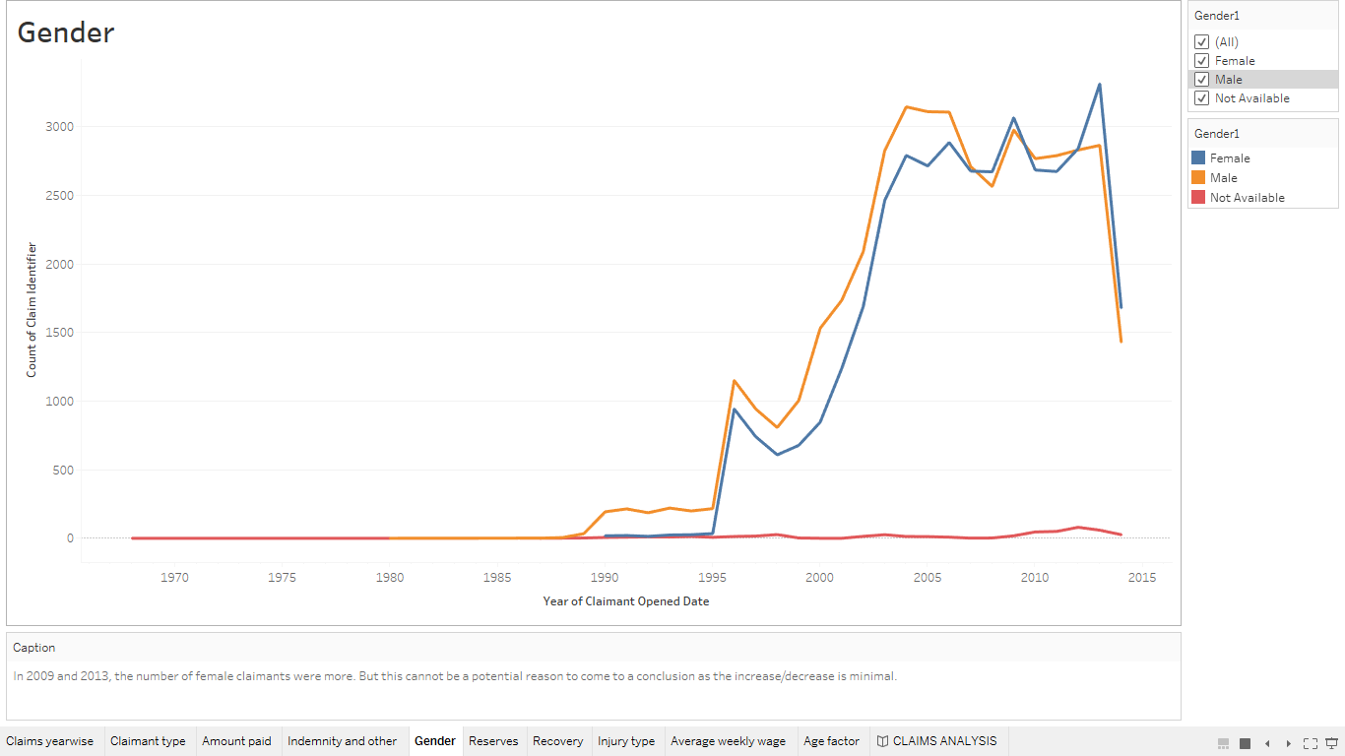

Slide 9
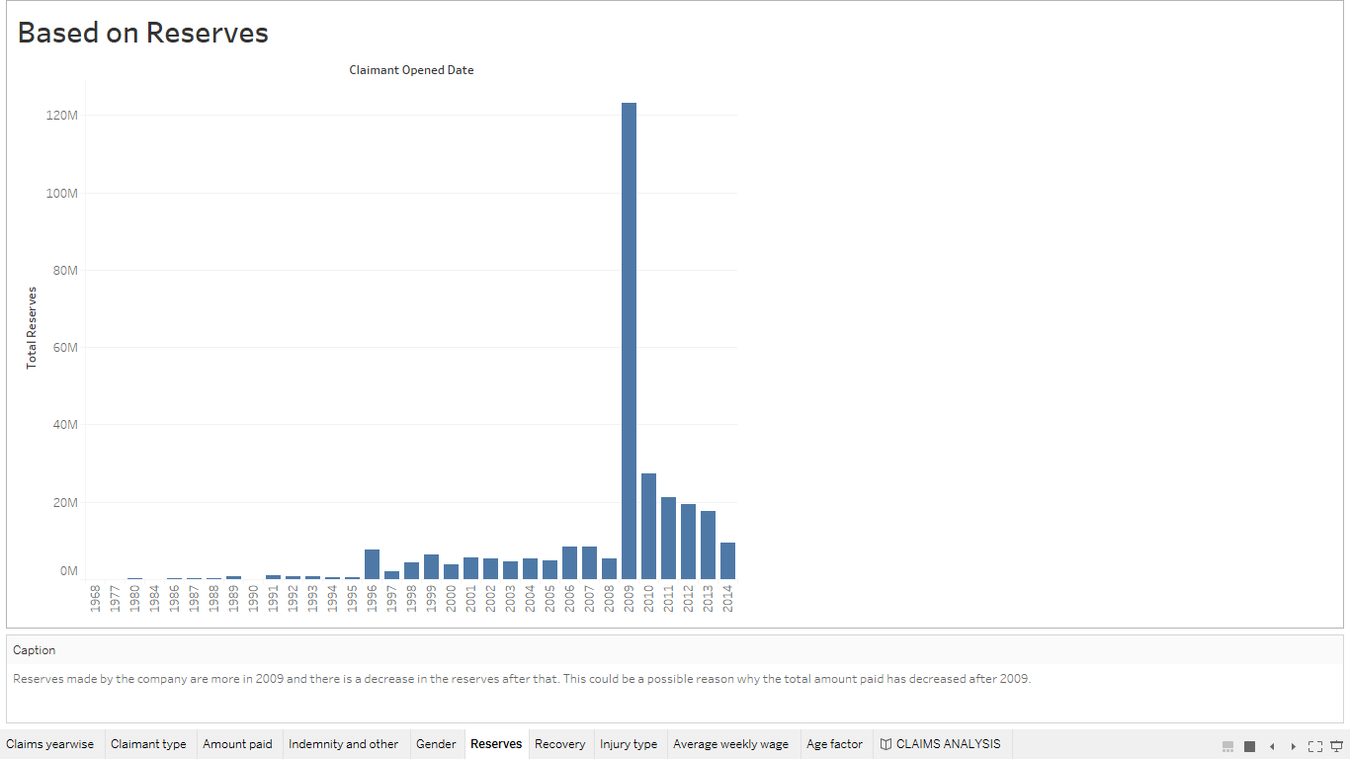

Slide 10
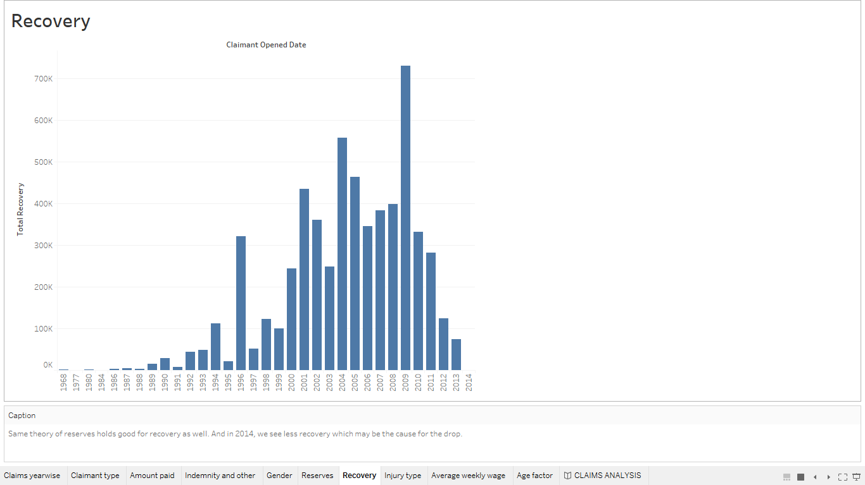

Slide 11
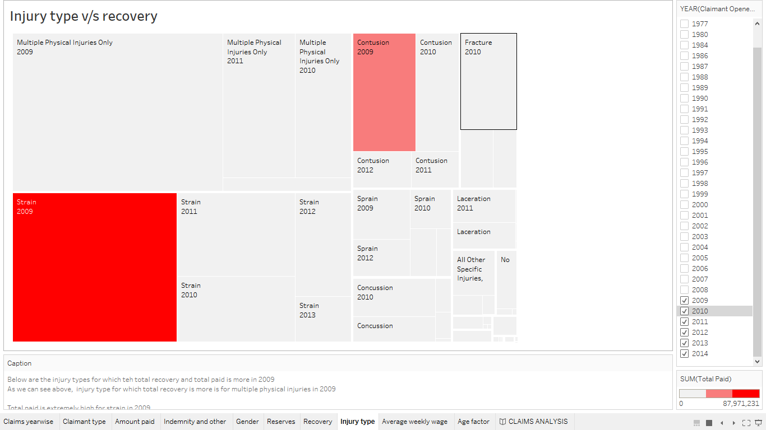

Slide 12
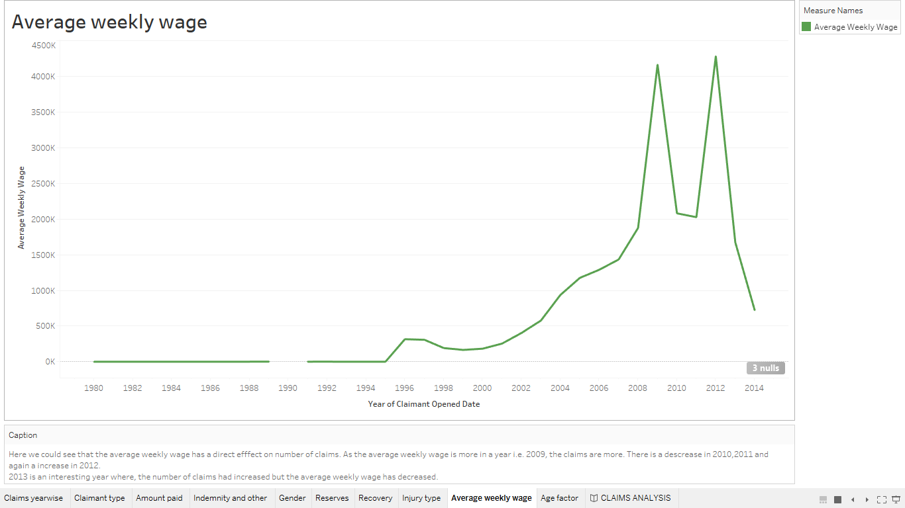

Slide 13
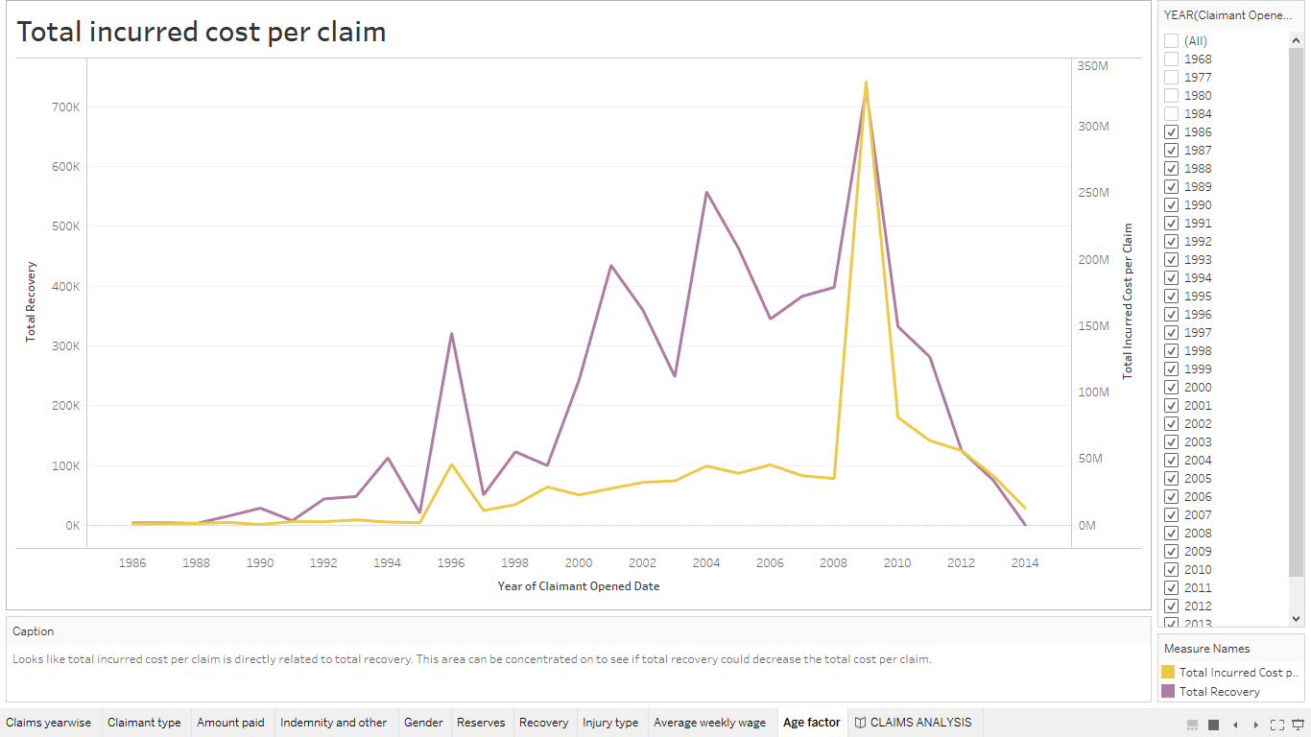

Slide 14
What can be analyzed by the claims company for improvement
When average weekly wage for a year was more, more claims were raised. So, it is potential to concentrate on the claims policy when the average weekly wage is more and understand what can be done to initiate people with low weekly wage to initiate the claims.
More recovery should eventually decrease the total cost per claim, which is not the case as per analysis. Need to be researched on why it could be possible.
Total paid has decreased after 2009, even though number claims are increased. This may be possible because reserves and recovery have decreased. But the payment needs to be concentrated on to increase the effect.

Slide 15
Questions?

