Slide 1
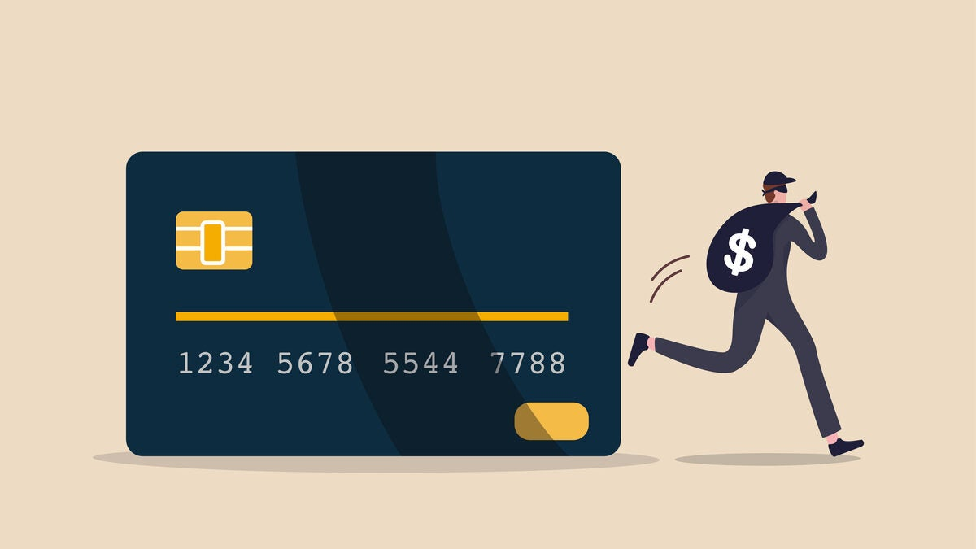
Credit Card Fraud Detection

Slide 2


Problem Definition
Credit card fraud is a growing issue affecting businesses and consumers. Detecting fraudulent transactions in real-time is critical to prevent financial losses and ensure customer trust. The goal of this project is to build a machine learning-based fraud detection system capable of identifying fraudulent transactions with high accuracy and efficiency.

Slide 3
What credit card-fraud detection does?
• The Credit Card Fraud Detection Problem includes modeling past credit card transactions with the knowledge of the ones that turned out to be fraud. This model is then used to identify whether a new transaction is fraudulent or not. Our aim here is to detect maximum of the fraudulent transactions while minimizing the incorrect fraud classifications

Slide 4
Traditional Rule-Based Method
Geolocation Rules: Flags transactions from locations far from the cardholder's usual areas.
Transaction Amount Rules: Flags large transactions exceeding a predefined threshold.
Frequency Rules: Flags multiple small transactions within a short time, especially from different locations.
Billing Address Mismatch: Flags transactions when the billing address doesn't match the cardholder's registered address.

Slide 5
Project Objectives
Analyze credit card transaction data to identify patterns of fraudulent behavior.
Build a predictive model to classify transactions as fraudulent or legitimate.
Visualize insights and trends using Power BI dashboards for stakeholder
reporting.
Implement and evaluate multiple machine learning algorithms to find the most
effective approach.
Ensure scalability and real-time fraud detection capabilities for
deployment.
For example, if a fraudster tries to use a card in a faraway city or
makes multiple small transactions quickly, the system can flag it immediately

Slide 6
Project Workflow
Content: Visual flowchart or bullet points covering.
Data Preprocessing: Cleaning, encoding, and feature engineering.
Exploratory Data Analysis: Identifying trends and patterns.
Model Development: Training and evaluating ML algorithms.
Visualization: Power Bl dashboards for insights and trends.
Let’s say a customer’s card is used for five transactions in five minutes from different cities.
The ML model identifies this as suspicious based on the patterns it has learned.
Power BI then displays this activity on a dashboard, showing the
locations and flagging the transactions as high-risk.

Slide 7
Tools and Technologies
Data Analysis Tools:
Python libraries such as Pandas, NumPy for data manipulation, and Matplotlib, Seaborn for preliminary visualizations.
Machine Learning Frameworks:
Scikit-learn for implementing Random Forest and Decision Tree algorithms.
Imbalanced-learn for handling skewed data distributions.
Visualization Tool:
Power BI for creating dynamic dashboards and presenting model results.
Data Source:
Public datasets like Kaggle’s Credit Card Fraud Detection Dataset.
Deployment Environment:
Local machine or cloud services for model development and testing.

Slide 8
ABOUT DATASET
• We gathered the data from
Kaggle(https://www.kaggle.com/datasets/kartik2112/fraud-detection/data)
This dataset of credit card transactions that spans from January 1, 2019, to December 31, 2020. The dataset includes a total of 1,048,574 transactions made by 1,000 customers across a diverse range of 800 merchants. Each transaction is labeled as either legitimate or fraudulent, allowing for insightful analysis into consumer behavior and fraud detection.
Key Features:
Transaction details: amt, category, trans_date,trans_time.
Customer demographics: gender, city, state.
Location data: lat, long, merch_lat, merch_long.

Slide 9
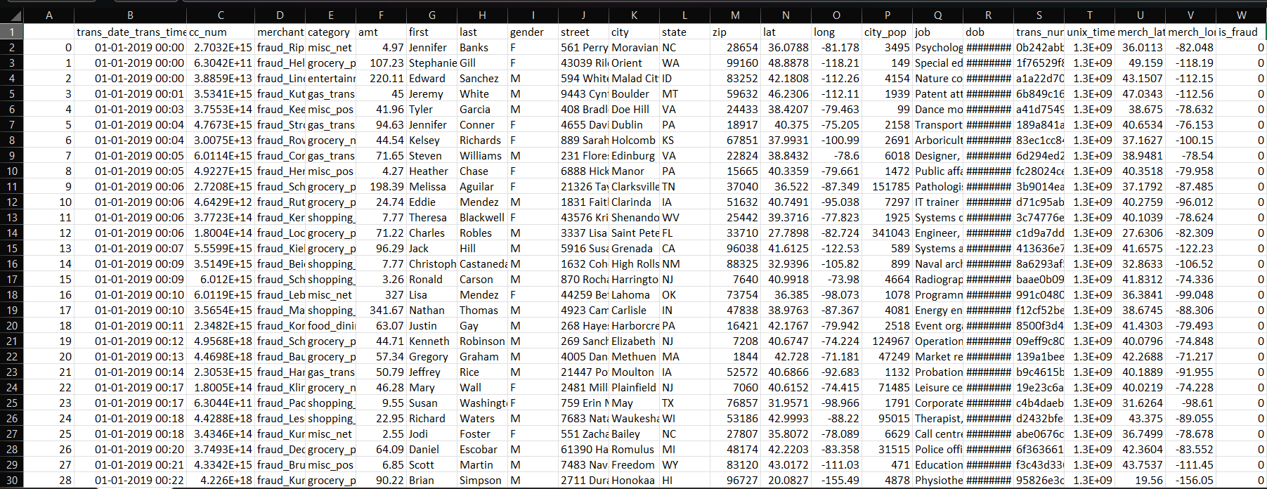

Slide 10


