Slide 1
Task 4: Dashboard Design
E-Commerce Sales Dashboard Summary

Slide 2
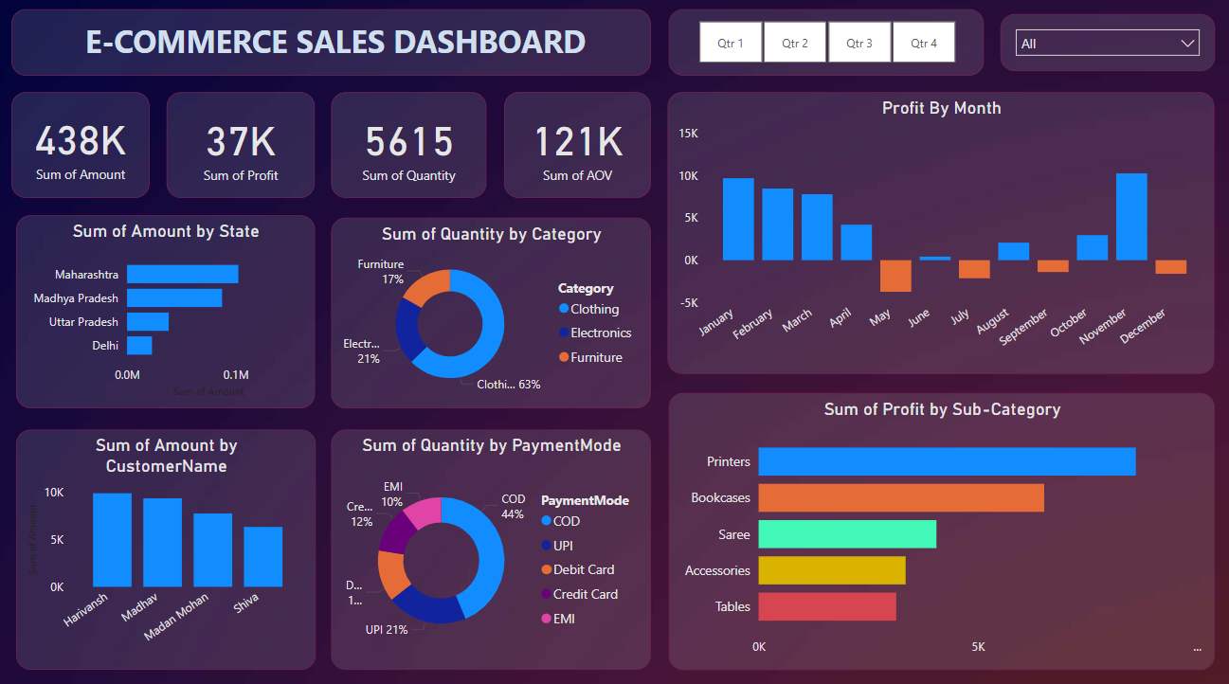
Dashboard Screenshot

Slide 3
Implementation Steps
Get Data: Import e_commerce_data.csv into Power BI
Data Preparation: Clean and transform in Power Query
DAX Measures: Total Amount, Profit, Quantity, Avg Order Value
Design Layout: KPI cards, charts, slicers, bookmarks
Interactivity: Quarter buttons, category slicer
Formatting: Dark theme, consistent fonts and colors
Publish: Export to Power BI Service or PDF/PPT

Slide 4
Key Insights
Q4 shows the highest profit of the year
Maharashtra leads in sales amount
Clothing constitutes 63% of quantity sold
COD represents 44% of payment mode share
Printers and Bookcases drive the highest profit

Slide 5
Best Practices
Use KPI cards for high-level metrics
Employ bookmarks for easy quarter filtering
Add slicers for dynamic data exploration
Maintain consistent dark theme and accent colors
Ensure clear labels and tooltips for accessibility

Slide 6
Deliverables
SalesDashboard.pbix
Dashboard_pic.png
Task4_Summary.pptx

