Slide 1
Problem Solving with Data Structures using Java:
A Multimedia Approach
Chapter 4: Objects as Agents: Manipulating Turtles

Slide 2
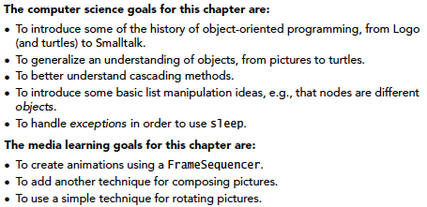
Chapter Objectives

Slide 3
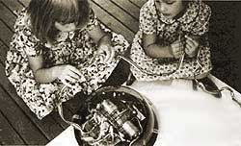
The Logo Turtle
Originally, a robot with pen
  For children to program graphics, in a day before graphics terminals.
  Literally, a pen would drop down (with the command penDown) and would draw on the paper below it, as the turtle moved with commands like forward and right.
Nowadays, replaced with a graphical representation.

Slide 4
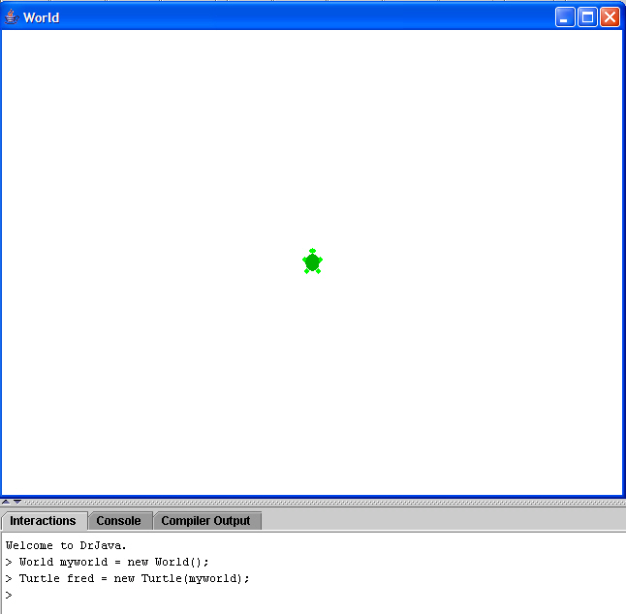
Notes:
You will need to recompile SimpleTurtle, World, ModelDisplay, and Pen. And maybe Turtle.

Slide 5
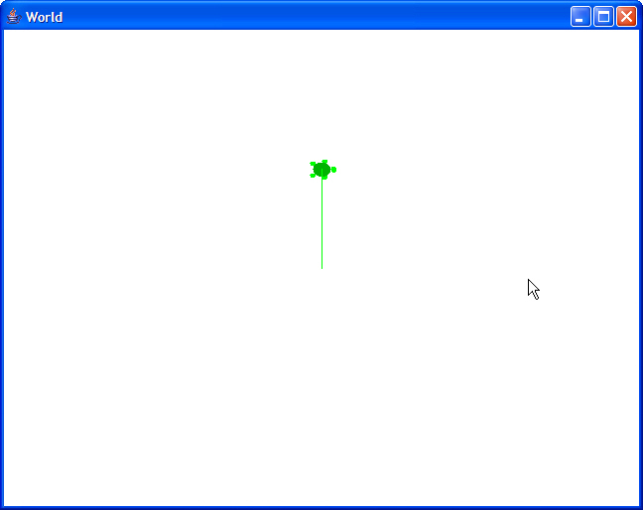
Turtles can go forward and turn;
they know heading and position
> fred.forward(100);
> fred.turn(90);
> fred.getHeading()
90
> fred.getXPos()
320
> fred.getYPos()
140

Slide 6
Obviously: Turtles are objects
Turtles can do:
  forward(pixels)
  turn(degrees)
Turtles know:
  Heading
  Position

Slide 7
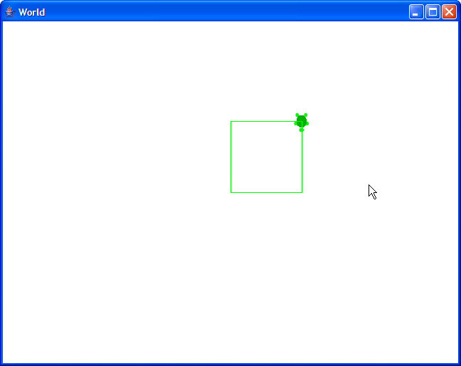
Drawing with Turtles
> for (int sides=0; sides <= 4 ; sides++)
{fred.forward(100); fred.turn(90);}
// Actually did five sides here...
Notes:
Can do these things body syntotically

Slide 8
Can we cascade?
Will this work?
turtle.forward(100).turn(90)
Hint: Think about the returns!

Slide 9
Modern turtles:
Turtle Geometry and StarLogo
diSessa and Abelson’s Turtle Geometry showed that simple turtle geometry could explore complex math, including Einstein’s Theory of Relativity
Mitchel Resnick’s StarLogo used thousands of turtles to explore behavior of traffic, ants, and termites.

Slide 10
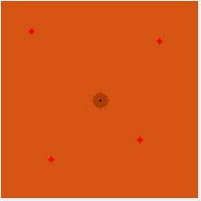
Exploring ants with turtles
Each turtle:
Move randomly
If you find food: Grab it, go home, dropping scent.
If you find scent, turn towards the direction of the scent.

Slide 11
public class LotsOfTurtles {
public static void main(String[] args){
// Create a world
World myWorld = new World();
// A flotilla of turtles
Turtle [] myTurtles = new Turtle[100];
// Make a hundred turtles
for (int i=0; i < 100; i++) {
myTurtles[i] = new Turtle(myWorld);
}
//Tell them all what to do
for (int i=0; i < 100; i++) {
// Turn a random amount between 0 and 360
myTurtles[i].turn((int) (360 * Math.random()));
// Go 100 pixels
myTurtles[i].forward(100);
}
}
}
100
Turtles

Slide 12
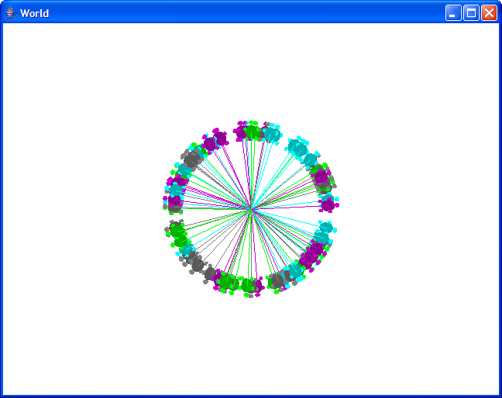
Making a circle

Slide 13
How did that work?
We created an array to hold 100 turtles,
then created 100 turtles in that array and in the World myWorld.
We told each to turn a random amount. If random is truly uniform (no peaks), then the turtles should pretty evenly cover the space from 0 to 360 degrees.
By going forward 100, we create a circle of turtles with radius 100.

Slide 14
Thought Experiment
What’s the difference between this:
Turtle [] myTurtles = new Turtle[100];
And this?
for (int i=0; i < 100; i++) {
myTurtles[i] = new Turtle(myWorld);
}
What are each doing?

Slide 15
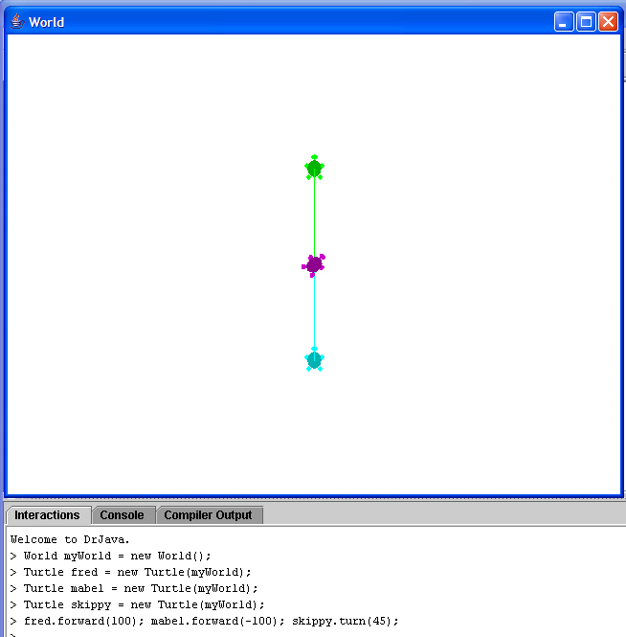
More than one
Turtle at once

Slide 16
If you have more than one turtle, how do they find each other?
How does C3PO find R2D2 after R2 wanders off randomly?
> World tattoine = new World();
> Turtle r2d2 = new Turtle(tattoine);
> r2d2.turn((int)
(360 * Math.random()));
> r2d2.forward((int)
(Math.random() * 100));
> Turtle c3po = new Turtle(tattoine);
> c3po.turnToFace(r2d2);
> c3po.forward((int)
(c3po.getDistance(
r2d2.getXPos(),r2d2.getYPos())));

Slide 17
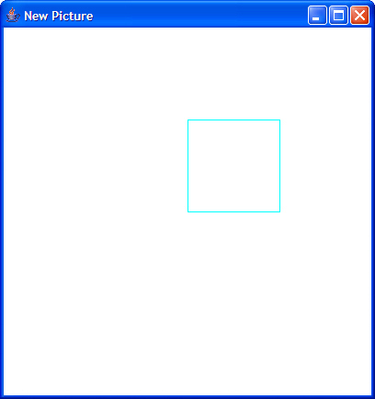
Putting Turtles on Pictures
> Picture canvas = new Picture(400,400);
> Turtle mabel = new Turtle(canvas);
> for (int sides=1; sides <= 4 ; sides++)
{mabel.forward(100); mabel.turn(90);}
> canvas.show();
Notes:
Won’t see the turtle here. Can tell the turtle to show, but then it’ll be stamped each time it pauses.

Slide 18
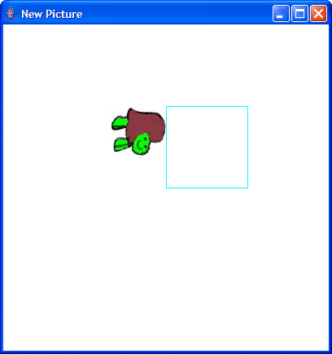
Using Turtles to compose Pictures
> Picture t = new Picture("D:/cs1316/MediaSources/Turtle.jpg");
> mabel.drop(t)
> canvas.repaint();

Slide 19
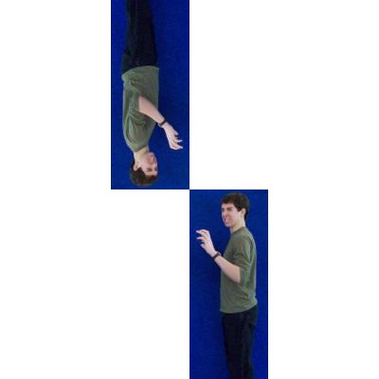
A more complicated composition
> Picture monster =
new Picture(FileChooser.getMediaPath("mscary.jpg"));
> Picture newBack = new Picture(400,400);
> Turtle myTurtle = new Turtle(newBack);
> myTurtle.drop(monster);
newBack.show();
> myTurtle.turn(180);
> myTurtle.drop(monster);
> newBack.repaint();

Slide 20
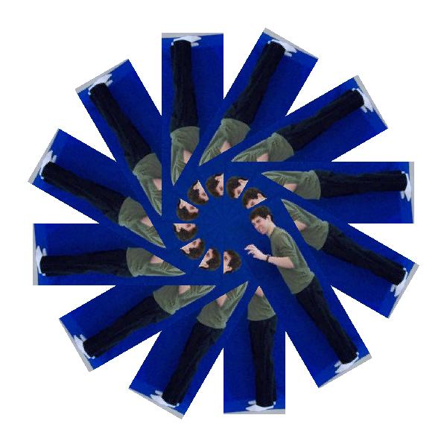
Even more monsters
> Picture frame = new Picture(600,600);
> Turtle mabel = new Turtle(frame);
> for (int i = 0; i < 12; i++) {
mabel.drop(monster); mabel.turn(30);
}

Slide 21
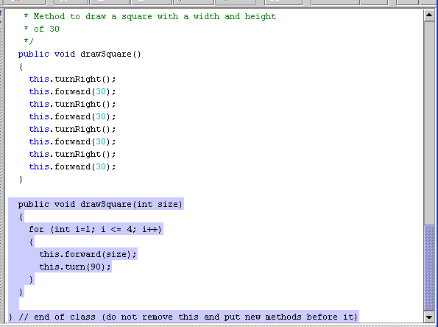
Adding new methods to Turtle

Slide 22
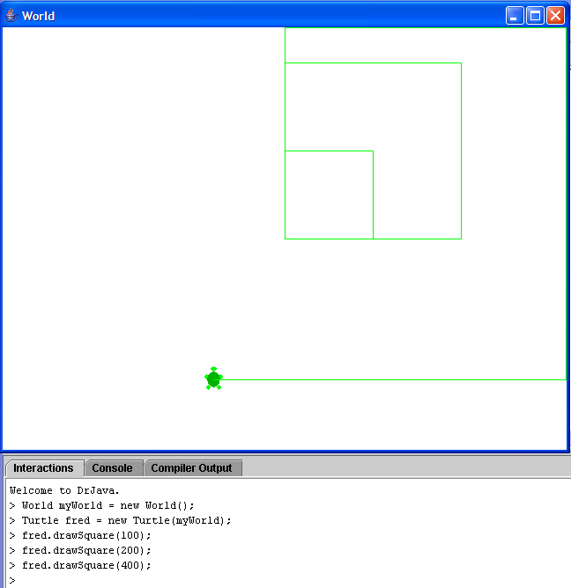
Testing
our new
method

Slide 23
Thought Experiment
We can have two methods with the same name?
How did Java know which one to use?

Slide 24
Making more complex pictures:
Using main()
public class MyTurtlePicture {
public static void main(String [] args) {
FileChooser.setMediaPath("D:/cs1316/MediaSources/");
Picture canvas = new Picture(600,600);
Turtle jenny = new Turtle(canvas);
Picture lilTurtle = new Picture(FileChooser.getMediaPath("Turtle.jpg"));
for (int i=0; i <=40; i++)
{
if (i < 20)
{jenny.turn(20);}
else
{jenny.turn(-20);}
jenny.forward(40);
jenny.drop(lilTurtle.scale(0.5));
}
canvas.show();
}
}
Also: Note use of setMediaPath and getMediaPath
Notes:
Introducing else

Slide 25
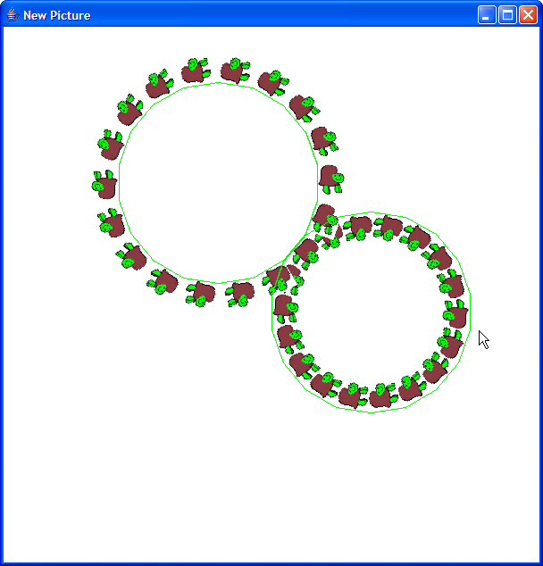
Result:

Slide 26
Thought Experiments
Is this myTurtlePicture a class? An object?
Can we access variables from the Interactions Pane?
Can we return values to the Interactions Pane?
When is it useful to use a main()?

Slide 27
Explaining public, and static, and void, and main, and String [] args
public static void main(String [] args);
Public: This method can be accessed by any other class.
Static: This is a method that can be accessed through the class, even if no instances of the class exist.
Void: This method doesn’t return anything.
String [] args: If called from the Command Line (outside DrJava), inputs could be provided.
  They’d show up as strings in this array.

Slide 28
Creating an animation with FrameSequencer
FrameSequencer stores out Pictures to a directory, and can show/replay the sequence.
  new FrameSequencer(dir): dir where the Pictures should be stored as JPEG frames
  .addFrame(aPicture): Adds this Picture as a frame
  .show(): Show the frames as they get added
  .play(fps): Play the sequence, at fps frames per second

Slide 29
Using FrameSequence
Welcome to DrJava.
> FrameSequencer f = new FrameSequencer("D:/Temp");
> f.show()
There are no frames to show yet. When you add a frame it will be shown
> Picture t = new Picture("D:/cs1316/MediaSources/Turtle.jpg");
> f.addFrame(t);
> Picture barb = new Picture("D:/cs1316/MediaSources/Barbara.jpg");
> f.addFrame(barb);
> Picture katie = new Picture("D:/cs1316/MediaSources/Katie.jpg");
> f.addFrame(katie);
> f.play(1); // display one frame per second

Slide 30
Making a turtle drawing animate
Welcome to DrJava.
> MyTurtleAnimation anim = new MyTurtleAnimation();
> anim.next(20);
> anim.replay(500);

Slide 31
/**
* An example class for creating a turtle
* animation
* @author Mark Guzdial
* @author Barb Ericson
*/
public class MyTurtleAnimation {
private Picture canvas;
private Turtle jenny;
private FrameSequencer f;
public MyTurtleAnimation() {
canvas = new Picture(600,600);
jenny = new Turtle(canvas);
f = new FrameSequencer("C:/Temp/");
}
Animated turtle

Slide 32
public void next() {
Picture lilTurtle = new Picture(FileChooser.getMediaPath("Turtle.jpg"));
jenny.turn(-20);
jenny.forward(30);
jenny.turn(30);
jenny.forward(-5);
jenny.drop(lilTurtle.scale(0.5));
f.addFrame(new Picture(canvas)); // Try this as
// f.addFrame(canvas);
}
public void next(int numTimes) {
for (int i=0; i < numTimes; i++) {
this.next();
}
}
public void show() {
f.show();
}
public void play(int framesPerSecond) {
f.show();
f.play(framesPerSecond);
}
public static void main(String[] args) {
MyTurtleAnimation anim = new MyTurtleAnimation();
anim.next(20);
anim.play(16);
}
}
Animated turtle

Slide 33
Declarations
public class MyTurtleAnimation {
Picture canvas;
Turtle jenny;
FrameSequencer f;
We’re going to need a canvas, a Turtle, and a FrameSequencer for each instance of MyTurtleAnimation.
  That’s what the instances know
  These are called instance variables

Slide 34
A constructor
public MyTurtleAnimation() {
FileChooser.setMediaPath("D:/cs1316/MediaSources/");
canvas = new Picture(600,600);
jenny = new Turtle(canvas);
f = new FrameSequencer("D:/Temp/");
}
A method with the same name of the class is called to initialize (or construct) the new instance.
Notice the use of setMediaPath
We don’t need to declare canvas, jenny, or f—the instance knows those already

Slide 35
Each step of the animation
public void next(){
Picture lilTurtle = new Picture(FileChooser.getMediaPath("Turtle.jpg"));
jenny.turn(-20);
jenny.forward(30);
jenny.turn(30);
jenny.forward(-5);
jenny.drop(lilTurtle.scale(0.5));
f.addFrame(canvas.copy());
}
Do one stage of the drawing.

Slide 36
Try it!
Try it like this:
> MyTurtleAnimation anim = new MyTurtleAnimation();
> anim.next(20); // Generate 20 frames
> anim.play(2); // Play them back, two per second
Why do we call .copy on the canvas?
Try it without it!
What does the result suggest to you about how FrameSequencer instances store their frames internally?

Slide 37
Being able to play it
public void next(int numTimes){
for (int i=0; i < numTimes; i++)
{this.next();}
}
public void show(){
f.show();
}
public void replay(int framesPerSecond){
f.show();
f.play(franesPerSecond);
} }

Slide 38

What happened when you removed the .copy()?
Think about the internal data structure of FrameSequencer.
It’s a list of references to Picture objects.

Slide 39
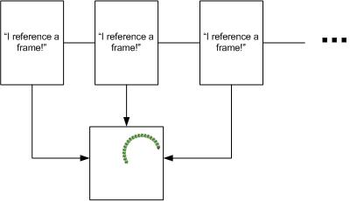
Without the copy, all frames reference one Picture.
So however the last Picture ends up, that’s what all the frames show.

Slide 40
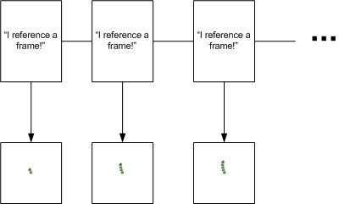
With the copy, different Pictures for each frame

Slide 41
Making a slow moving turtle
How could we make a turtle that moves slowly?
  It would be a special kind-of Turtle, so a subclass of Turtle is needed.
    We override forward to make it go slow.
  We need to pause execution.
    We need to sleep
  But something can go wrong during sleep, so we need to handle an exception.

Slide 42
Handling exceptions
Weird things can happen outside of your program’s control.
  The network fails.
  The disk you’re trying to write to is full.
We use try-catch to deal with extraordinary events.
try {
//code that can throw the exception
} catch (Exception e) {
System.err.println("Exception: " + e.getMessage());
System.err.println("Stack Trace is:");
e.printStackTrace();
}

Slide 43
Threads and sleep
Your program executes within a thread.
  Yes, you can have more than one thread, so more than one thing can be happening at once.
Threads can be told to sleep, but if something happens that interrupts that sleep, an exception occurs.
Java requires you to catch all exceptions that might get thrown.

Slide 44
SlowWalkingTurtle
/**
* A class that represents a slow walking turtle
* @author Mark Guzdial
* @author Barb Ericson
*/
class SlowWalkingTurtle extends Turtle {
/** Constructor that takes the model display
* @param modelDisplay the thing that displays the model
*/
public SlowWalkingTurtle (ModelDisplay modelDisplay) {
// let the parent constructor handle it
super(modelDisplay);
}

Slide 45
/**
* Method to have the turtle go forward then wait a moment
* and then go on.
* @param pixels the number of pixels to go forward
*/
public void forward(int pixels) {
super.forward(pixels);
try {
Thread.sleep(500); // Wait a half sec
} catch (Exception e) {
System.err.println("Exception: " + e.getMessage());
System.err.println("Stack Trace is:");
e.printStackTrace();
}
}
}

Slide 46
Using our slow turtle
Works just the same. Just slowly.
> World earth = new World()
> SlowWalkingTurtle mark = new SlowWalkingTurtle(earth)
> mark.forward(100); mark.forward(100);

Slide 47
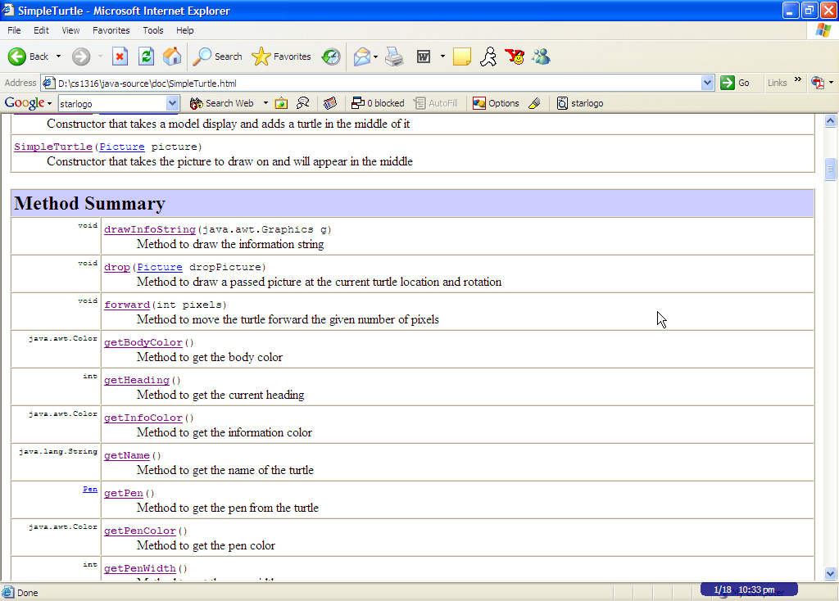
JavaDoc on SimpleTurtle

Slide 48
Thought Experiment
Why SimpleTurtle (and SimplePicture)?
Hint:
  Think about information hiding

