Slide 1
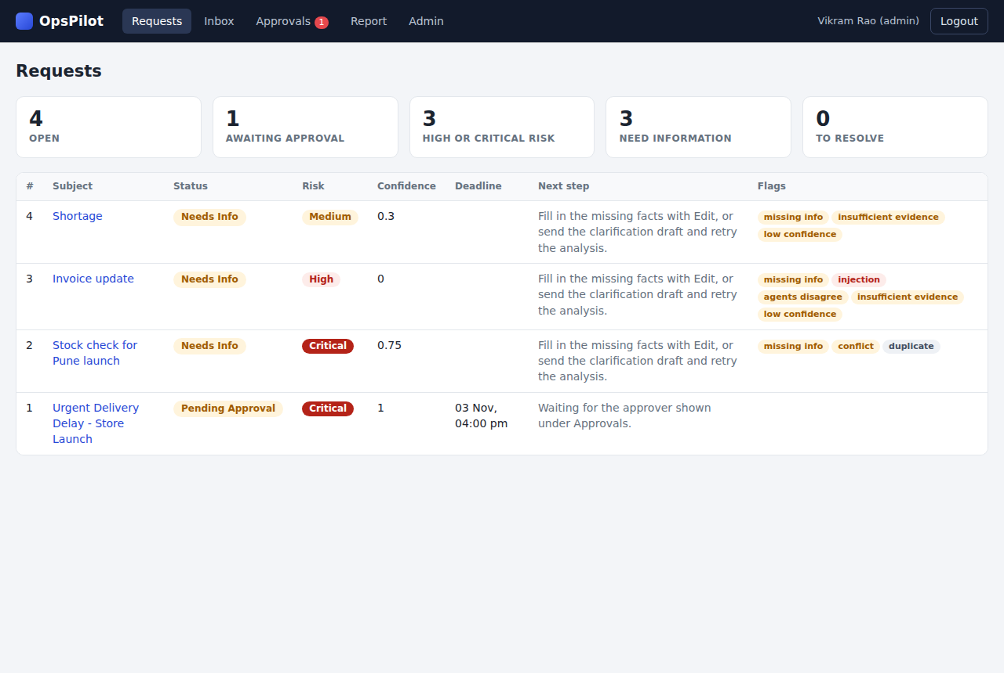
INTERVIEW ASSIGNMENT
OpsPilot
Agentic operations assistant: from request email to closure, with people in control of every decision
Sonik Sarungale
opspilot.soniksarungale.com | github.com/soniksarungale/opspilot

Slide 2
Business problem and user needs
Today
Analyst
•
Requests arrive by email: late deliveries, stock gaps, supplier issues, urgent approvals, customer commitments
Checked facts and options, fast, without retyping the email
•
Each one is read, checked, costed, approved and reported by hand
Manager / regional head
Only the decisions within their limit, with the evidence and the cost
•
About an hour per request
•
Approvals miss deadlines and the same issue is worked twice
Admin
•
No record of who decided what
Control of the system, failure drills and the full audit trail
Example from the brief
"500 display units for the Pune launch delayed 10 days, 120 in stock, approve the extra cost by 4 PM today."
Leadership
A short summary of risk, decisions and overdue approvals
OpsPilot | opspilot.soniksarungale.com
2

Slide 3
Proposed solution
Agents do the reading, checking and drafting. People decide.
1 Read
2 Check
3 Assess
Reads an email or typed request and extracts facts. Every value comes with the quote it was taken from.
Compares with inventory. Flags missing, conflicting, duplicate and unsafe content.
Rates risk twice, once by an agent and once by rules, and proposes 2-3 options with their extra cost.
4 Approve
5 Track
6 Report
Routes the cost to the right approver by amount, escalates when overdue, blocks self-approval.
Follows every request to closure and always shows the next step.
Drafts stakeholder emails and management reports. Every agent and human action is audited.
OpsPilot | opspilot.soniksarungale.com
3

Slide 4
User workflow
1
2
3
4
5
6
7
8
9
Receive
Extract
Verify
Assess
Recommend
Decide
Approve
Resolve
Close
Risk + rules
With note
Reporter agent
Person
Intake agent
Rules
Planner agent
Person
Approver
Status track
processing
needs info / review
pending approval
in progress
resolved
closed
Cancel is possible at any open stage
•
Agent steps and human checkpoints are visibly separate
•
Every request shows its status, risk and next step
•
Approval and resolution always need a person
Every request shows its status, risk and next step
OpsPilot | opspilot.soniksarungale.com
4

Slide 5
Agentic AI and LLM design
Workflow orchestrator: runs the agents in order
Intake
Risk
Planner
Comms
Reporter
•
Agents never call each other; context is the stored request
(extraction)
(urgency, impact)
(options)
(emails)
(summaries)
•
Each agent gets only the slice it needs and returns strict JSON
Rules (code)
•
Code, not the model, decides grounding, final risk, confidence and limits
Evidence grounding, inventory check, duplicates, injection screening, rule-based risk, confidence, approval limits
•
Model: Claude Sonnet; prompt version logged with every run
Request record (shared context)
Facts, evidence quotes, flags, risk, options. Agents read from it and write back to it, never to each other.
OpsPilot | opspilot.soniksarungale.com
5

Slide 6
Human control, confidence and audit
Approval is mandatory when
Confidence, computed in code
Extra cost is above zero, risk is high or critical, or confidence is below 0.6. Approver by amount: manager up to Rs 50,000, regional head up to Rs 5,00,000, admin above. Never the person who chose the action.
Start at 1.0, then subtract 0.1 per missing field, 0.15 per unsupported value, 0.15 per inventory conflict, 0.2 for agent and rule disagreement, 0.3 for suspected injection, 0.3 if the planner lacks evidence.
Unsupported or wrong output
Monitoring and audit
Schema check, one retry, then a person takes over. Values without a matching quote are removed and flagged. Users correct fields with a reason and the analysis re-runs.
Append-only trail of every agent run (model, duration, attempt, error) and every human action (before, after, reason). Refused attempts are logged too.
OpsPilot | opspilot.soniksarungale.com
6

Slide 7
Technical architecture
FastAPI service
SQLite
requests, approvals, messages, audit, inventory, suppliers, stores, users
• API and auth
Browser
nginx
• Workflow orchestrator
Claude Sonnet
HTML and JavaScript
>
>
>
HTTPS, TLS
via its command line tool, one call at a time
• Agents
• Rules engine
Mock inbox and outbox
• Escalation loop every 60 s
outbox has a failure switch
Security
Testing and production path
Server-side role checks; salted password hashes; HttpOnly session cookie; parameterised SQL; escaped output; input limits; 30 analysis actions per user per hour
77 automated tests with a fake model; Dockerfile; health endpoint. Next: Postgres, job queue, real mail, SSO, cloud deploy
OpsPilot | opspilot.soniksarungale.com
7

Slide 8
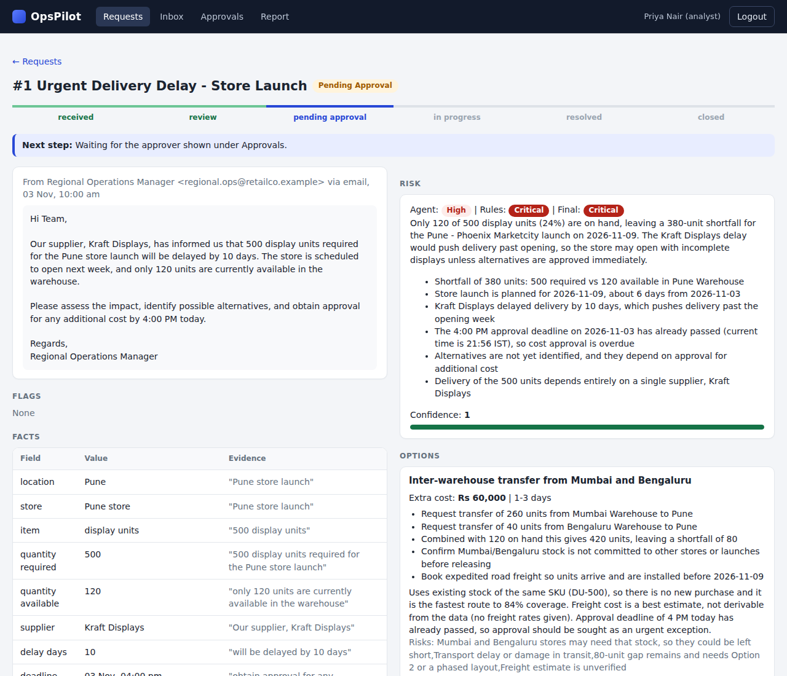
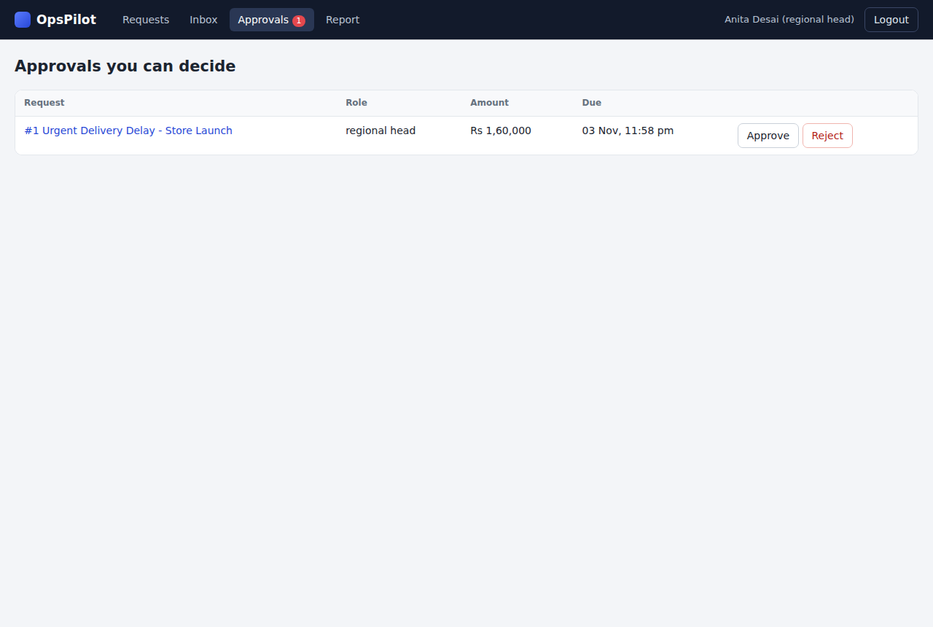
Product demonstration
Approver sees only what is within their limit, with the due time
Facts with evidence quotes, three-way risk, confidence, costed options
End to end: email, facts, risk, options, approval, resolve with outcome, close
OpsPilot | opspilot.soniksarungale.com
8

Slide 9
Edge cases and failure handling
All 15 edge cases from the brief: detected, shown, recoverable, audited
Missing info
Conflicting info
Duplicate
Unclear intent
Incorrect extraction
needs info + clarification draft
both numbers shown, confidence down
linked to earlier request
all intents listed
user fix, re-analysis
Low confidence
Approval delay
Approval rejection
Changing circumstances
Model unavailable
reason + approver required
escalates to next role
planner re-plans without it
approval cancelled, reassessed
flag, retry or manual entry
Unauthorized action
Prompt injection
Communication failure
Contradictory agents
Cancellation
flagged, ignored, human review
approvals cancelled, approvers notified
refused, logged
marked failed, retry send
higher risk used, flagged
OpsPilot | opspilot.soniksarungale.com
9

Slide 10
Business impact, risks and roadmap
Pilot impact targets
Risks and mitigations
Roadmap
Receipt to reviewed plan under 10 minutes (from about 60)
Over 90% of approvals on time
100% of requests fully audited
0 unauthorized approvals
Wrong or manipulated AI output: grounding, rules, mandatory approval
Estimated costs: approver checks; price catalogue next
Slow model calls: queue now, API concurrency later
Adoption: start with one region and one request type
Real mailbox and outbound mail
Live inventory, supplier and price data
Postgres and a job queue
SSO and chat notifications
Cycle-time dashboards
Live demo: opspilot.soniksarungale.com | Users: analyst, manager, head, admin | Password: demo1234
OpsPilot | opspilot.soniksarungale.com
10

