Slide 1

CloudTunes Automating Spotify ETL Data Pipeline using AWS
COSC 6375 CLOUD COMPUTING
Narayan Soni Hitesh Reddy Yerradoddi Monika Kommineni
(2301240) (2301944) (2287571)

Slide 2
Objective
The main objective of the project is to create a system that extraxts, processes, and loads Spotify data into a format that is useful for various purposes.
It has the following goals:
Gather data from the Spotify Web API, including user-specific information like playlists, saved songs, listening history, and metadata about songs, albums, and artists.
Process the raw data to make it usable and informative. This can involve cleaning, structuring, and enriching the data to extract valuable insights and facilitate various applications.
Store the transformed data efficiently and securely, on AWS storage services.
Use the processed data to derive valuable insights, such as user listening habits, popular songs or genres, and trends in music consumption.
Notes:
We are centering this analysis around video categories and trending metrics.

Slide 3
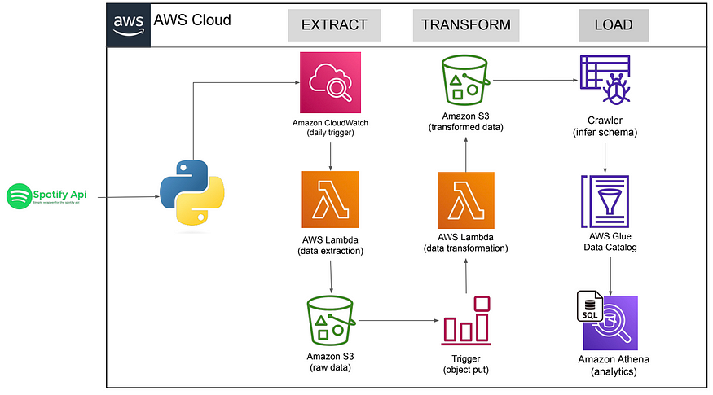
Architecture
Notes:
- The data flows from left to right.
Quicksight is used for data analytics after everything shown in the framework has been done.

Slide 4
Services and Tools
Amazon S3: Easily store and retrieve large amounts of data.
AWS IAM: identity and access management to securely manage access to AWS services and resources.
AWS Glue: serverless data integration service that makes it easy to prepare, and combine data for analysis, application development.
AWS Lambda: Serverless compute service to run code without managing servers. Wewill use Lambda to deploy the Python code to perform data extraction and transformation.
AWS CloudWatch: Monitor and collect metrics from AWS resources. Can be used to monitor log files and set alarms.
Notes:
We are centering this analysis around video categories and trending metrics.

Slide 5
Services and Tools
AWS Athena: Interactive query service to analyze data stored in various sources using standard SQL queries. You can query data from the Glue Data Catalog, S3 and other supported data sources.
AWS Crawler: Component of AWS Glue that automatically scans and analyzes data sources to infer their schema and create metadata tables.
AWS Glue Data Catalog: Fully managed metadata repository provided by AWS Glue. It acts as a central repository for storing and organizing metadata information about various data sources, including tables, schemas, and partitions. You can use the Glue Data Catalog without the Crawler if you already have the metadata information or prefer to define and manage the metadata manually and can directly create and populate tables in the Glue Data Catalog.

Slide 6
ETL Overview
Extract
Extract data from Spotify API using the Spotipy library
Deploy the data extraction code using the Lambda function
Run trigger using EventBridge to automate data extraction every Tuesday at 4 pm
Data extract is saved in the spotify_etl_project_06112023/raw_data/to_process folder in the S3 bucket
Transform
Run S3 trigger when any new data is added into the spotify_etl_project-06112023/raw_data/to_process folder in the S3 bucket. This will run the data transformation code on Lambda
The transformation code will clean and transform the data to prepare 3 files for the album, artist, and songs. The data will be stored in the 3 subfolders in transformed_data. Lastly, files in the to_process folder will be copied to processedthe processed folder and files in to_process will be deleted. We are just moving data from one folder to another.
Load
Glue crawler will infer schema when new data arrives in the 3 folders in the transformed_data folder
Data catalog manage metadata repository
Query S3 data using Athena

Slide 7
Further Applications
- Extend the project to allow users to purchase music, merchandise, or concert tickets related to their favorite artists or songs.
You can use the collected Spotify data to build a personalized music recommendation system. By analyzing listening habits and preferences, you can suggest new songs or playlists to users.
Incorporate location data to offer location-based recommendations, such as local concerts, events, or music scenes.
Enable users to share their listening habits and playlists with friends on social media platforms, fostering a sense of community around music.

Slide 8
Conclusion
Successfully designed and deployed a cloud-based ETL pipeline to ingest Spotify data
Automates scalable extraction, processing and loading of playlist data
Enables analytical SQL queries for user insights
Demonstrated skills in system architecture, Python, data pipelines, BI
Overcame challenges with APIs, unstructured data, process integration
Achieved core goal of maintaining updated Spotify analytics repository
Established foundation for enhancements like dashboards, recommendations
Provided real-world data engineering exposure with industry tools

Slide 9
References
https://docs.aws.amazon.com/
https://developer.spotify.com/documentation/web-api
https://aws.amazon.com/what-is/etl/
https://ieeexplore.ieee.org/document/9441984

