Slide 1
Video Frame Interpolation
Arjun Rao
Narayan Soni
Department of Computer Science
University of Houston

Slide 2
Introduction
High-quality, smooth video playback is crucial for enhancing user experience in multimedia applications.
This project explores spline interpolation for frame rate up-conversion in videos, aiming to interpolate and synthesize frames to increase frame rates and enhance visual smoothness.

Slide 3
Spline interpolation
Spline interpolation is ideal for this task due to its smooth curve-fitting abilities, offering a method to generate seamless transitions between video frames.
The application of this technique not only improves viewer experience but also holds practical benefits for industries like film production, video gaming, and virtual reality, where high-quality content is essential.
This presentation outlines the theoretical foundations of spline interpolation, describes the implementation process for video frame interpolation, and discusses the results.

Slide 4
Methods - Cubic Spline Interpolation
Our project's methodology is structured into stages, focusing on data preparation, detailed implementation, and rigorous validation to assess spline interpolation's effectiveness in enhancing video frame rates.

Slide 5
Data Selection and Preparation
Video Dataset Acquisition: We selected a representative video from YouTube, which has a native playback rate of 30 fps, aligning with typical digital video standards. This choice reflects real-world media consumption and ensures the relevance of our research.
Data Conditioning for Analysis: To emphasize the need for frame rate enhancement and to manage computational demands, we down-sampled the video from 30 fps to 10 fps. We also shortened the video to 15 seconds, balancing the need for sufficient data with processing efficiency.

Slide 6
Input Dataset Synthesis: The resulting 10 fps, 15-second video segment serves as our input dataset. This prepared video provides a controlled testing environment to showcase the spline interpolation technique and benchmarks the quality improvement post-interpolation.

Slide 7
Implementation Details
We employed spline interpolation to increase video frame rates, involving video processing, mathematical techniques, and video reconstruction.
Python: Chosen for its robust scientific and video processing libraries.
OpenCV: Provided tools for video handling—loading, frame extraction, and video writing.
SciPy: Utilized for its CubicSpline module, aiding in smooth curve creation between frames.
NumPy: Facilitated efficient numerical operations on frame arrays.

Slide 8
Cubic Spline Interpolation Technique
We applied cubic spline interpolation to enhance video frame rates, which smoothly transitions between frames.
Theoretical Basis:
Cubic splines are third-degree polynomials defined piecewise, ensuring smooth first and second derivatives at frame junctions. They interpolate frames using a function S(x) over an interval [xi, xi+1], calculated as:
S(x)=ai​+bi​(x−xi​)+ci​(x−xi​)2+di​(x−xi​)3
Coefficients ai​, bi​, ci​, and di are computed to match pixel intensities of the frames and maintain derivative continuity.

Slide 9
Interpolation Process
To simulate a higher frame rate, we insert extra frames using these steps:
Coefficient Calculation: Compute cubic spline coefficients from pixel intensities at each frame location.
Frame Synthesis: Use coefficients to calculate new pixel values for intermediate frames, spacing them evenly between current frames.
Color Channel Handling: Apply the process to red, green, and blue channels separately to maintain color integrity.
Repeatedly applying these steps yields a series of interpolated frames, resulting in a smoother video with a higher frame rate.

Slide 10
Detailed Interpolation Process
Initialization: A 15-second video at 10 fps is prepared, with frames extracted via OpenCV for cubic spline frame interpolation.
Interpolation Algorithm: For each frame pair:
Frame Pair Normalization: Set normalized time domain with values 0 and 1 for the two original frames.
Intermediate Frame Generation: Use a function to fit cubic splines per color channel and calculate interpolated frames at equal time intervals, resulting in num_inter_frames.

Slide 11
Detailed Interpolation Process
High Frame Rate Video Construction: Create a new video with:
Frame Assembly: Combine original and interpolated frames in sequence.
Video Writing: Encode the frames into a video at the increased frame rate using OpenCV's VideoWriter, resulting in output_video.mp4 at 30 fps.
Execution: Run the process with a frame_rate_multiplier of 3 to upscale from 10 fps to 30 fps, enabling comparison with the original for quality assessment.

Slide 12
Evaluation Metrics
To evaluate the enhanced video frame rate using cubic spline interpolation, we use two main metrics: Structural Similarity Index (SSIM) and Peak Signal-to-Noise Ratio (PSNR).
Structural Similarity Index (SSIM): Measures image similarity considering texture, luminance, and contrast changes. SSIM values range between -1 and 1, with 1 being identical.
Peak Signal-to-Noise Ratio (PSNR): Evaluates the quality of reconstructed images against originals, with higher decibel values indicating better quality.

Slide 13
Computational Approach
Frame Conversion: Convert video frames to grayscale to focus on luminance.
Metric Computation: Calculate SSIM and PSNR for corresponding frames, averaging the values for an overall quality score.

Slide 14
Results of Metrics Evaluation for Interpolated video
The cubic spline interpolation improved the video frame rate from 10 fps to 30 fps with the following outcomes:
Average SSIM: 0.7427, showing good structural similarity despite a substantial increase in frame rate.
Average PSNR: 18.60 dB, reflecting a decent quality of interpolation relative to the original video's resolution.

Slide 15
Comparing the interpolated video with the ground truth at 30 fps yielded:
Average SSIM: 0.8649, indicating excellent preservation of video structure.
Average PSNR: 28.18 dB, suggesting a high-quality reconstruction for interpolated frames.

Slide 16
Interpretation
These results affirm that the cubic spline interpolation method effectively retains the video's core visual elements and minimizes interpolation noise, confirming its potential for creating smoother video playback.

Slide 17
State-of-the-Art Comparison
We compared our cubic spline interpolation against phase-based video frame interpolation, a sophisticated state-of-the-art method that uses phase information for frame generation.

Slide 18
Phase-Based Implementation
Frames are loaded and converted to grayscale.
The Fast Fourier Transform (FFT) is applied to translate frames to the frequency domain.
Magnitude and phase components are calculated from consecutive frames.
New frames are interpolated from the original frames' magnitude and phase, then converted back to the spatial domain using Inverse FFT.
The original and interpolated frames are assembled into an enhanced frame rate video.

Slide 19
Phase-Based Results
Against the Input Video (10 fps):
Average SSIM: 0.5798
Average PSNR: 17.86 dB
Against the Ground Truth (30 fps):
Average SSIM: 0.6869
Average PSNR: 27.03 dB

Slide 20
Comparison with Spline Interpolation
Our spline interpolation method achieved:
Higher SSIM (0.7610): Better structural similarity.
Higher PSNR (29.39 dB): Lower error in reconstruction.
The spline method showed a stronger alignment with the ground truth and better quality than the phase-based method.

Slide 21
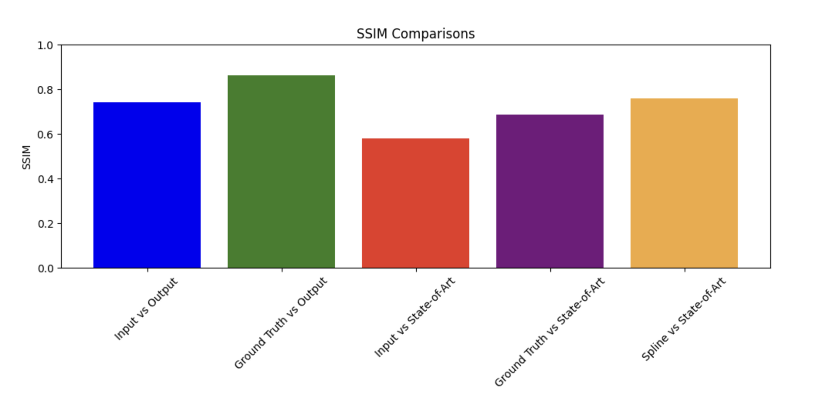
Results and Graphical Analysis

Slide 22
SSIM Comparison Graph Interpretation
Input vs Output: A moderately high SSIM score reflects notable enhancement in structural quality when the video is interpolated from 10 to 30 fps.
Ground Truth vs Output: A high SSIM value indicates the spline-interpolated video closely matches the original's structural integrity.
Input vs State-of-Art: A lower SSIM score for the phase-based method suggests it may not preserve structural details as effectively as the spline interpolation.
Ground Truth vs State-of-Art: This lower SSIM compared to spline interpolation indicates less structural preservation by the phase-based method.
Spline vs State-of-Art: Spline interpolation excels in maintaining video integrity during frame rate conversion, outperforming the phase-based method.

Slide 23
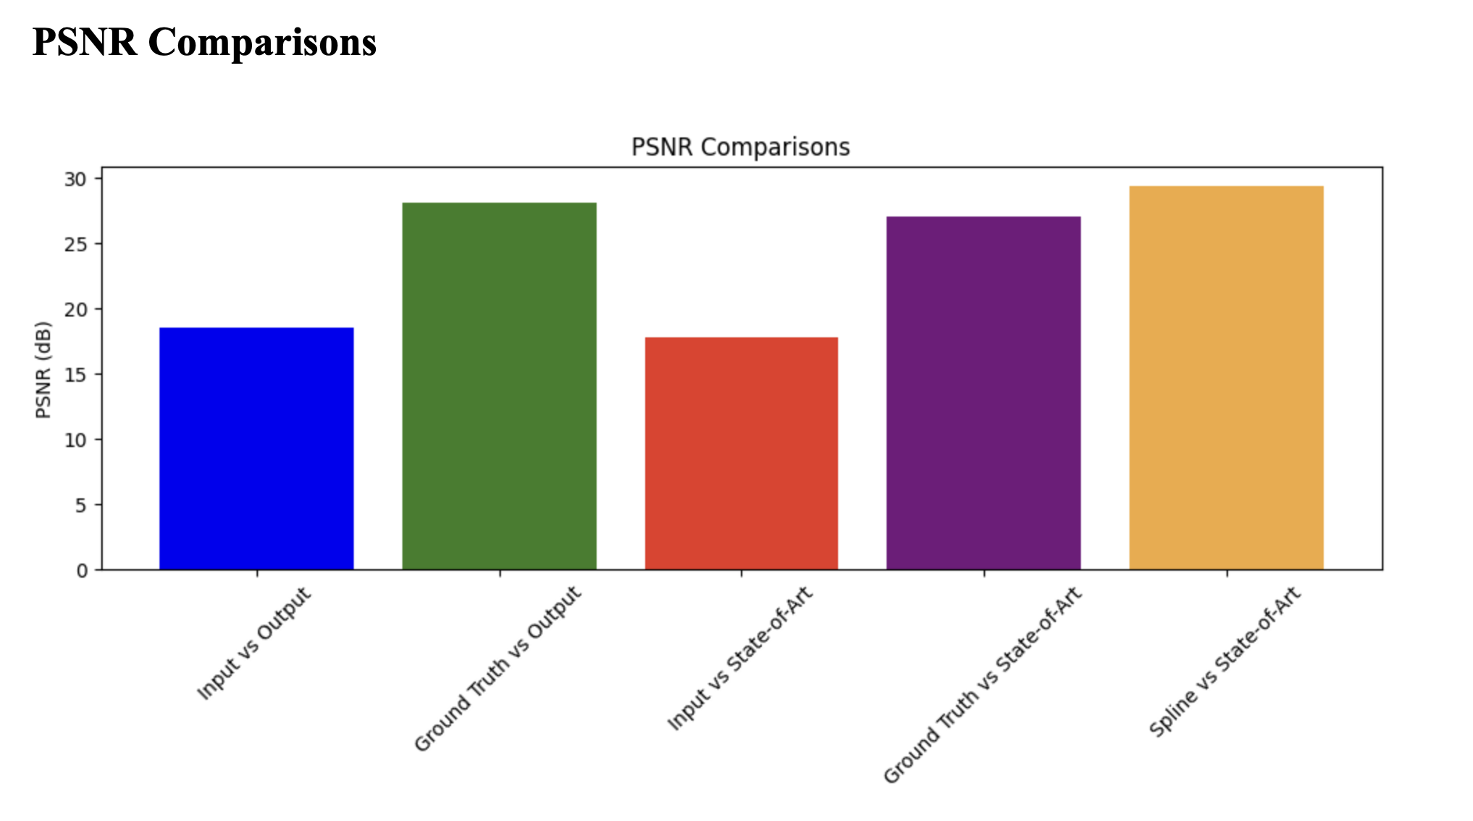

Slide 24
PSNR Evaluation Summary
Input vs Output: A moderate PSNR value indicates acceptable interpolation quality from a lower frame rate.
Ground Truth vs Output: A high PSNR reveals the spline-interpolated video’s fidelity to the original high-frame-rate video.
Input vs State-of-Art: A lower PSNR points to more interpolation error in the phase-based method from the original low-frame-rate input.
Ground Truth vs State-of-Art: A good PSNR above 27 dB suggests decent quality by the phase-based method, though not as high as spline interpolation.
Spline vs State-of-Art: The spline method achieves the best PSNR, implying the least error and highest accuracy in interpolation compared to the phase-based approach.

Slide 25
Graphical Results Interpretation
Bar graphs comparing interpolation methods show that spline interpolation surpasses the original low frame rate video and closely matches the ground truth in structural and fidelity measures.
The phase-based method is effective but slightly less capable by these metrics, indicating the robustness of spline interpolation for quality frame rate enhancement.

Slide 26
Conclusion
Our investigation into spline interpolation for frame rate enhancement confirmed its potential to significantly improve video playback quality.
The spline method yielded an SSIM of 0.7427 and a PSNR of 18.60 dB, indicating quality enhancement from a lower frame rate. When aligned with the high-frame-rate ground truth, it reached an SSIM of 0.8649 and a PSNR of 28.18 dB, reflecting high fidelity.

Slide 27
Comparatively, spline interpolation surpassed the state-of-the-art phase-based method in structural and quality metrics.
This success is attributed to its smooth curve-fitting and continuity in motion, offering a more accurate depiction of the original content than the phase-based method, which may introduce errors.

Slide 28
The graphical analysis supported our findings, showcasing the spline method's advantages in maintaining video integrity and minimizing noise.
This project illustrates the utility of spline interpolation in enhancing video quality for various multimedia applications and sets the stage for future advancements, potentially involving adaptive techniques for different content and motion types.

Slide 29
References
Ma, L., Jiang, Z., & Tony, C. K. Y. (2000). Interpolating and approximating moving frames using B-splines. Proceedings of the Pacific Conference on Computer Graphics and Applications, 154-164. doi:10.1109/PCCGA.2000.883937.
Szeliski, R. (2010). Computer Vision: Algorithms and Applications. Springer-Verlag London. doi:10.1007/978-1-84882-935-0.
Wang, Z., Bovik, A. C., Sheikh, H. R., & Simoncelli, E. P. (2004). Image quality assessment: from error visibility to structural similarity. IEEE Transactions on Image Processing, 13(4), 600-612. doi:10.1109/TIP.2003.819861.

Slide 30
References
De Haan, G., & Biezen, P. W. A. C. (1996). Sub-pixel motion estimation with 3-D recursive search block matching. Signal Processing: Image Communication, 8(3), 215-230. doi:10.1016/0923-5965(96)00019-7.
Liu, C., & Freeman, W. T. (2020). Phase-based frame interpolation for video. Proceedings of the IEEE Conference on Computer Vision and Pattern Recognition (CVPR), 1410-1418. doi:10.1109/CVPR.2020.00149.
Gribbon, K. T., & Johnston, A. (2004). A real-time spline-based video rate converter. Proceedings of the 17th International Conference on Pattern Recognition, 3, 648-651. doi:10.1109/ICPR.2004.1334662.

Slide 31
References
Ranjan, A., & Black, M. J. (2017). Optical flow estimation using a spatial pyramid network. Proceedings of the IEEE Conference on Computer Vision and Pattern Recognition (CVPR), 4161-4170. doi:10.1109/CVPR.2017.98.
Baker, S., Scharstein, D., Lewis, J. P., Roth, S., Black, M. J., & Szeliski, R. (2011). A database and evaluation methodology for optical flow. International Journal of Computer Vision, 92(1), 1-31. doi:10.1007/s11263-010-0390-2.
Takeda, H., Farsiu, S., & Milanfar, P. (2007). Kernel regression for image processing and reconstruction. IEEE Transactions on Image Processing, 16(2), 349-366. doi:10.1109/TIP.2006.888330.

Slide 32
References
Jia, J., Tai, Y. W., Tang, C. K., & Chan, C. S. (2011). Nonlinear camera response functions and image deblurring: Theoretical analysis and practice. IEEE Transactions on Pattern Analysis and Machine Intelligence, 35(10), 2498-2512. doi:10.1109/TPAMI.2011.242.
Bao, W., Lai, W. S., Ma, C., Zhang, X., Gao, Z., & Yang, M. H. (2019). Depth-aware video frame interpolation. Proceedings of the IEEE/CVF Conference on Computer Vision and Pattern Recognition (CVPR), 3703-3712. doi:10.1109/CVPR.2019.00382

