Slide 1
Medallion Architecture
Data
Source
Streaming Analytics
Raw Data
Ingestion
Filtered, Cleaned, Augmented
Business-level
Data
BI and Reporting
Data Quality
Streaming Analytics

Slide 2
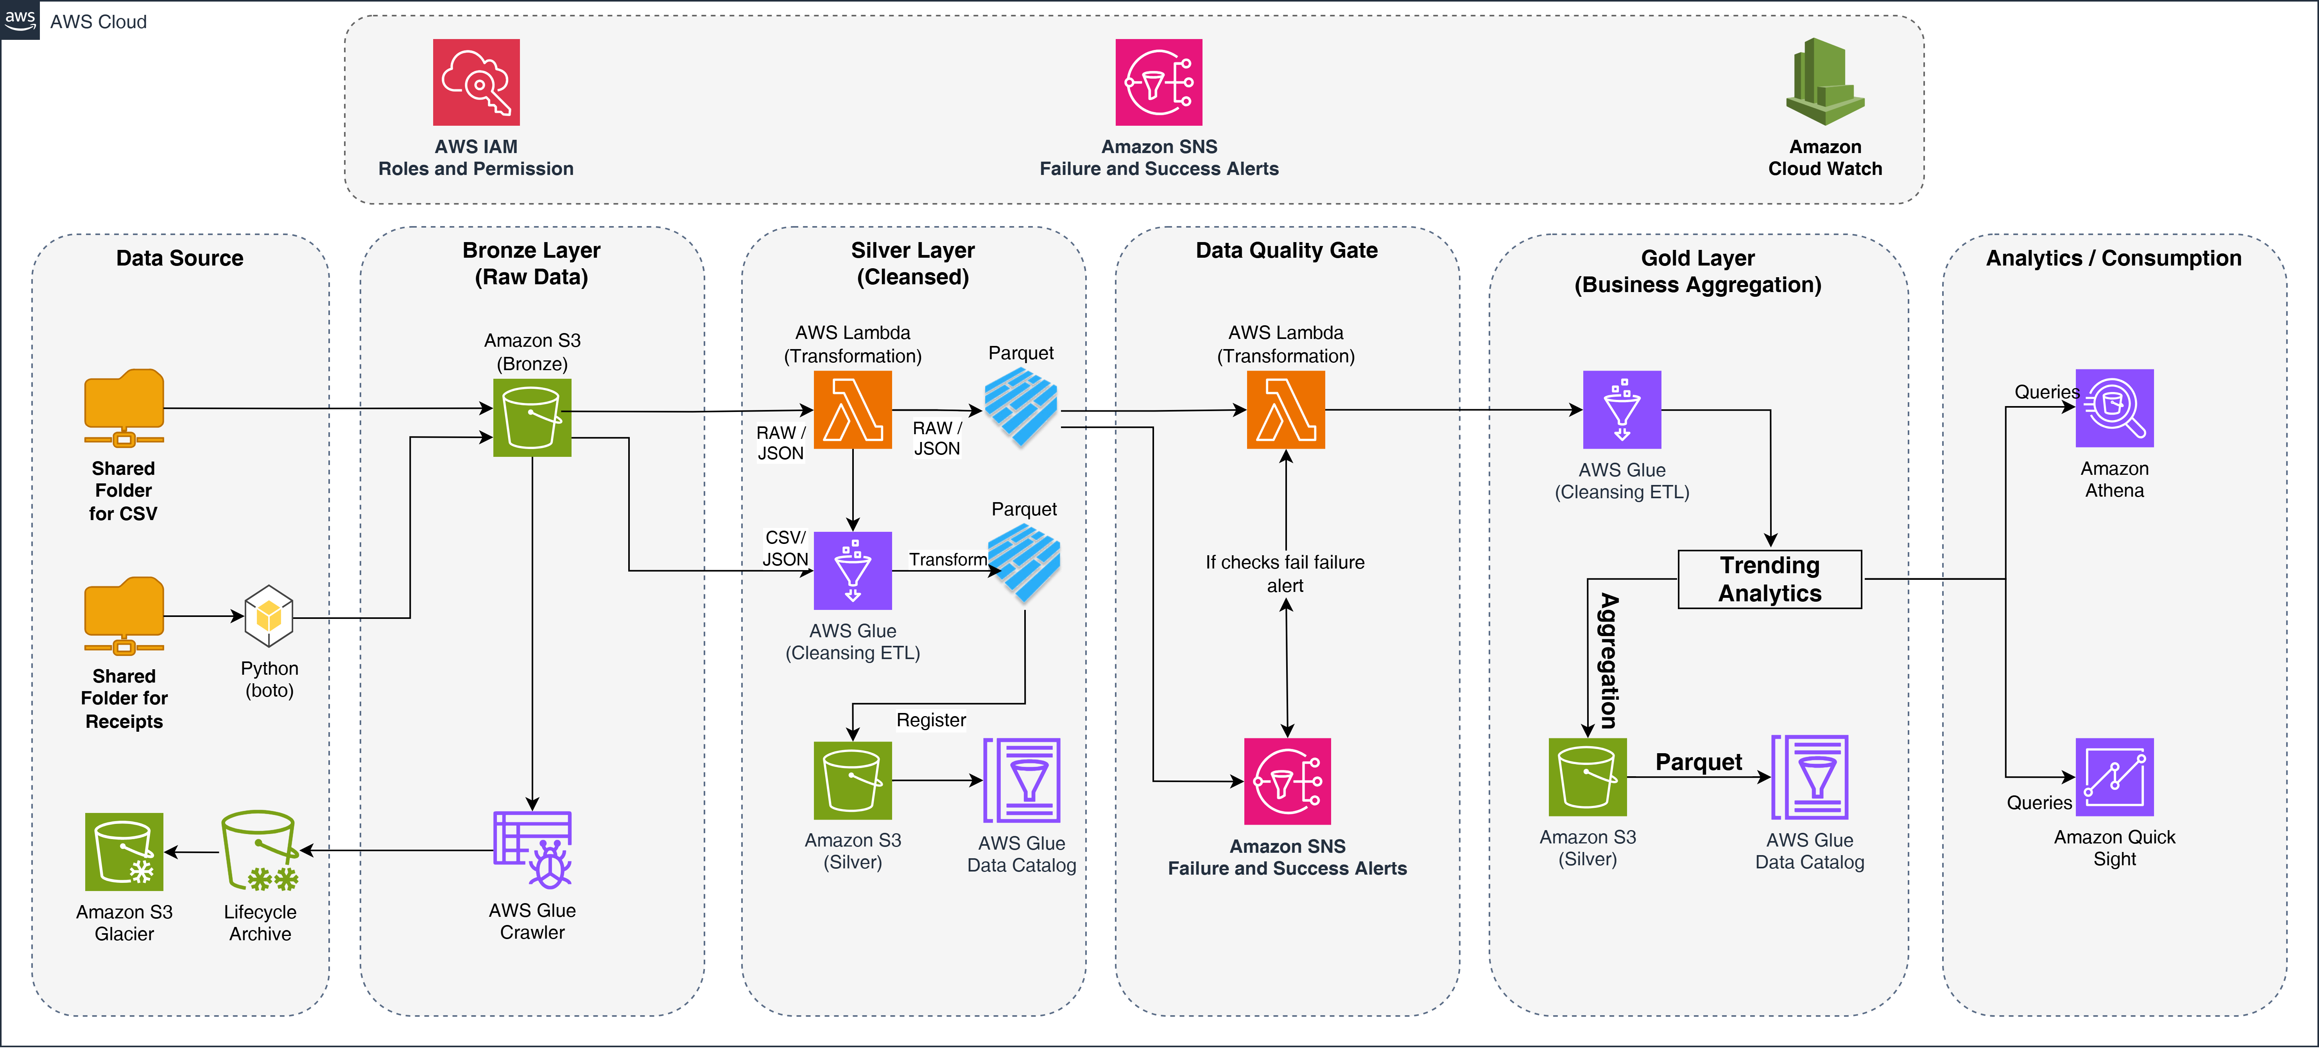
GOA Interview Project
By: Nayan Soni

