Slide 1

Note: The data and information in this document is reflective of a hypothetical situation and client. This document is to be used for KPMG Virtual Internship purposes only.
Sprocket Central Pty Ltd
Data analytics approach
[Division Name] - [Engagement Manager], [Senior Consultant], [Junior Consultant]

Slide 2
Note: The data and information in this document is reflective of a hypothetical situation and client. This document is to be used for KPMG Virtual Internship purposes only.
Agenda
Introduction
Data Exploration
Model Development
Interpretation

Slide 3
Note: The data and information in this document is reflective of a hypothetical situation and client. This document is to be used for KPMG Virtual Internship purposes only.
Introduction
New Customers Analysis
Analyze the following factors for new customers
Age distribution criteria
Bike Purchase in 3 years
Job Industry Category
Car owns by the new customer

Slide 4
Note: The data and information in this document is reflective of a hypothetical situation and client. This document is to be used for KPMG Virtual Internship purposes only.
Data Exploration
Age Distribution Factor
It is observed that mostly new customers are of age between 40 – 49 as it was noticed in the old customer data sets.
The ratio of new customer age between 60 – 69 has increased.
The age group of 20 – 29 remained same in both the data sets.

Slide 5
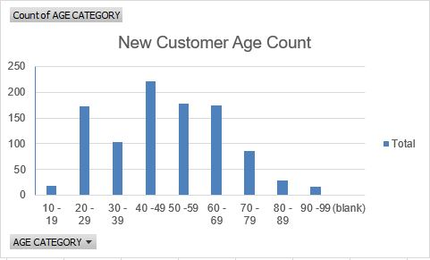
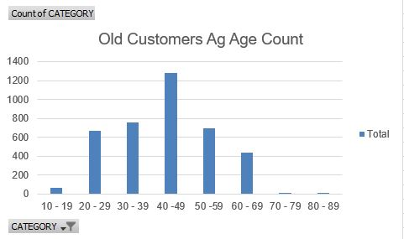
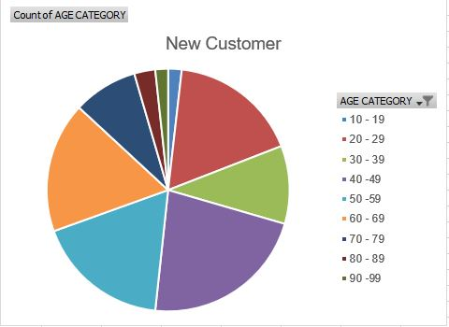
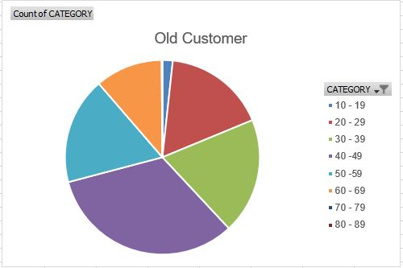
Note: The data and information in this document is reflective of a hypothetical situation and client. This document is to be used for KPMG Virtual Internship purposes only.
Data Exploration

Slide 6
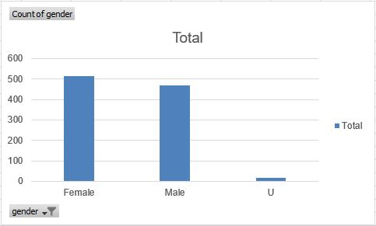
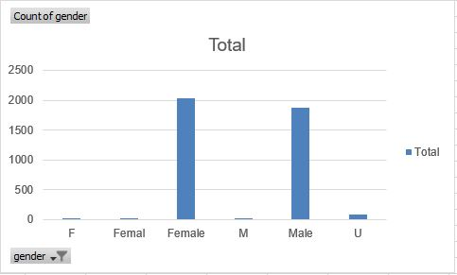
Note: The data and information in this document is reflective of a hypothetical situation and client. This document is to be used for KPMG Virtual Internship purposes only.
Model Development
Last 3 Years of Bike Purchasing
Around 51% females purchased bike in last three years as compare to 47% male purchased.
The target audience for marketing should me for focused on females than males.
NEW CUSTOMER
OLD CUSTOMER

Slide 7
Note: The data and information in this document is reflective of a hypothetical situation and client. This document is to be used for KPMG Virtual Internship purposes only.
Interpretation
Job industry
Mostly new customers are on Finance industry and Manufacturing customers are still on top two
The rest industries is still same

