Slide 1


VOXIO

Slide 2
Imagine a world without sound ….

Slide 3
“Life is meaningful only when it means something to others”
- A.S JOSEPH CHARLES

Slide 4

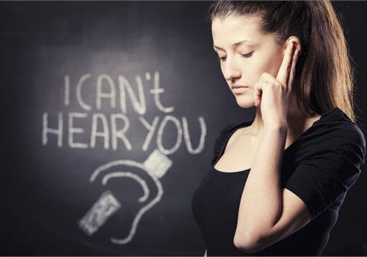

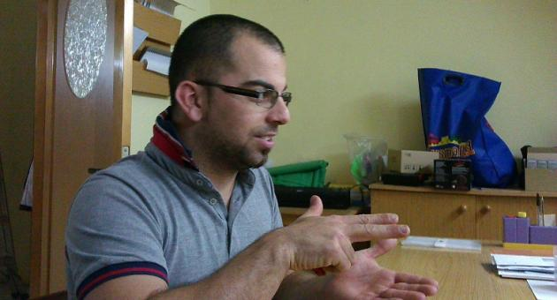

Slide 5

DESCRIPTION
VOXIO – Voice to text & sign language translator
The interpretation based on American standard sign language(ASL).
what we say or write in English is immediately translated into corresponding text and sign
It is not meant as a replacement for human interpreters.
It gives deaf a new voice. Deaf people can use this app as a personal assistant.
Providing a framework for developers to create an applications using our sign language library.
friends of the Hard of Hearing can learn Sign Language interactively through mirroring the signs of the avatar and memorizing the most important words they want to say
.
CSE Department , JECC

Slide 6


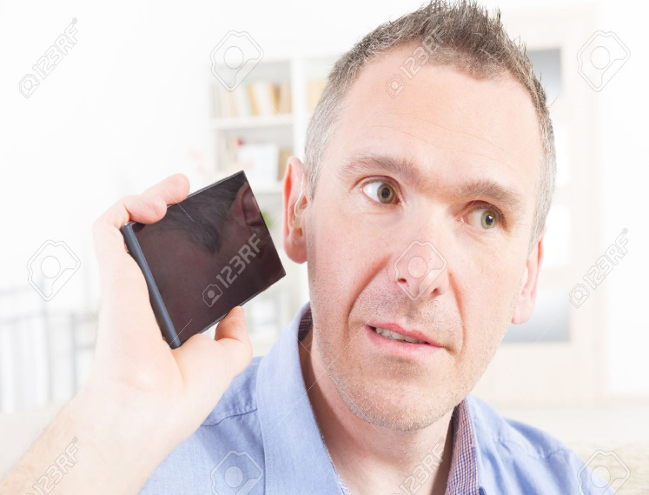

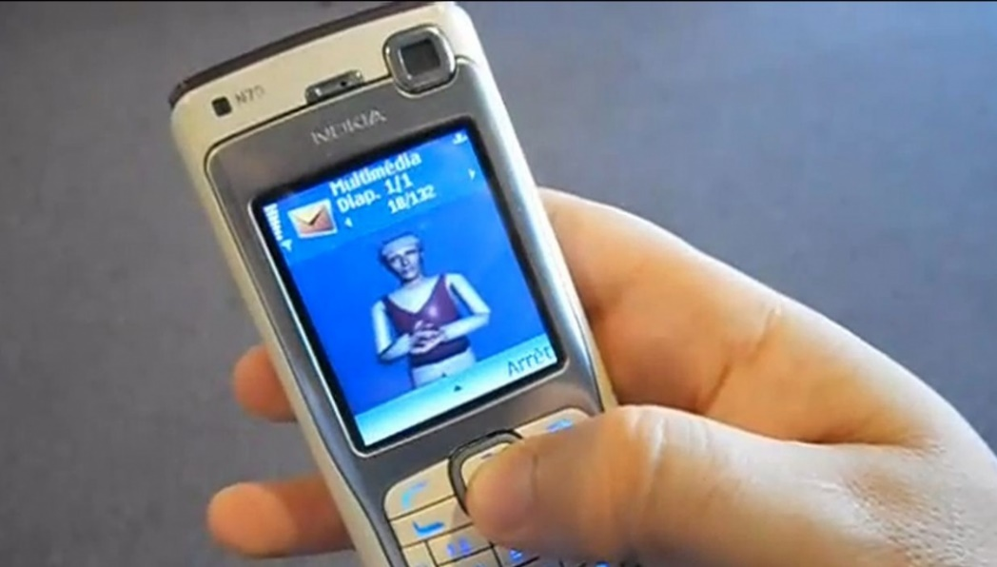


Slide 7
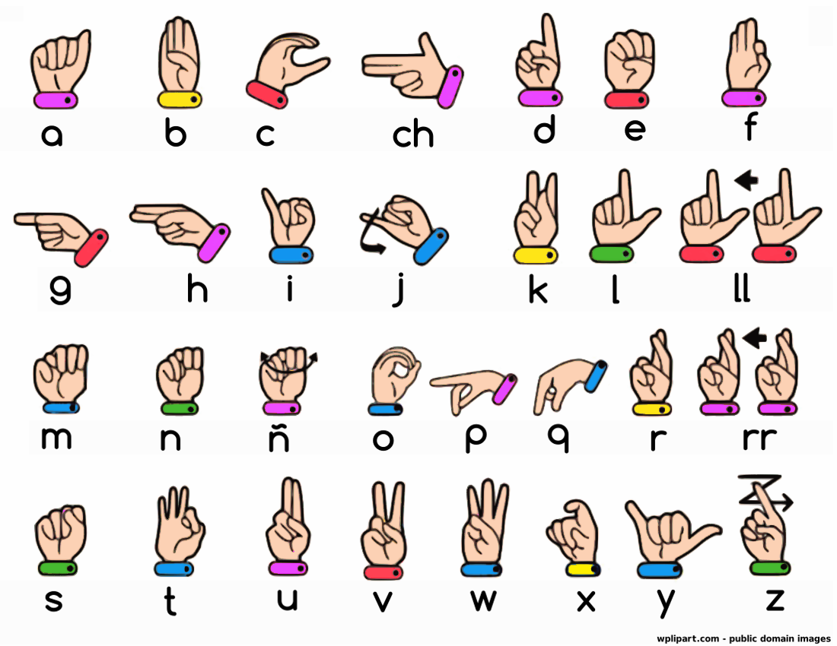
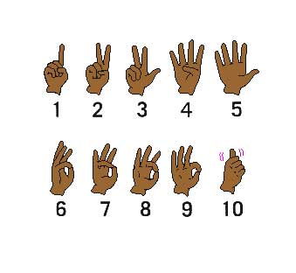
American Standard Sign Language

Slide 8
FEATURES OF THE SYSTEM
Real time translation
User friendly
Sign language learning tool
Speech Recognition
Play Quiz
Efficient, effective communication
Increase language and literacy skills
Enhance independence and self-confidence.
CSE Department, JECC

Slide 9
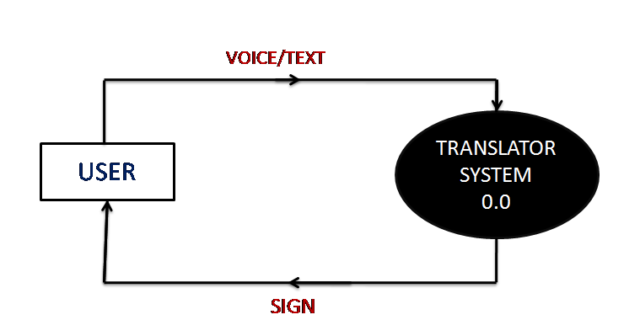
DATA FLOW DIAGRAM
LEVEL 0
CSE Department , JECC

Slide 10
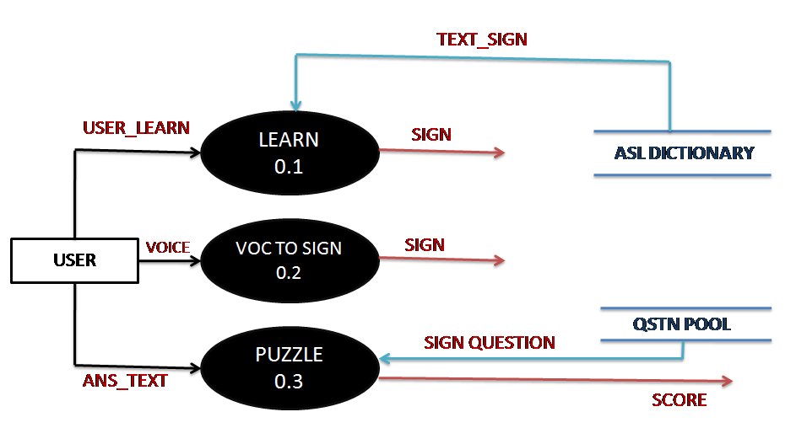
DATA FLOW DIAGRAM
LEVEL 1
CSE Department , JECC

Slide 11
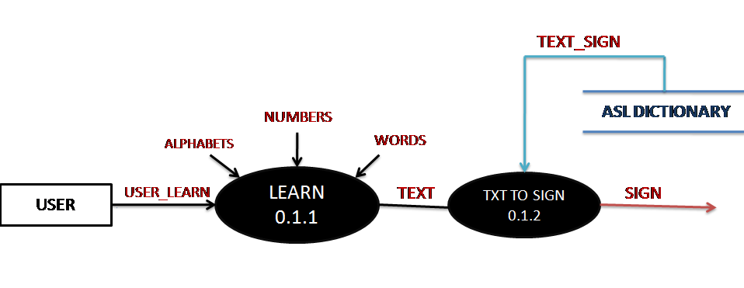
DATA FLOW DIAGRAM
LEVEL 2
CSE Department , JECC

Slide 12
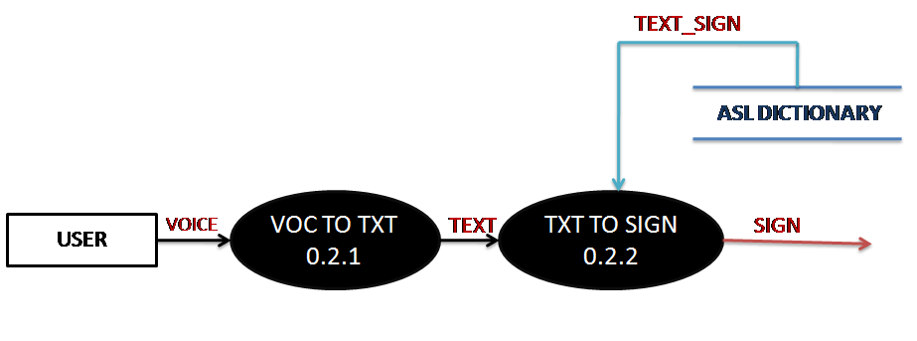
DATA FLOW DIAGRAM
LEVEL 3
CSE Department , JECC

Slide 13
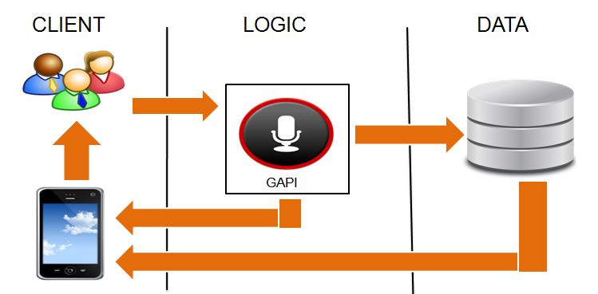
ARCHITECTURE DIAGRAM
CSE Department , JECC

Slide 14
MODULE DIVISIONS
      Learn
      Voice to text
      Text to sign
      Quiz
CSE Department , JECC

Slide 15
LEARN MODULE
This module is for learning purpose.
Three attributes-
Alphabets.
Numbers.
Words.
User can learn about the corresponding sign language of English alphabet set,
numbers and words by accessing ASL dictionary.
This module can be usable for any kind of users (need not be a deaf/hard hearing).
CSE Department , JECC

Slide 16
VOICE TO SIGN
Voice to sign translator system
- Speech to text
- Text to sign
CSE Department , JECC

Slide 17
VOICE TO TEXT
Google Voice recognition.
It is translated to corresponding text.
Ensures accuracy.
TEXT TO SIGN
Text is translated to corresponding sign.
Text is matched with sign image in data base.
CSE Department , JECC

Slide 18
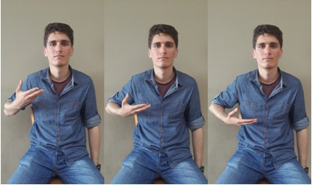
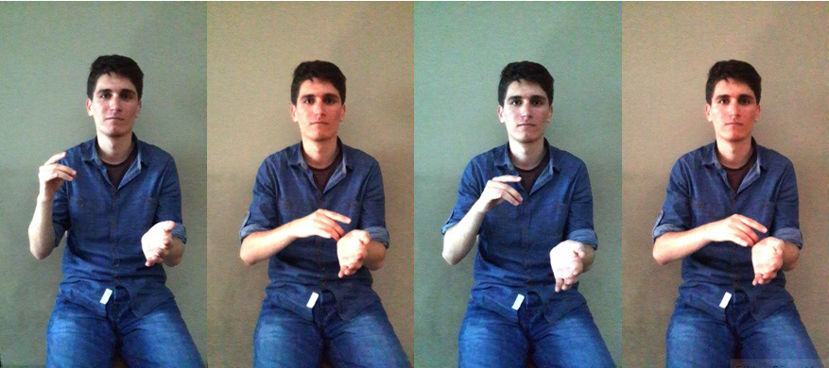
Fig. “I AM”
Fig. “A Doctor”
CSE Department , JECC

Slide 19
QUIZ
The user is given by a Sign Question.
He should identify what is meant by that sign.
He should select correct option.
If the answer option matches the answer of corr. question , he will get a score.
Each user is provided with a number of questions.
The one who get high score will be the winner.
CSE Department , JECC

Slide 20
SYSTEM SPECIFICATIONS
HARDWARE REQUIREMENTS
System : Pentium IV 2.4 GHz
Hard Disk : 40 GB
Phone : Android
Ram : 2GB
Keyboard : 104 keys
Mouse : Normal
SOFTWARE REQUIREMENTS
Operating system : Windows 7
Coding Language : Java 1.7 & XML
Tool Kit : Android 4.4
IDE : Android Studio
Database : SQLite
CSE Department , JECC

Slide 21
APPLICATION OF THE SYSTEM
The system provides consistent two-way communication accessible in different environments, including home, school, and the workplace.
The system will be applicable for both deaf or hard hearing person as well as common people
The system will be a personal assistant for hard hearing person.
System can open up a whole new range of communication.
The system will be a aggregate total of all the current working systems with more accuracy and efficiency.
CSE Department , JECC

Slide 22
FUTURE ENHANCEMENTS
Dictionary with more than 1000 words , sentences , synonyms, phrases etc.
More verbal language compatibility.
Increase dictionary.
Sign to voice conversion.
Compatible to almost every sign languages (e.g. BSL).
Customizable settings can be added.
Language selection tool.
CSE Department , JECC

Slide 23

CSE Department , JECC

