Slide 1

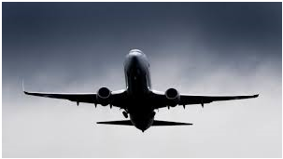
Business Analysis for Chicago Air1

Slide 2
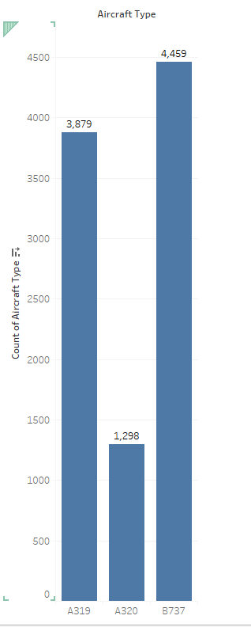
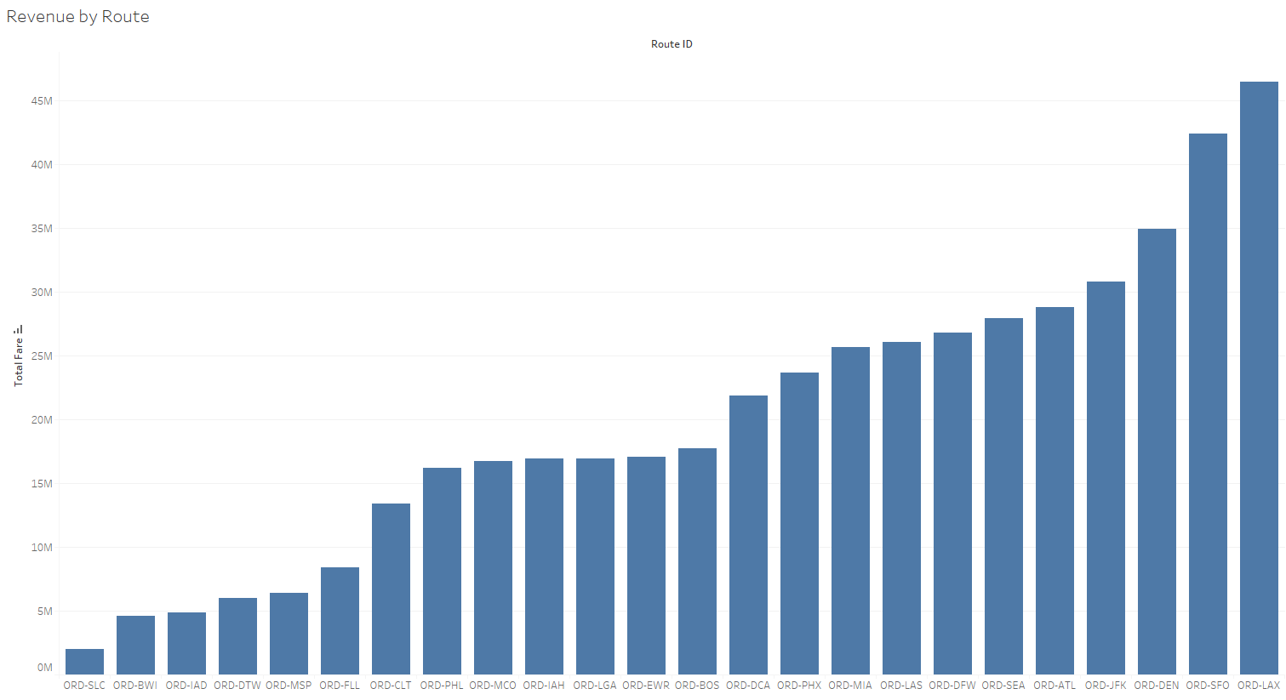
SECTION - 1
3879 flights use the A319 aircraft
B737 is the most common type of aircraft across all flights.
ORD-SLC accounts for the lowest percentage of total revenue

Slide 3
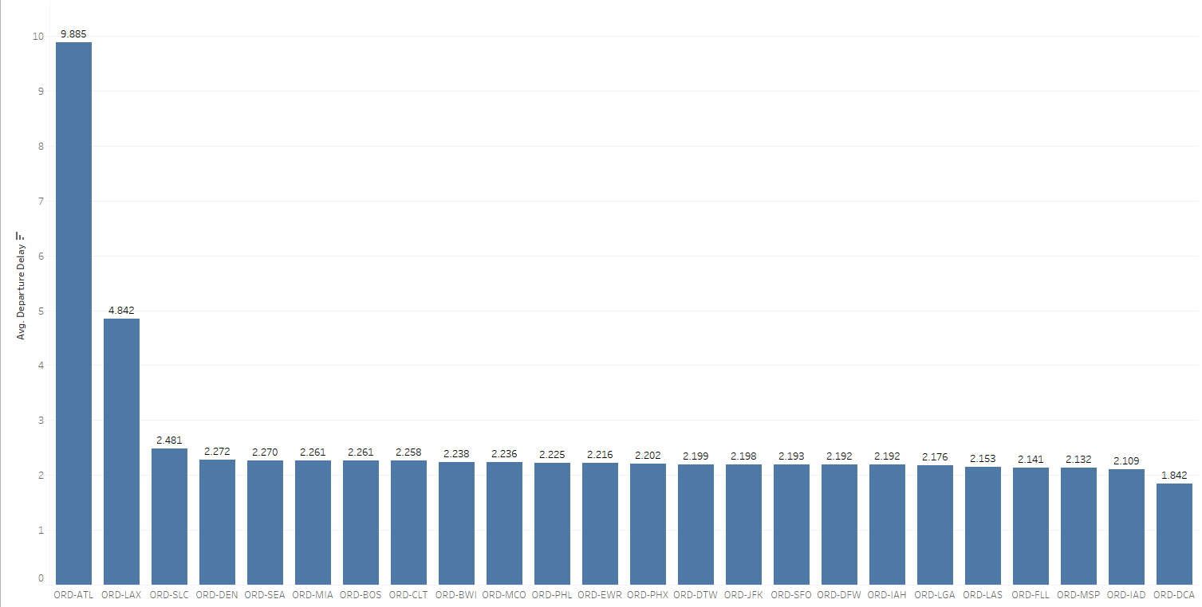
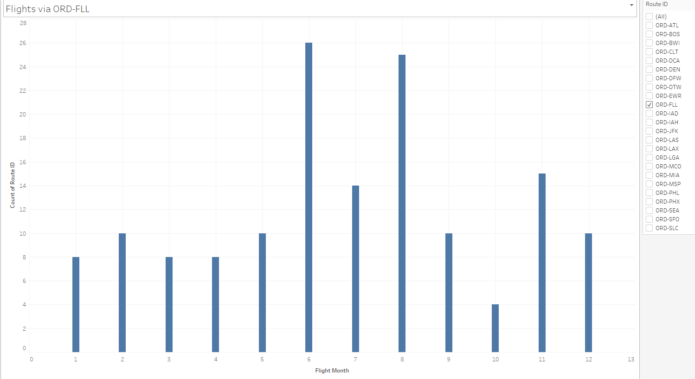
SECTION - 1
ORD-ATL faced the highest average
departure delay of 9.885
June is the most popular month to fly to Fort Lauderdale (FLL)

Slide 4
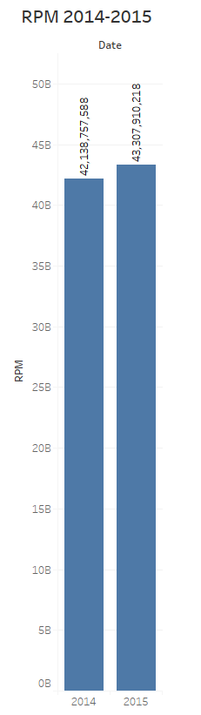
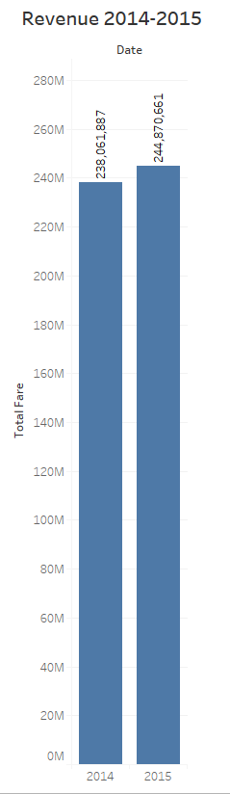
SECTION - 2
Key Performance Indicators (KPIs) provide objective evidence of progress towards achieving a desired result . For the given scenario recommended KPI's would be as given below -
REVENUE PASSENGER MILES (RPM) –
Definition – Revenue passenger miles (or RPM) measures demand for air transport. An increase in RPM is desired as this indicates that more passengers are using their service. To improve RPM, companies should either add more seats or improve efficiency by utilizing existing capacity.
Calculation - Total passengers * distance travelled by flight
Insight – RPM jumped 2.78% in 2015 , that increased the revenue by 2.86 %.
Assumption – Since no. of passengers is not given, we consider seating capacity = no. of passengers.

Slide 5
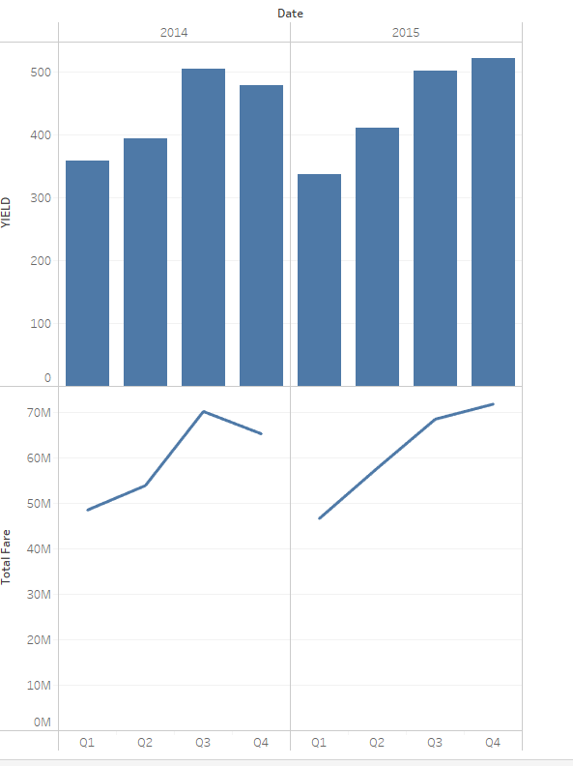
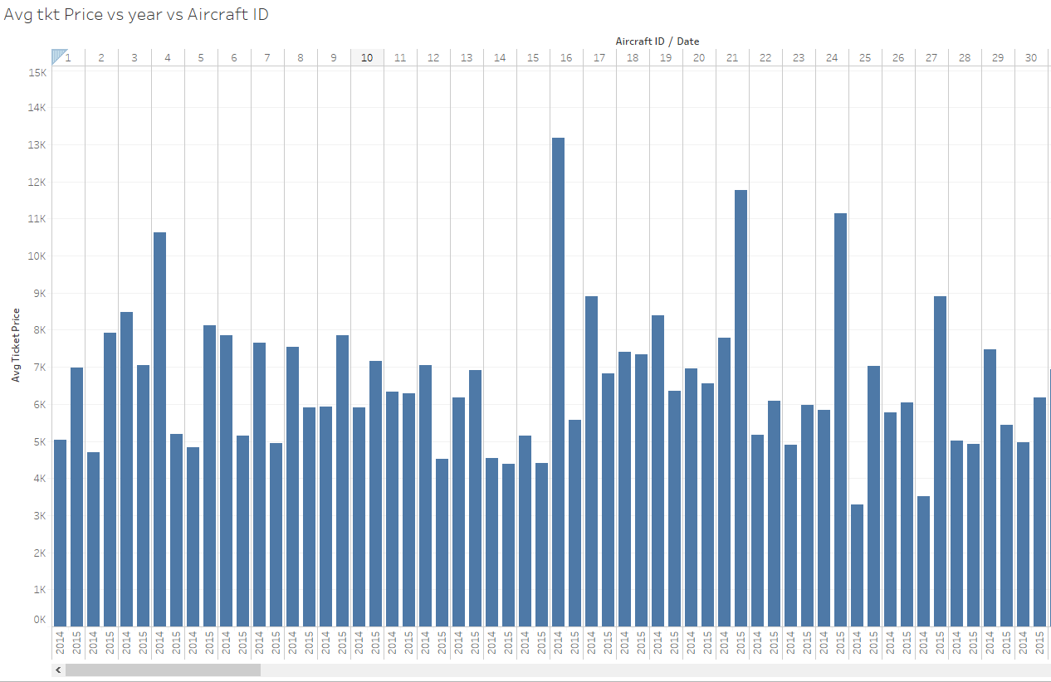
SECTION - 2
II. YIELD
Definition – This unit is a measure of average fare paid per mile, per passenger. Since demand for air travel is seasonal, yield is higher during peak seasons. Typically the measure is presented in cents per mile and is useful measure in assessing changes in fares over time.
Calculation – passenger Revenue / RPM
Insight – 2.9% increase in Yield leads to improve in Revenue by 2.86%
III. AVERAGE TICKET PRICE
Definition – Total ticket price per passenger is average ticket price.
Calculation – Average Ticket Price column given in dataset.
Insight –. We see that Average ticket price shows high positive correlation with Revenue (‘Total Fare’). So this is an important KPI for airlines. A comparison of the price listings for flights throughout the industry is a decent way to stay ahead of the growing market competition.
Assumptions – Total Fare = Total Revenue

Slide 6
Hypothesis
HYPOTHESIS | Data Required
working on improving ground staff services will increase sales | age. of passengers travelled,gender of passengers ,travelled, Depature airport, Arrival airport, ticket price, flight duration, distance, passenger feedback on below metrics on a scale of (1-5) for ground staff- ---------------------------------------------- Reliability, Responsiveness, Assurance, Empathy, Tangibles, check –in, onboarding
Staff positively influences the recommendation of the airline | age. of passengers travelled, gender of passengers travelled, Depature airport, Arrival airport, ticket price, flight duration, distance, passenger feedback on below metrics on a scale of (1-5) for the below - ------------------- food and beverage ,staff services, baggage handling data, entertainment , overall journey, how likely to recommend to a friend
cost management improves sales | fuel cost per seatmile avg ticket price operational costs tax rates/GST
Departure delay can impact sales | departure delay time, passenger age, passenger gender, onboarding airport arrival airport customer reaction on delay [ fine/not good/bad/ very bad ]
Flight cancellation policy impacts sales | date of cancellation, was customer informed in advance, if customer was informed then how much before, was refund processed within a week? ,if not then how long refund took? customer complaints reg this(if any)

Slide 7
THANK YOU

