Slide 1
Melbourne House Prices
Exploratory Data Analysis & Data Preparation
EDA Case Study
Dataset:
4,766 records · 10 attributes
Domain:
Residential property market, Melbourne, Australia
Goal:
Understand pricing drivers & prepare modelling-ready data
Output:
25-feature matrix · Train / Test split · Log-price target
Prepared by: Sonita Boro

Slide 2
Dataset Overview
What the data contains
4,766
10
0
0
3
Total Records
Attributes
Missing Values
Duplicates
Property Types
Attribute | Type | Description
Rooms | Integer | Number of rooms
Type | Category | h = house · u = unit · t = townhouse
Price | Integer | Sale price in AUD
Method | Category | Selling method (S, SP, PI, VB, SA …)
Regionname | Category | Broad Melbourne region
Bathroom | Integer | Number of bathrooms
Car | Integer | Number of car spots
Landsize | Float | Land size in square metres
Distance | Float | Distance from CBD (km)
Bedroom | Integer | Number of bedrooms

Slide 3
Data Quality Assessment
Quality Check | Count | % of Data | Action Taken
Landsize = 0 | 826 | 17.33 % | Flag + impute with median
Bedroom > Rooms | 1,437 | 30.15 % | Kept, different room definitions
Car = 0 | 331 | 6.95 % | Retain (valid — no parking)
Bathroom = 0 | 13 | 0.27 % | Flag + impute with median
Bedroom = 0 | 7 | 0.15 % | Flag + impute with median
Bathroom > Rooms | 230 | 4.83 % | Kept — open-plan properties
Key Takeaways
• No missing values or duplicate rows, clean raw file
• Zero values in Landsize, Bathroom, Bedroom are data-entry artefacts
• Binary flags preserve the zero-occurrence signal for modelling
• Bedroom > Rooms reflects coding difference between variables, not errors

Slide 4
Numeric Feature Statistics
Variable | Min | Q1 | Median | Mean | Q3 | Max
Rooms | 1 | 2 | 3 | 3.08 | 4 | 8
Price | 112k | 620k | 840k | 1,019k | 1,244k | 6,240k
Bathroom | 0 | 1 | 1 | 1.59 | 2 | 12
Car | 0 | 1 | 2 | 1.59 | 2 | 26
Landsize | 0 | 155 | 370 | 449.7 | 640 | 75,100
Distance | 5.0 | 16.5 | 19.3 | 19.3 | 22.2 | 33.1
Bedroom | 0 | 2 | 3 | 2.94 | 4 | 30
Notable Observations
• Price: median $840k vs mean $1.02M, strong right skew (skewness = 2.51)
• Log(Price) skewness drops to 0.45, log transformation recommended for modelling
• Landsize max = 75,100 m², extreme outliers need clipping
• Distance is relatively tight: 75% of properties within 22 km of CBD

Slide 5
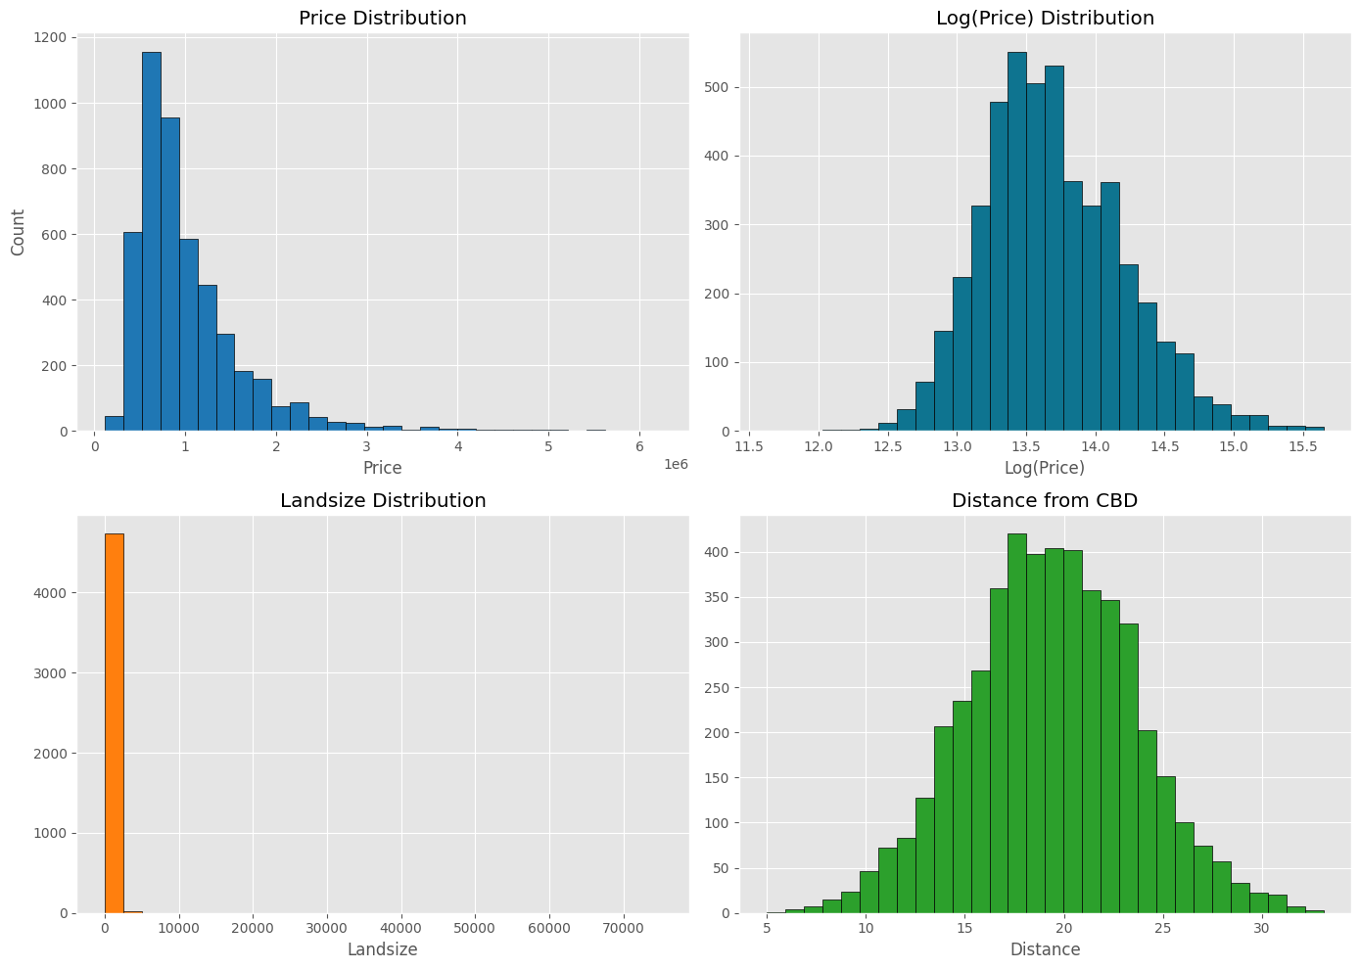
Target Variable: Price Distribution

Slide 6
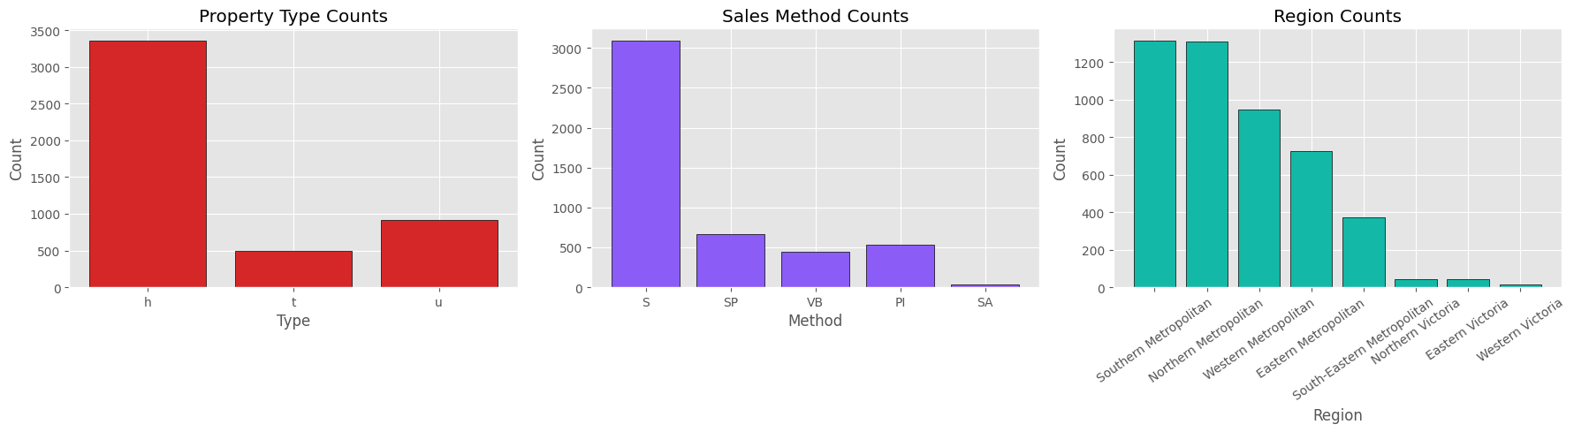
Categorical Feature Distributions
Property Type
Selling Method
Top 3 Regions
• h (house): 70.35 %
• S (sold): 64.9 %
• Southern Metro: 27.55 %
• SP (sold prior): 14.0 %
• u (unit): 19.30 %
• Northern Metro: 27.49 %
• PI (passed in): 9.7 %
• t (townhouse): 10.34 %
• Western Metro: 19.89 %
• VB / SA: ~11 %

Slide 7
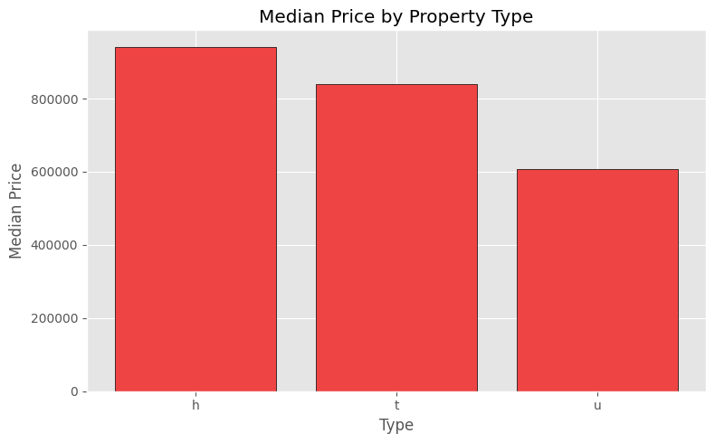
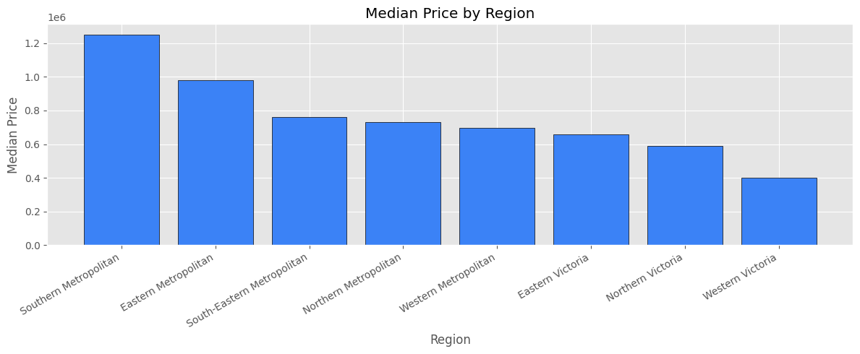
Price by Segment
Region and property type are the strongest pricing signals
Segment | Median Price | Key Insight
House (h) | $940,000 | Highest median — detached land premium
Townhouse (t) | $840,000 | Mid-range — shared boundary properties
Unit (u) | $606,750 | Most affordable — no land component
Southern Metropolitan | $1,250,000 | Most expensive region by far
Western Victoria | $400,000 | Most affordable regional market

Slide 8
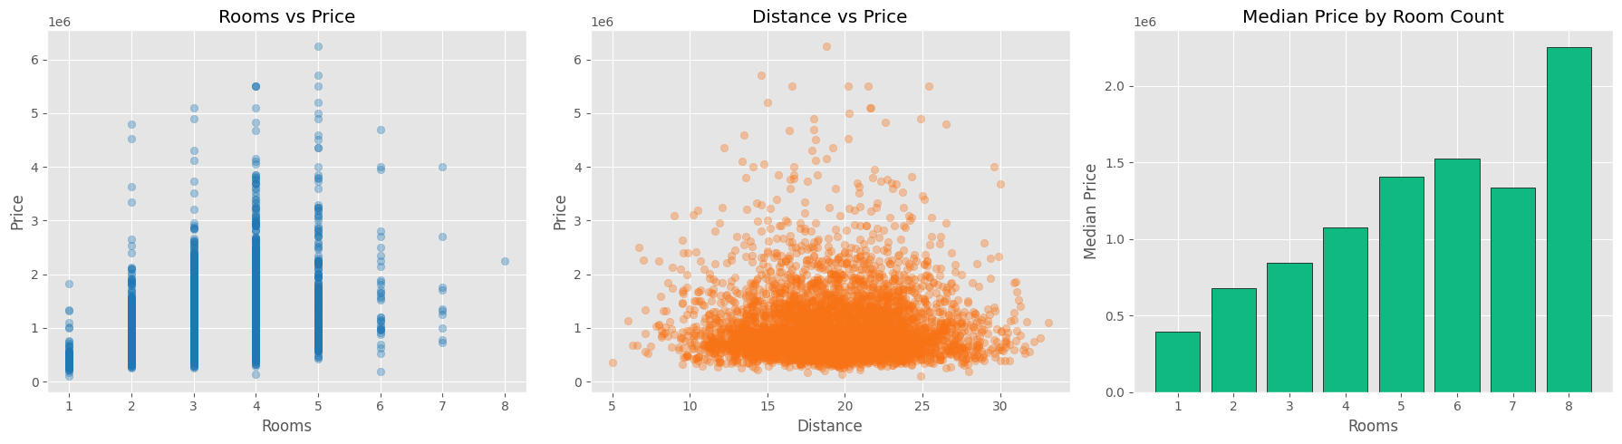
Correlations & Feature Relationships
Feature | Corr w/ Price | Corr w/ Log(Price) | Interpretation
Rooms | +0.403 | +0.449 | Strongest numeric predictor
Bathroom | +0.257 | +0.286 | Moderate — collinear with Rooms
Bedroom | +0.216 | +0.260 | Weaker due to 0-value noise
Car | +0.160 | +0.156 | Parking adds modest value
Landsize | +0.068 | +0.073 | Weak — distorted by extremes
Distance | -0.138 | -0.167 | Negative — closer to CBD = higher price

Slide 9
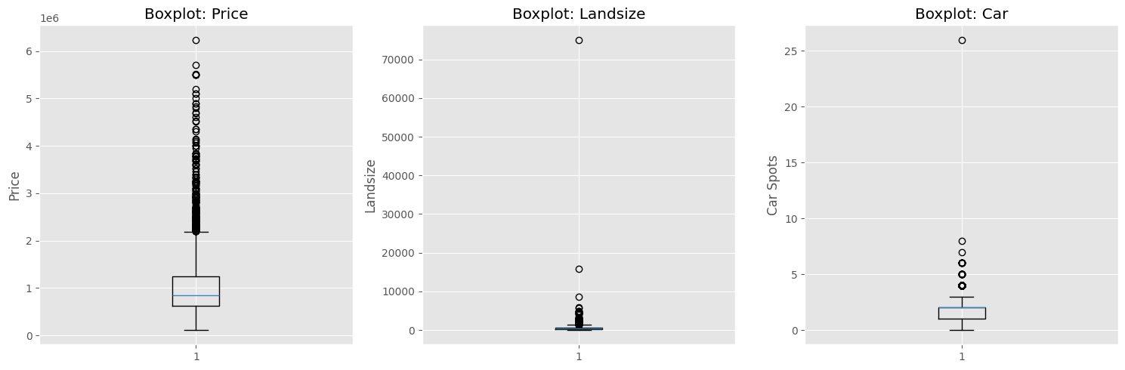
Outlier Analysis (IQR Method)
Variable | IQR Lower | IQR Upper | Outlier Count | Outlier % | Treatment
Price | $-241,375 | $2,105,625 | 253 | 5.31 % | Clip at P1 / P99
Landsize | -637.5 | 1,432.5 | 91 | 1.91 % | Clip at P1 / P99
Car | -2.5 | 5.5 | 206 | 4.32 % | Clip at P1 / P99
Bathroom | -0.5 | 3.5 | 30 | 0.63 % | Clip at P1 / P99
Bedroom | -1.0 | 7.0 | 34 | 0.71 % | Clip at P1 / P99
Distance | 4.65 | 35.35 | 0 | 0.00 % | No action needed

Slide 10
Data Preparation Pipeline
1
Zero → Missing:
Bathroom, Bedroom, Landsize zeros converted to NaN
2
Binary Flags:
3 indicator columns added: *_was_zero
3
Median Imputation:
Missing values filled with column median (non-zero)
4
Percentile Clipping:
All numeric features clipped at 1st – 99th percentile
5
Robust Scaling:
RobustScaler applied (IQR-based, outlier-resistant)
6
One-Hot Encoding:
Type, Method, Regionname encoded via DictVectorizer
7
Log Target:
LogPrice = log1p(Price) created as modelling target
8
Train/Test Split:
80 / 20 split with random_state=42

Slide 11
Prepared Feature Matrix
4,766
25
3,812
954
2
Feature Rows
Feature Columns
Train Rows
Test Rows
Target Variants
Feature Group | Features Included | Count
Numeric (scaled) | Rooms, Bathroom, Car, Landsize, Distance, Bedroom | 6
Indicator flags | Bathroom_was_zero, Bedroom_was_zero, Landsize_was_zero | 3
Property Type | Type=h, Type=u, Type=t | 3
Selling Method | Method=PI, Method=S, Method=SA, Method=SP, Method=VB | 5
Region | 8 region dummy columns | 8
Target (excluded) | Price (raw) · LogPrice (log1p transformed) | 2
Output File
• melbourne_prepared_for_modeling.csv — 4,766 rows, 27 columns (25 features + Price + LogPrice)

Slide 12
Key Findings & Recommended Next Steps
Price is right-skewed:
Median $840k vs mean $1.02M. Use Log(Price) as the modelling target.
Region drives price:
Southern Metro median $1.25M vs Western Victoria $400k — 3× difference.
Type matters:
Houses command a $333k premium over units (median).
Rooms is top numeric signal:
Pearson r = 0.45 with Log(Price). Median rises with every extra room.
Landsize needs care:
17% zero values + extreme outliers. Clipping + flag strategy applied.
Bedroom ≠ Rooms:
30% of records have Bedroom > Rooms — treat independently.
Recommended Models
Linear Regression
Random Forest Regressor
Gradient Boosting (XGB)
Strong baseline. Interpret coefficients for pricing factors.
Handles non-linearity and interactions. Good benchmark.
Usually best accuracy; train on LogPrice, exponentiate output.

