Slide 1


Code Mood: Revolutionizing the Developer Experience
Code Mood is an intelligent VS Code extension. It reads a developer's emotional state. Code Mood transforms the coding environment. It's based on real-time mood analysis. This bridges productivity and emotional intelligence in software development.
Team: UG-3 Team 8
Team Members: Mokshith,Sonith,Sasaank,Madhav,Pavan,Jyothiraditya

Slide 2

The Problem: Coding Can Be an Emotional Journey
Emotional Rollercoaster
Impact on Performance
Developers experience complex emotional states while coding. Traditional tools ignore emotional context.
Most of developers report that stress impacts coding performance. Code Mood addresses this critical gap.

Slide 3






Code-Mood Features
Dynamic Themes
Adjustments based on mood.
Personalized Music
Playlists for different moods.
Adaptive Fonts
Color scheme customization.
Contextual Humor
Real-time emotional feedback.
Productivity Score
Analysis of the per-file time data generated by Code-Mood

Slide 4
Technical Architecture
1
VS Code API
2
JavaScript (Node.js)
3
Hugging Face Inference API
The extension UI and logic are built using commands and terminal integration.
Core language for implementing features with modular CommonJS structure.
Detects developer mood through sentiment analysis.
4
Chart.js
5
yt-dlp + ffplay
6
Diagnostics & Decoration API
Integrated into webviews for visualizing time data using interactive pie charts.
Terminal-based tools used for extracting and streaming music audio based on mood.
Used to highlight code smells and add inline ghost comments with a sarcastic tone in Python files.

Slide 5


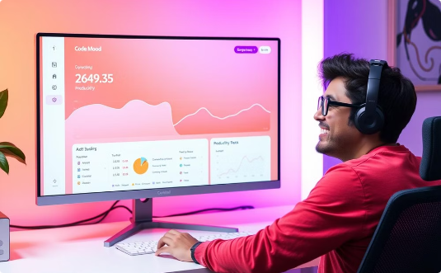
Why Proposed Solution is Better?
Adaptive Environment
Contextual Humor
Increased Productivity
Dynamic themes and music are tailored to the developer's emotional state.
Real-time emotional feedback reduces developer stress and boosts their mood.
Productivity insights can improve work habits and output over time.

Slide 6





Future Roadmap
Improve Mood Detection Accuracy
Improve accuracy using deeper code analysis.
Multi-Language Support
Expand detection to languages beyond Python.
Advanced Time Analytics
Track coding streaks, breaks, and trends.
Smarter Music Integration
Add smarter controls and support for Spotify playlists.

