Slide 1

Cloud Computing Employee Years at Company Prediction
Members: Sagar Varma Samanthapudi, Priyanka Surapaneni, Leena Guduru
Advisor: Prof. Dr. Sunandan Chakraborty

Slide 2
Problem Statement : Prediction of employee's years at company Employee churn is a major problem for many firms these days. Great talent is scarce, in high demand and hard to keep if found. Why this problem: Hiring and retaining employee are highly difficult activities that necessitate a lot of money, effort, and expertise. Some study tells that a company may pay 15% to 20% of an employee's income to hire a new employee, which is a significant sum, especially for large corporations with thousands of employees. Reference: https://medium.com/study/data/employee_retention The time it takes to get a new worker up to speed costs an average company between 1% and 2.5 percent of their entire revenue.
Solution: Develop a model which will be highly effective in determining the number of years that an employee can stay at an organization.

Slide 3
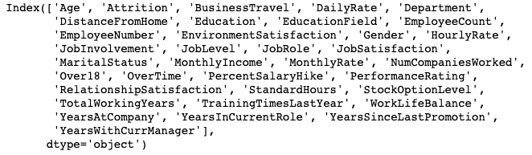
Dataset Sources : URL_1 URL_2 Total number of records : 5882
Total number of features : 35
Output features : 1 (YearAtCompany)

Slide 4
Workflow
EDA
Data Cleaning and Feature Engineering
Data split
(Train
Test)
Evaluation(validate on test)
Modeling

Slide 5
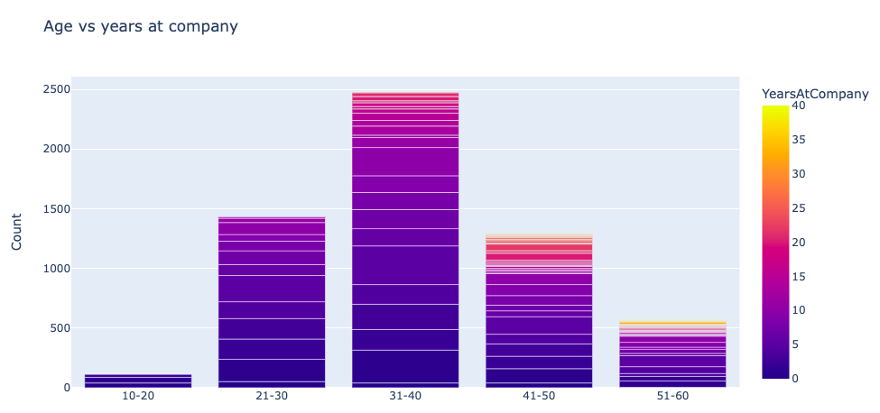
EDA

Slide 6
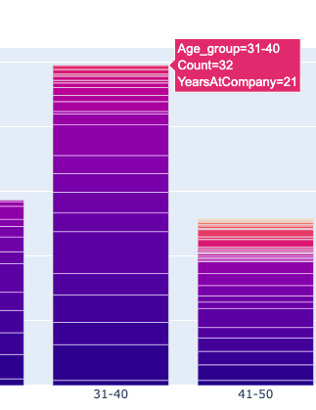
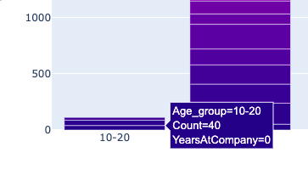
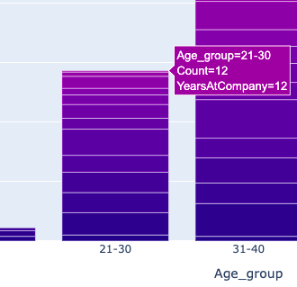
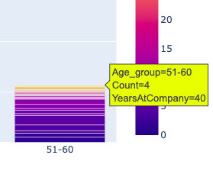
EDA

Slide 7
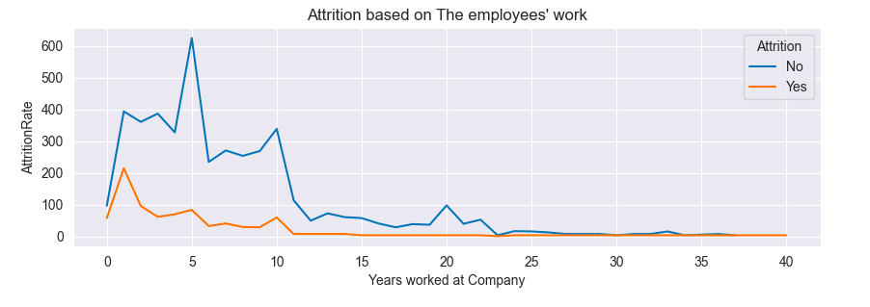
EDA

Slide 8
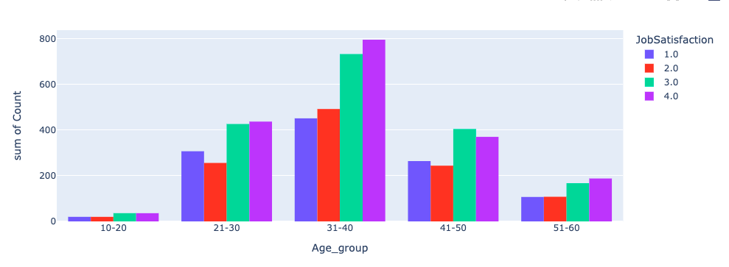
EDA

Slide 9
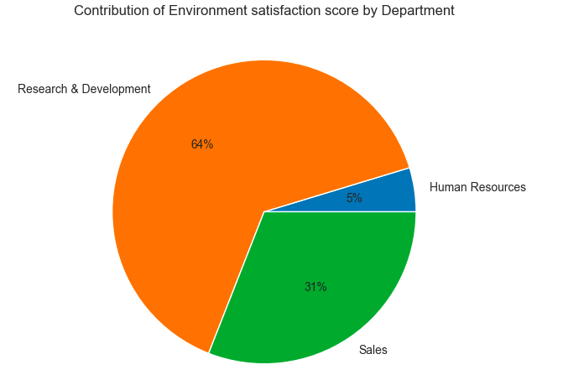
EDA

Slide 10
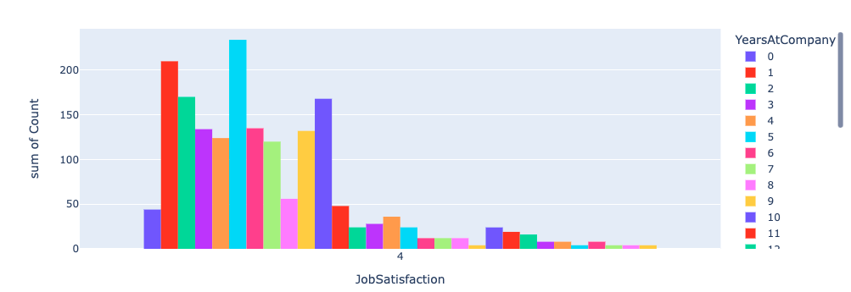
EDA

Slide 11
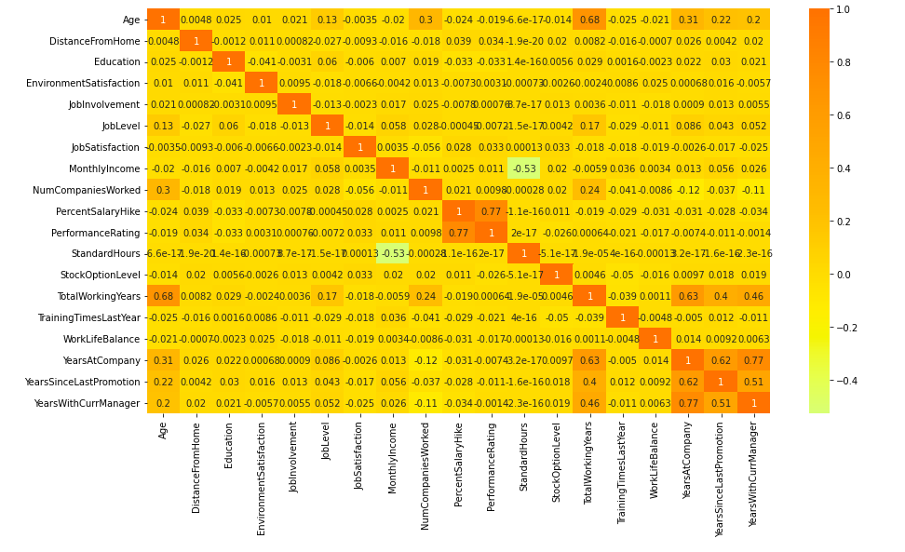
EDA

Slide 12
Data Cleaning Combined the data from both URLs Replaced null values with median Handled outliers with MAD method Dropped Columns like age, employee count Dropped age group 10-20 with zero experience Feature engineering Converting categorical into vectors for modeling and assembling the indexed data and numeric features in a vector

Slide 13
Modeling: Split the data into train and test with 70-30% Implemented Linear regression , Decision tree regressor, Random forest model Model tested on test set Tools : Pyspark, Jupyter Notebook Results:
Models | RMSE | R2
Linear Regression | 3.182349 | 0.729678
Decision Tree Regressor | 2.12158 | 0.894548
Random Forest | 2.08155 | 0.896293

Slide 14
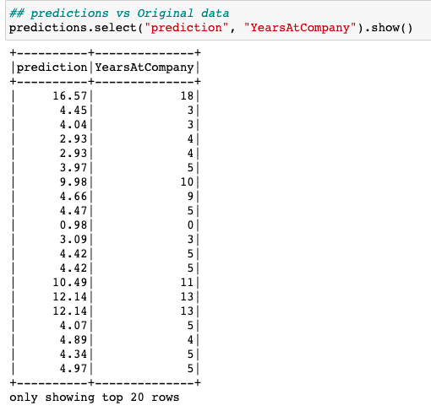
Predictions:

Slide 15
References: https://spark.apache.org/docs/latest/ml-classification-regression.html

Slide 16
Thank you

