Slide 1

Cloud Computing Employee Years at Company Prediction
Members: Sagar Varma Samanthapudi, Priyanka Surapaneni, Leena Guduru
Advisor: Prof. Dr. Sunandan Chakraborty

Slide 2
Problem Statement : Employee churn is a major problem for many firms these days. Great talent is scarce, in high demand and hard to keep if found Why this problem: Hiring and retaining employee are highly difficult activities that necessitate a lot of money, effort, and expertise. Some study tells that a company may pay 15% to 20% of an employee's income to hire a new employee, which is a significant sum, especially for large corporations with thousands of employees. Reference: https://medium.com/study/data/employee_retention The time it takes to get a new worker up to speed costs an average company between 1% and 2.5 percent of their entire revenue.
Solution: Develop a model which will be highly effective in determining the number of years that an employee can stay at an organization.

Slide 3
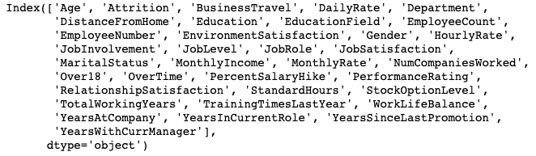
Dataset Sources : https://www.kaggle.com/datasets/employeeData https://www.kaggle.com/datasets/EmployeeInfo Total number of records : 5882
Total number of features : 35
Output features : 1 (YearAtCompany)

Slide 4
Workflow
EDA
Data Cleaning and Feature Engineering
Data split
(Train
Test)
Evaluation(validate on test)
Modeling

Slide 5
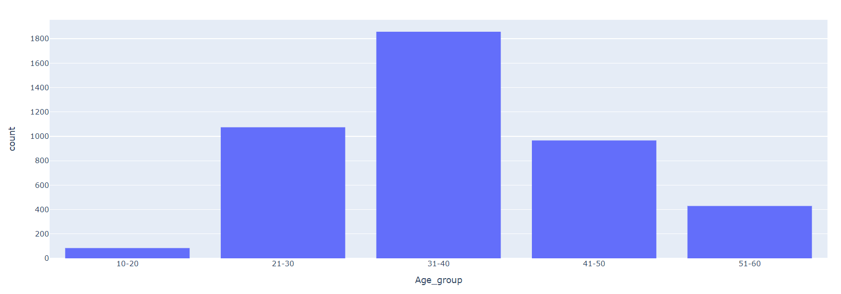
EDA

Slide 6
Modeling: Linear regression we will start with linear regression and then explore other models. (support vector regression and random forest or decision tree) Tool: Pyspark Jupyter notebook / AWS sagemaker.

Slide 7
Next steps: Translate the work and Implement Pyspark. Performing significant analysis for the employees based on the data for features selection. Explore other models to determine the employee's years and improve accuracy

Slide 8
Thank you

