Slide 1

Raah Financial
Presented by-Sonika Tiwari

Slide 2
About Company
Raah financial is an united-kingdom based private Investment company established in 2012.its headquarter is in London . This company makes profit by investing in companies ,buying and selling shares and real-states. Investment in growing company its main objective.70% of our profit comes from investment in right company .
Problem Statement:
This time company want to invest in Indian start-ups . Before investment they want to study Indian market and trends.
Sector
City
Funds
Other Investors

Slide 3






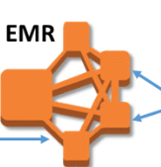
Project pipeline :
Glue crawlwer
Athena query
Lambda function
Aws quicksight

Slide 4
Project Steps:
Step1:
Data collection:
This is very starting phase of project just to take rough idea .we are using company data who approached the company for investment. For this we are going to use that data.
Step2:
Data is on json form . I created a lambda function to convert json to csv.
Step 3:
Saved the csv file in amazon s3.

Slide 5
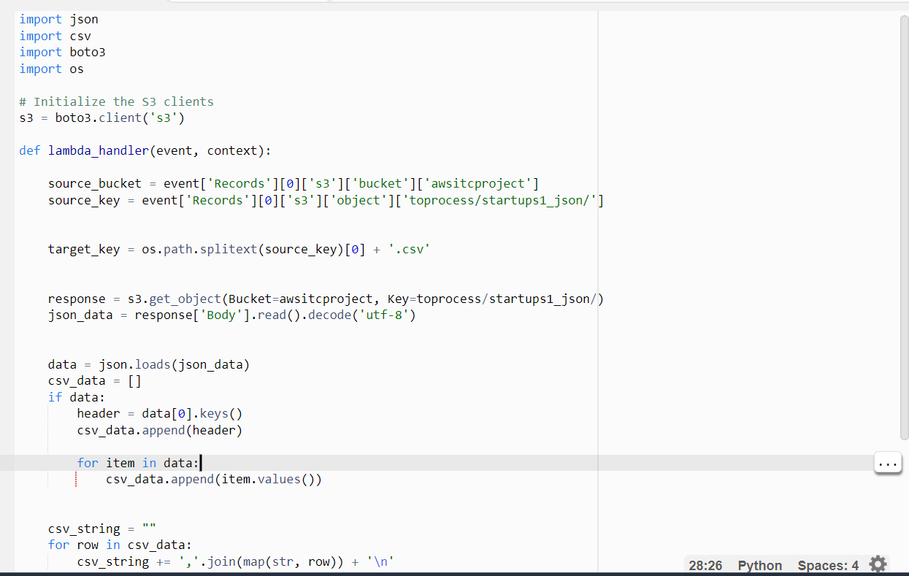
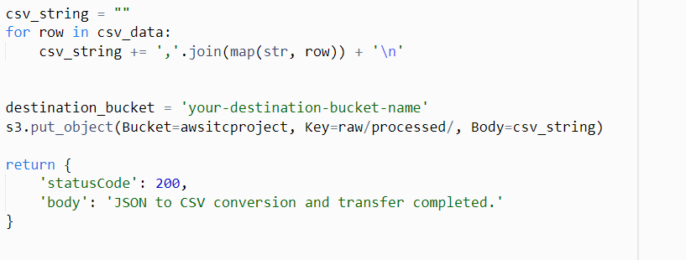

Slide 6
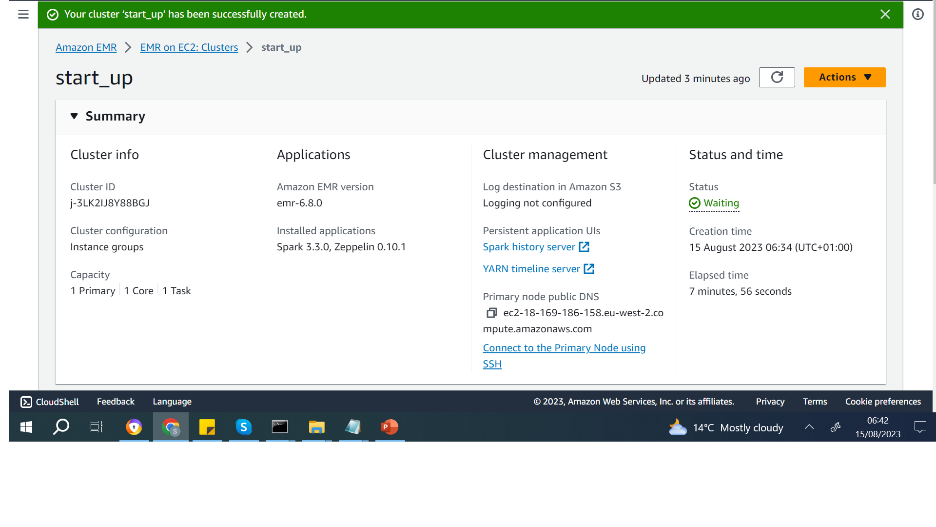
Step 4:
Data analysis : For data analysis we created an aws emr.

Slide 7
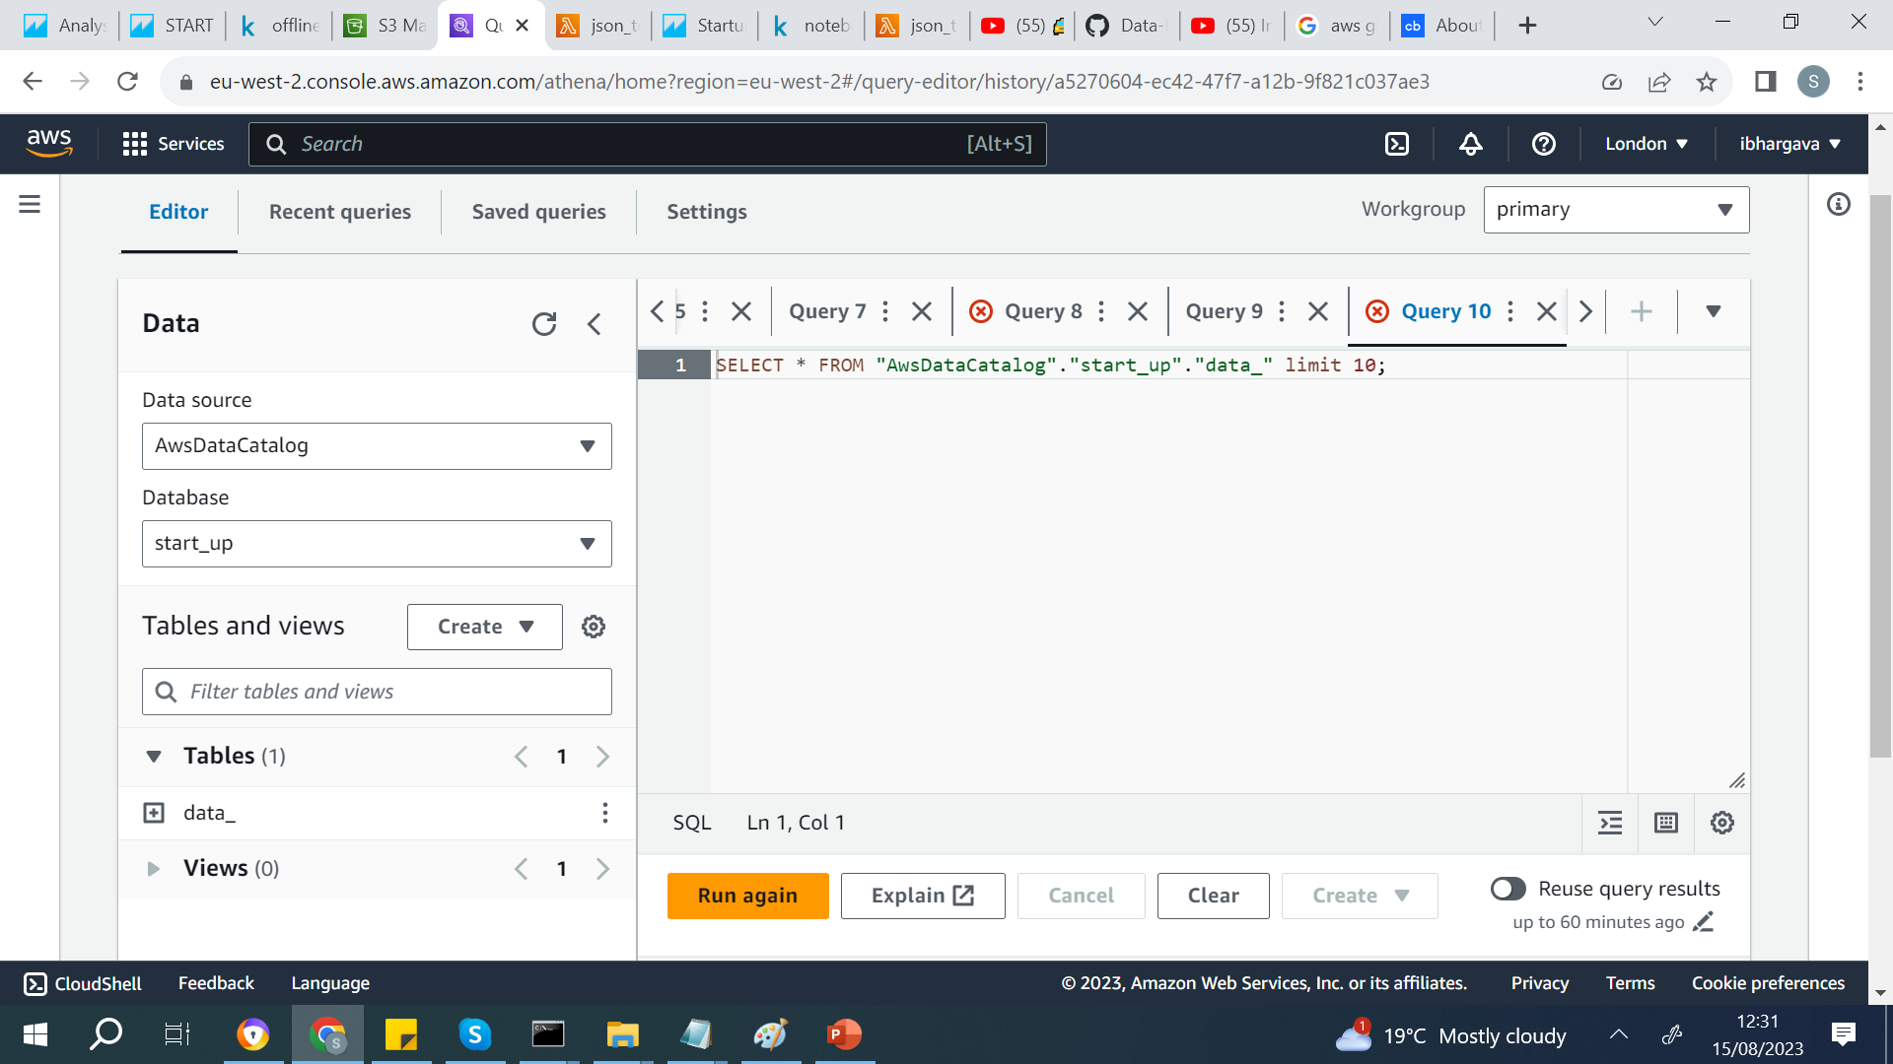
Step5:
After analysis .I used Aws glue extracts metadata and creates table definitions in the AWS Glue Data Catalog.

Slide 8
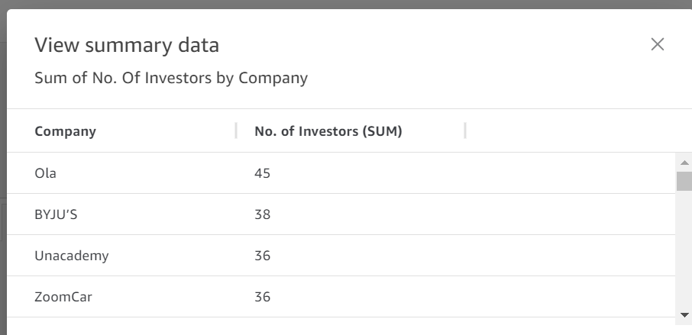
Data Insights : I used Aws Quick Sight for visualization.

Slide 9
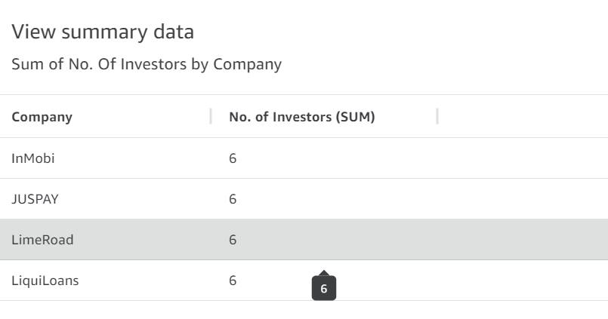

Slide 10
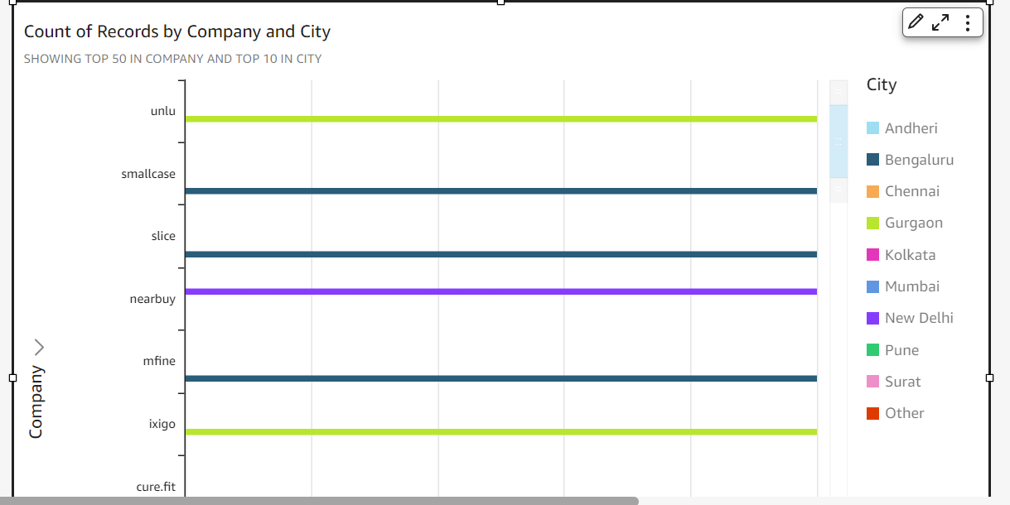
Most Start-ups are based in Bangalore.

Slide 11
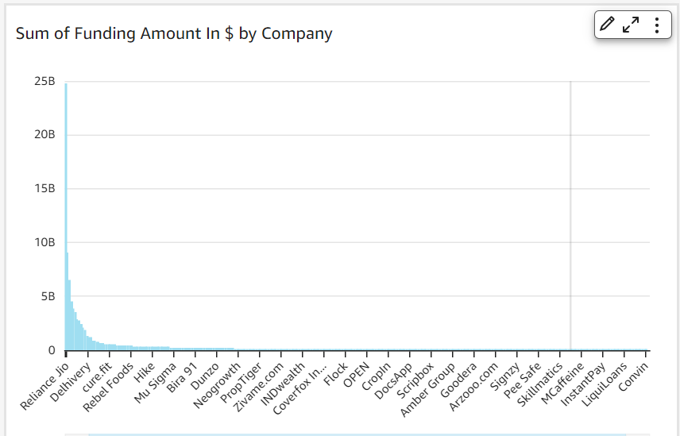
Sum of funding amount by company

Slide 12
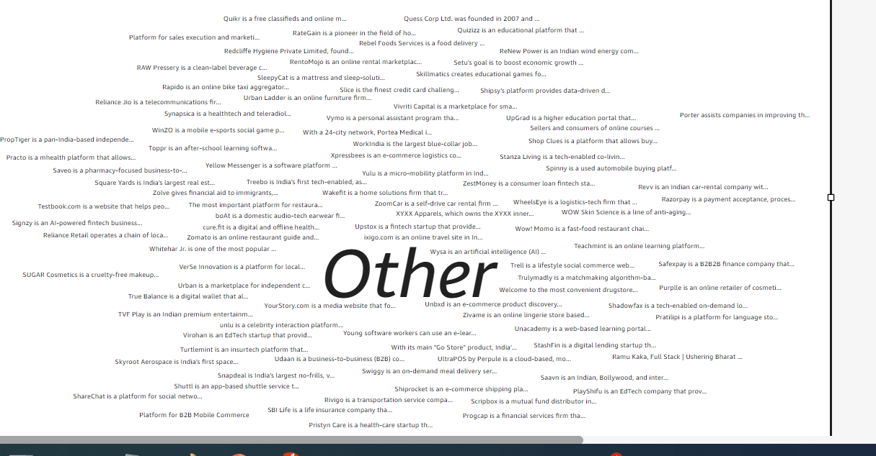
Company with sector

Slide 13
Thank you

